Slide 1
Start with GeoGebra
students‘ results
PGU Unna

Slide 2
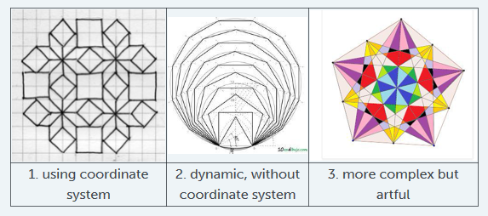
Task: Create with GeoGebra nice artwork
Use the commands regular polygon, midpoint, segment, …
Hints: 1. If you don't like to have the labels you can hide all easily at the end of the work: mark the whole construction by a rectangle. Than click right mouse and hide all labels.
2. You can cut out your construction by making an rectangle frame around your construction and
export it to the cliport, open e.g. PAINT program and paste it. Colouring is very easy. Then save
the file as png.

Slide 3
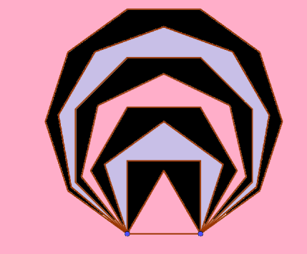

Slide 4
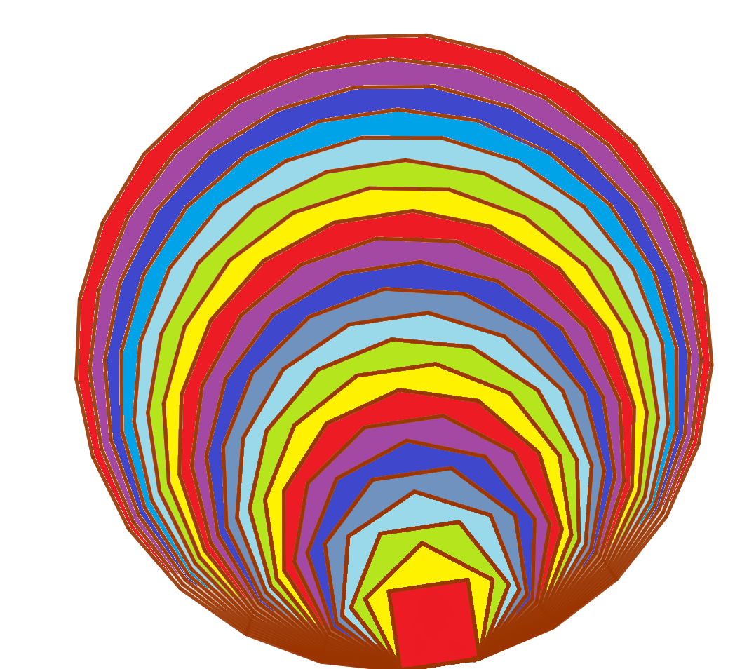

Slide 5
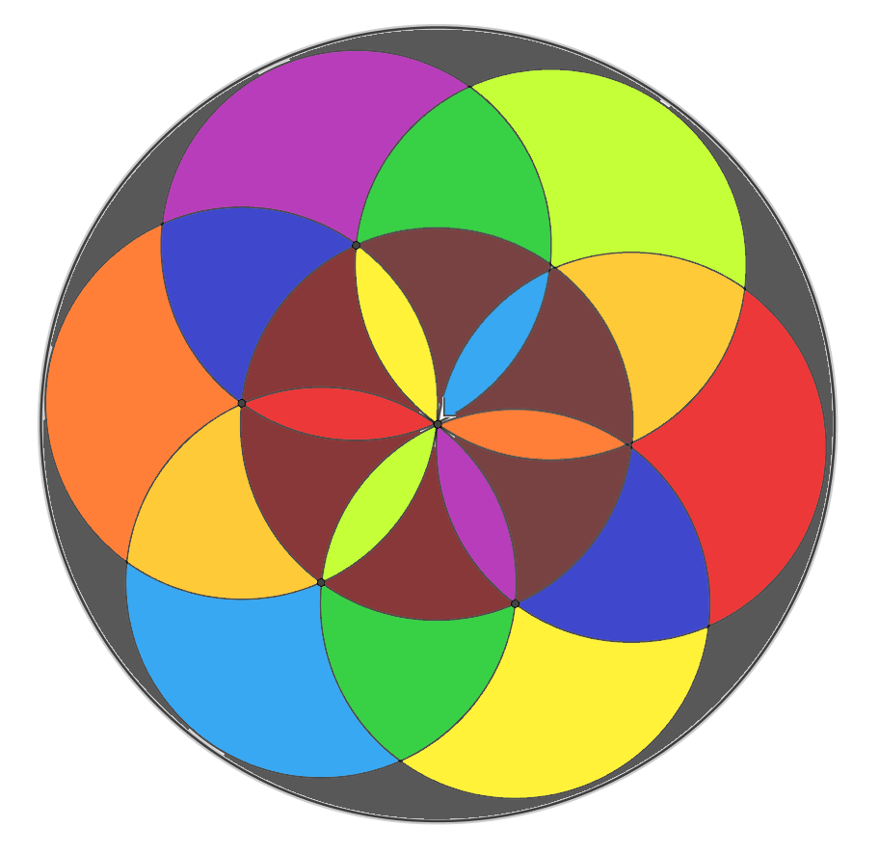

Slide 6
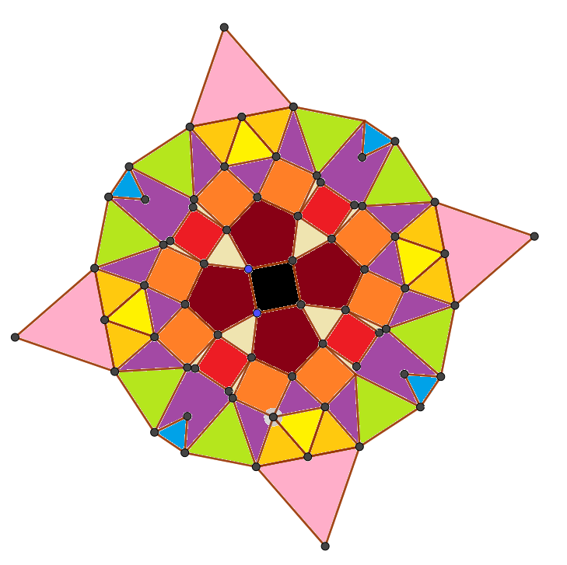

Slide 7
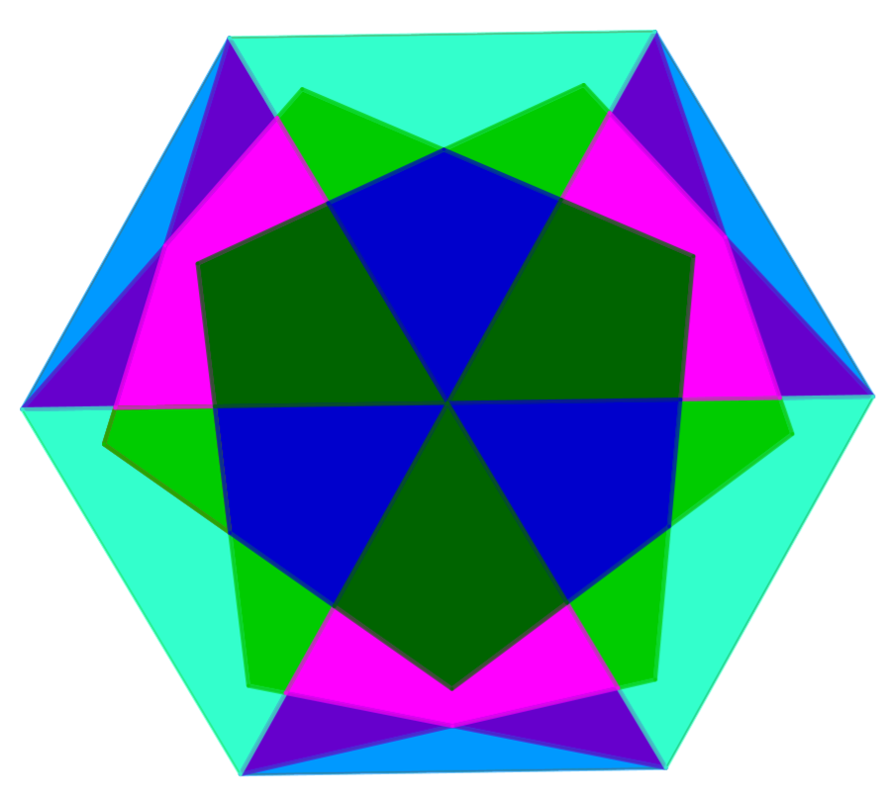

Slide 8
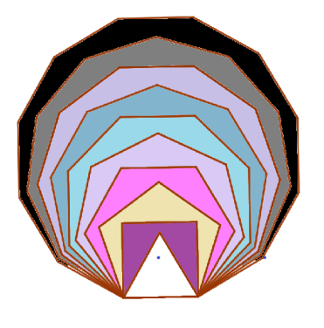

Slide 9
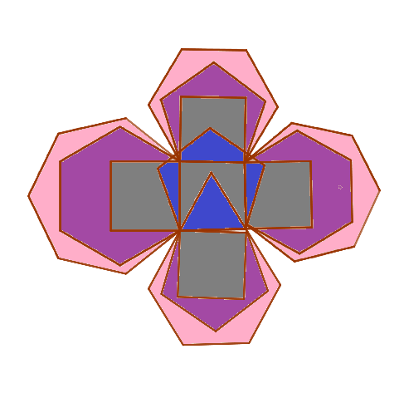

Slide 11
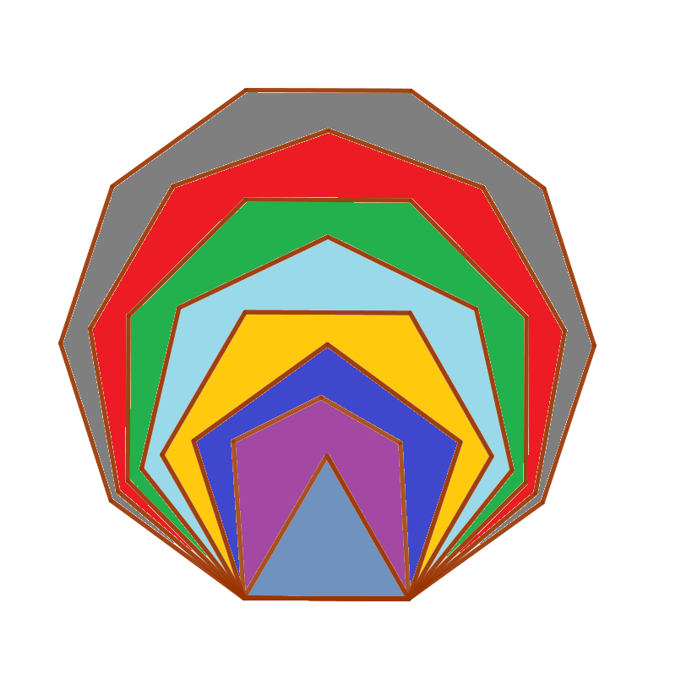

Slide 12
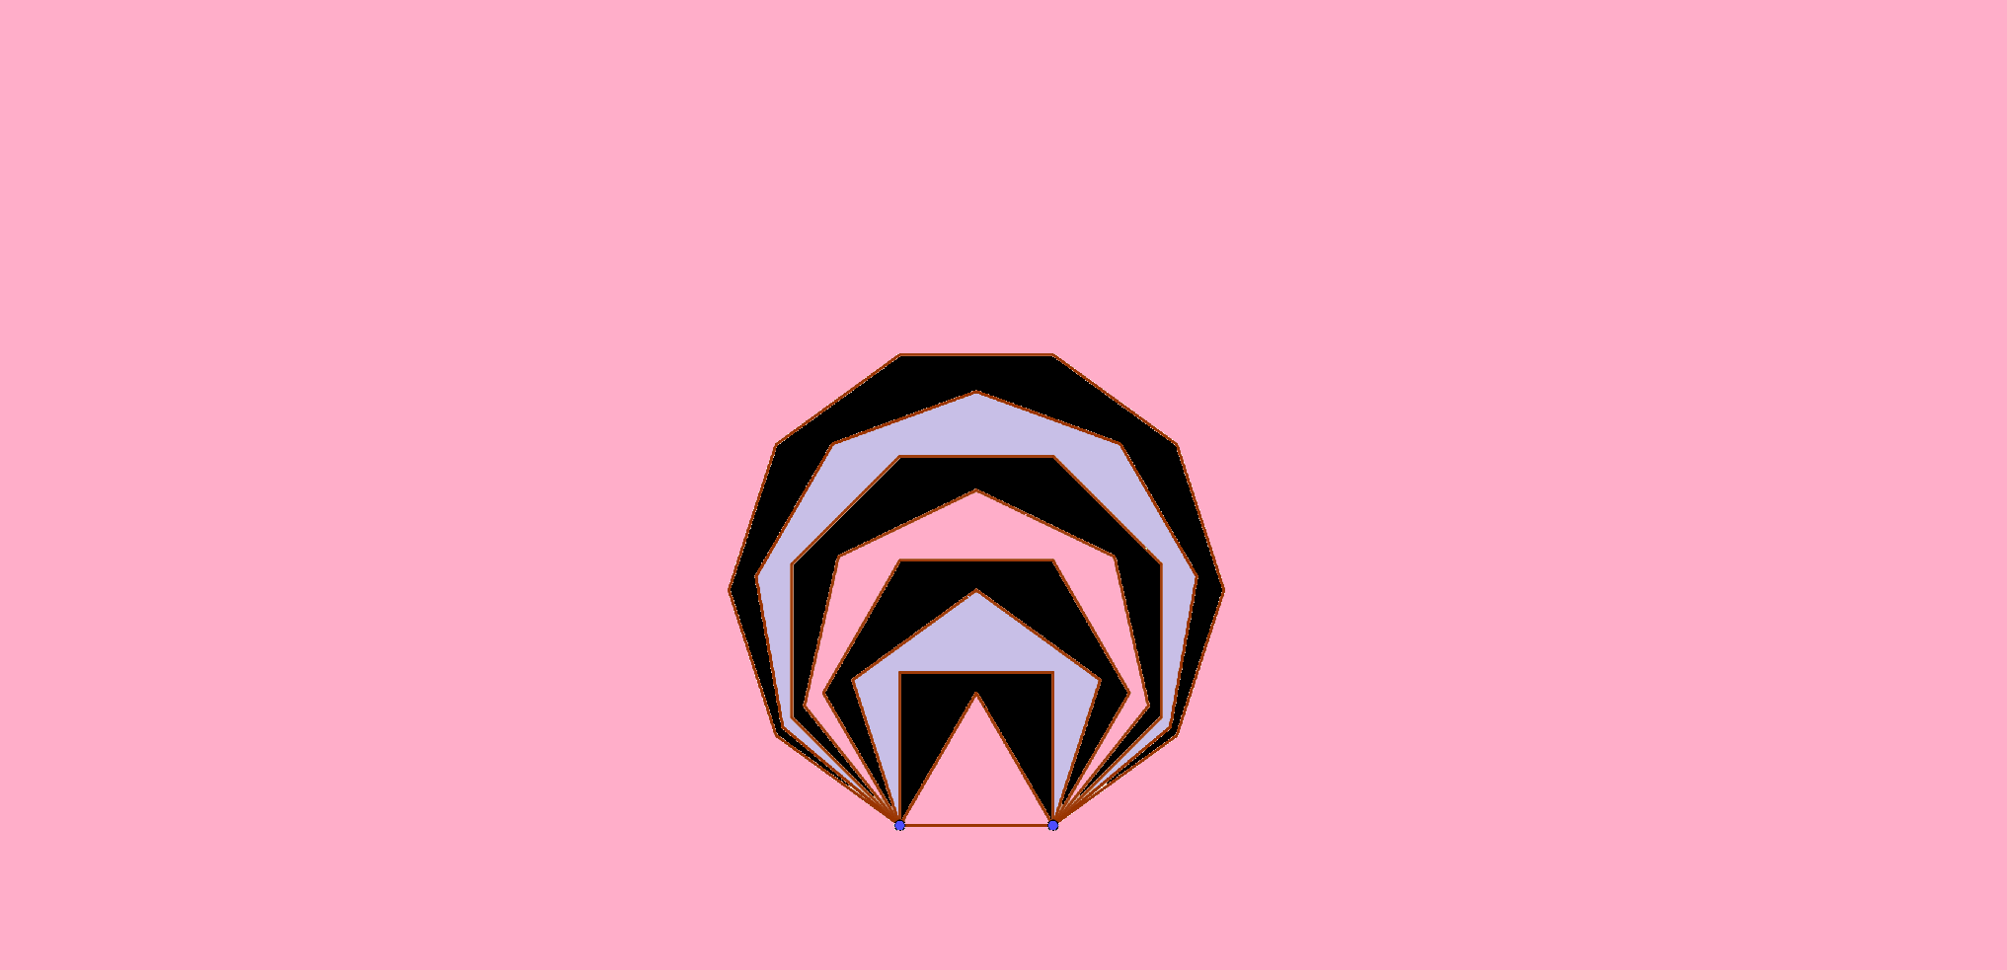

Slide 13
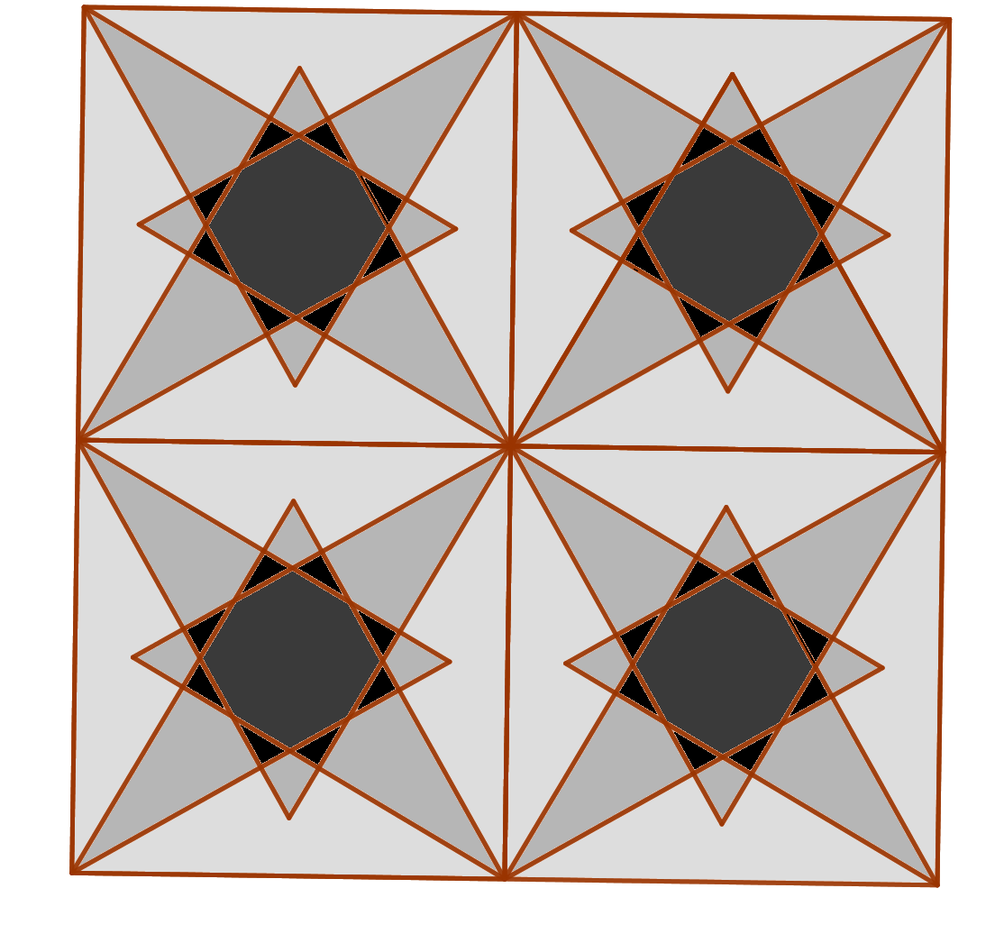

Slide 14
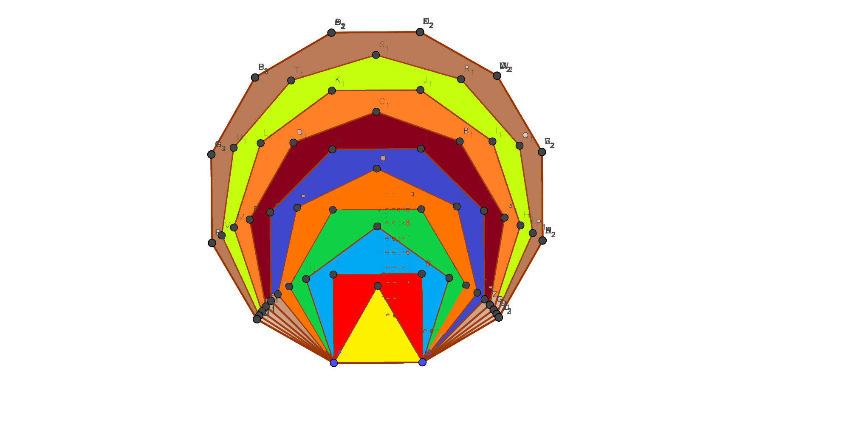

Slide 15
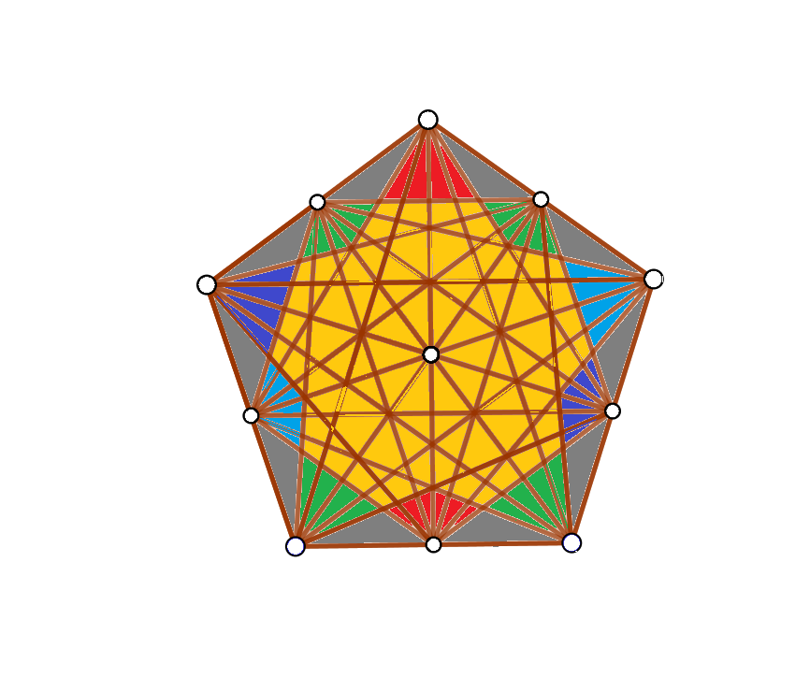

Slide 16
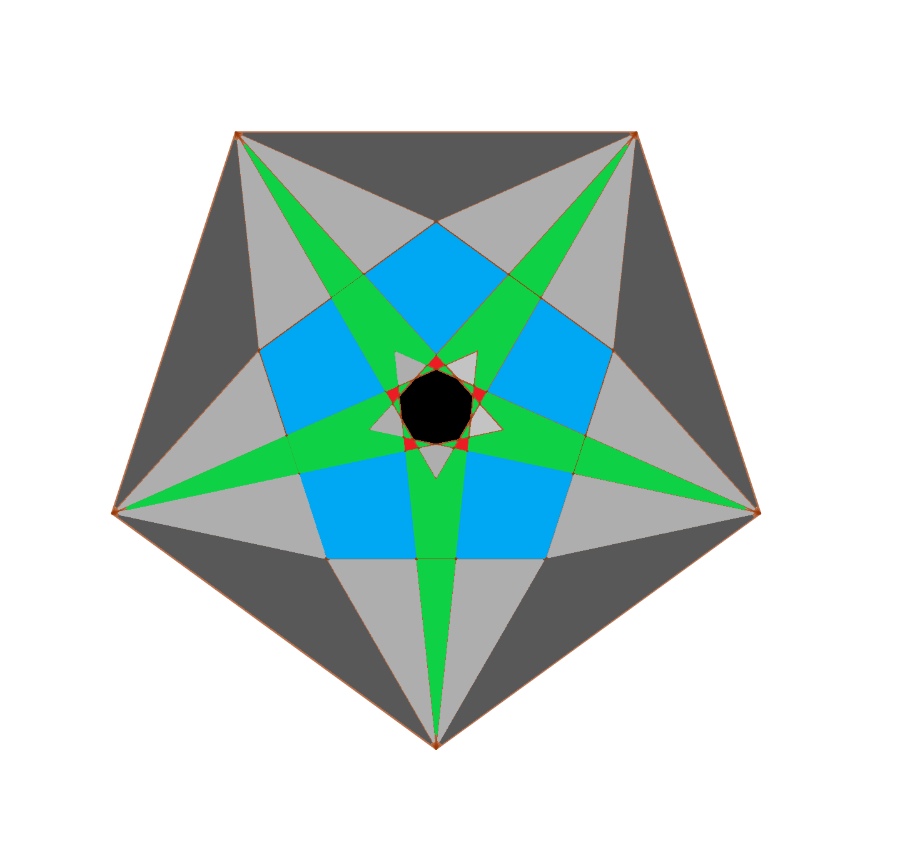

Slide 17
