Slide 1
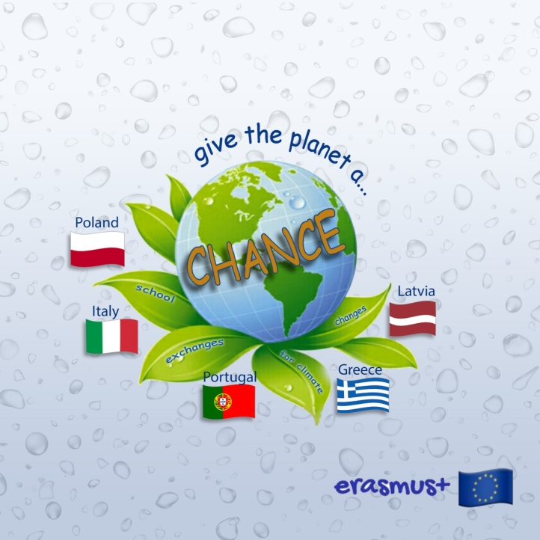
Recycling and Renewable energy sources in Greece

Slide 2
The habit of recycling in Greece is not very popular. According to a European study of 2019, the percentage of recycling in our country comes up to 18,9%, a very low percentage (24th place from the 28 countries of the EU) since at the same time in some countries in Europe the percentage of recycling comes up to 70%.

Slide 3
On the contrary, Greece is considered to be one of the first countries at the existence of landfills (80%), that is specialized places where we bury our garbage. Furthermore, in some islands there are several illegal rubbish dumps.

Slide 4
Since 2003, the corporation below has been activated in recycling by applying the Blue Bins system and has organized several educational programs, always in collaboration with the local municipality or other public services.

Slide 5
In the blue bin we throw all the things you see below:

Slide 6
The Blue Bell serves exclusively the collection of glass packaging deriving from municipal waste. The goal of this particular project is to create a packaging waste stream that is as clear and pure as possible, close to its point of generation.

Slide 7
Today 95% of our country's population is covered with blue bins. 8.700 blue cones and 162.000 blue bins are placed in Greece. The students are constantly informed about recycling. Today, recycling must be a priority for the protection of the enviroment. It is not a trend, but a stable and daily procedure, necessary for our future.

Slide 8
The goal that Greek policy has consists of the preservation and improvement of the environment, the natural renewable sources, the biodiversity and aquatic sources, the correct management of the non renewable energy pores and the forwarding of the renewable energy sources, encouragement to save energy, confrontation of climate change and respect in the cultural legacy.

Slide 9
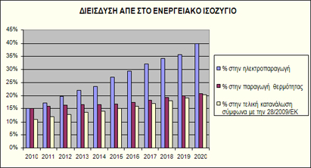
National Plan of Action 20-20-20
Which means: the contribution of the Renewable Energy Sources in the final energy consumption to rise in rate 20% during 2020

Slide 10
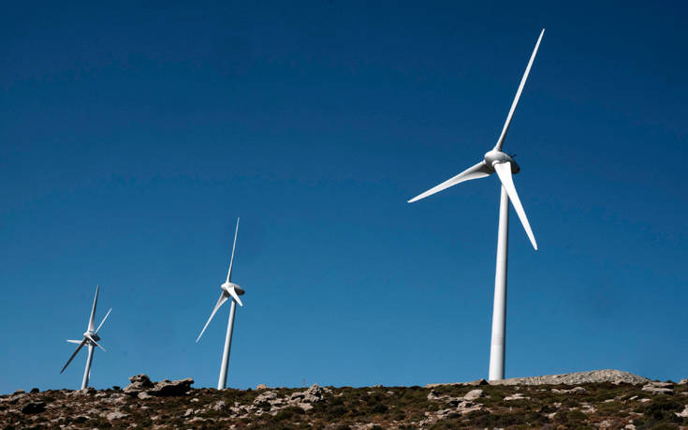
Our country is rich in wind dynamic, in many areas such as Crete, Peloponnese, Evia and of course the Aegean islands. In these areas we will come across many wind parks.

Slide 11
Program Sun The plan «Sun» is an energy investment plan that foresees the extraction of clean energy from renewable sources from Greece to other countries in Central Europe.
Today, technology exploits a very low percent of the solar energy ,that we have on our planet’s surface, with three kinds of system:

Slide 12
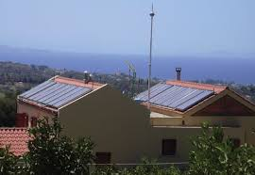
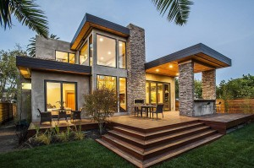
Thermal solar systems (solar water heaters)
Passive solar systems
(bioclimatic architecture)

Slide 13
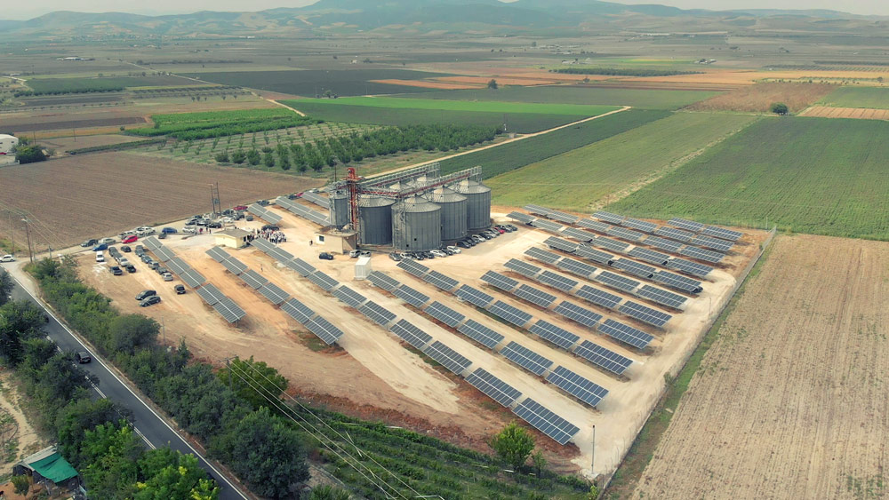
Solar Panel Systems Solar panels cover about 7% of Greece’s needs in electric energy, we are in one of the first “seats” internationally in what has to do with the contribution of solar panels in the all in all demand for electric energy. Our district, Thessaly, comes first in Greece for our rural solar panel parks.

Slide 14
Biomass
By the term biomass we mean:
The vegetal and woodland residues (firewood, haystacks, sawdust, olive kernels, pits),
The animal residues (manure, useless fish catches),
The plants that are being cultivated in the energy fields in order to be used as an energy source,
Civil waste and the residues of the food industry, the farming industry and the biodegradable fraction of civil waste.
Biomass is being used mainly for the production of thermal and electrical energy.

Slide 15
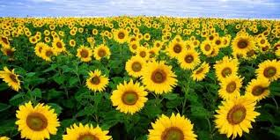
Greece has also delayed significantly in the exploitation of the rich biomass dynamic that it has. It is estimated that the exploitation of the biomass could satisfy 1/4 of the total country's needs for electricity.
-Almost 20% of the renewable electrical energy of the E.U. comes from the exploitation of biomass. -Almost 90% of the renewable thermal energy comes of the E.U. comes from the exploitation of biomass. -The E.U is the largest producer of pellet wood internationally

Slide 16
Hydroelectric power
Its contribution to energy production in Greece is 8-10%.
Today there are 6 big hydroelectric stations and other smaller ones.

Slide 17
Geothermal energy
Today in Greece, the exploitation of geothermal energy is happening exclusively for the use of it to thermal applications (greenhouse heating). Still, because of the rich in geothermal energy subsoil of our country, mainly across the volcano bow of south Aegean (Milos, Nisiros, Santorini), it could have a large application for the thermal desalination of the sea water, mainly in the dry islands and the areas near water.

Slide 18
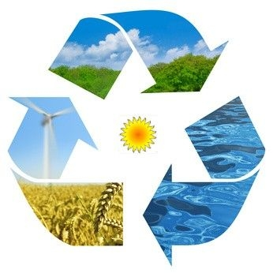
The confrontation of climate change requires energy production with zero gas pollutant emissions. Renewable energy sources are the solution and according to recent scientific researches, they could cover the overall demand with no huge cost in comparison to the conditions we are in today.

Slide 19
Thank you for your attention The Greek team

