Slide 1
Air and light pollution in Greece
Erasmus+ Project “CHANCE”
Gymnasium of Platykampos

Slide 2
Air Pollution
Air pollution is an environmental hazard.
7.000.000 people die globally annually.
90% of the air can be classified as toxic.
New research confirms the adverse effects of atmospheric on health.

Slide 3
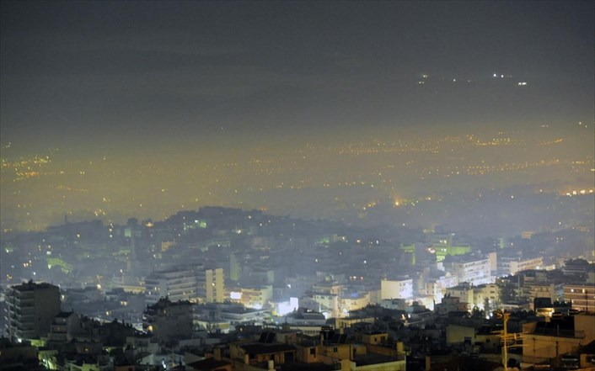
Athens

Slide 4
In Greece, it is estimated that more than 8.000 people die each year from air pollution.
Southern Greece is a crossroads of air pollution from Europe, Africa and Asia. Saharan dust and industrial pollutants are added to locally produced pollutants in the region.
Industrial activity is one of the factors that contributes to air pollution in various parts of Greece.

Slide 5
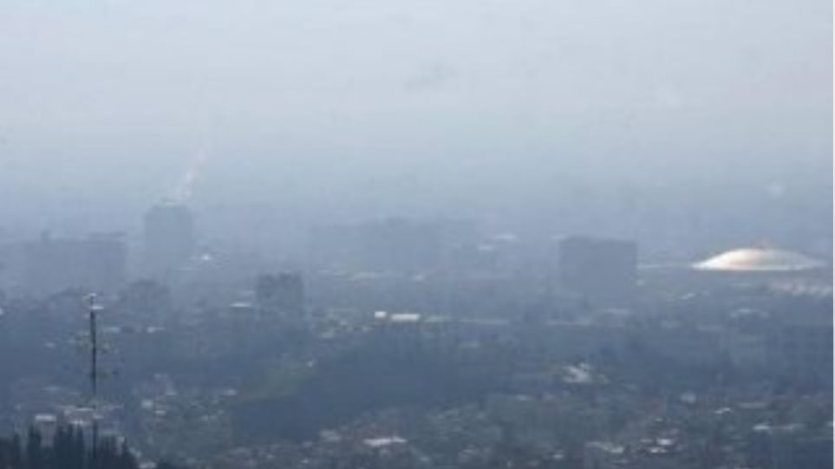
In the years of financial crisis, people burned everything, wood, plastic, rubber, clothes, to heat their homes.
The air pollution was very high.

Slide 6
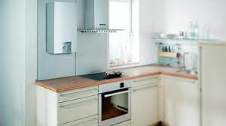
Today the situation in our country and in our region is better. The state subsidizes households with money and to install natural gas for heating, that is more green.

Slide 7
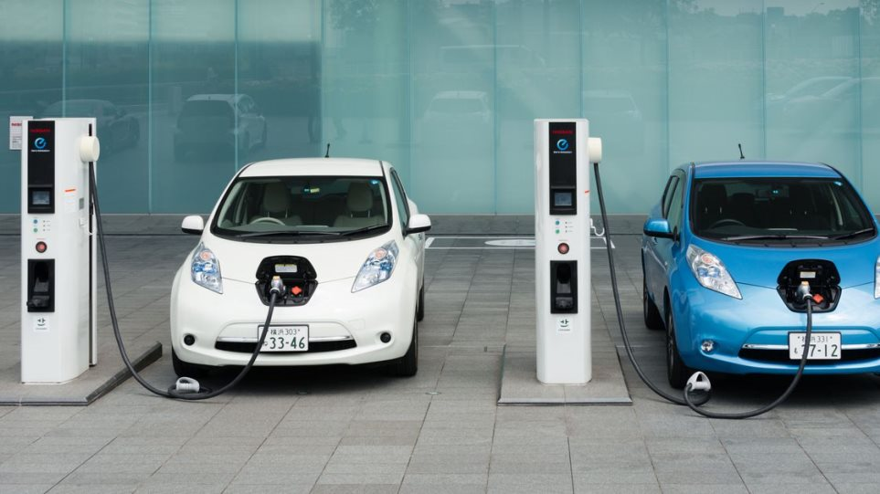
‘Environmentally friendly' means of transport for our trips are used. Electric cars are a green solution for the environment, but our country has not yet been motivated by the state to buy them.
Greece benefitted from long-standing bans on diesel cars in the two biggest cities, Athens and Thessaloniki.

Slide 8
The Pan-Hellenic Infrastructure for the Study of Atmospheric Composition and Climate Change (PANACEA) is the only integrated Research Infrastructure for atmospheric composition and climate change in Greece.
During the summer of 2019, the PANACEA campaign takes place with the participation of Greece's leading academic and research institutions. The campaign aims to record air pollution and subsequent human exposure to it, in 6 urban areas in Greece.
A second campaign will most likely take place in the same areas for the winter of 2019-2020.

Slide 9
Light Pollution
With the term "light pollution" we describe the phenomenon of excess and wrong lighting in cities and its causes.
What is more, a huge part of light-pollution is caused by the squandered light.
Light pollution affects humans, the environment, fauna and flora, but is also of a significant economic importance as it is a waste of valuable energy resources but it does not cause the movement that was believed for the reaction in our country.

Slide 10
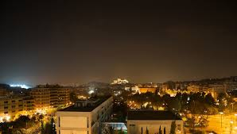
Greece is the fifteenth more light polluted country in the world regarding the rate of population who live in conditions of light pollution and the reason is the gathering of population in Athens and in other busy cities.

Slide 11
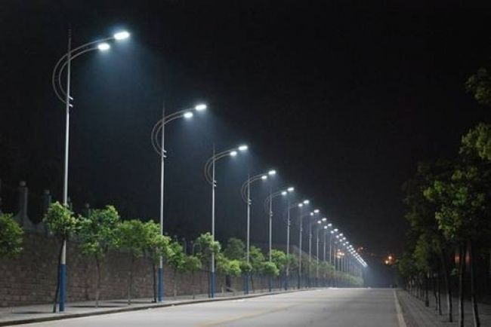
The Greek countryside and the Greek mountains more hopes for improvement than the major cities, but the danger of rapid deterioration in recent years still exists.
The reason is the replacing of high-pressure sodium lamps with LEDs, which can result in 2 to 3 times increase in light pollution as increased emissions in the blue part of the spectrum LEDs lead to more scattering of light in the atmosphere and increased light pollution, because they are cheaper.

Slide 12
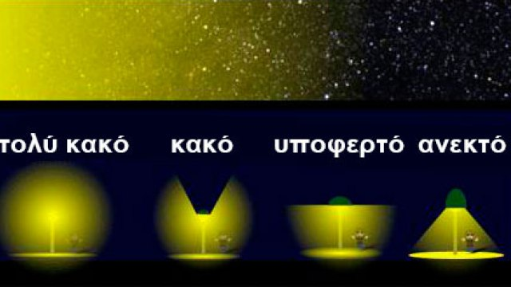
The good thing about LED bulbs is that they direct light downwards and its reflection on Earth limits the light going to the sky in relation to the round bulbs that 50% of the light is directed upwards.

Slide 13
The right and efficient lighting is the key of confrontation of the light-pollution. To achieve an efficient system of lighting for a place, it is important to follow the two steps below:
The definition of the needs of the lighting.
The choice of the appropriate electrical material.

Slide 14
Thank you for your attention !
The Greek team
Maria Donta
Georgia Lamari
Dimitris Voukatas
Panagiotis Kolokas
Apostolis Ntafoulis

