Slide 1
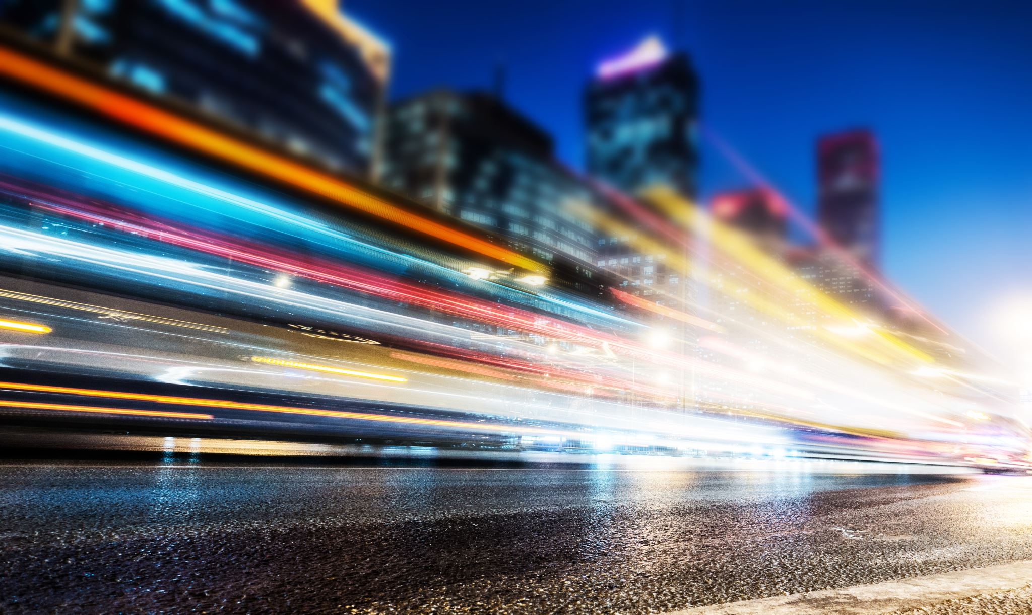
LIGHT POLLUTION

Slide 2
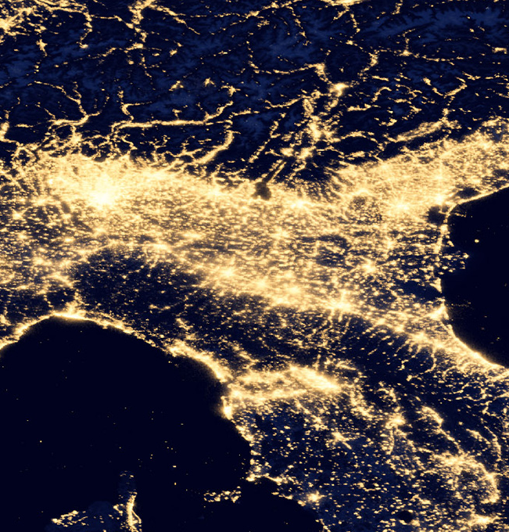
WHAT IS LIGHT POLLUTION?
Light pollution is an alteration of light levels naturally present in the night enviroment. This change causes various damages: environmental, scientific, cultural and economic. It is one of the most widespread forms of environmental pollution.

Slide 3
CAUSES:
external lighting emission not up to standard, that is, plants that not only emit functional light for night vision, but disperse part of it in other directions.

Slide 4
CONSEQUENCES:
- at night you cannot see the starry sky due to eccessive lighting
- adverse health effects
- the quality of sleep is lowered
- the extinction and death of many animal species

Slide 5
SOLUTIONS:
-using the amount of light needed
1
-direct the light of the street lamps in the necessary areas (downwards).
2
-use sodium vapor lamps, which pollute less.
3

Slide 6
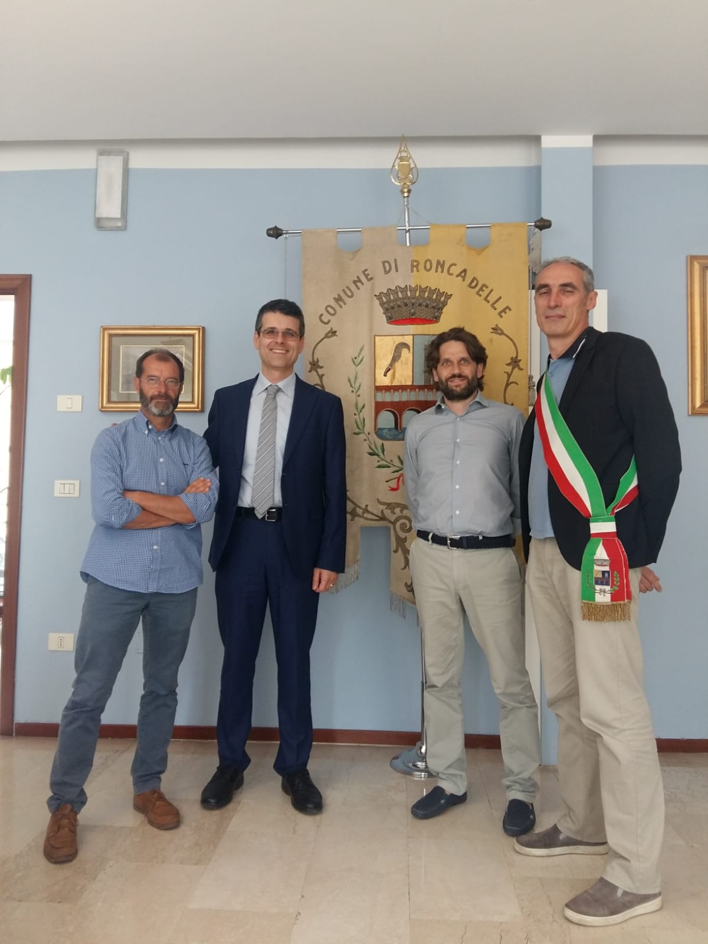
lighting in Roncadelle
The municipality of Roncadelle has made a contract with the association HERA LUCE for the management and redevelopment of public lighting. It is planned to replace 1,975 light systems with new LED lights, which will lead to energy savings.

Slide 7
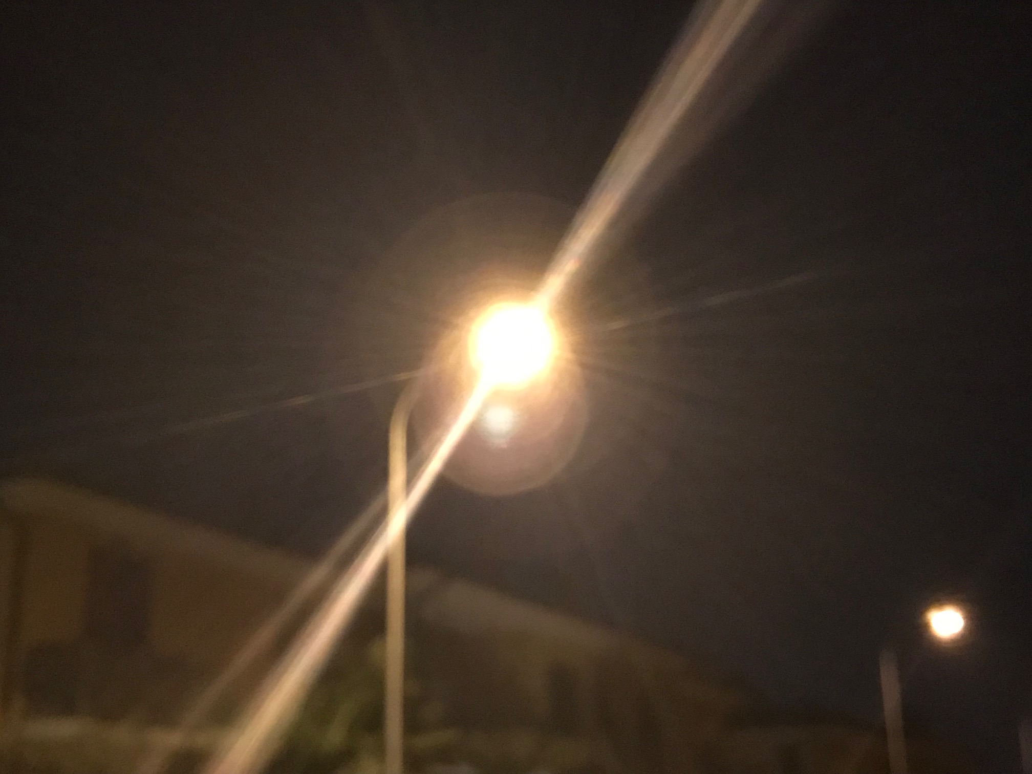
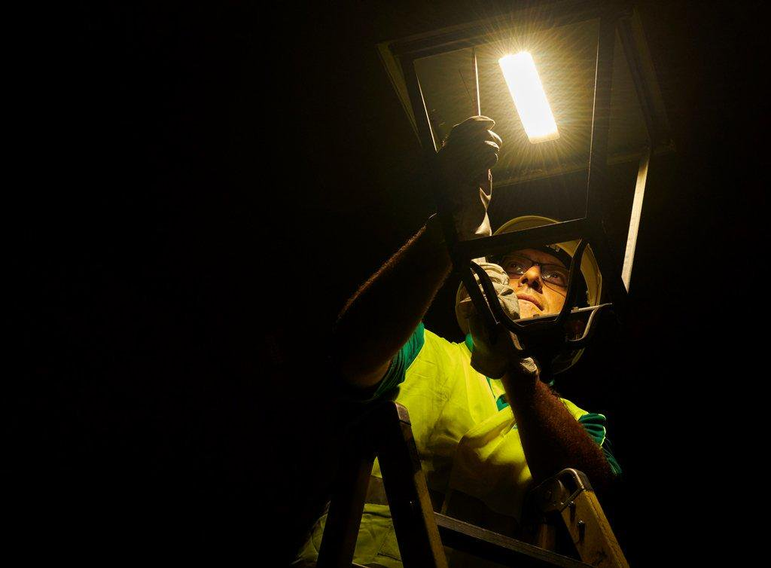
REPLACEMENT STREET LAMPS

Slide 8
“let's light up our future”
energy saving
Economic
New technology
Ecologic
innovative idea
Direction

Slide 9
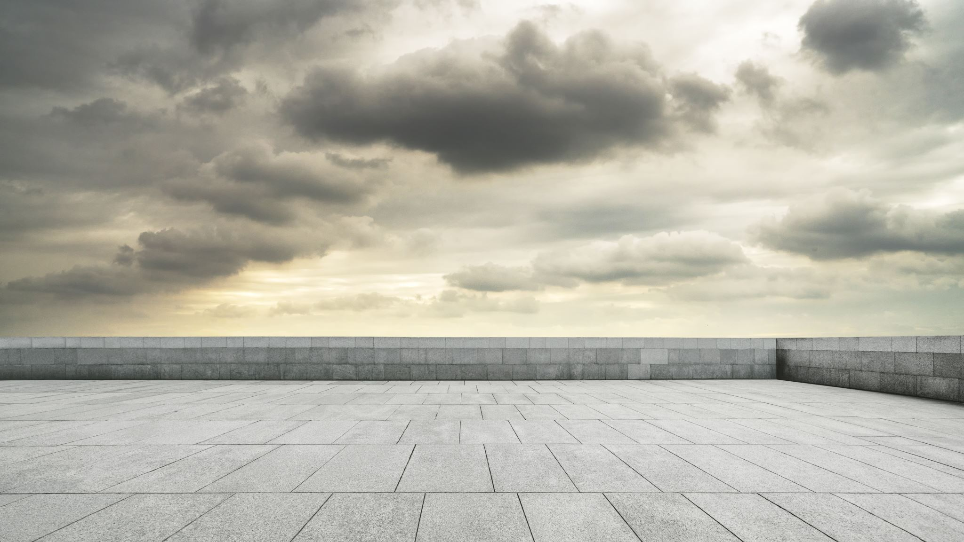
ATMOSPHERIC POLLUTION

Slide 10
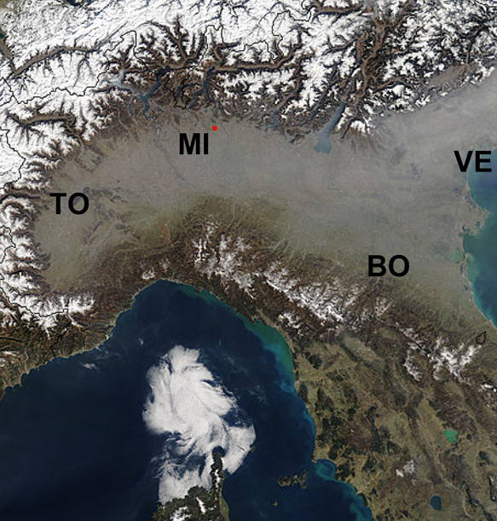
ATMOSPHERIC POLLUTION
atmospheric pollution is a form of pollution, that is the set of all physical, chemical and biological agents that modify the natural features of the earth’s atmosphere.

Slide 11
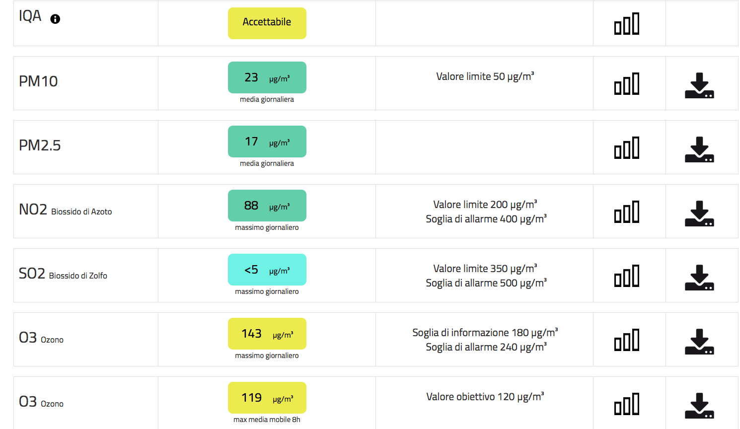
ATMOSPHERIC POLLUTION IN RONCADELLE

Slide 12
CAUSES:
-industries
-agriculture
-traffic
-energy production

Slide 13
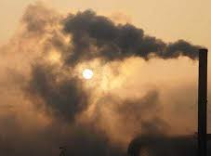
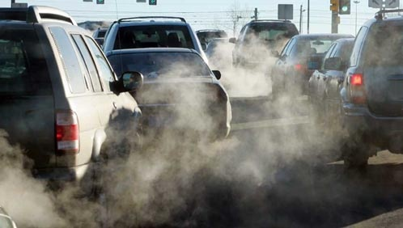
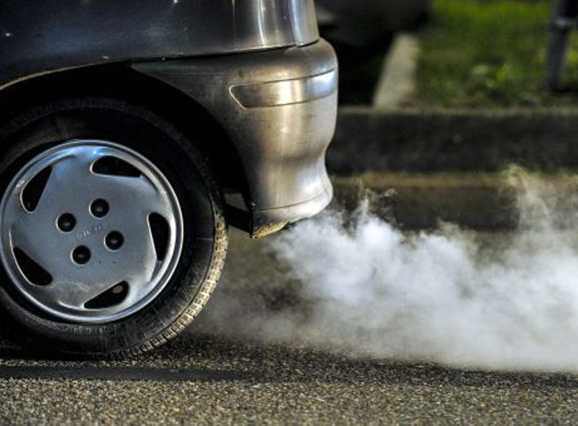
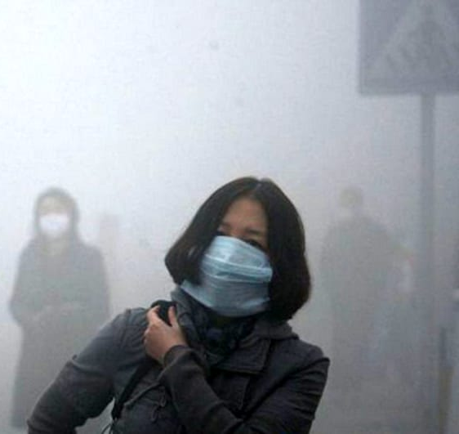
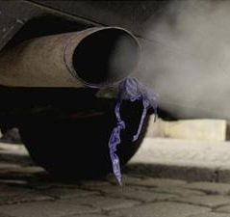

Slide 14
CONSEQUENCES:
impact on the ENVIRONMENT:
-Damages and pollutes fruits and vegetables
-Greenhouse effect
-Climate change
impact on MEN AND ANIMALS:
-nasal irritation
-lung disease
-animal extinction

Slide 15
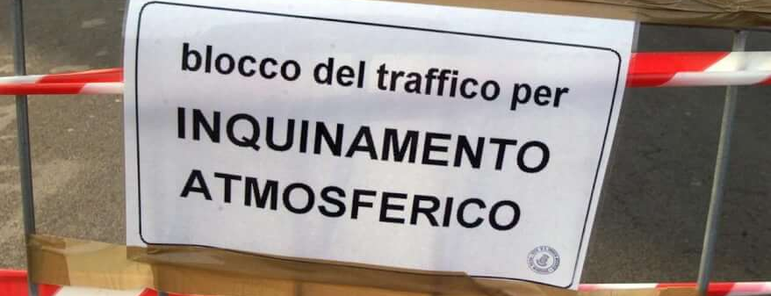
Solutions:
recycle waste
block the circulation of cars
replacement of old vehicles with ecological ones.
do not overdo in heating/cooling domestic enviroments.

Slide 16
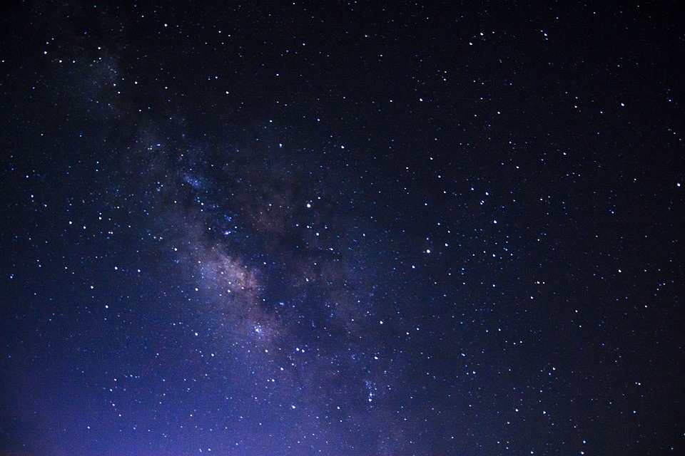
“Our ancestors knew the sky, used it as a clock and as a compass. Nobody knows how to do it today”.

Slide 17
POWER POINT ON AIR AND ATMOSPHERIC POLLUTION
Made by Roncadelle’s Students

