Slide 1
Air in latvia

Slide 2
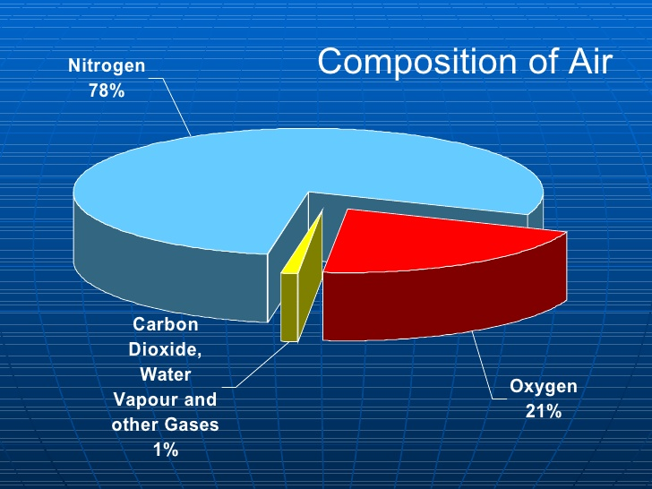
The atmosphere is the air envelope of the Earth

Slide 3
The significance of air.
We used to call the atmosphere by the word “sky”.
The blue sky is a thick layer of air, lit by the sun. If the Earth wasn’t surrounded by air, we would see the fiery Sun disc in the deep black sky.
Air is really very important for all living creatures on the Earth, cause all of them: animals, birds, plants and humans, breath air.

Slide 5
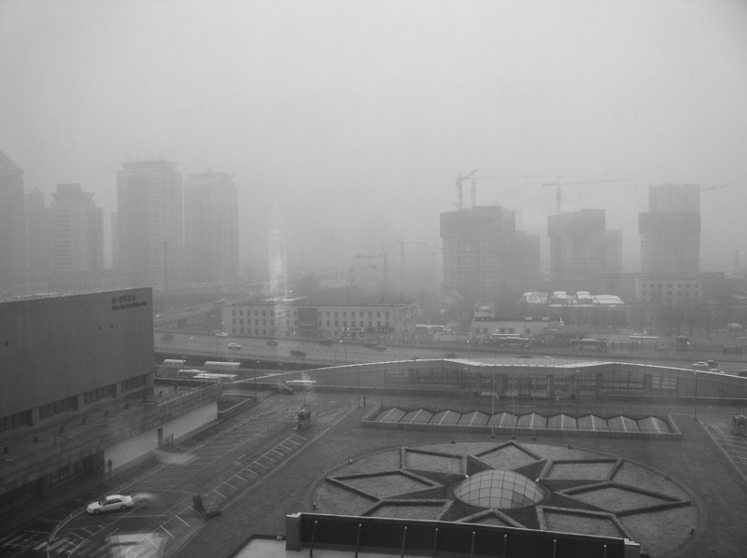
Air pollution impact on human health:
irritation of the mucous membrane
diseases of the respiratory system
allergies
malignant tumor

Slide 6
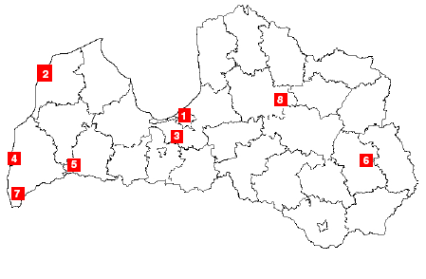
Gaisa kvalitātes monitoringa vietas Latvijā

Slide 7
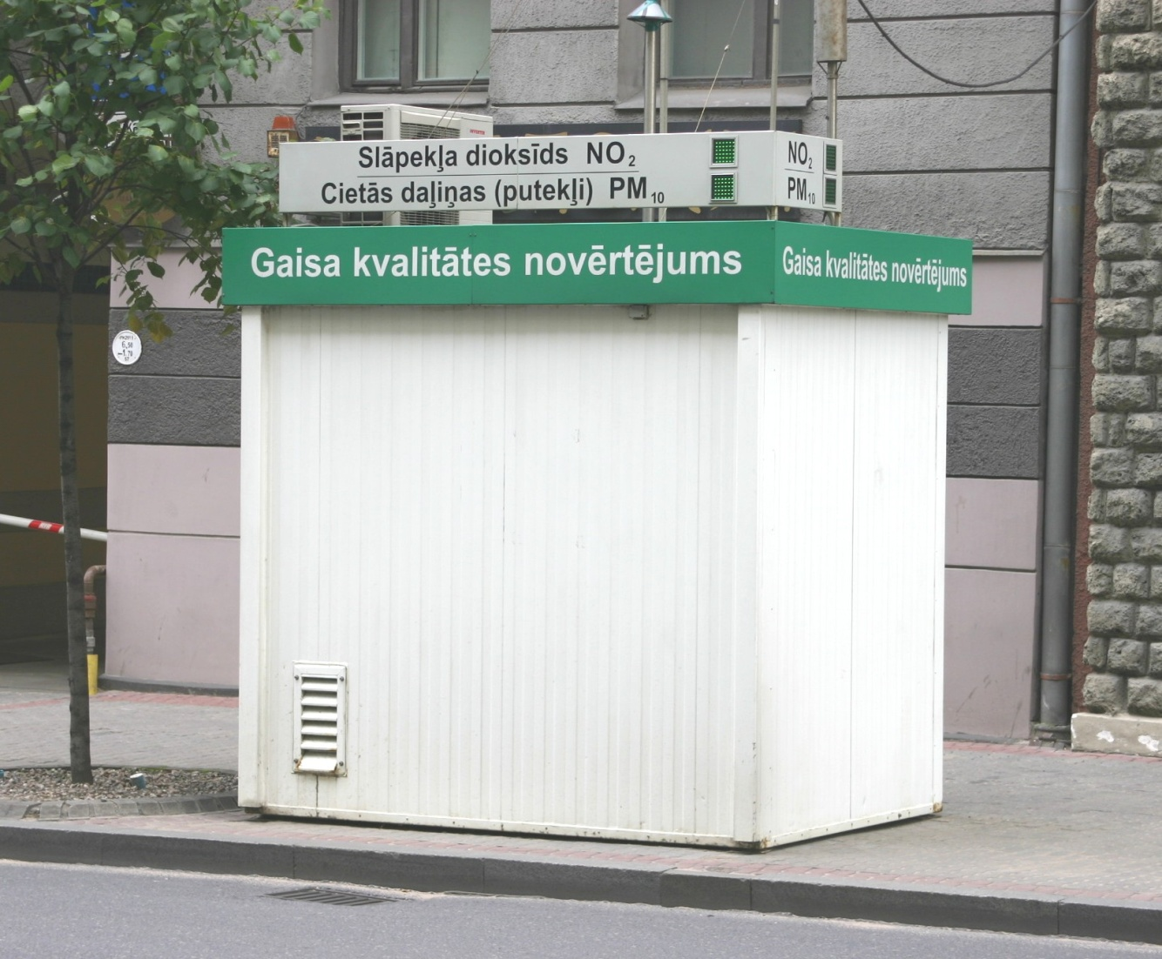
Gaisa kvalitātes monitoringa stacija Rīgā, Kr. Valdemāra ielā

Slide 8
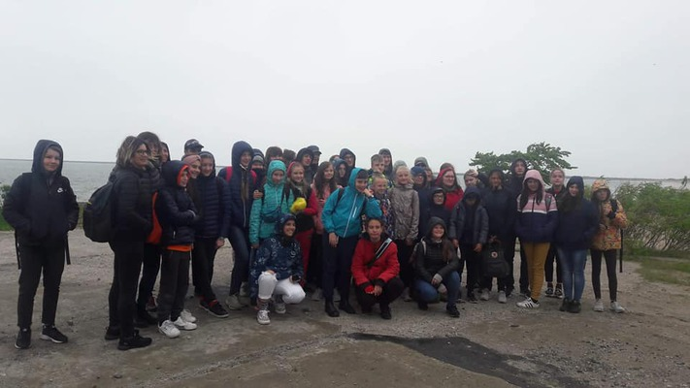
Air on see
On the see is a lot of air, because near the see is wind. There is good air because there are not a lot of cars.
The surface area of the sea (without Islands) is 419 thousand km2.

Slide 9
See is home to birds and fish! There are 116 types of fish. The Baltic sea is rich in seafood.

Slide 10
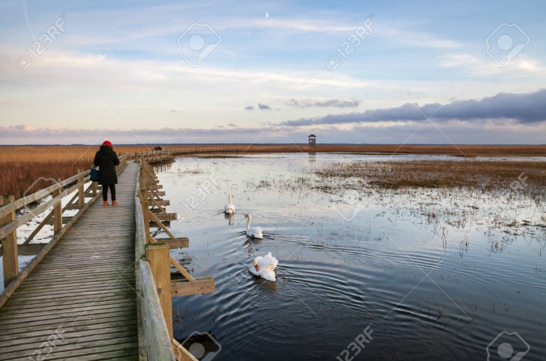
Nature lovers no longer have to leave Liepaja to appreciate the great outdoors and the wildlife it supports. You can now take a look at the wetlands surrounding Lake Liepaja on its north-western edge where Lauku iela meets in Eduarda Tise iela.

Slide 11
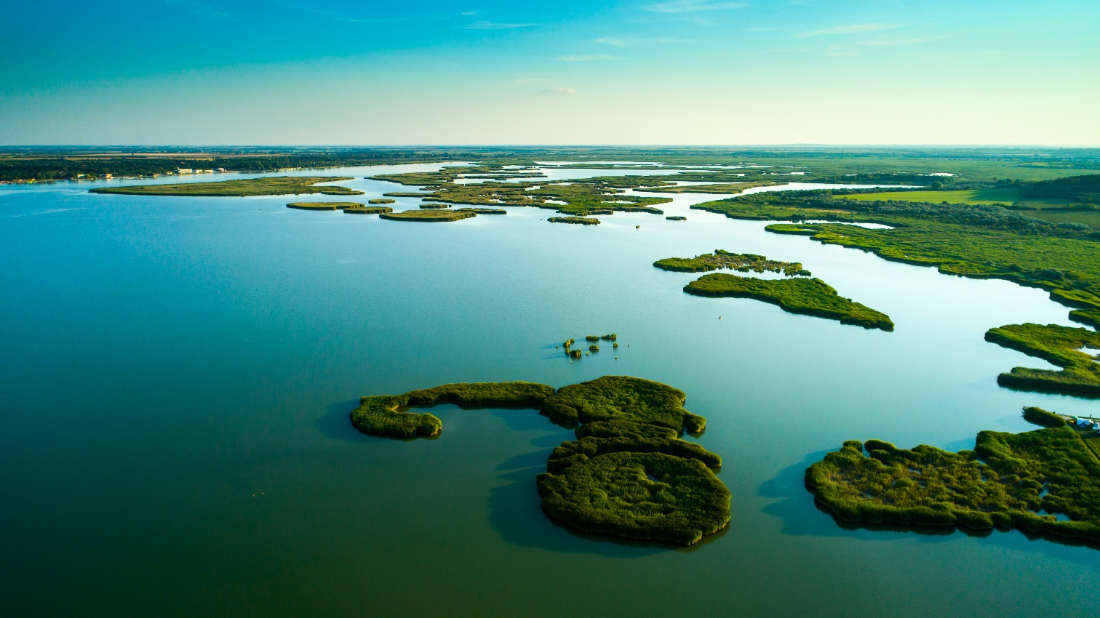
Lake Liepaja is shallow and eutrophic (around 40%), and it is one of the most important lakes on the shores of the Baltic Sea for nesting and migrating birds . More than 100 different species of birds have been spotted there. The lake is no less important for plants which flourish in salty biotopes

Slide 12
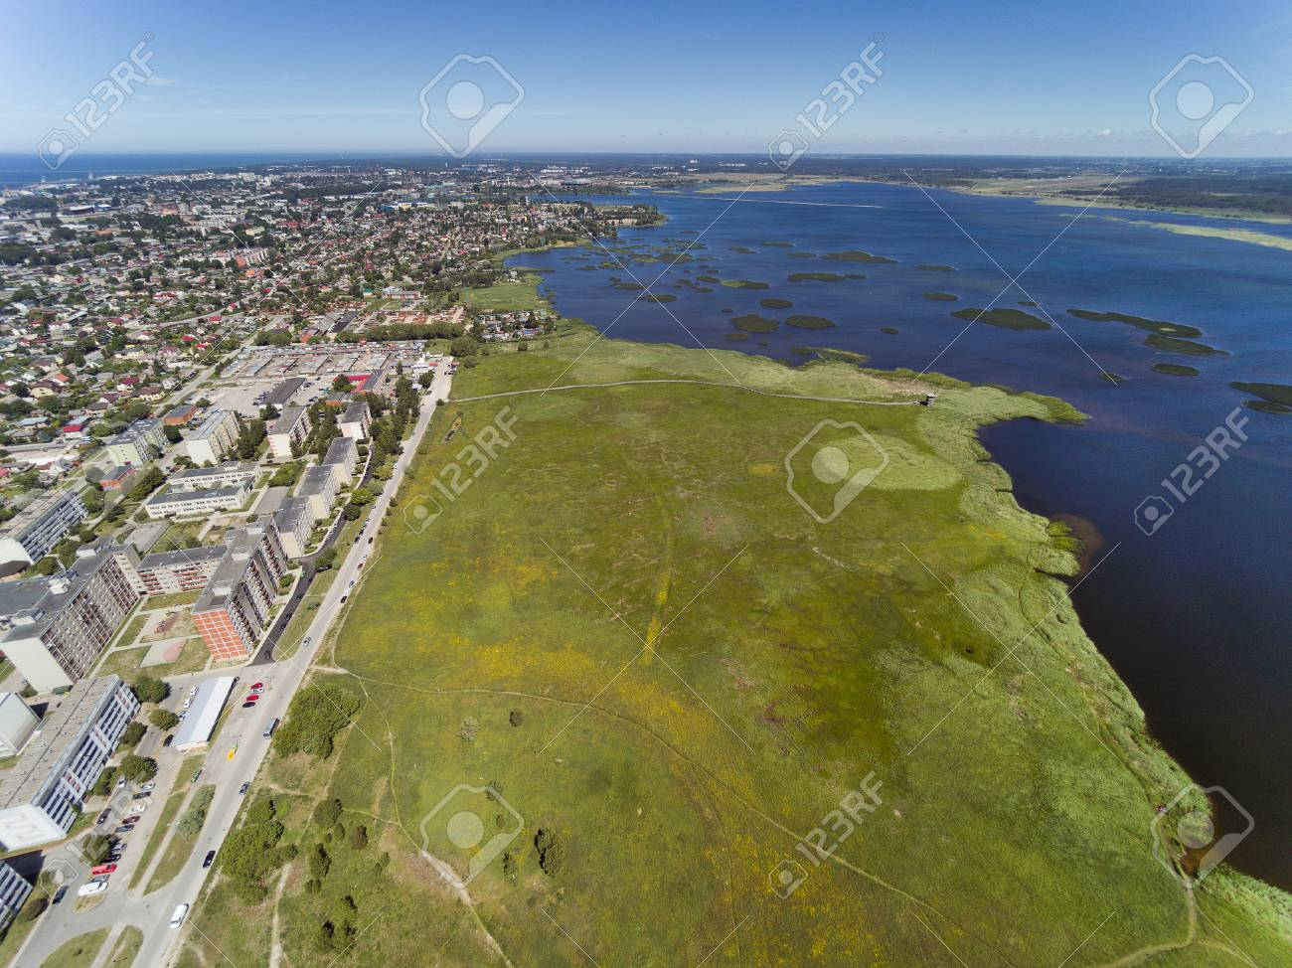
On the north-eastern shore of Lake Liepāja there are flood-land plains which are the home to domestic animals which have been adapted to life in the wild. There is also a viewing tower, available upon request with the guide. Just follow the roughly 1km-long wooden boardwalk and see if you can spot a rare bird or a unique aquatic creature only minutes from the city centre.

Slide 13
Forest - the lungs of the Earth

Slide 14
There are 4 reserves and 4 national parks in Latvia
Gauja national park
Slitere national park
Ķemeri national park
Raznas national park
Moricala nature reserve*
Teiči reserve
Krustkalni reserve
Griņi reserve
There are protected 800 giant trees in Latvia (485 oak-trees, 117 linden and others)
* The oldest reserve in Latvia (1912)

Slide 15
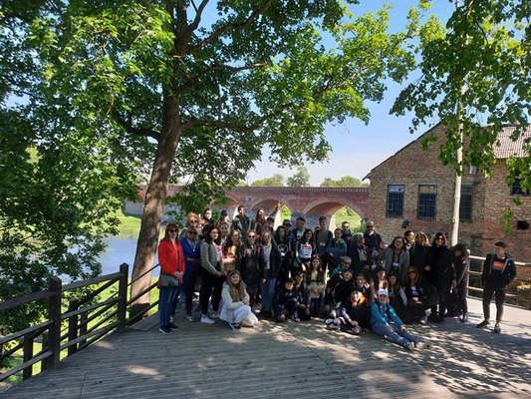
Forest of Latvia
Latvia is a small country (square is 64573 km2) but 50% of territory is forest.

Slide 16
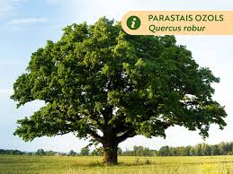
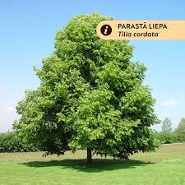
Types of Latvia’s trees
Latvia is located in the mixed forest zone
Pine
Fir
Spruce
Alder
Aspen
Oak*
Maple
Ash
Hazel
Rowan-tree
Larch
Birch
Linden*
* The national tree of Latvia

Slide 17
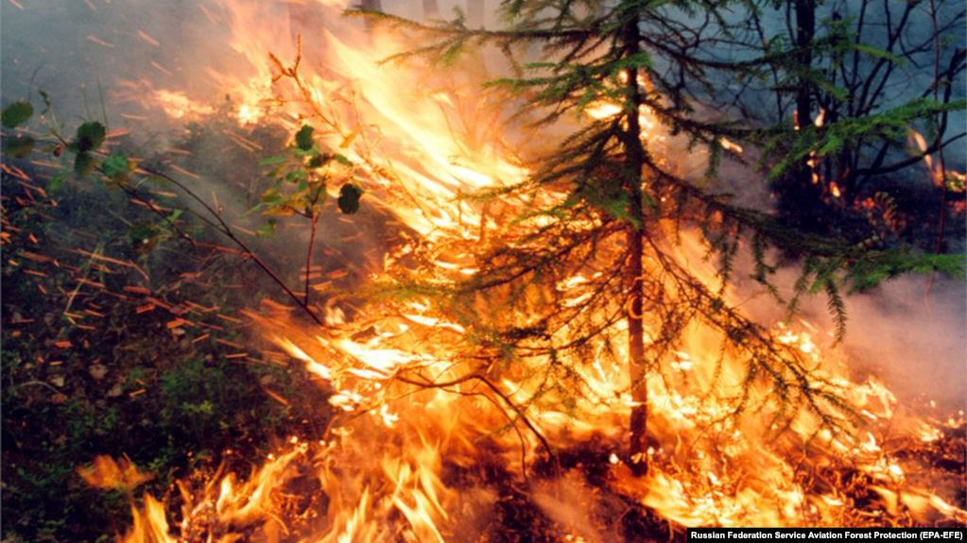
Problems of forest
Clearing
Fires
Pollution

Slide 18
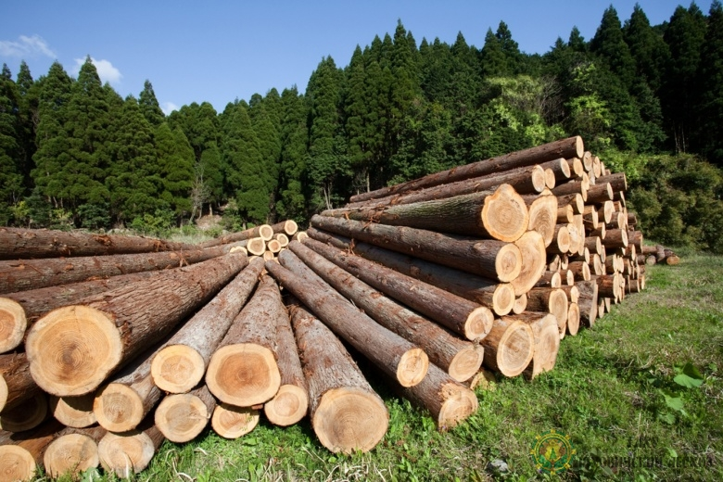
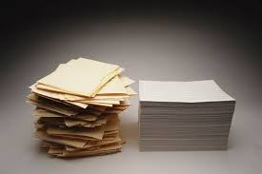
Wood
Building material
Paper
Furniture
Fuel

Slide 19
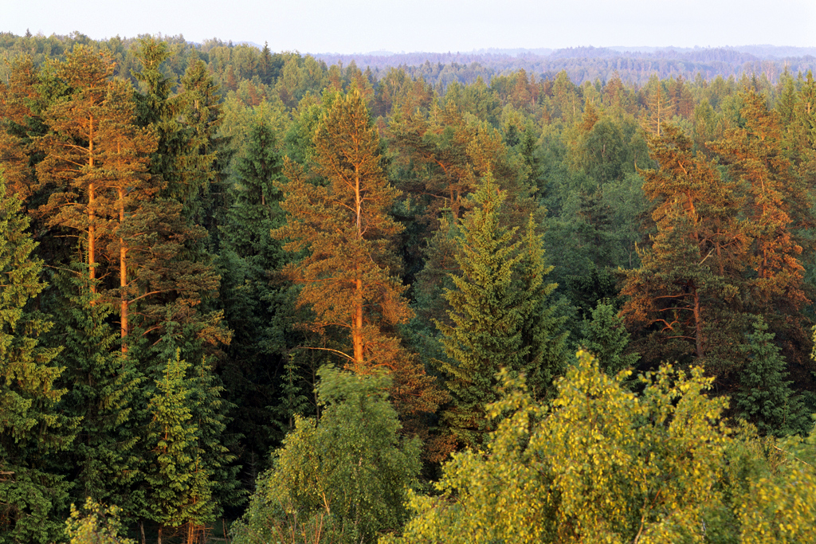
The value of the forest
Air cleaning (1 tree for 3 people O₂)
Dust decrease (1 hectare of forest stops 100 tone of dust)
Stop noise (noise reduce of 11 decibels)
Save soil
Stop strong wind
Home for animals
Food and medicinal herbs
Wood
Relax for people

Slide 20
Protect and save our planet!

