Slide 1
WELCOME TO POLAND!
All you need to know about Poland ☺

Slide 2
After watching the presentation you will know:
Some of the national symbols of Poland
The capital city of Poland
A few basic information about Inowrocław
THEN YOU WILL PLAY A GAME IN WHICH YOU WILL ANSWER QUESTIONS FROM THE PRESENTATION SO WATCH IT CAREFULLY! ☺

Slide 3
Where is Poland?
Poland is in the centre of Europe.

Slide 4
Poland has got 7 neighbours:
Germany, the Czech Republic, Slovakia, Ukraine, Belarus, Lithuania and Russia

Slide 5
Polish flag
Polish flag is white and red.

Slide 6
The White Eagle is the national emblem of Poland.
The eagle has got a golden crown on its head. It’s also got golden claws and a golden beak.

Slide 7
Polonez (polonaise)
Polonez is a national dance from Poland. It is danced during formal parties, especially on ‘studniówka’, a kind of senior prom that occurs approximately 100 days before the final exams.

Slide 8
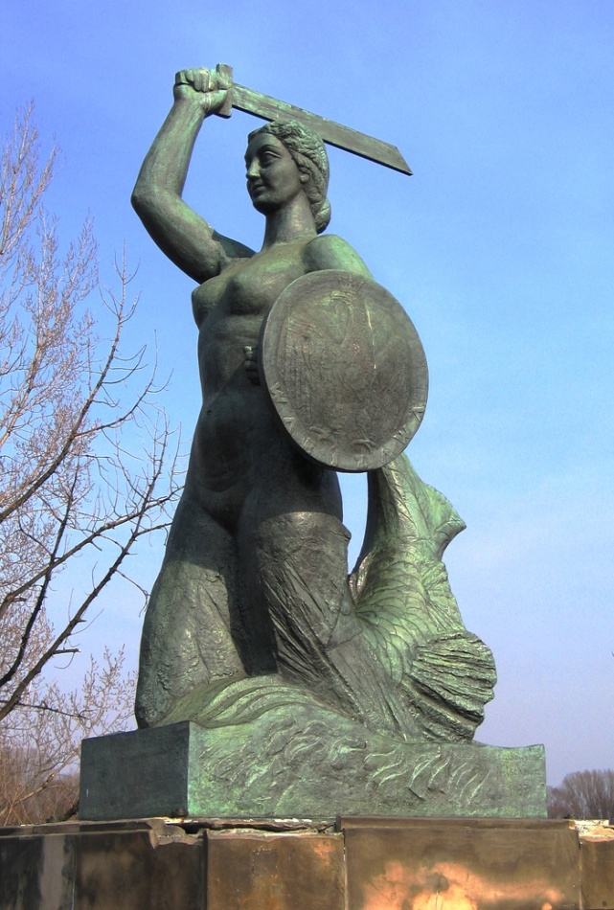
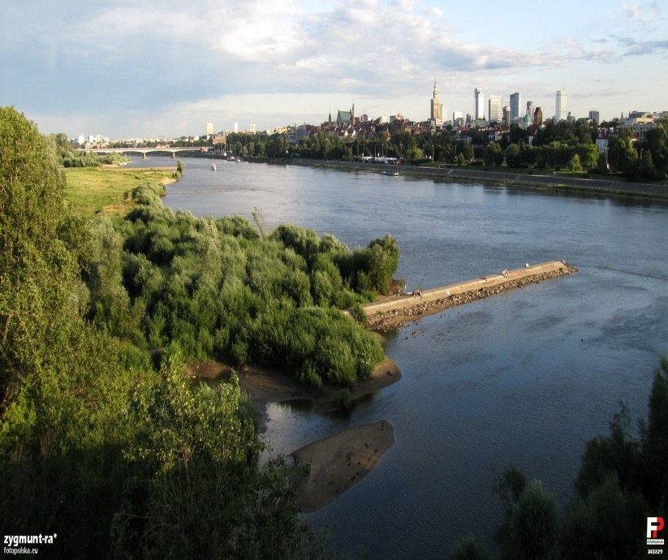
Warsaw is the capital city of poland
The legend says Warsaw is guarded by a mermaid.
The longest river in Poland, the Vistula River, winds its way from the Beskidy mountains in the south of Poland, through Warsaw and up to the Baltic Sea.

Slide 9
Traditional polish food includes:
bigos
pierogi

Slide 10
Poland is also known for its delicious chocolate.
The most famous one is by Wedel.

Slide 11
INOwrocław is in central poland

Slide 12
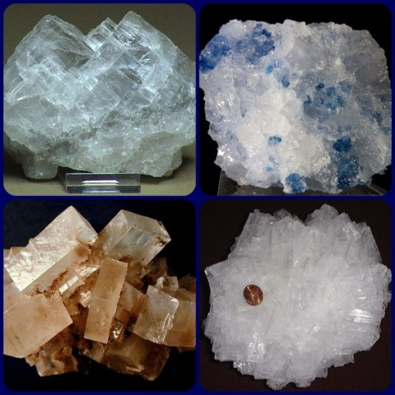
Inowrocław is called the salt city because of salt mines

Slide 13
Inowrocław is also famous for the graduation towers in a lovely solanki park

Slide 14
This is our school ☺
It’s a primary school, with about 450 pupils and 50 teachers.
Pupils learn English and one more foreign language. They may choose French or German.

Slide 15
Here are some basic words you should know when you come to poland
Dzień dobry – good morning
Cześć – hello
Jak masz na imię? – What’s your name?
For boys:
Jesteś piękna ☺ - You’re beautiful.

Slide 16
Thanks a lot for all your attention
Have a nice day ☺

