Slide 1
WELCOME TO POLAND!
All you need to know about Poland ☺

Slide 2
After watching the presentation you will know:
Some of the national symbols of Poland
The capital city of Poland
A few basic information about Inowrocław
THEN YOU WILL PLAY A GAME IN WHICH YOU WILL ANSWER QUESTIONS FROM THE PRESENTATION SO WATCH IT CAREFULLY! ☺

Slide 3
Quick view of poland

Slide 4
Where is Poland?
Poland is in the centre of Europe.

Slide 5
Poland has got 7 neighbours:
Germany, the Czech Republic, Slovakia, Ukraine, Belarus, Lithuania and Russia

Slide 6
Polish flag
Polish flag is white and red.

Slide 7
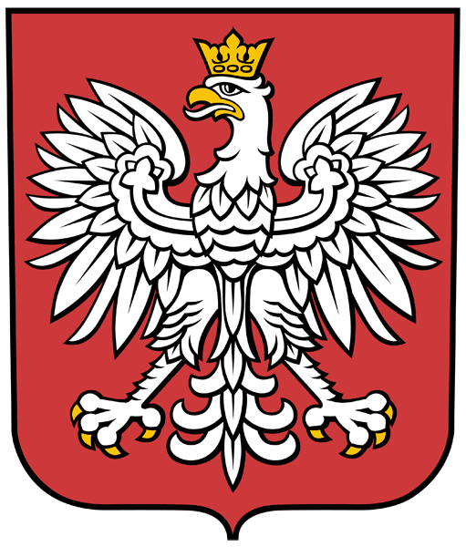
The White Eagle is the national emblem of Poland.
The eagle has got a golden crown on its head. It’s also got golden claws and a golden beak.

Slide 8
Polonez (polonaise)
Polonez is a national dance from Poland. It is danced during formal parties, especially on ‘studniówka’, a kind of senior prom that occurs approximately 100 days before the final exams.

Slide 9
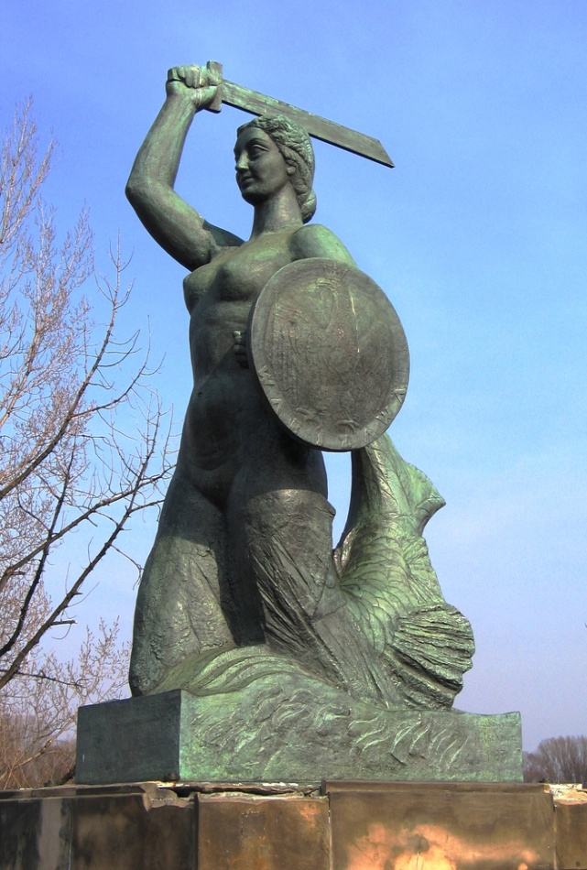
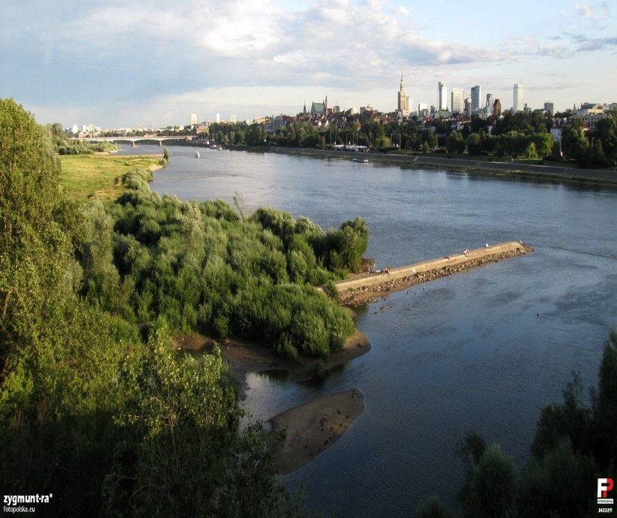
Warsaw is the capital city of poland
The legend says Warsaw is guarded by a mermaid.
The longest river in Poland, the Vistula River, winds its way from the Beskidy mountains in the south of Poland, through Warsaw and up to the Baltic Sea.

Slide 10
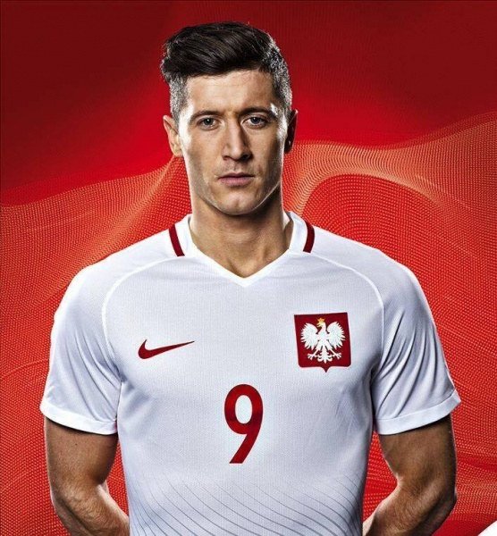
Most famous polish people
Lech Wałęsa
Jan Paweł II
Robert Lewandowski

Slide 11
Traditional polish food includes:
bigos
pierogi

Slide 12
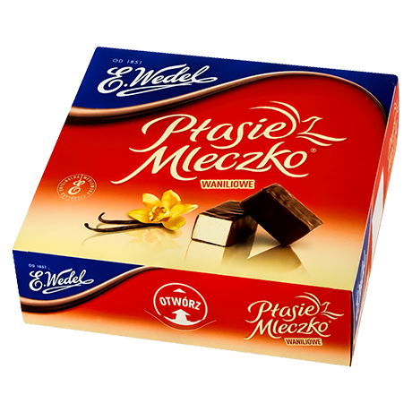
Poland is also known for its delicious chocolate.
The most famous one is by Wedel.

Slide 13
INOwrocław is in central poland

Slide 14
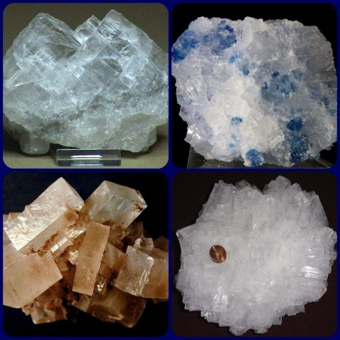
Inowrocław is called the salt city because of salt mines

Slide 15
Inowrocław is also famous for the graduation towers in a lovely solanki park

Slide 16
This is our school ☺
It’s a primary school, with about 450 pupils and 45 teachers.
Pupils learn English and one more foreign language. They may choose French or German.

Slide 17
Here are some basic words you should know when you come to poland
Dzień dobry – good morning
Cześć – hello
Jak masz na imię? – What’s your name?
For boys:
Jesteś piękna ☺ - You’re beautiful.

Slide 18
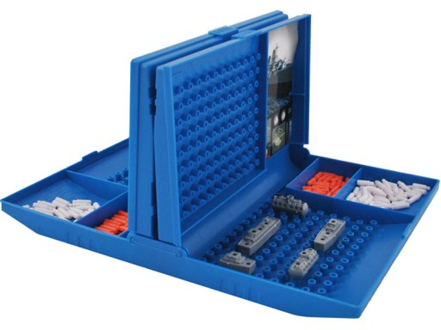
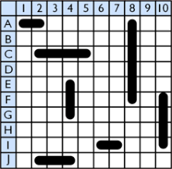
Let’s play the battleship

Slide 19
1. What is the capital of poland?
Wrocław
Watykan
warsaw

Slide 20
2. What is the longest river?
Odra
Vistula
Warta

Slide 21
3. Which country is not a neighbour of poland?
France
The czech republic
germany

Slide 22
4. Who is the best polish footballers?
Robert Lewandowski
Michał Boruc
Kamil Stoch

Slide 23
5. What does the polih flag look like?
Red and white
White and red
Red, white and red

Slide 24
6. What is the name of the sea?
The dead sea
The baltic sea
The mediterranean sea

Slide 25
7. What is not the traditional food?
Bigos
Pierogi
bakalie

Slide 26
8. What is the national dance in poland?
polka
Polonez
tango

Slide 27
9. What Does the White Eagle the national emblem of Poland have?
Golden Crown
beautiful Eyes
Black wings

Slide 28
10. How would you say in polish „Hello”?
Jesteś piękna
Cześć
Dzień dobry

Slide 29
Thanks a lot for all your attention
Have a nice day ☺

