Slide 1
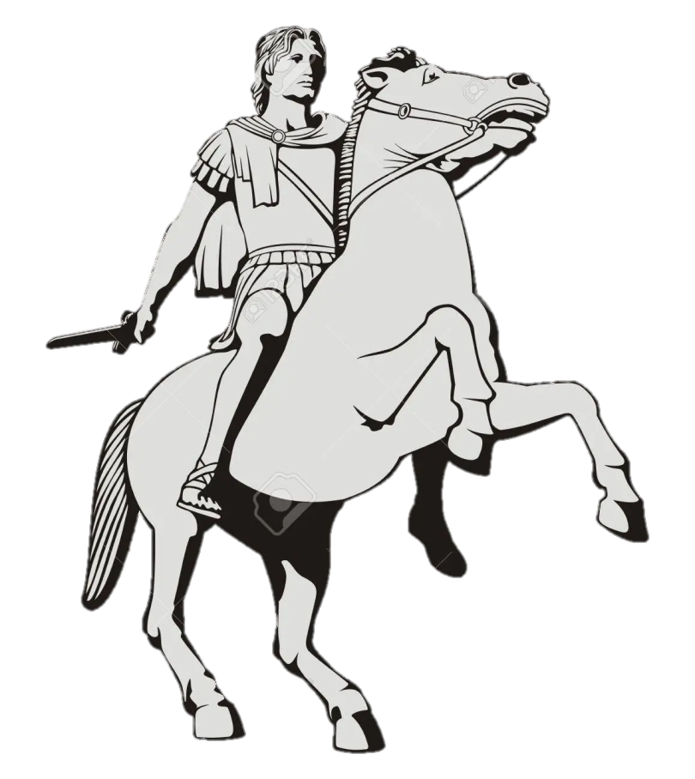
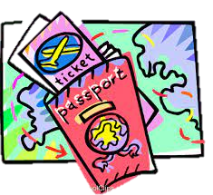
Greece
Thessaloniki
Let us all travel there!!!!

Slide 2
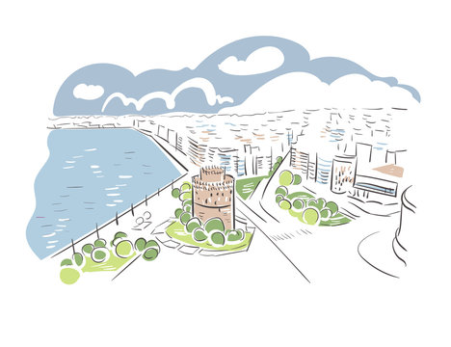
"There is a homeland for everyone,
while there is Thessaloniki."
(Niκ. Houmnos, 14th c. Byzantine dignitary and a Scholar).

Slide 3
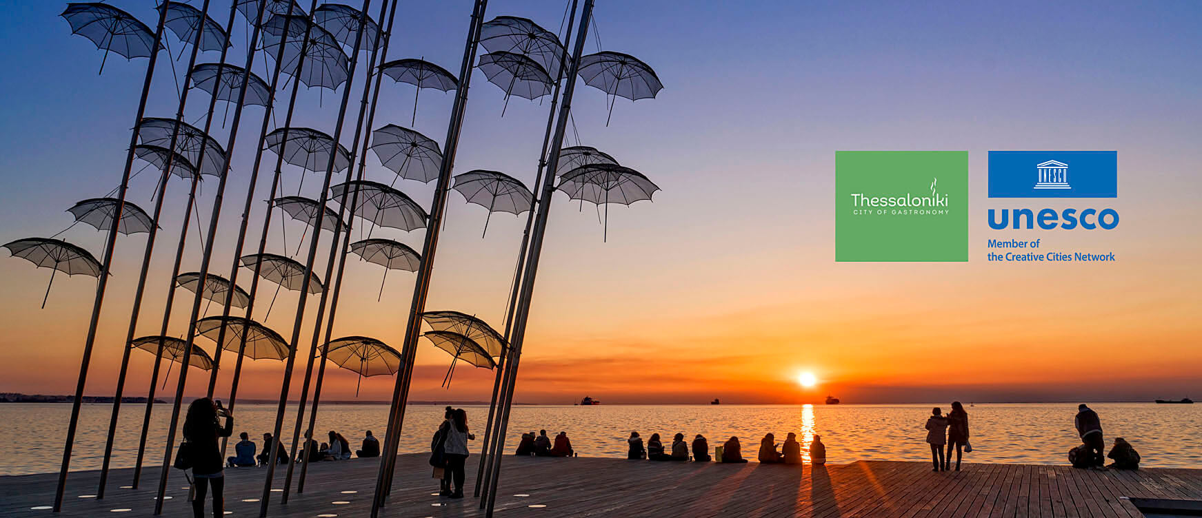
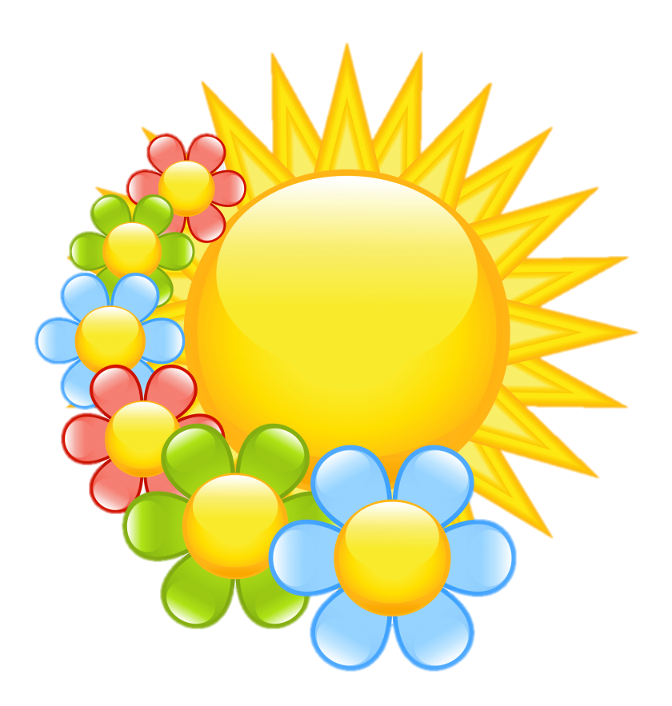
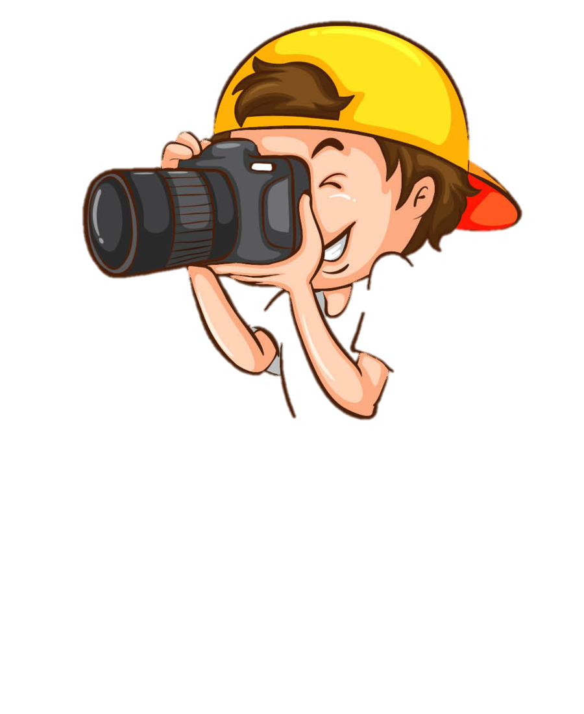

Slide 4
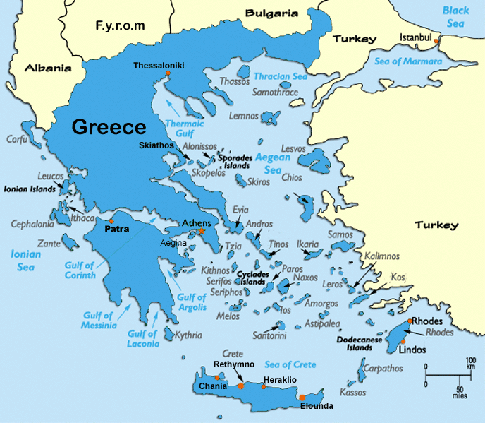
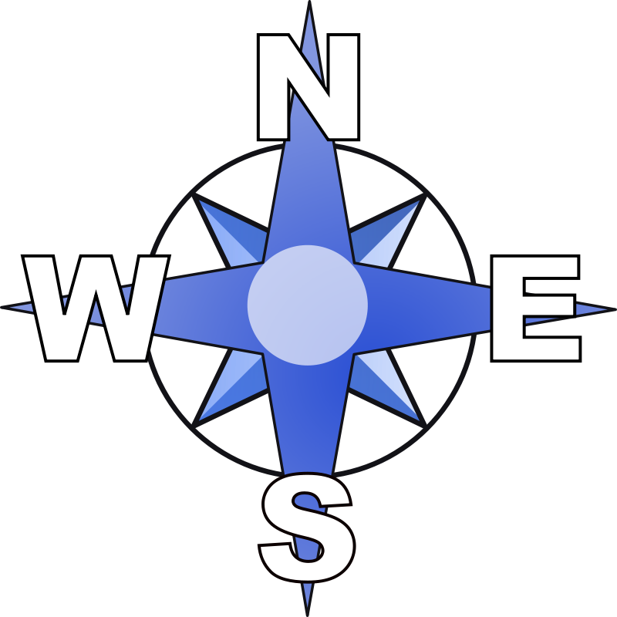
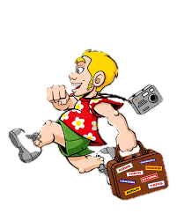
location and population
Thessaloniki is situated in the northern part of Greece.
It is the second largest city in Greece where more than 1.2 million people live.
The city is built on the Thermaic Gulf at the northwest corner of the Aegean Sea.
It is the most important administrative, cultural, and business center in northern Greece.

Slide 5
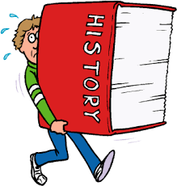
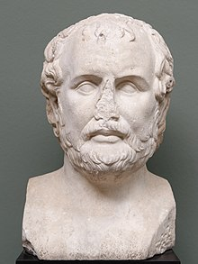
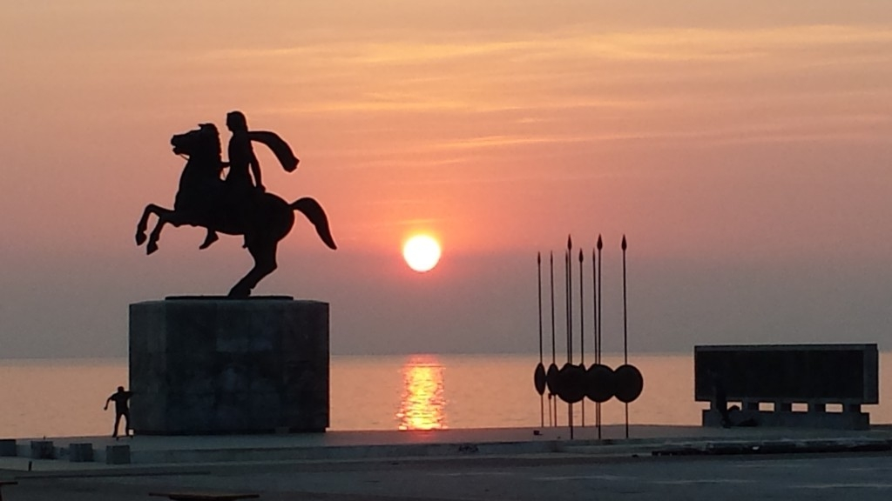
some historical facts
The city of Thessaloniki was founded in 315 BC by Cassander of Macedon and was named after his wife Thessalonike, daughter of Philip II of Macedon and sister of Alexander the Great.
An important metropolis by the Roman period, Thessaloniki was the second largest and wealthiest city of the Byzantine Empire.
It was conquered by the Ottomans in 1430 and remained an important seaport and multi-ethnic metropolis during the nearly five centuries of Turkish rule.
It passed from the Ottoman Empire to the Kingdom of Greece on 8 November 1912.

Slide 6
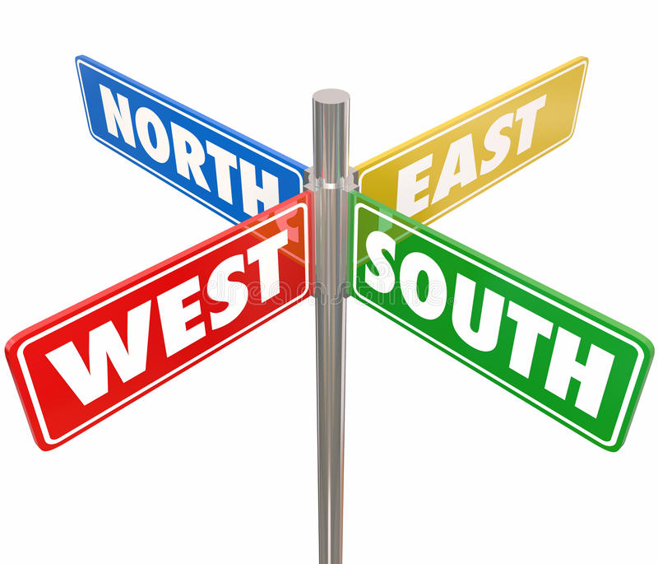
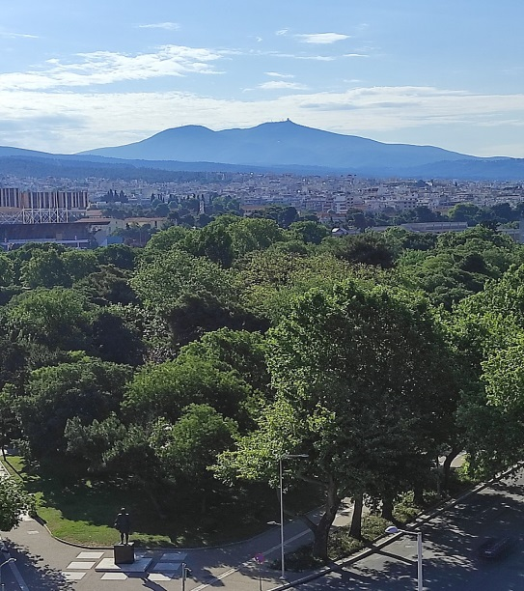
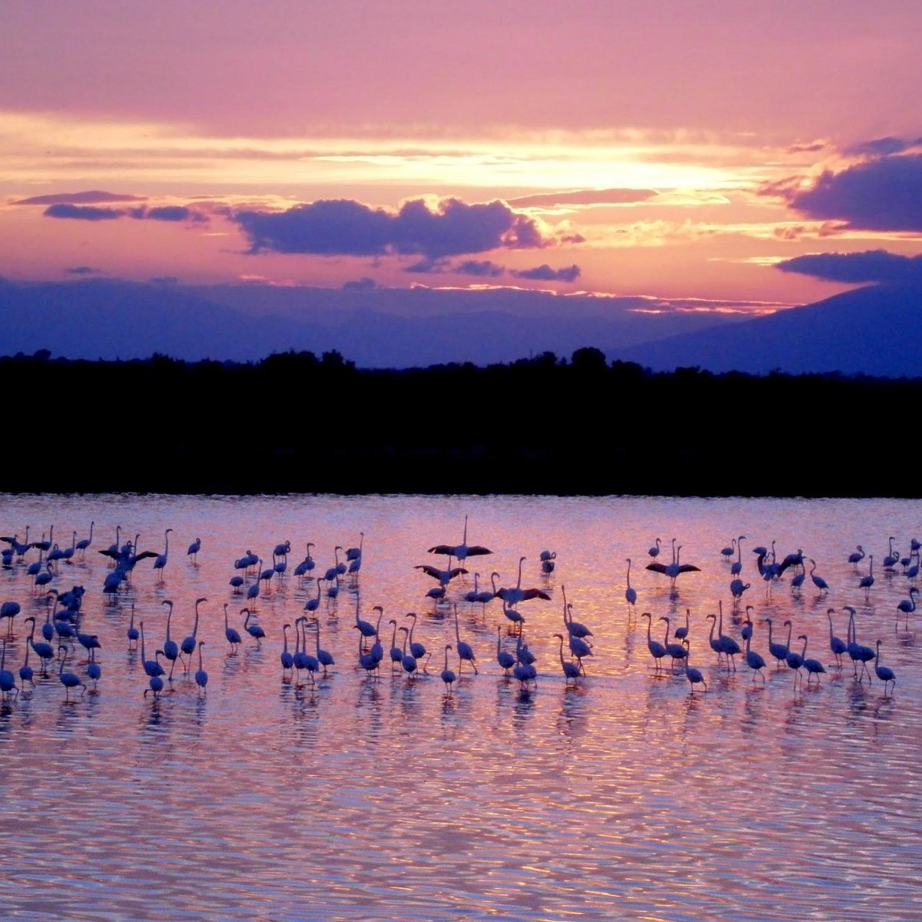
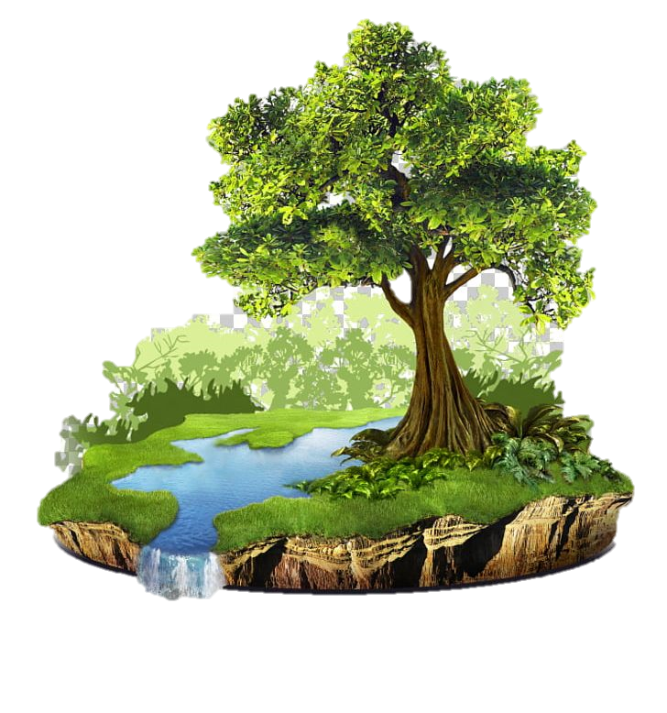
natural environment
Thessaloniki is located in the western part of the peripheral unit of Thessaloniki, at the mouth of the Thermaic Gulf, opposite Mount Olympus. It is built amphitheatrically on the slopes of Kedrin Hill and is surrounded to the east by the Seikh Su forest.
To the southeast of the city rises Mount Chortiatis, whereas to the northwest lies its fertile plain. The passage of Derveni separates Mount Sivri to the north from Chortiatis.
Three rivers, the Axios, the Loudias and the Echedoros, flow west of the city while the Aliakmonas flows even further south.
The Axios Delta is a wetland of 22,000 acres of special importance, protected by the Ramsar Convention.

Slide 7
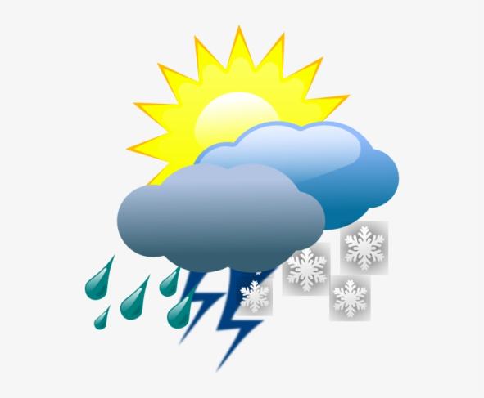
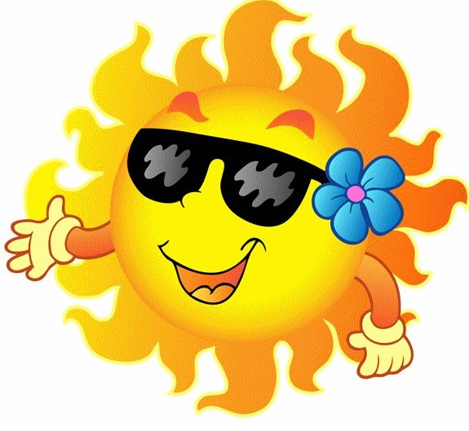
climate
Thessaloniki has a Mediterranean climate with a lot of humidity.
Winters are usually dry, with morning frost. Snowfalls occur sporadically more or less every winter. Fog is common, as well.
Wind is also usual in the winter months.
Summers are hot and quite dry. In the summer months strong heat waves are very common.

Slide 8
flora and fauna
Seikh Su forest hosts 277 plant species, among which pine trees, cypress and plane trees.
Kedrin Hill is also home to a rich variety of fauna.
Mammals include hares, foxes, martens, squirrels, weasels and hedgehogs.
Around 80 types of birds frequent the forest, the eagle, the common cuckoo, nightingales, owls and the song thrush.
Salamanders, frogs, turtles, grass snakes and lizards are the most common amphibians and reptiles.

Slide 9
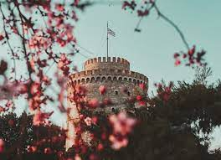
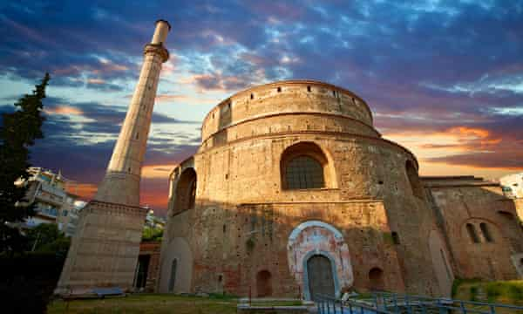
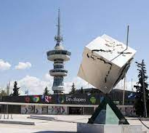
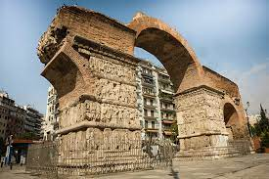
places of interest
The White Tower is the symbol of the city. It was a prominent Ottoman addition to the city walls built in the 15th century.
There are plenty of interesting places for the visitor to see in the city.
The Tower of OTE was built on 7th August, 1966 and it is located at the International Exhibition Center.
The Arch of Galerius or Kamara, was built in 303 and is the most famous meeting point of the city.
Rotonda is a 4th century circular building, similar to the Pantheon in Rome. It is included in the Early Christian and Byzantine monuments of Thessaloniki as an UNESCO World Heritage Site.

Slide 10
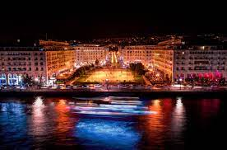
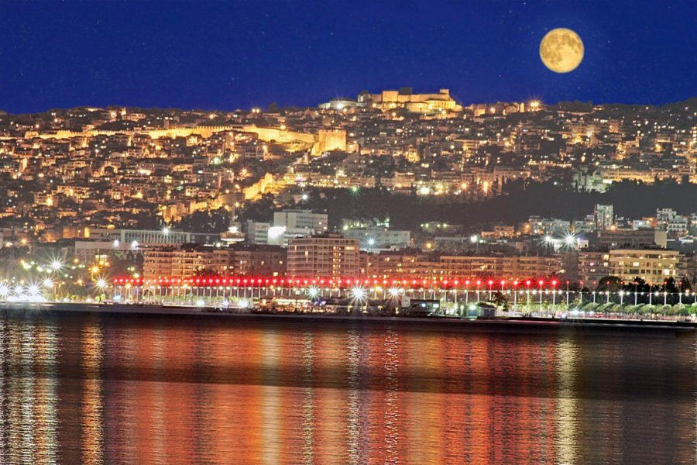
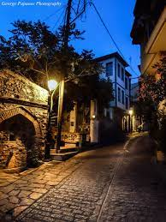
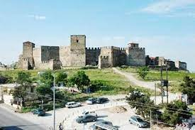
Aristotelous Square is the main city square located on the waterfront, in the city center. It was designed by the French architect Ernest Hébrard in 1918.
panoramic view of the city
with full moon
The Byzantine Walls of Thessaloniki
The Trigonion Tower is one of the most impressive elements of the Walls and a favourite spot for tourists and photography lovers!

Slide 11
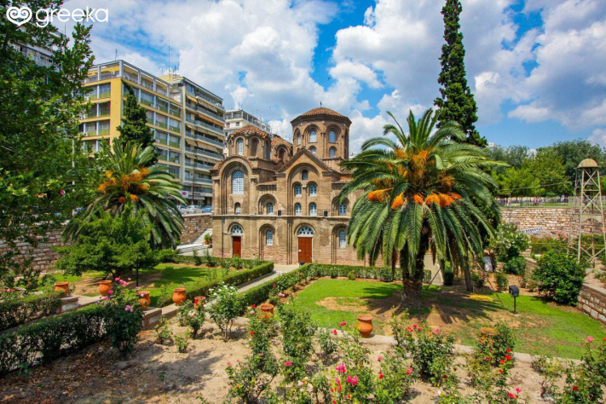
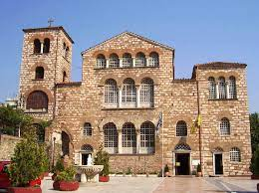
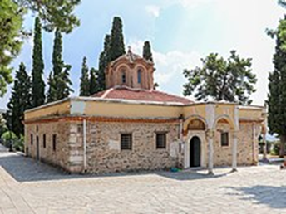
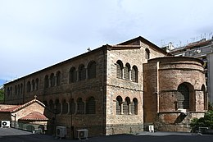
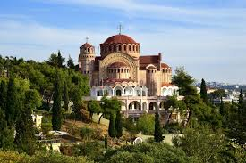
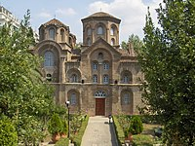
Agia Sofia is one of the oldest and most important Christian churches of the city. Its temple was built in the middle of the 7th century.
UNESCO World Heritage
churches
The Patriarchal Vlatadon Monastery was constructed in 14th century, and it is located in Ano Poli.
This is the city’s largest church and the main sanctuary dedicated to its patron saint, Agios Dimitrios. The church was constructed after 413 and it is located in the homonymous street.
The church of the Acheiropoietos is a 5th-century Byzantine church
The church of Panagia of Halkeon is a Byzantine church, built in the 11th century and it is located in the center of Thessaloniki.

Slide 12
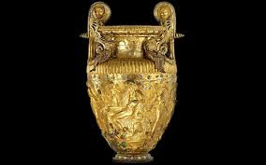
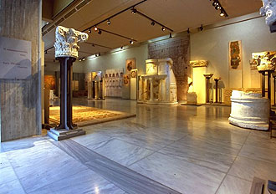
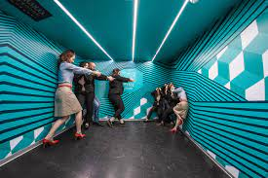
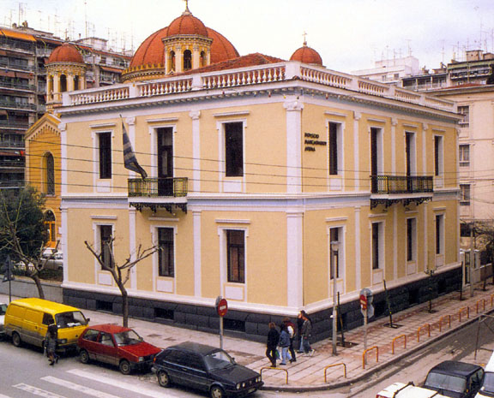
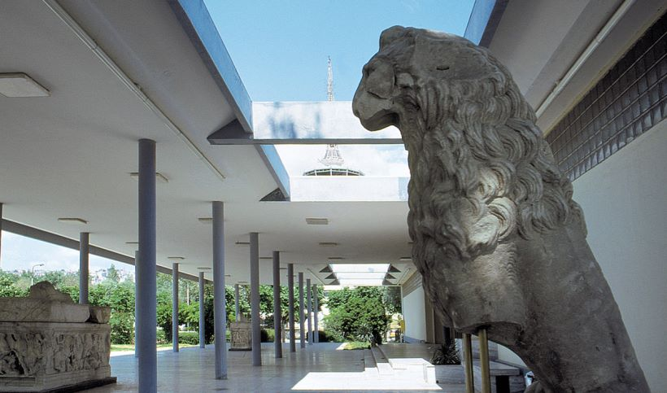
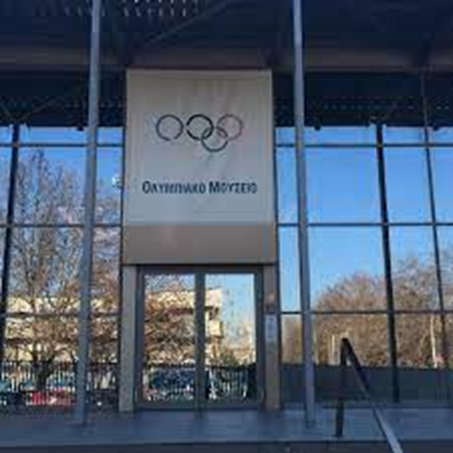
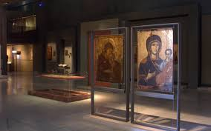
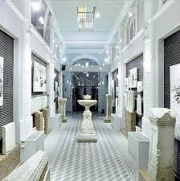
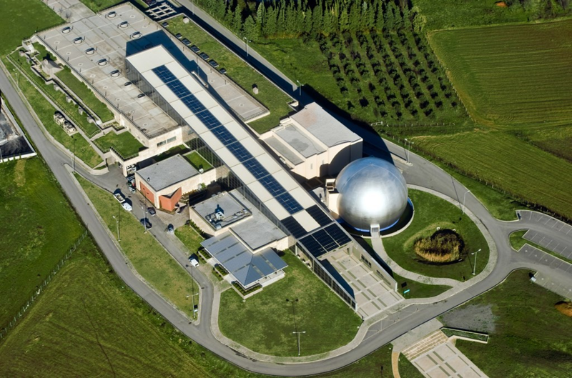
museums
There is a wealth of museums, all with fascinating collections.
Archaeological Museum
Museum for the Macedonian Struggle
Museum of Illusions
Museum of Byzantine Culture
Olympic Museum
Science Dissemination Centre NOISIS Technology Museum
Jewish Museum

Slide 13
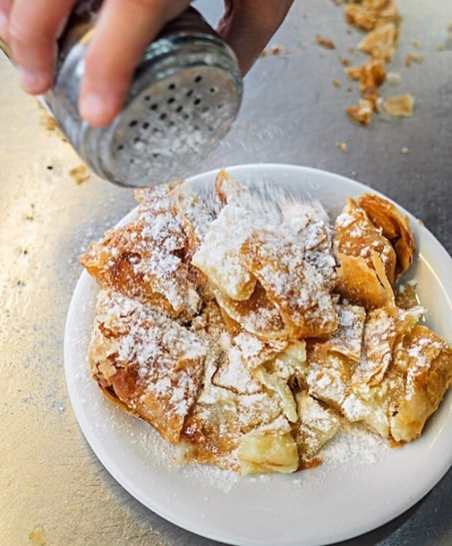
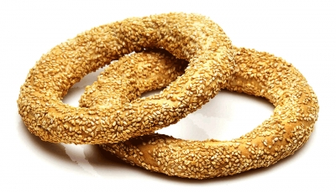
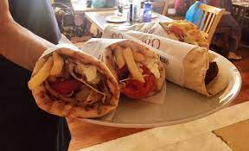
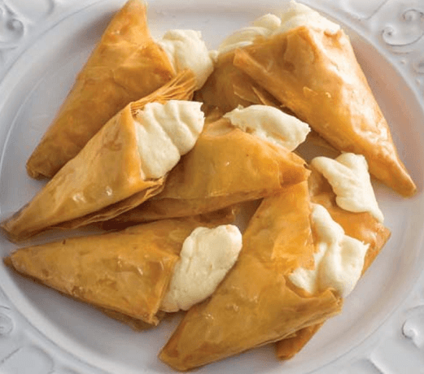
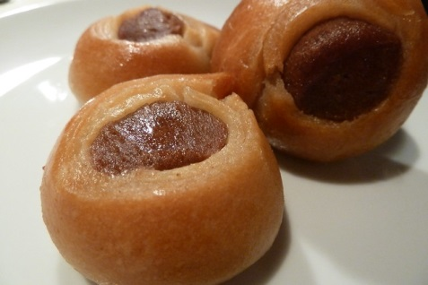
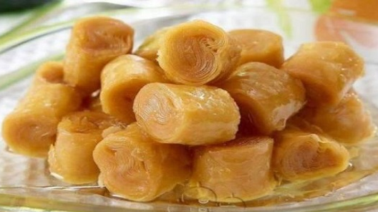
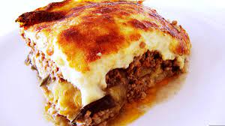
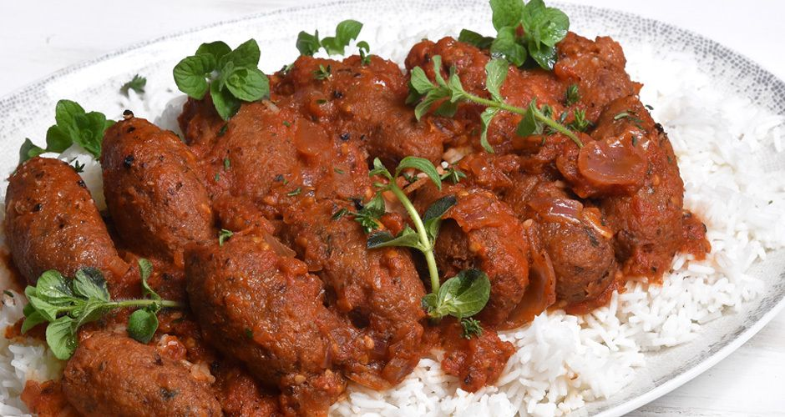
typical food
In Thessaloniki you can find super duper foods and drinks to enjoy.
Bougatsa, a breakfast pastry, which can be either sweet or savory, is very popular throughout the city.
Another popular snack is koulouri (sesame bun).
Notable sweets of the city are the famous Trigona Panoramatos , Roxákia, Kourkoubinia and Armenonville.
A stereotypical coffee drink is Frappé coffee. Frappé was invented in the Thessaloniki International Fair in 1957 and has since spread throughout Greece and Cyprus to become a hallmark of the Greek coffee culture.
Last but not least, you should definitely eat gyros with pita and tzatziki, soutzoukakia with Greek salad and, of course, moussaka.

Slide 14
festivities and traditions
The city is renowned for its festivals, events and vibrant cultural life in general, and is considered to be Greece's cultural capital.
Thessaloniki Food Festival
As the culinary capital of Greece, it is not surprising that this food festival is one of the most anticipated events of the year that explores the rich, traditional gastronomy of the city.
Street Mode Festival
It celebrates street culture through music, street art, dance performances and even sports.
Thessaloniki International Book Fair
Bookworms will certainly enjoy visiting the Thessaloniki International Book Fair, which is held annually during the month of May.
Thessaloniki International Film Festival
International Trade Fair
Thessaloniki Biennale of Contemporary Art
This festival is perfect for art lovers who are visiting the city.
Dimitria
This three-month-long festival of cultural events has been held every September–December since 1966.

Slide 15
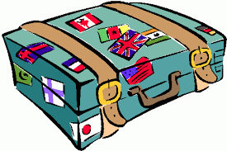
Melina, Eva, Vasia, Fay, Katerina, Christina, Konstantina, Vasiliki, Marianna, Marina, Sophie, Jimmy, Aggelos, Jason, Stelios, Manolis, John, Jim, Ardis, Socrates, Christos, George, Enrico, Nikos.

