Slide 1
HİSTORY of PARABOLA
Sena Sude Y.
Salihli Şahin Şen Girls Anatolian Imam Hatip High School
10 grade

Slide 2
Historically, the geometric properties of the parabola were studied by the ancient Greeks. Menaechmus (c. 380–320 BCE) appears to have been the first to study the properties of the parabola along with the hyperbola and ellipse. These curves arose through the study of the cone. Apollonius of Perga (262–190 BCE) wrote a major treatise on the conic sections, but his definition of the parabola was in terms of ratios and without any use of coordinates. The focus-directrix definition used in this module goes back to Pappus (290–350 CE). It was not until the advent of coordinate geometry at the time of Descartes that further real progress could be made, although the reflective property was known to the Greeks

Slide 3
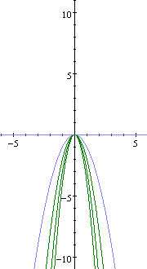
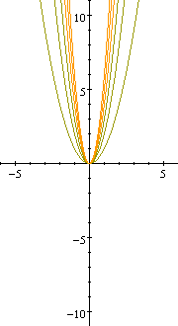
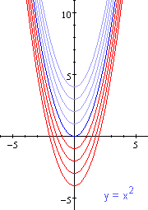
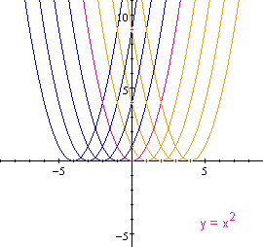
Galileo (1564–1642) realised that the motion of a projectile under gravity formed a parabolic path. Kepler (1571–1630) was the first to realise that the planets revolve around the sun in orbits that are very close to being elliptical. Newton proved this using his universal law of gravitation and the calculus.

Slide 4
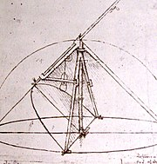

Slide 5
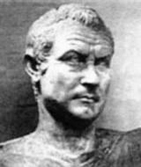
Menaechmus (380 BC - 320 BC) found the parabola

Slide 6
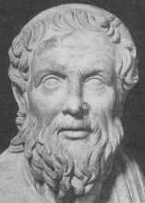
Apollonius (262 BC - 190 BC) named the parabola

Slide 7
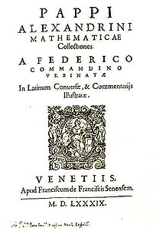
Pappus (290 - 350) found the focus and directrix
of the parabola

Slide 8
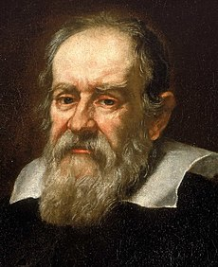
Galileo (1564 - 1642) saw the objects falling due to the gravity due so in parabolic paths

Slide 9
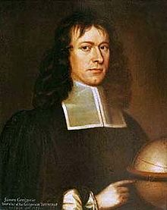
GREGORY (1638 -1675) studied properties of the parabola

Slide 10
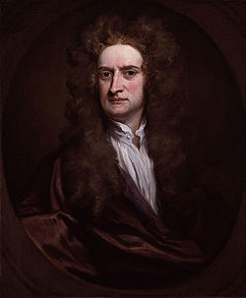
Newton (1638 - 1675) studied properties of the parabola

Slide 11
REFERENCES
https://en.m.wikipedia.org (photos of mathematicians)
http://parabolaonline.tripod.com/history.html
https://amsi.org.au/ESA_Senior_Years/SeniorTopic2/2a/2a_4history.html

