Slide 1
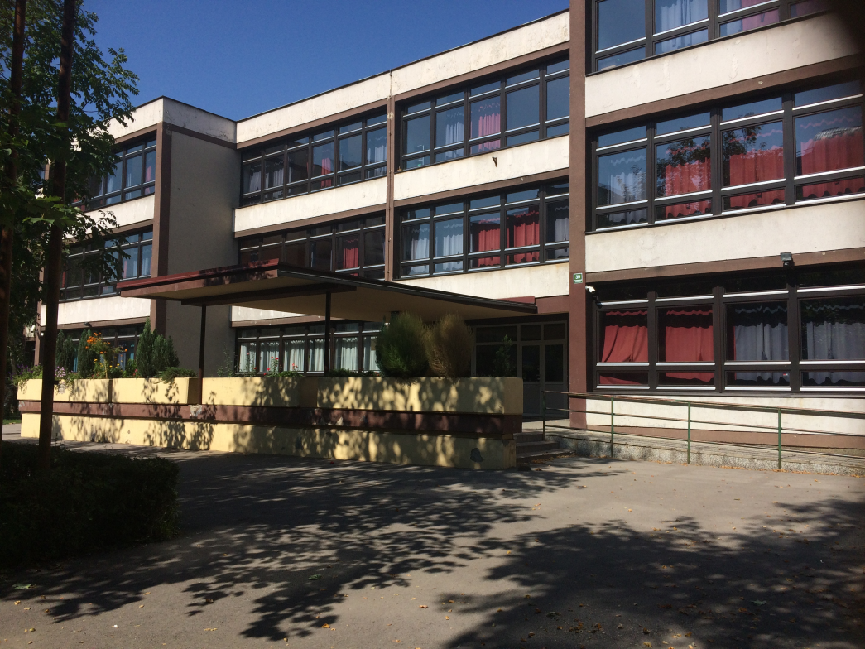
O.Š. “OSMAN NAKAŠ”

Slide 2
HISTORIJA
11. septembra 1967. godine, otvorena je naša škola, njen je prvobitni naziv bio Osnovna škola "Petar Dokić".
Osnovna škola "Osman Nakaš", ime poznatog slikara, minijaturiste iz 16. vijeka, nosi od 1994. g.
Osmanov ilustrativni stil je opisan kao "običan, ali perceptivan". ﻿Njegove ilustracije pokazuju opreznu pozornost na najviše detalje, prikazuje zbivanja u realnom stilu. ﻿Njegov rad pod uticajem nove generacije slikara u Osmanskom carstvu, smatra se važnim dijelom ovog razdoblja jer potiče od njegova stila.

Slide 3
HISTORY
Our school first opened on 11th of September, 1967. It’s original name was “Petar Dokić” Elementary school.
The name “Osman Nakaš”, a famous painter from the 16th century, was given to the school in 1994.
Osman’s art style is described as “basic, yet perceptive”. His pieces show careful attention to detail as well as a high dose of realism. His work, under the impact of the new generation of painters in the Ottoman dynasty, is considered an important part of this time period because it descends from his own style.

Slide 4
Naša škola u 1967. / Our school in 1967.

Slide 5
O našoj školi
Lokacija: Bosna i Hercegovina, Sarajevo 71000, Ul. Gradačačka 39
Misija naše škole je stvaranje sigurne, lijepe i inovativne sredine za rad i učenje.
Osoblje škole nas podučava lijepom ponašanju, pomaže nam da izgradimo svoju ličnost, predstavljaju nam naše mogućnosti što se tiče daljeg školovanja i još mnogo toga.

Slide 6
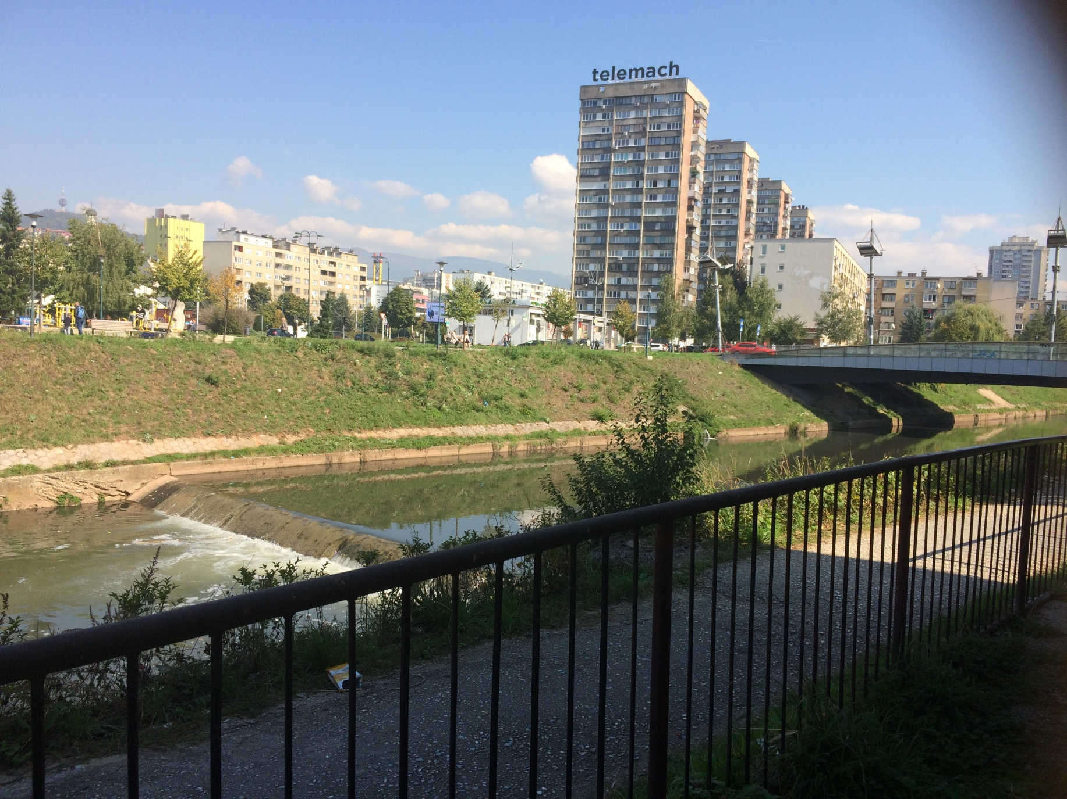
z
Lokacija/location

Slide 7
About our school
Location: Bosna i Hercegovina, Sarajevo 71000, Ul.Gradačačka 39
Our school’s mission is to create a safe, beautiful and inovative enviroment for work and studies.
Our school staff teaches us good manners, helps us build our personality, introduces us to opportunities regarding further education and much more.

Slide 8
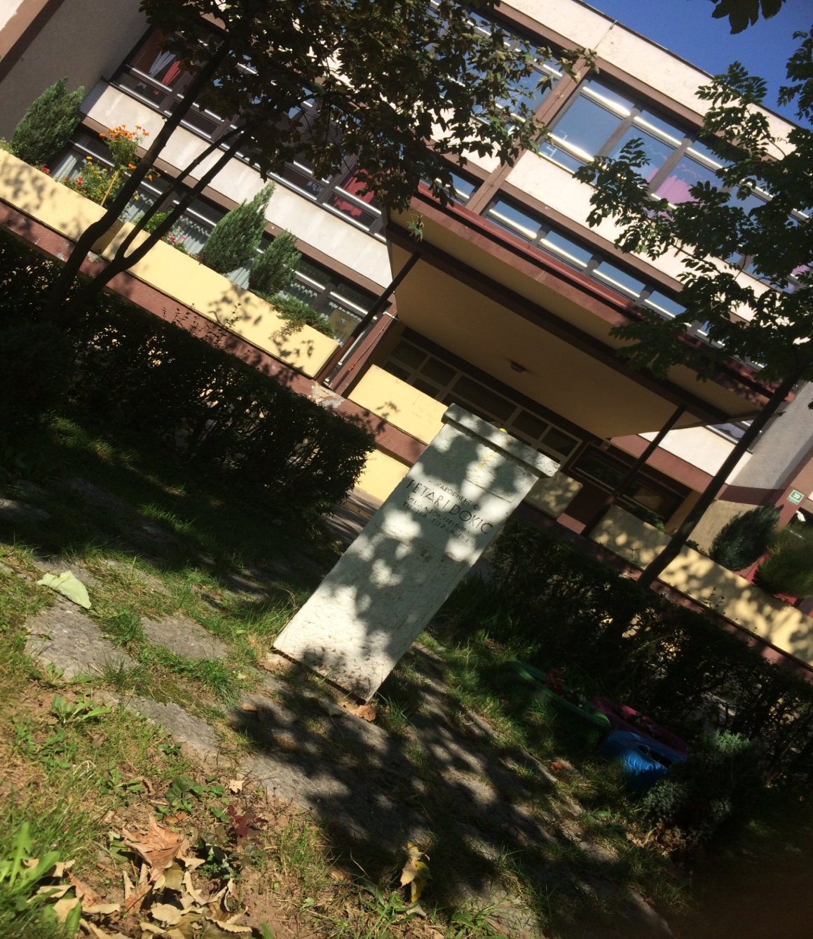

Slide 9
Aktivnosti i sekcije
Literarna sekcija
Novinarska sekcija
Recitatorska sekcija
Likovna sekcija
Dramska sekcija
Bibliotekarska sekcija
Hor i orkestar
Folklorna sekcija
Saobraćajna sekcija
Računarska sekcija
Ritmička sekcija
Košarka
Nogomet
Mladi fizičari
Mladi hemičari
Mladi geografi
Mladi matematičari
Mladi historičari
Prva pomoć i zaštita
Kulturna baština

Slide 10
Activities and school clubs
Literary club
Journalism club
Recitation club
Art club
Drama club
Library club
Choir and orchestra club
Folklore club
Traffic club
Computer club
Rhythmic club
Basketball team
Football team
Young physicists
Young chemists
Young mathematicians
Young historians
First aid club
Cultural heritage

Slide 11
U našoj školi pored ovih sekcija imamo i razne aktivnosti kao što su organizacije čišćenja dvorišta, briga o okolišu, razni projekti ,kvizovi, predstave, itd.

Slide 12
Apart from these school clubs our school holds tons of activities like yard cleaing, different projects, quizzes, shows and more.

Slide 13
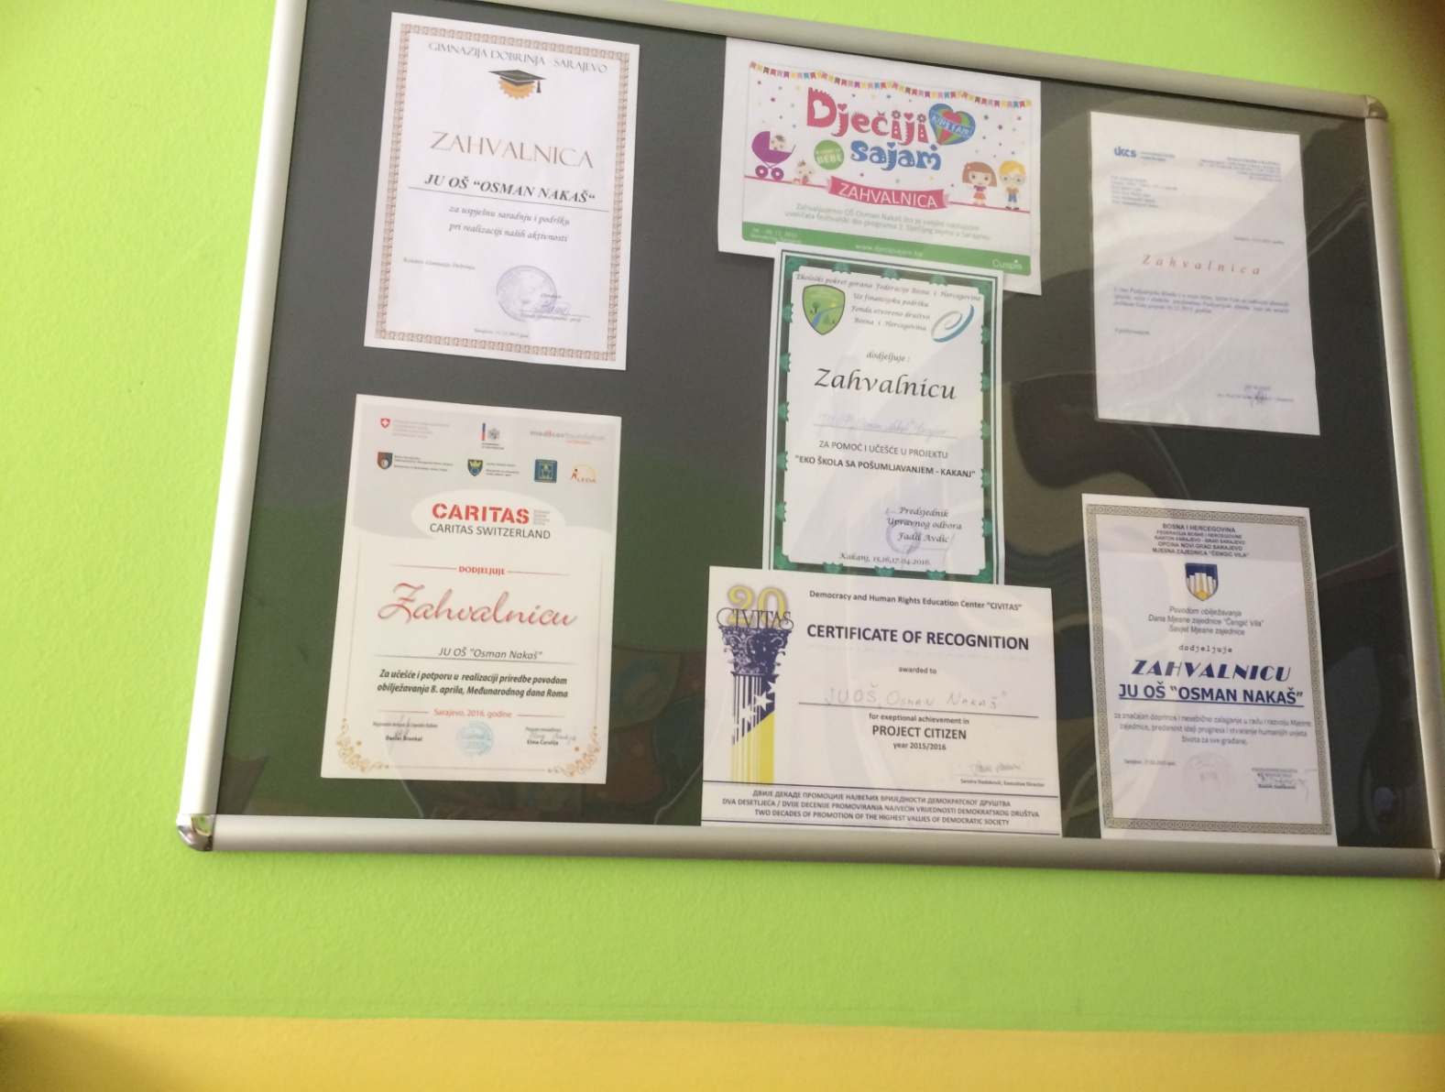
Neke od diploma naše škole/Some of our school’s diplomas

Slide 14
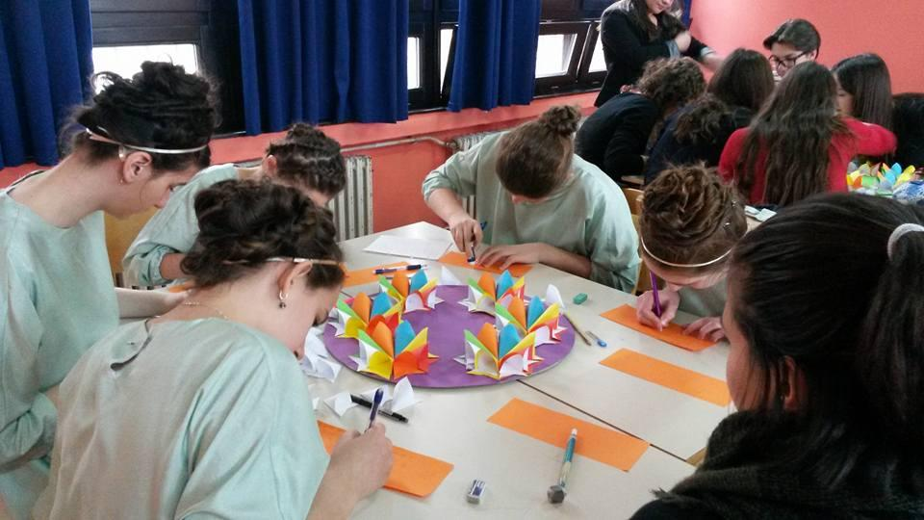
Projekat: I žene su matematičarke
Project: Women are mathematicians, too

Slide 15
Radovi naših učenika/Works by our students

Slide 16
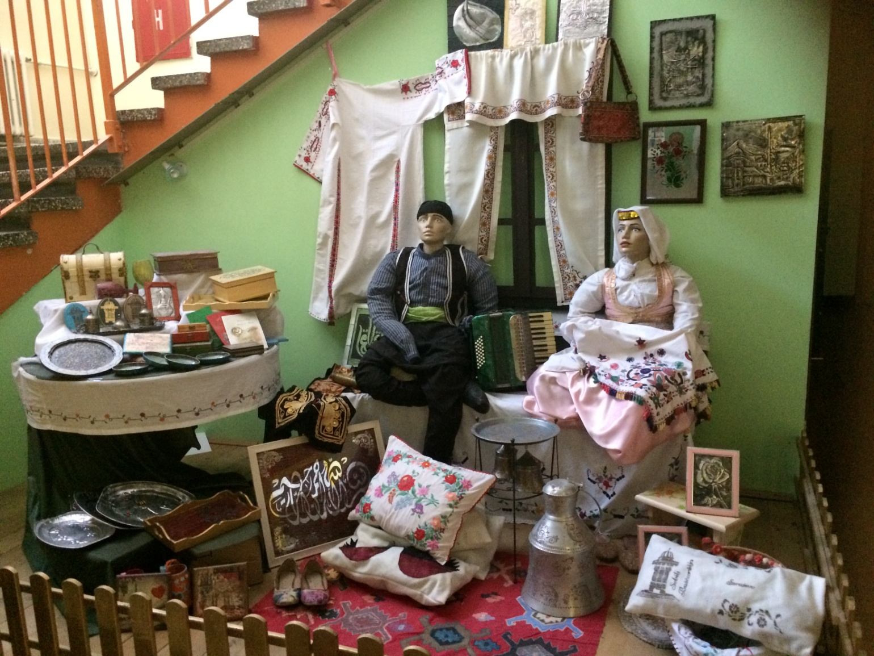
Sekcija kulturna baština/Cultural Heritage club

Slide 17
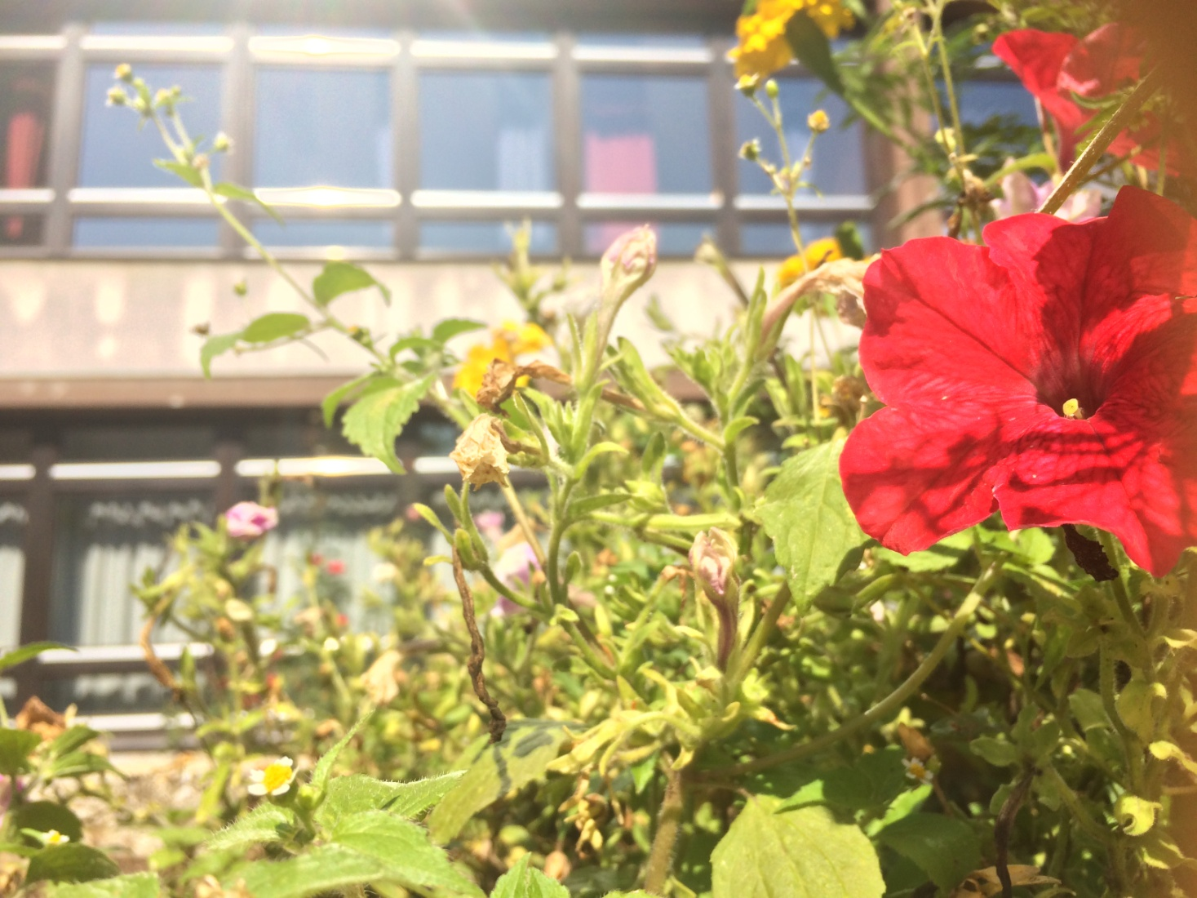
Fotofilmska sekcija/Photo-film club

Slide 18
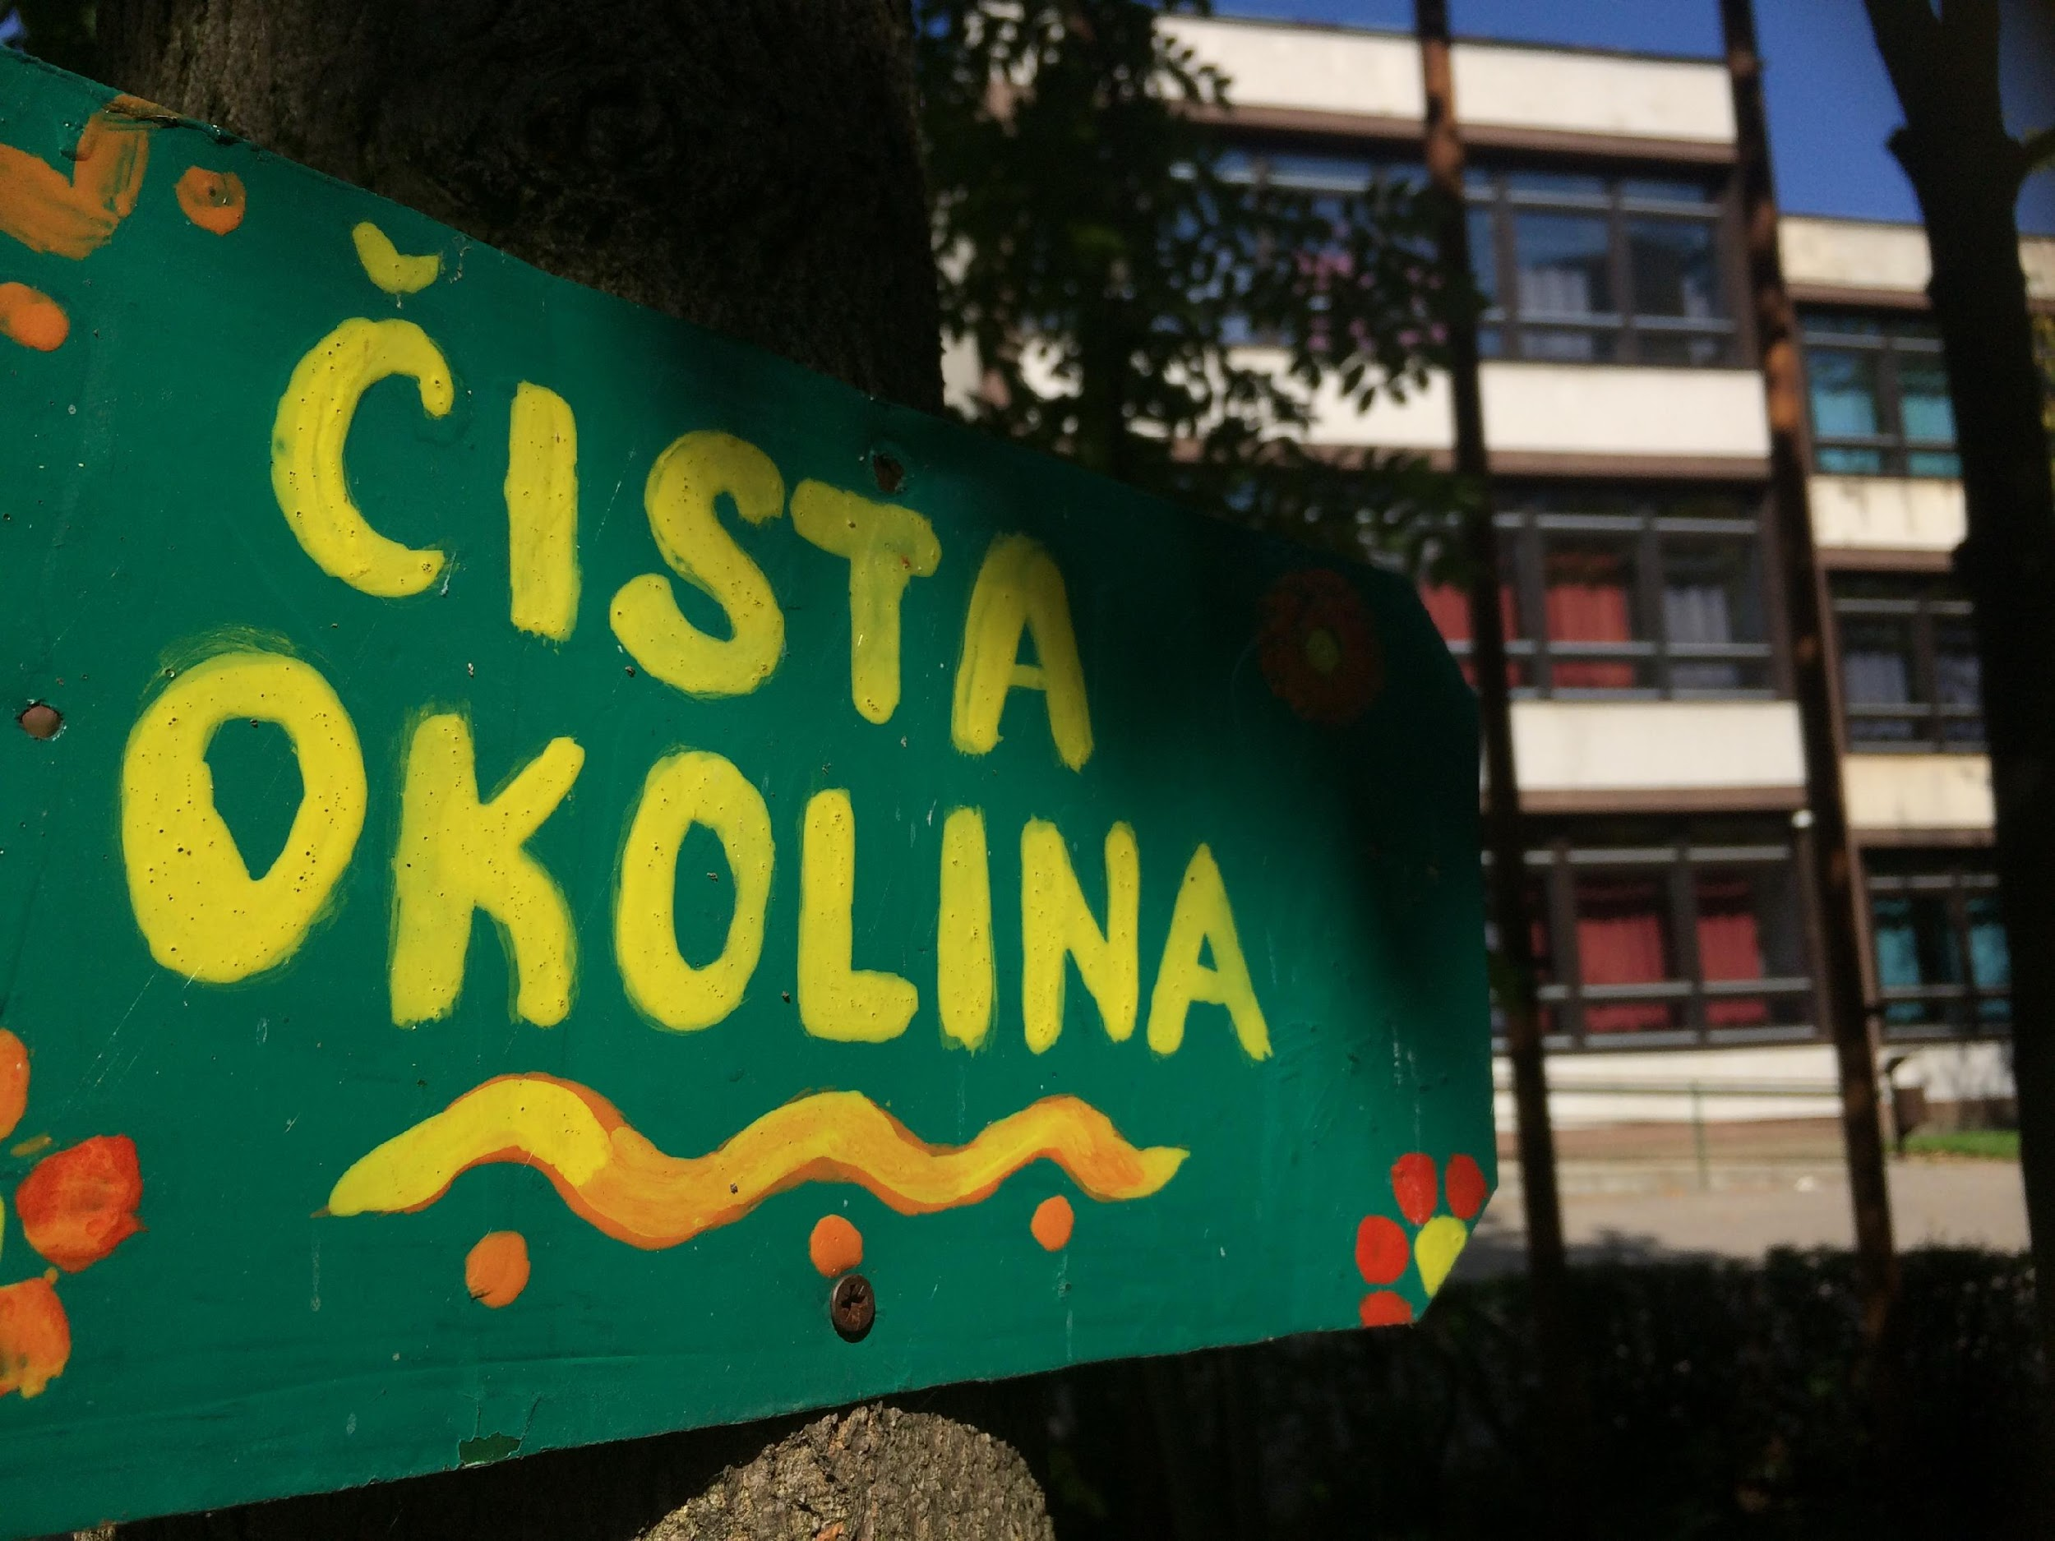
Rad likovne sekcije/Work by art club participants

Slide 19
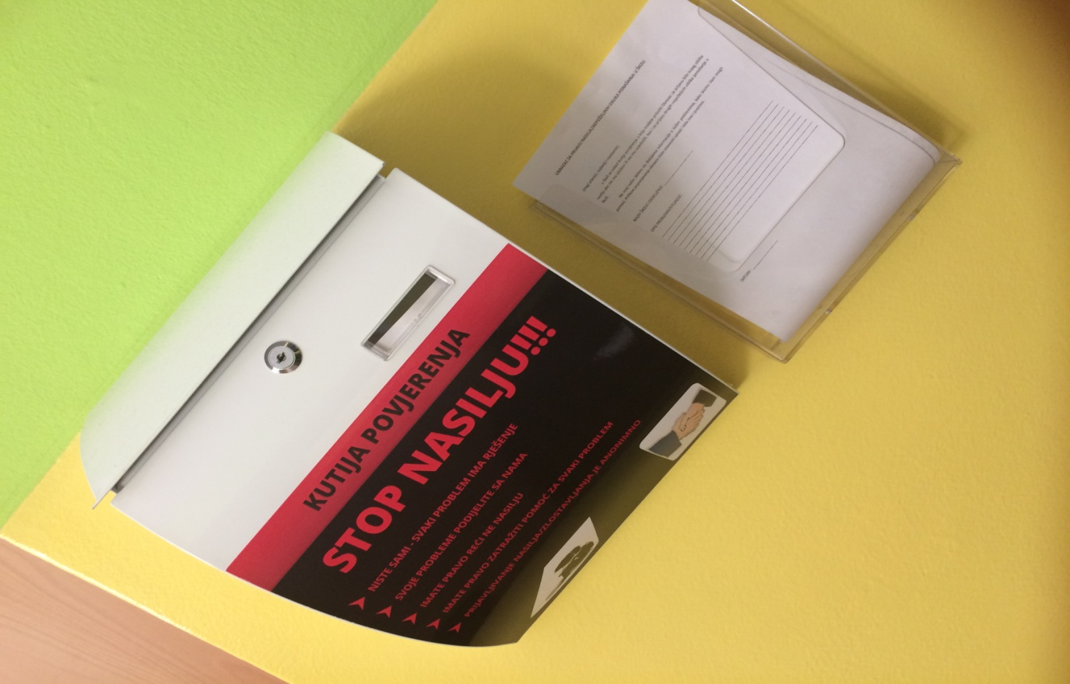
“Kutija povjerenja”, tačnije u našoj školi borimo se protiv bilo koje vrste nasilja. Ovo je kutija kojoj pristupa naš pedagog škole i pomaže nam u rješavanju nasilja.
“Box of trust”-more specifically, in our school we fight against every form of bullying. Our schoolmaster has access to the box and helps us stop bullying.

Slide 20
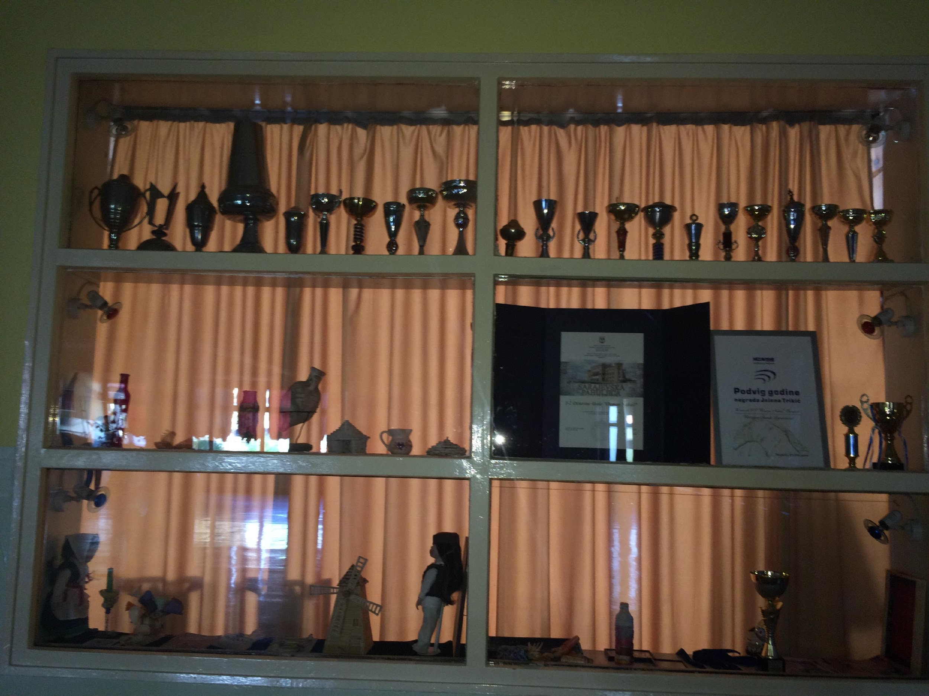
Postignuća naše škole/Our school’s achievements

Slide 21
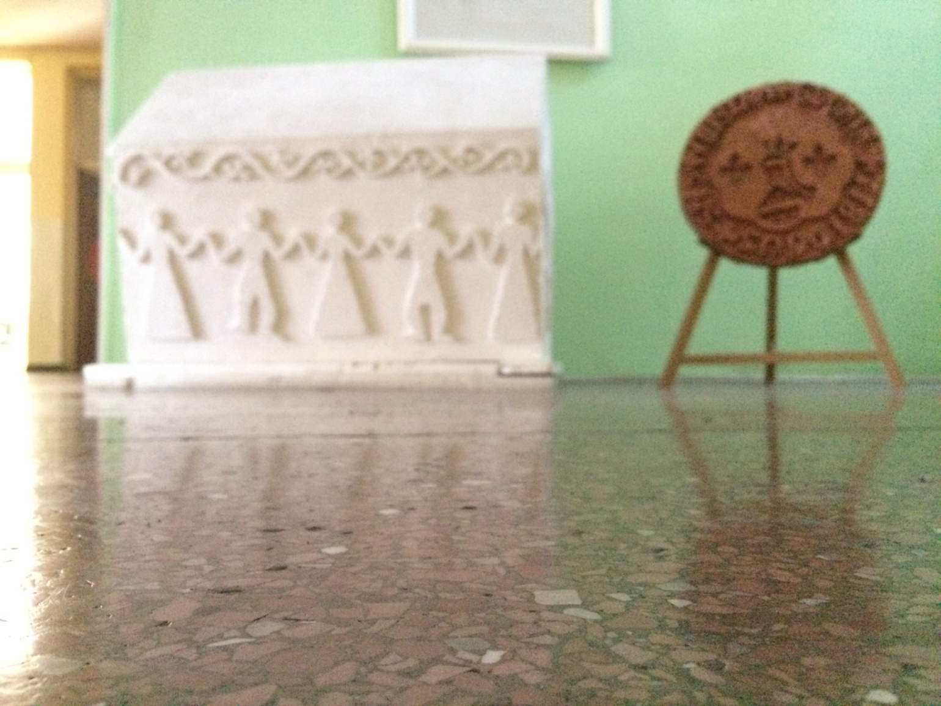
Kulturna baština/Cultural heritage

Slide 22
Naša škola vrijedno radi na tome da svojim učenicima priušti najbolje moguće obrazovanje i lakše odrastanje.
Osoblje je tu da nas sasluša kad imamo neki problem i obezbjeđuje nam najbolje uslove za razvijanje mašte i budućnosti.
Our school works hard on giving it’s students the best possible education and easier way of growing up.
The staff is always there to help us with our problems and they ensure we have the best conditions for developing our imagination and future.

Slide 23
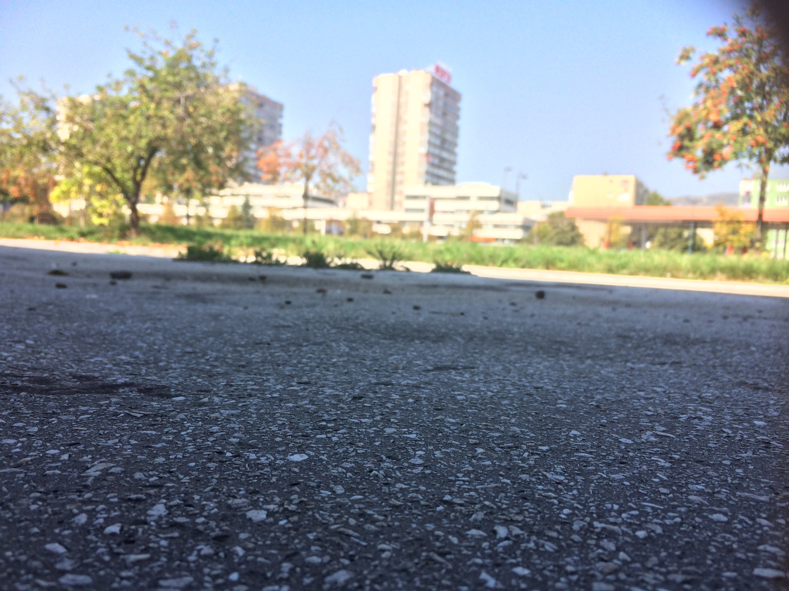
HVALA NA PAŽNJI
THANK YOU FOR YOUR ATTENTION

