Slide 1
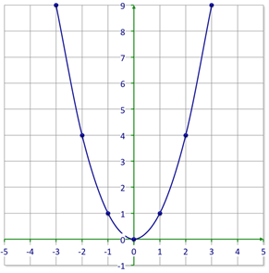
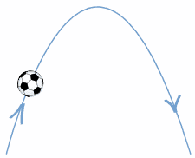
The First High School of Kragujevac
Hidden world of parabolas
Кragujevac, 29.11.2019.

Slide 2
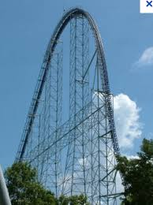
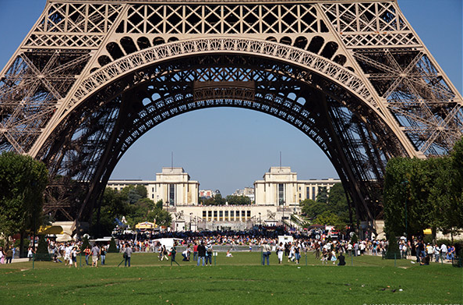
Parabolas are everywhere!

Slide 3
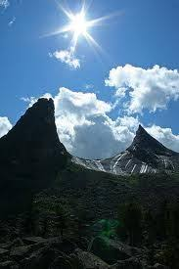
Parabola
Parabola is a plane curve which is mirror-symmetrical and is approximately U-shaped;
Term PARABOLA was probably coined by Apollonius, who, acording to Pappus, had terms for all three conic sections (παραβολή).

Slide 4
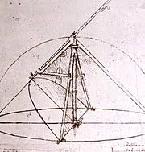
Parabolic compass designed by Leonardo da Vinci

Slide 5
Conic sections

Slide 6
Is the rainbow from the picture a parabola?
yes
no

Slide 7
Correct!

Slide 8
Try again!

Slide 9
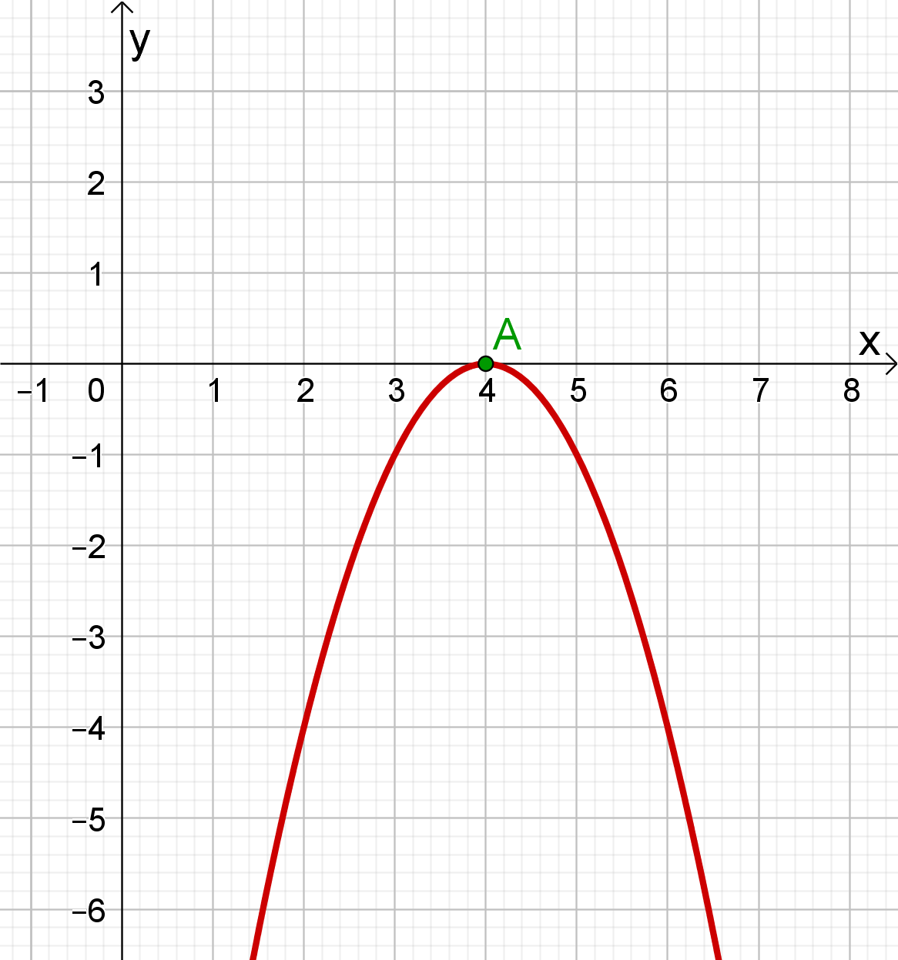
Which of the following coordinates are suitable for vertex in this picture?
(0, 4)
(0, -4)
(-4, 0)
(4, 0)

Slide 10
Correct!

Slide 11
Try again!

Slide 12
Is this fountain a parabola?
yes
no

Slide 13
Correct!

Slide 14
Try again!

Slide 15
Which of the following coordinates are suitable for vertex in this picture?
(1,-3)
(-1,-3)
(4,-3)
(-1,4)

Slide 16
Correct!

Slide 17
Try again!

Slide 18
How many axes of symmetry does this parabola have?
1
3
none
2

Slide 19
Correct!

Slide 20
Try again!

Slide 21
This quadratic function…
is always positive.
has a variable sign.
is always negative.

Slide 22
Correct!

Slide 23
Try again!

Slide 24
Thank you for your attention!
Aleksandar
Nemanja
Martina
II7

