Slide 1
The benefits of parabolA
Samet Bayram
Gorele Anatolian High School TURKEY

Slide 2
Everyday Parabolas
Parabolas can, in fact, be seen everywhere, in nature as well as manmade items. Consider a fountain. The water shot into the air by the fountain falls back in a parabolic path. A ball thrown into the air also follows a parabolic path. Galileo had demonstrated this. Also, anyone who rides a roller coaster will be familiar with the rise and fall created by the track’s parabolas.

Slide 3
A parabola is a conic section created from the intersection of a right circular conical surface and a plane parallel to a generating straight line of that surface. The parabola has many important applications, from the design of automobile headlight reflectors to calculating the paths of ballistic missiles.

Slide 4
Parabolas in Architecture and Engineering
Even architecture and engineering projects reveal the use of parabolas. Parabolic shapes can be seen in The Parabola, a structure in London built in 1962 that boasts a copper roof with parabolic and hyperbolic lines. The famous Golden Gate Bridge in San Francisco, California, has parabolas on each side of its side spans or towers.

Slide 5
Using Parabolic Reflectors to Focus Light
Parabolas are also commonly used when light needs to be focused. Over the centuries, lighthouses underwent many variations and improvements to the light they could emit. Flat surfaces scattered light too much to be useful to mariners. Spherical reflectors increased brightness, but could not give a powerful beam. But using a parabola-shaped reflector helped focus light into a beam that could be seen for long distances. The first known parabolic lighthouse reflectors formed the basis of a lighthouse in Sweden in 1738. Many different versions of parabolic reflectors would be implemented over time, with the goal of reducing wasted light and improving the surface of the parabola. Eventually, glass parabolic reflectors became preferable, and when electric lights arrived, the combination proved to be an efficient way of providing a lighthouse beam.

Slide 6
The same process applies to headlights. Sealed-beam glass automobile headlights from the 1940s to the 1980s used parabolic reflectors and glass lenses to concentrate beams of light from bulbs, aiding driving visibility. Later, more efficient plastic headlights could be shaped in such a way that a lens was not required. These plastic reflectors are commonly used in headlights today.

Slide 7
Using parabolic reflectors to concentrate light now aids the solar power industry. Flat photovoltaic systems absorb the sun’s light and free electrons, but do not concentrate it. A curved photovoltaic mirror, however, can concentrate solar power much more efficiently. Huge curved, mirrors comprise the enormous Gila Bend parabolic trough solar facility, Solana. The sunlight is focused by the parabolic mirror shape in such a way that it generates very high heat. This heats tubes of synthetic oil at the trough of each mirror, which can then either generate steam for power, or be stored in massive tanks of molten salt to store energy for later. The parabolic shape of these mirrors allows more energy to be stored and made, making the process more efficient.

Slide 8
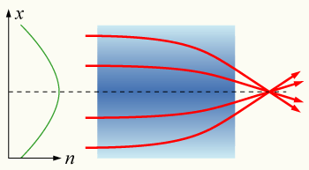

Slide 9
Parabolas in Spaceflight
The shimmering, stretched arc of a rocket launch gives perhaps the most striking example of a parabola. When a rocket, or other ballistic object, is launched, it follows a parabolic path, or trajectory. This parabolic trajectory has been used in spaceflight for decades. In fact, airplanes can create zero- and high-gravity environments by flying in parabolas. Special airplanes fly at a steep angle, giving a higher-gravity experience, and then drop into what is called freefall, giving a zero-gravity experience. Experimental test pilot Chuck Yeager went through such tests. This has provided tremendous research for both human pilots and their tolerance of spaceflight and flying in various gravities, to performing experiments requiring low or zero gravity. Such parabolic flights save money by not having to perform every experiment in space itself.

Slide 10
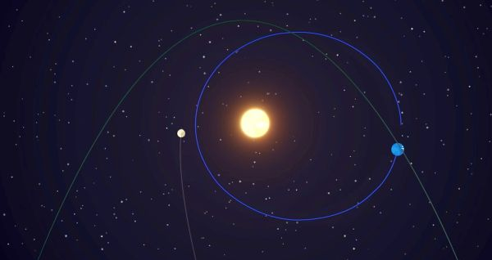

Slide 11
Other Uses for ParabolaS
Consider the satellite dish. These structures have a parabolic shape, allowing the reflection and focus of radio waves.
In much the same way that light can be bent, electrons can be as well. It has been discovered that beams of electrons can be sent through holographic film and curved around barriers in a parabolic fashion. These are called Airy beams, and they do not grow faint and diffract. These beams may prove useful in imaging.
From spaceflight and car headlights to bridges and amusement parks, parabolas can be seen everywhere. Not only is a parabola an elegant geometric shape, its functional capability aids humanity in many ways.

Slide 12
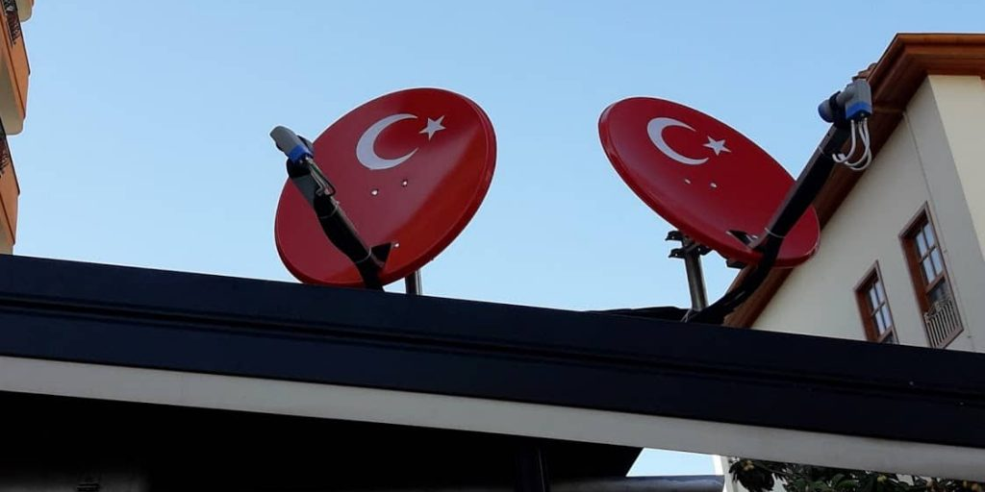

Slide 13
Mirrors at Home
Plane mirrors are simply flat mirrors without curves. Because these can be found almost anywhere, the average person is incredibly familiar with them (even if they don't know the technical term). While the first manmade mirrors were made from intensely polished bronze, silver and other metals, today most mirrors are made from glass sheets finished with a thin layer of aluminum. That said, plane mirrors can be made from liquid as well: Gallium and mercury can be used for this purpose. Regardless of material construction, however, all flat mirrors function the same way. They reflect rays of light, producing an image.

Slide 14
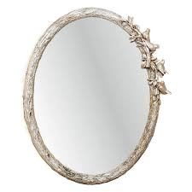

Slide 15
Real vs. Virtual Image
The images reflected by a plane mirror are known as "virtual images" – but they're different than the simulated digital images you can see on your computer screen or in a video game. In physics, the difference between a real vs. virtual image is that a real image is formed when light converges at a point – like when you look at an apple on your desk – whereas a virtual image is formed from two divergent rays of light that never meet. In simple terms, a plane mirror creates an image of an object you cannot touch. All mirrors create virtual images in this manner, but plane mirrors reflect light differently than concave or convex mirrors do.

Slide 16
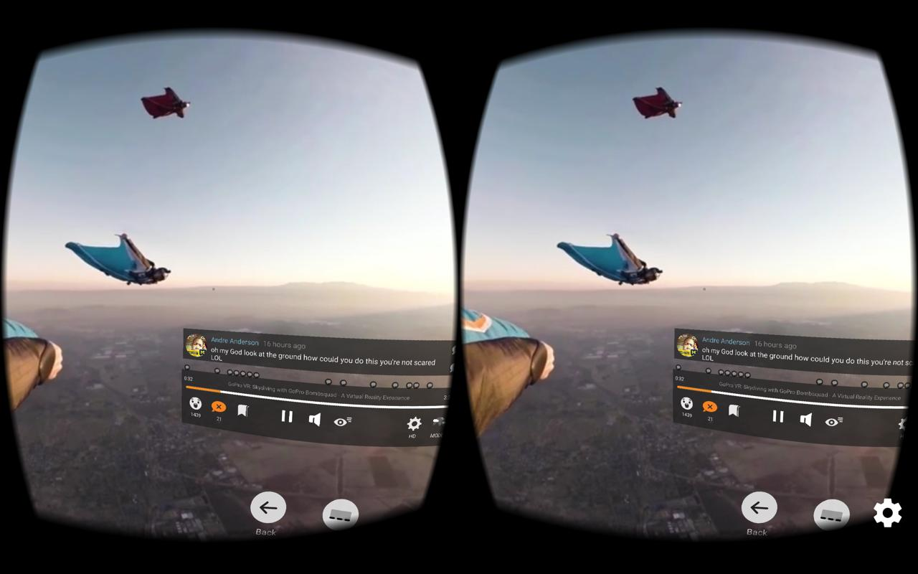

Slide 17
Weapons of War
The catapult dominated for centuries as a fear-inducing weapon of war. Catapults vaulted incendiary objects, arrows, stones of all sizes, and even corpses and vectors of pestilence into or over castle walls. Catapults represented objects of technological prowess as well as military might, and rulers celebrated the early engineers and mathematicians involved in making catapults. Prior to the advent of gunpowder’s regular use, catapults featured in an arms race of sorts among rulers. Catapults endured through the Middle Ages as siege weapons; even in World War I, catapults were used in trench warfare.

Slide 18
In the mid-20th century, catapults made their way to aircraft carriers. Enormous steam-powered catapults, hundreds of feet long, launched aircraft from the short runways of the carriers. The sheer size of steam catapults proved to be a liability, taking up significant space and requiring the perfect amount of steam to launch airplanes depending on their weight. In the 21st century, a new technology using aircraft catapults emerged: the Electromagnetic Aircraft Launch System (EMALS). EMALS does not require steam, but rather uses sleds that electromagnetically push and pull the catapult until the craft is airborne. These EMALS can operate in rapid succession and are more efficient than their steam-powered predecessors. They allow heavier airplanes to be launched from carriers, leading to increased range and strike capability.

Slide 19
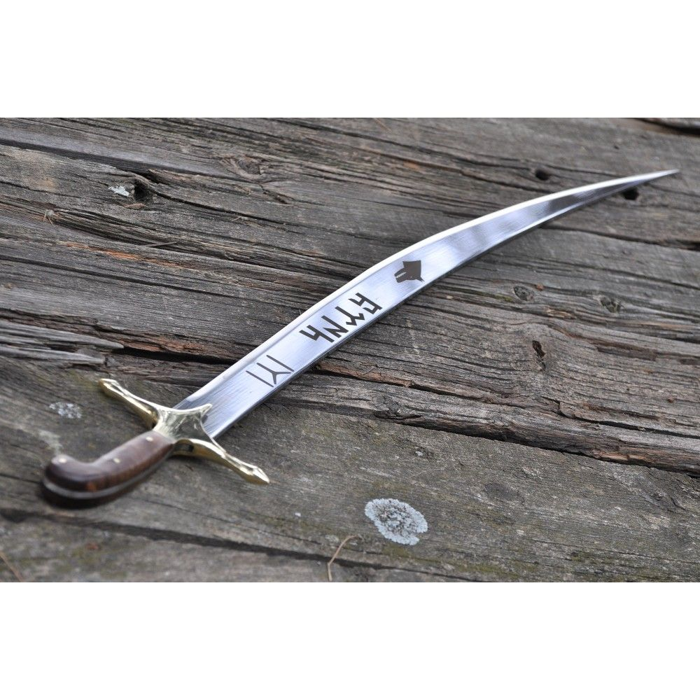

Slide 20
Binoculars and Telescopes
Binoculars and telescopes employ convex lenses to magnify objects and make them appear closer, but convex lenses don't transfer light accurately; they create distortions and blurs. Binocular and telescope manufacturers therefore install concave lenses in or before the eyepieces to help focus images more clearly for the viewer.

Slide 21
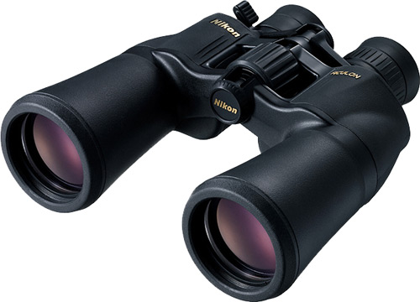

Slide 22
REFERENCES
https://sciencing.com/real-life-parabola-examples-7797263.html

