Slide 1
Yarn and thread whisper stories of the past
Embroidery of India

Slide 2
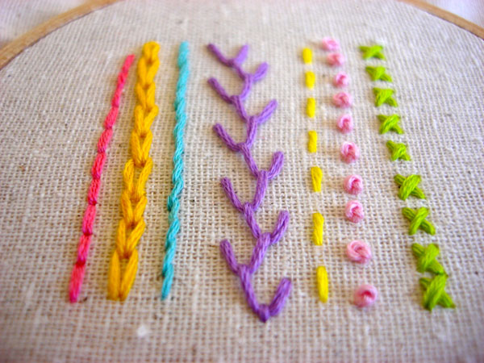

Slide 3
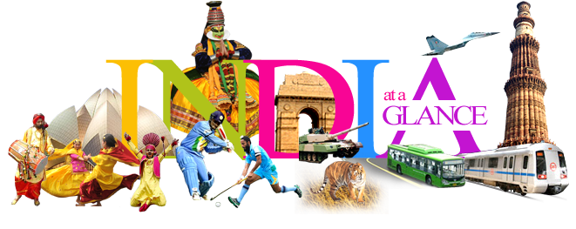

Slide 4
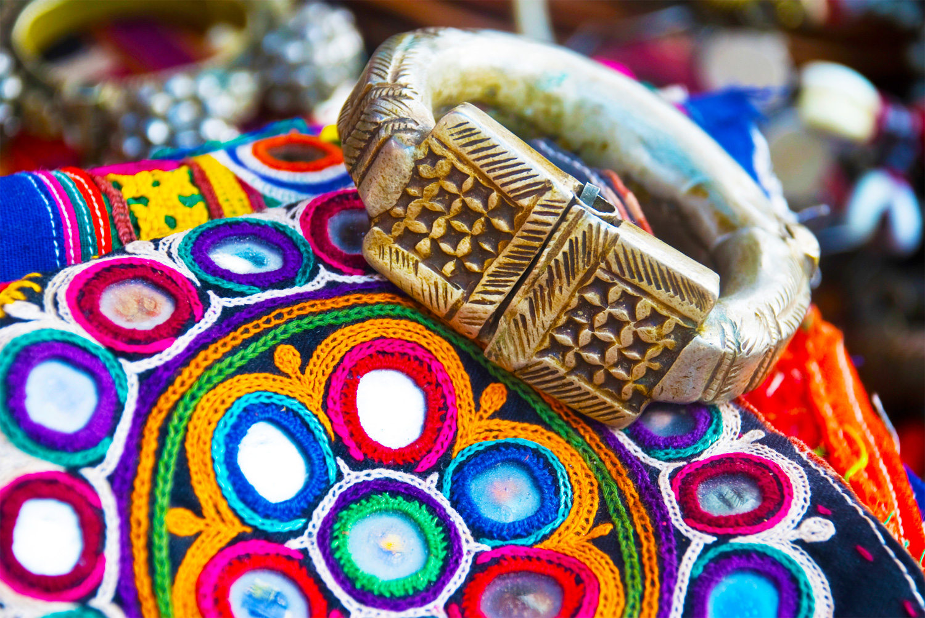
The women of Rajasthan and Gujarat traditionally carry embroidered torans (frieze), dowry bags, shawls, cholis (blouses) and dupattas as part of their dowry. This work can be identified by its use of tiny mirrors with colorful threads that shape floral and figurative designs. Its shiny brilliance makes it a hot favorite with tourists.
Mirror
work

Slide 5
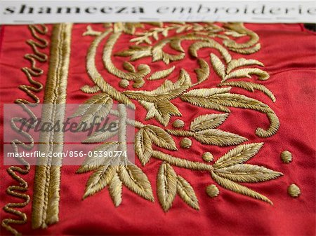
Zari is gold, and zardozi embroidery is the glitteringly ornate, heavily encrusted gold thread work practiced in Rajasthan, Uttar Pradesh, Kashmir and Delhi. Of course, the days of using real gold and silver thread are now history. Metal ingots are melted and pressed through perforated steel sheets, to be converted into wires. They are then hammered to the required thinness. Plain wire is called badla, and when wound round a thread, it is called kasav. Smaller spangles are called sitara, and tiny dots made of badla are called mukaish.
Zardozi

Slide 6
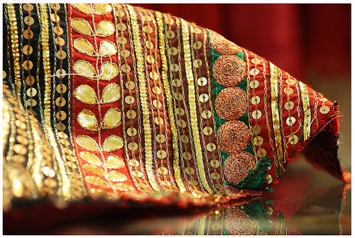
Gota and
kinari
Akin to applique, gota work involves placing woven gold cloth onto other fabric to create different surface textures. Kinari, or edging, as the word suggests, is the fringed or tasselled border decoration. This art is predominantly practiced by Muslim craftsmen.

Slide 7
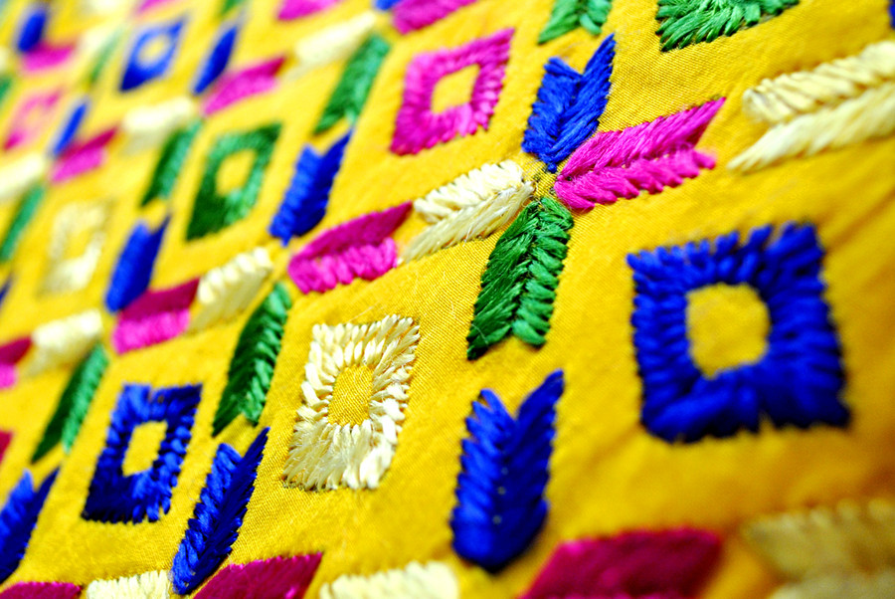
Phulkari
Embroidered extensively in Haryana and Punjab, the phulkari shawl is a spectacular piece of clothing. Birds, flowers and human figures are normally embroidered on red or orange khaddar (coarse cotton cloth made of handspun yarn). The design is fed into the cloth from the reverse side using darning needles and one thread at a time, leaving a long stitch below to form the basic pattern. The embroidery is usually done with silk or satin thread, in both a vertical and horizontal pattern so that when the phulkari is finally ready, the play of light on its shiny surface lends it breathtaking beauty.

Slide 8
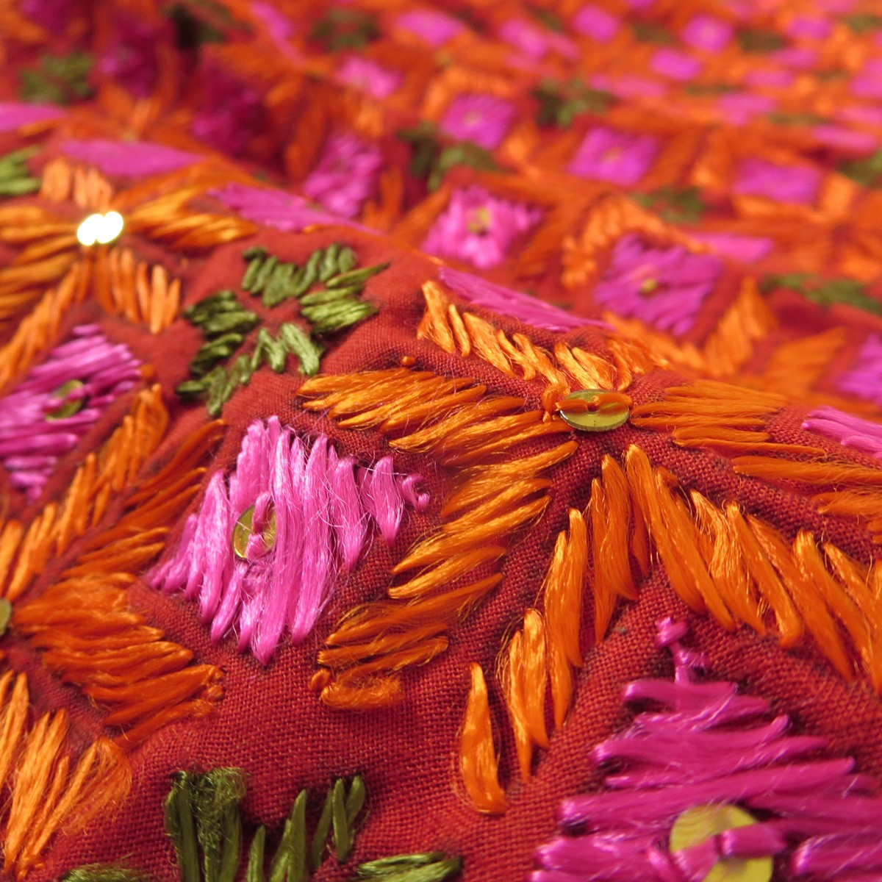
Bagh
The bagh is an offshoot of phulkari and almost always follows a geometric pattern, with green as the basic color. Green is probably predominant because Muslims have traditionally been doing bagh work. Although lacking in technical finesse, it makes up for the loss by a variety of colorful motifs. Simply everything goes into the design – elephants, houses, crops, the sun, the moon, gardens and even kites.

Slide 9
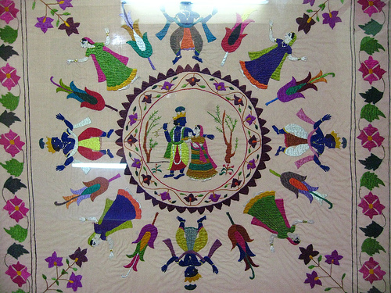
The red and orange richly embroidered silk scarves of Chamba are simply beautiful. They often depict scenes from the Mahabharata, the Ramayana and the Raaslila of Radha and Krishna. The embroidery is done in silk yarn on tussar (silk) or fine cotton. The ground is usually white or cream, but the embroidery threads (usually red and orange) are in striking contrast.
Chambal
Rumals

Slide 10
Chikankari Lucknow in Uttar Pradesh is the hotbed of white thread embroidery on white or colored cotton. Intricate and complex, this work is similar to what is commonly known as shadow work. The beauty of the embroidery comes through on fine muslin cloth, where you can see the stitches forming lace-like patterns on the underside.
Chikankari

Slide 11
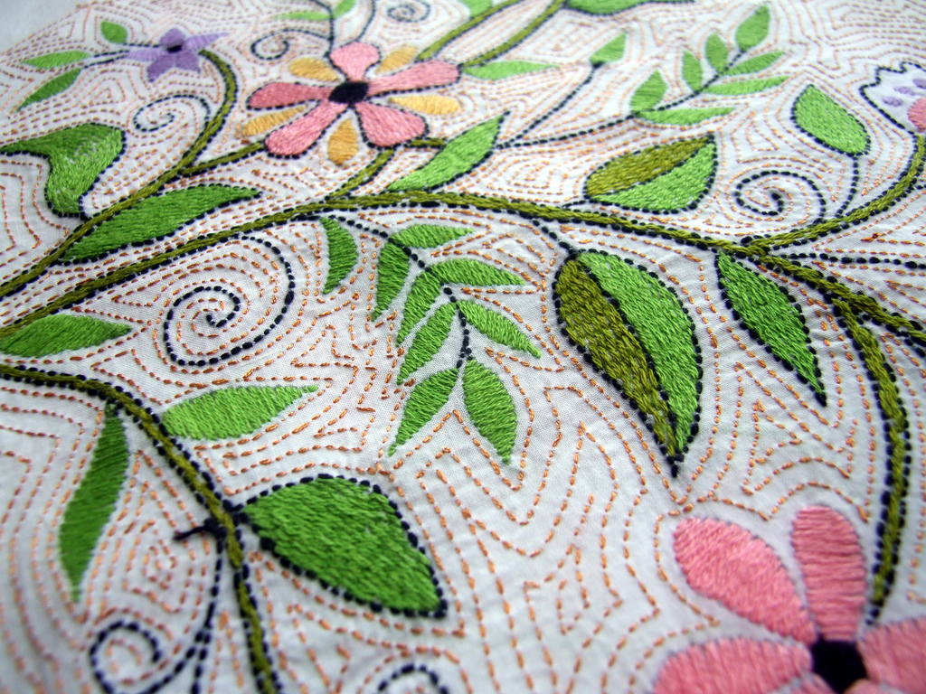
Bihar and Bengal are known for their simple embroidery called kantha which is nothing more than patterns traced in a running stitch with short gaps. Floral, animal and bird motifs embroidered on both cotton and silk are extremely popular.
Kantha

Slide 12
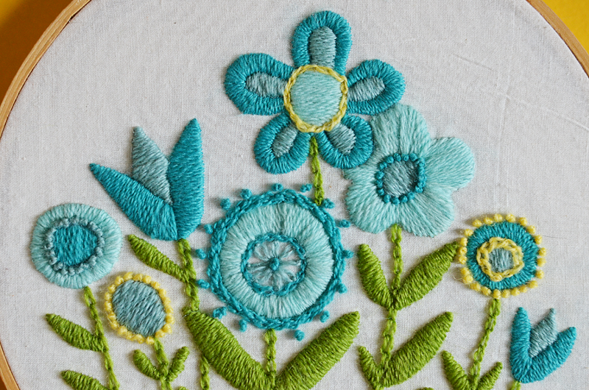
Kashmir is known for phirans (woolen kurtas) and namdahs (woolen rugs) with big floral embroidery in cheerful colours. Crewel embroidery is the same as chain stitch, is usually done with an awl (a small pointed tool for making holes) and is worked from underneath the fabric rather than above.
Crewel

Slide 13
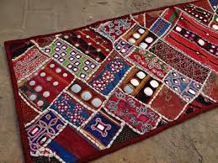
Banjara
The embroidery of the lamada gypsy tribe of Andhra Pradesh, banjara is a mix of applique with mirrors and beadwork. Bright red, yellow, black and white colored cloth is laid in bands and joined with a white criss-cross stitch.

Slide 14
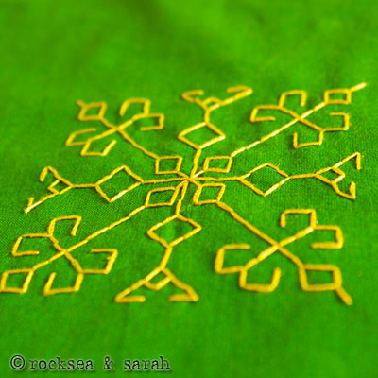
Dharwar (Karnataka) is home to kasuti, a delicate single thread embroidery done on handloom saris. Motifs consist of temples, peacocks, elephants, flowering trees and geometric forms spread across the sari.
Kasuti

Slide 15
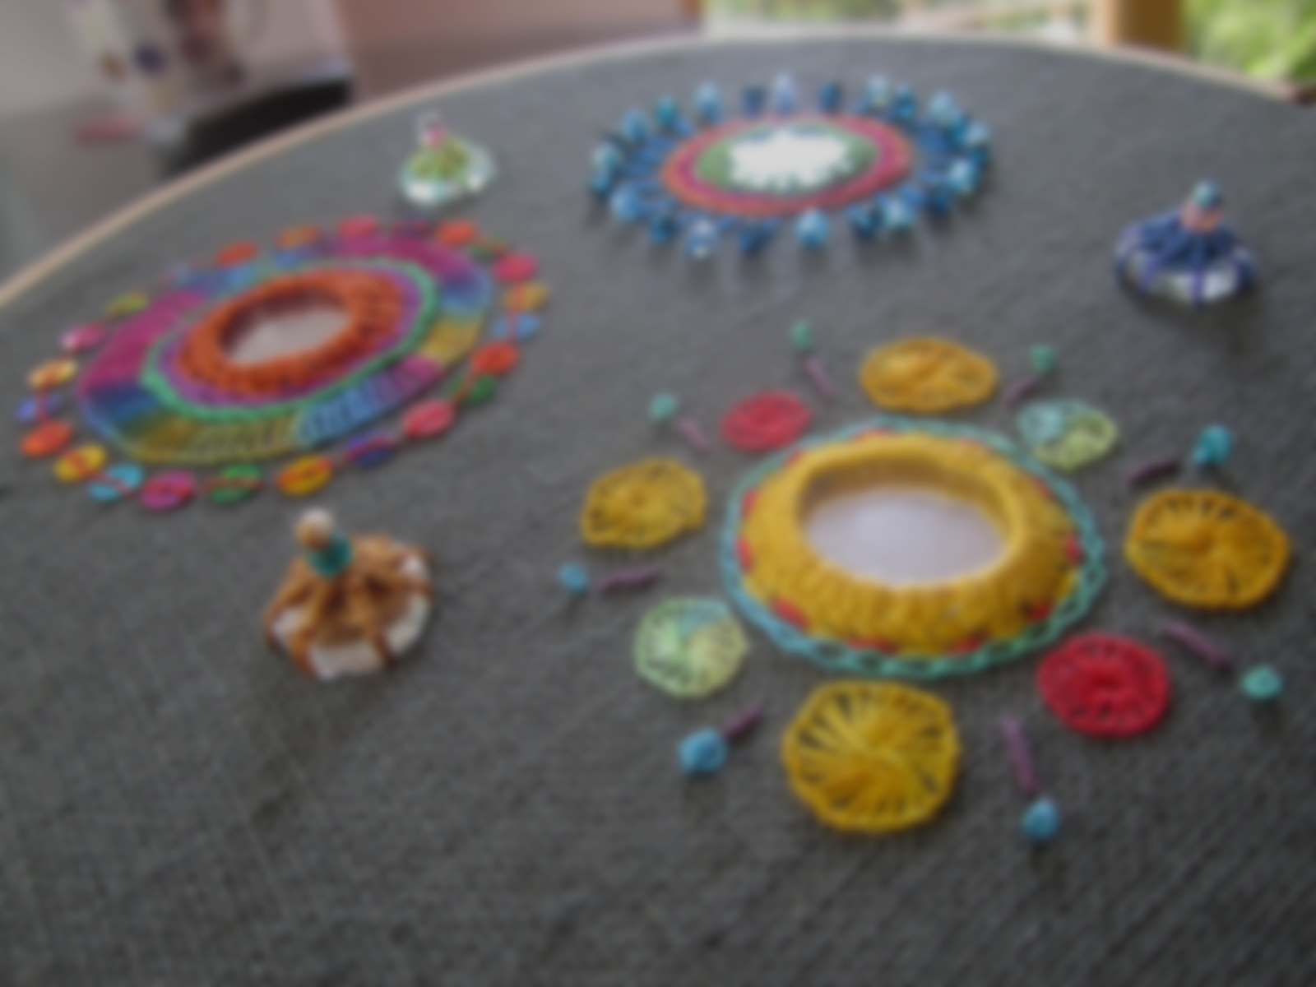
India: An analysis
Hand embroidery in India has been in trend from ancient times and there hasn’t been much change in the designs except for the patterns with the changing trends
Hand embroidery on various fabrics are considered ethnic and are often preferred by the fashion conscious.
Though Machine embroidery has been found to be cheaper and very close to the hand embroidery popularity, it hasn’t really been able to reduce its preferences and demand.
Even today, the age old system of hand embroidery is strictly adhered to especially zardozi, which uses real gold and silver threads on silk fabrics

Slide 16
Shared by the eTwinning team of PPMG “Akad. Ivan Tsenov”, Vratsa, Bulgaria
The presentation is made as a result of a cooperation with a school from India

