Slide 1
Yarn and thread whisper stories of the past
Embroidery of China

Slide 2
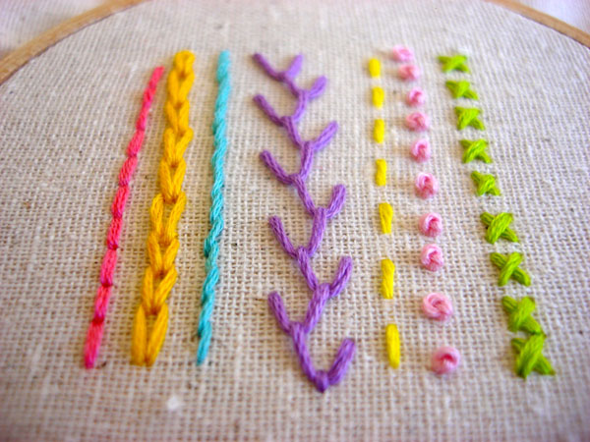

Slide 3
CHINA

Slide 4
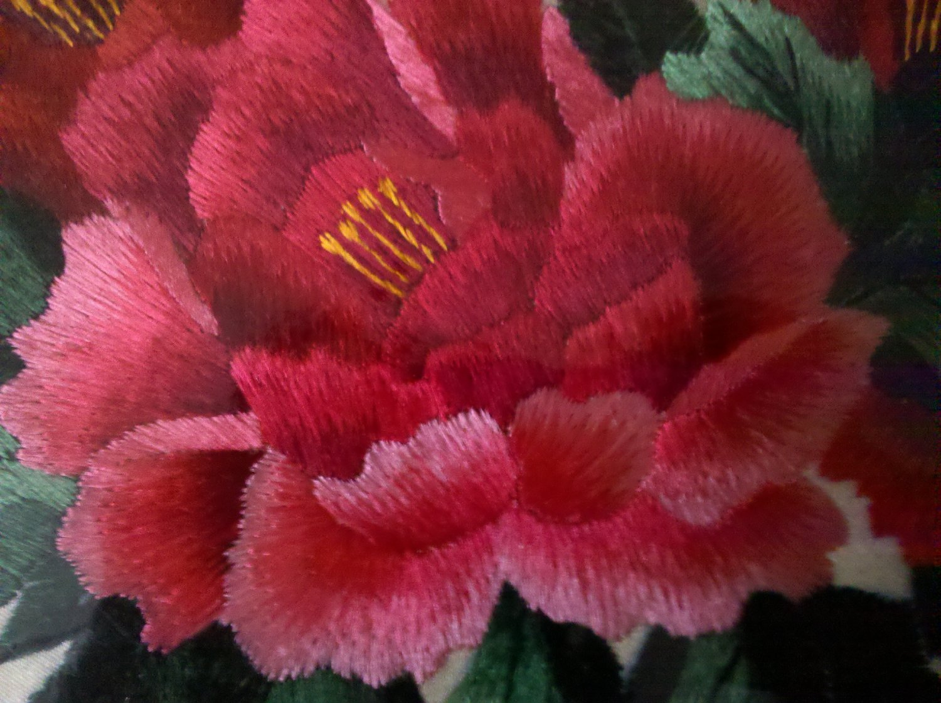
Su is the short name for Suzhou. Su Embroidery reflects tranquillity, refinement, and elegance. Embroidery with fish on one side and kitty on the other side is a representative of this style.
As early as the Song Dynasty, Su Embroidery was already well known for its elegance and vividness. In the Ming Dynasty, influenced by the Wu School of painting, it began to rival painting and calligraphy in its artistry.
In history, Su Embroidery dominated the royal wardrobe and walls. Even today, it occupies a large share of the market in China as well as in the world.
Suzhou

Slide 5
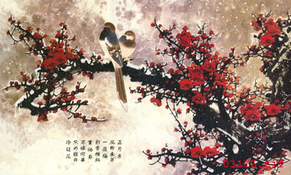
Shu
Shu Embroidery, influenced by its geographic environment and local customs, is characterized by a refined and brisk style. In the Qing Dynasty, Shu Embroidery entered the market. Workshops and governmental bureaus promoted the development of the industry. From the paintings by masters, to patterns by designers, to landscape, dragons and phoenix, it seemed all could be the topic of embroidery. Folk stories like the Eight Immortals Crossing the Sea, Kylin presenting a Son and other auspicious patterns such as magpie on plum and mandarin ducks playing on the water were also favorite topics. Patterns with strong local features like lotus and carp, bamboo forest and pandas.

Slide 6
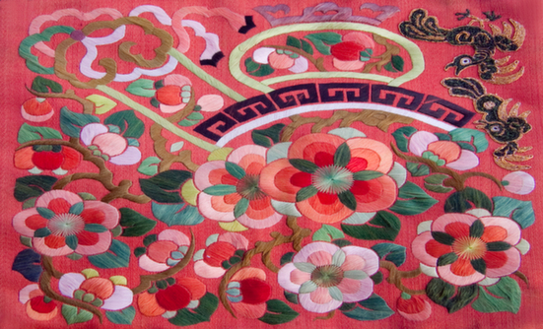
Xiang was a gift to the royal family during the Spring and Autumn Period.
Developing over two thousands years, Xiang Embroidery became a special branch of the local art. It gained popularity day by day. Besides the common topics seen in other styles, it absorbed elements from calligraphy, painting and inscription.
Its uniqueness is that it is patterned after a painting draft, but is not limited by it. Perhaps because of this technique, a flower seems to send off fragrance, a bird seems to sing, a tiger seems to run, and a person seems to breathe.
Xiang

Slide 7
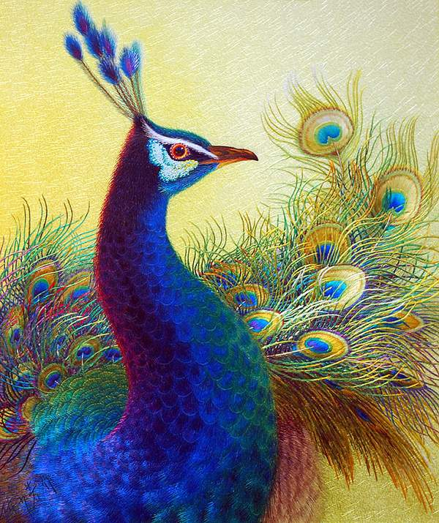
Yue
Portrait and flowers and birds are the most popular themes as the subtropical climate favors the area with abundant these plants that are rarely seen in central China. In addition, it uses rich colors for strong contrast and a magnificent and bustling effect.
Since Cantonese take to fortunes in an almost superstitious attitude, attaching a lucky implication to everything, red and green, and auspicious patterns are widely used. The most famous piece is hundreds of Birds Worshiping Phoenix. Fish, lobsters, bergamots and lychee are also common patterns.

Slide 8
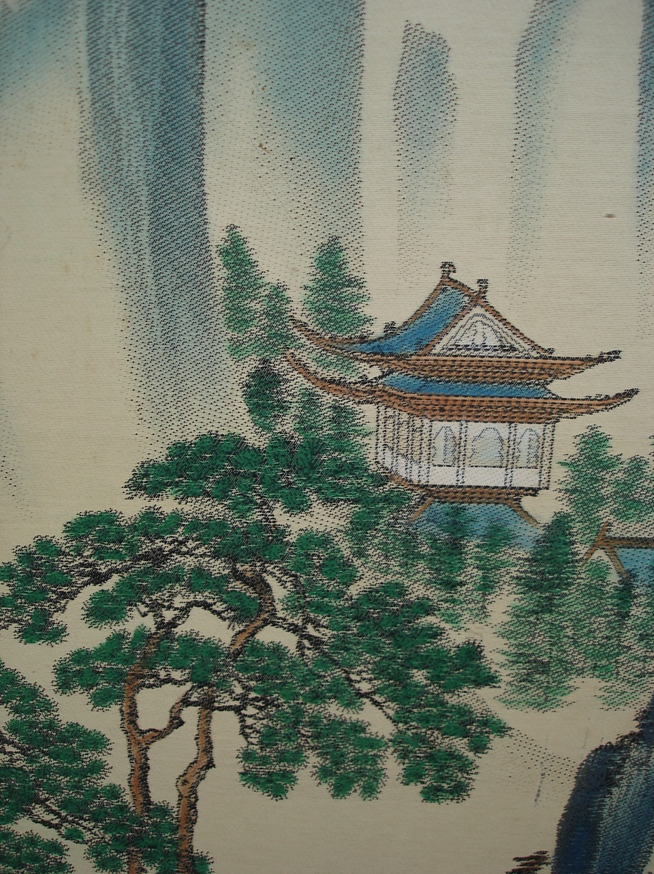
Gu
Gu Embroidery distinguishes itself from other local styles by the fact it originated from Gu Mingshi's family during the Ming Dynasty in Shanghai , instead of from a certain place. It is also known as Lu Xiang Yuan Embroidery. Lu Xiang Yuan, Dew Fragrance Garden in Chinese, was where the Gu Family lived. From the start, it was different from other styles as it specialized in painting and calligraphy. The inventor was a concubine of Gu Mingshi's first son, Gu Huihai. Later, Han Ximeng, the wife of the second grandson of Gu Mingshi developed the skill and was reputed as "Saint Needle". Some of her masterpieces are kept in the Forbidden City. Today it has become a special local product in Shanghai.

Slide 9
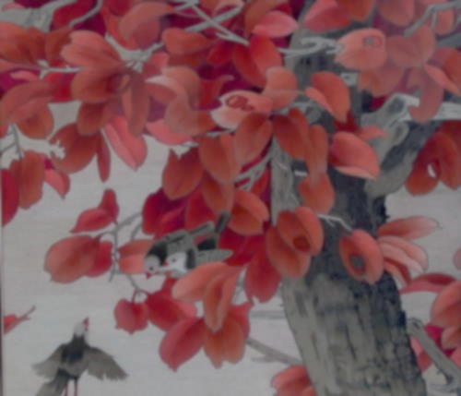
China: An analysis
The Chinese embroidery too has a similar history and its embroidery is almost as old as the discovery of silk.
Chinese embroidery is vibrant with a wide array of designs, right from animals to geometric patterns.
This is vey similar to the Indian hand embroidery which develops a pattern using dots, circles, squares and various other shapes.
Both Indian and Chinese hand embroideries are world famous and are the few of the most sought after art works not in the fashion world, but also in the interior designing one.

Slide 10
Shared by the eTwinning team of PPMG “Akad. Ivan Tsenov”, Vratsa, Bulgaria
The presentation is made as a result of a cooperation with a school from India

