Slide 1
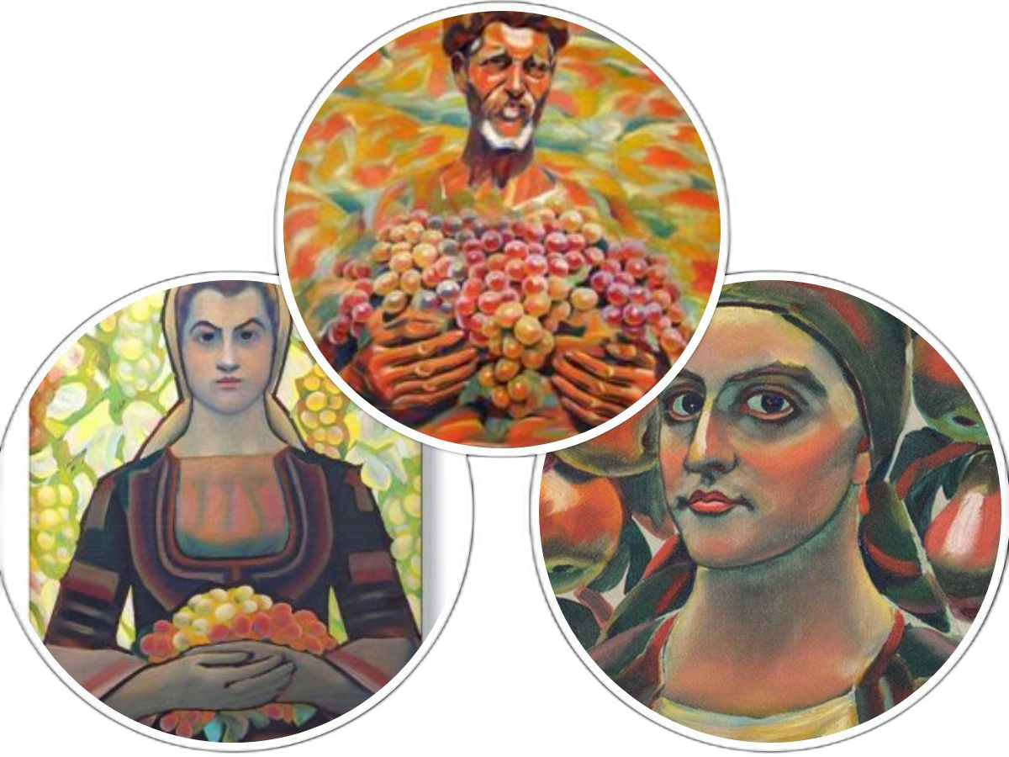
Reviving famous paintings of Vladimir Dimitrov-Maystora

Slide 2
Vladimir Dimitrov-Maystora
The talented Bulgarian artist (1882-1960) created colourful paintings depicting our beautiful nature. He also portrayed people wearing Bulgarian national clothes.
We took pictures of ourselves dressed in national clothes and holding fruit as the characters of Maystora.

Slide 12
