Slide 1
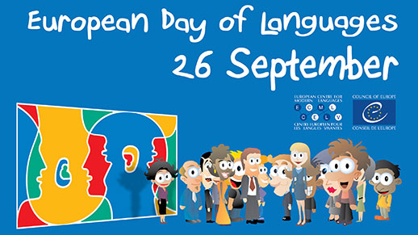
European Day of Languages
Prepared by: Vasil Gunovski

Slide 2
The European Day of Languages (EDL) was first celebrated in 2001 during the European Year of Languages. At the end of this campaign the Council of Europe's Committee of Ministers decided to make EDL an annual event, to be celebrated each 26 September. Every year, millions of people in the Council's member states and elsewhere organise or take part in activities to promote linguistic diversity and the ability to speak other languages.

Slide 3
“Yarn and thread whisper stories of the past”
Bulgarian | English | Georgian
бродерия | embroidery | საქარგავი/sakargavi/
гоблен | tapestry | გობელინი/gobelini/
шия | sew | კერვა /k’erva/
игла | needle | ნემსი /nemsi/
конец | thread | ძაფი /dzapi/
ножица | scissors | მაკრატელი /makʼratʼeli/
кука | knitting needle | ბარჯი /barji/
прежда | yarn | თასამა /tasama/
килим | carpet | ხალიჩა /khalicha/
стан | loom | საქსოვი დაზგა /saksovi dazga/
тъка | to weave | ქსოვილი /ksovili/

Slide 4
