Slide 1
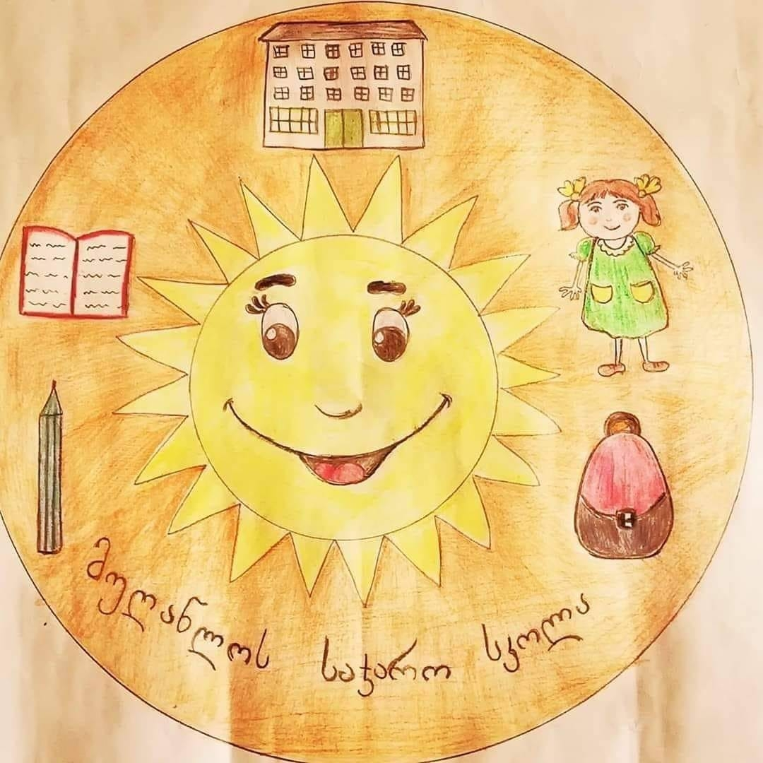
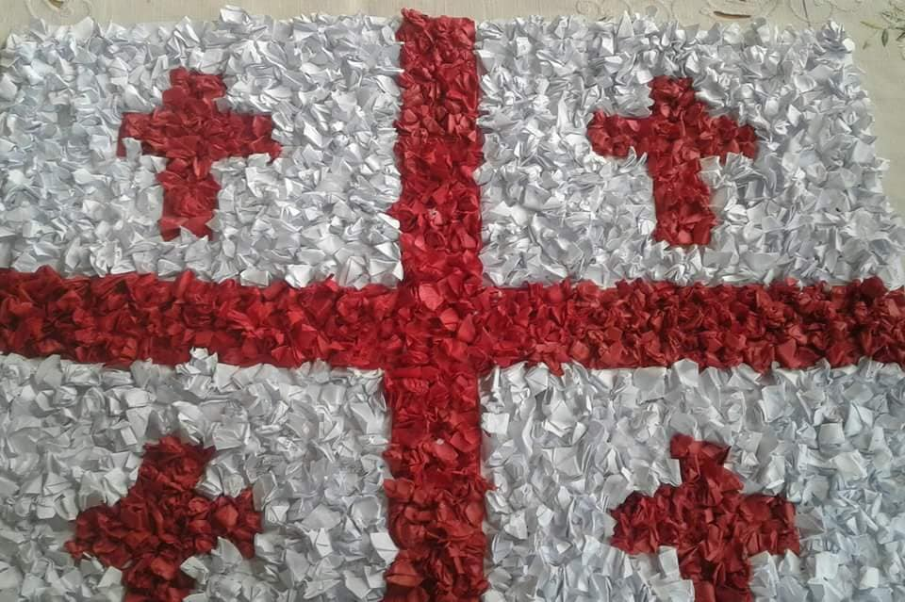
Welcome from Georgia. We are students of Mughanlo Public School. The school has 470 students. We are actively involved in various projects. We are interested in getting to know the culture of another country. Introduce you to our country and the development of embroidery in the country. We will now tell you about the development of Khevsureti and embroidery culture in one of the corners of Georgia.

Slide 2
Khevsureti
Khevsureti is one of the most beautiful parts of Georgia. Mountains in the alpine zone create a beautiful landscape and have a captivating effect on the visitor.
The beauty of Khevsureti is Shatili, a unique village perched on a rock that was both a residence and a fortress, it guarded the northern passages of Georgia for centuries. Shatili's strategically planned architecture made it accessible and the most protected fortress.

Slide 3
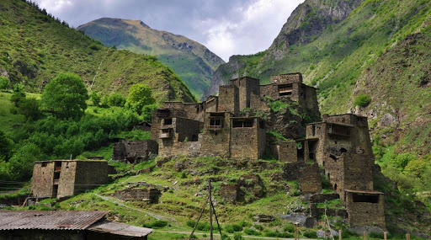

Slide 4
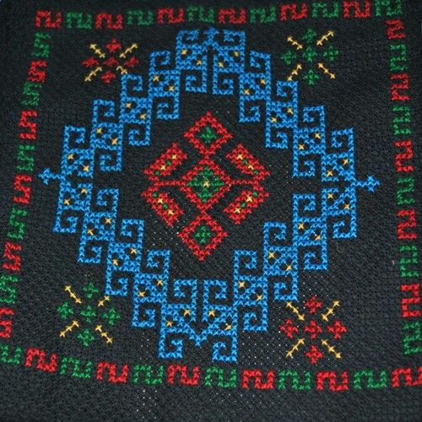
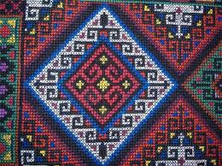
Khevsurian embriodery
Khevsurian embroidery is a direction of folk embroidery. This type of embroidery includes three essential components: the fabric on which it is embroidered, the material with which
Embroidered, and an embroidery method based on the eye
This is one of the oldest types of embroidery
It is quite popular nowadays and many
The lady owns his technique.

Slide 5
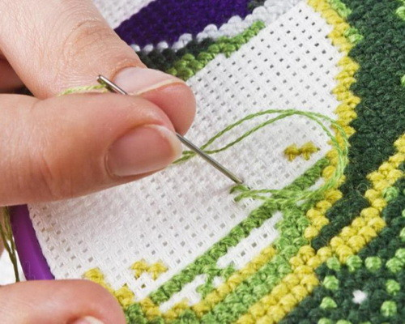
embroidery technique
Embroidery starts according to a pre-prepared sketch, but there are masters! Who embroider and create with their own creative imagination without a sketch masterpieces. The movement of the threaded needle is of great importance when cross-stitching.

Slide 6
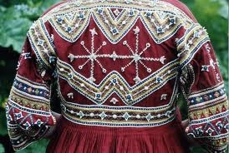
A characteristic feature of Khevsurian cross embroidery is the method of involving beads In embroidery. The highest culture of embroidery with embroidery beads to date Survived the mountain population. This is especially well reflected in Khevsurian clothes In the masculinity of a man or a woman. Metal was also used extensively for decoration and is still used today Jewelry and money. Buttons are also used, mainly in white

Slide 7
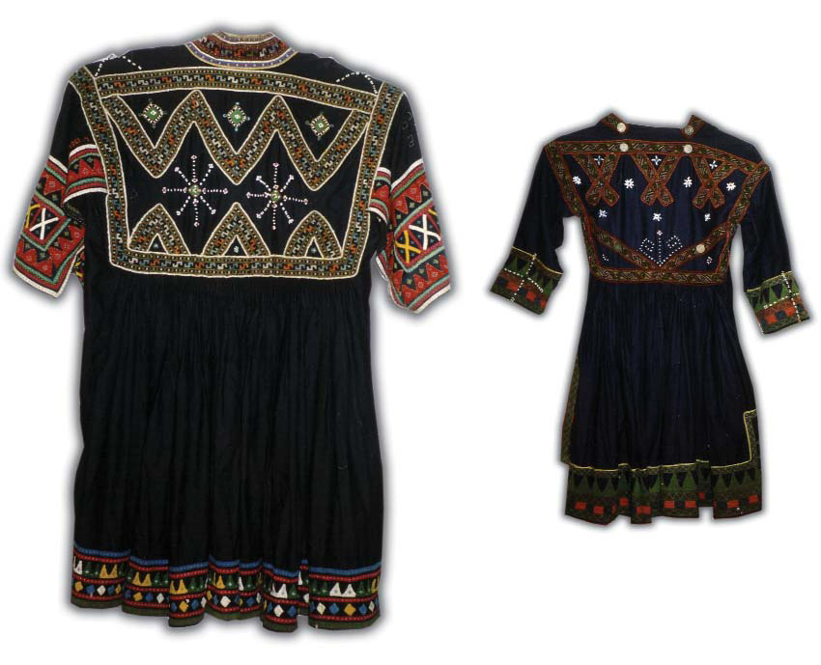
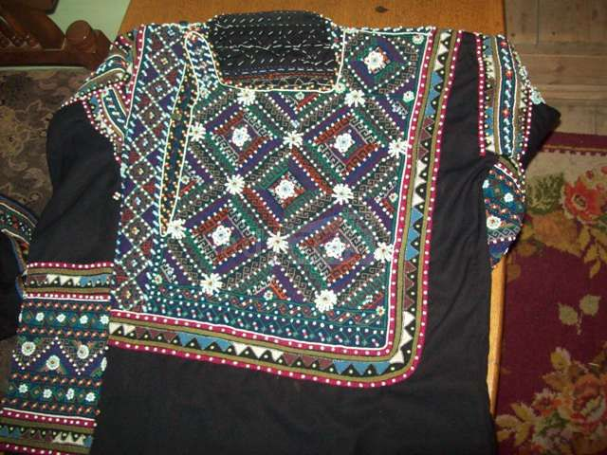

Slide 8
Our school has an embroidery circle led by an experienced teacher. Then in the presentation we will present our works and tell you about them.

