Slide 1

Erasmus + KA 2 project ,,Creating, communicating, our diversity we are celebrating”
2017–2019
Lithuania

Slide 2
Little Blue Riding Hood
Prienai ,,Revuona” basic school
6a form students

Slide 3
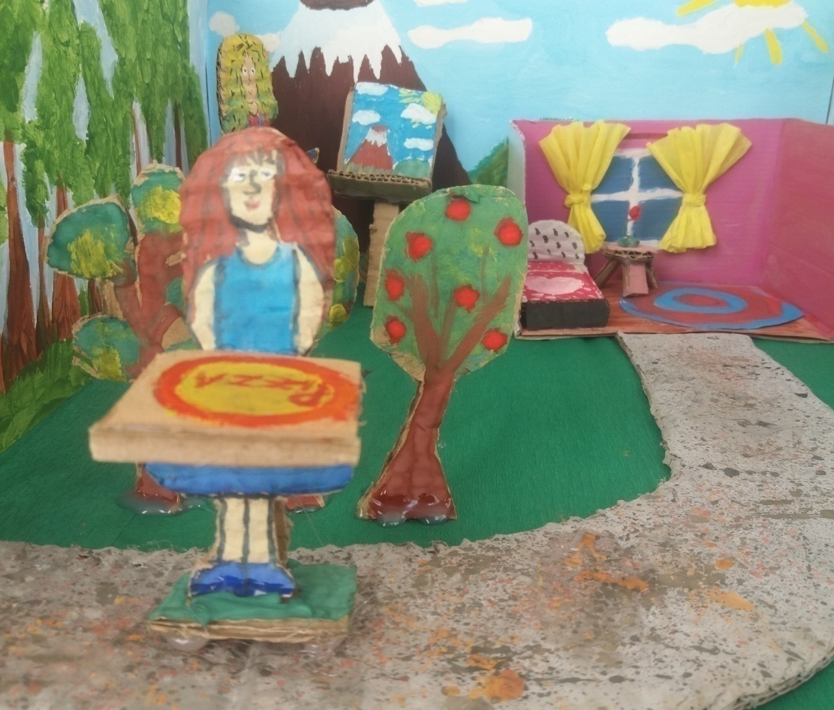
Once upon a time, there was a Little Blue Riding hood. She was skipping through the woods. She had a pizza and she was taking it to her grandmother’s house.

Slide 4
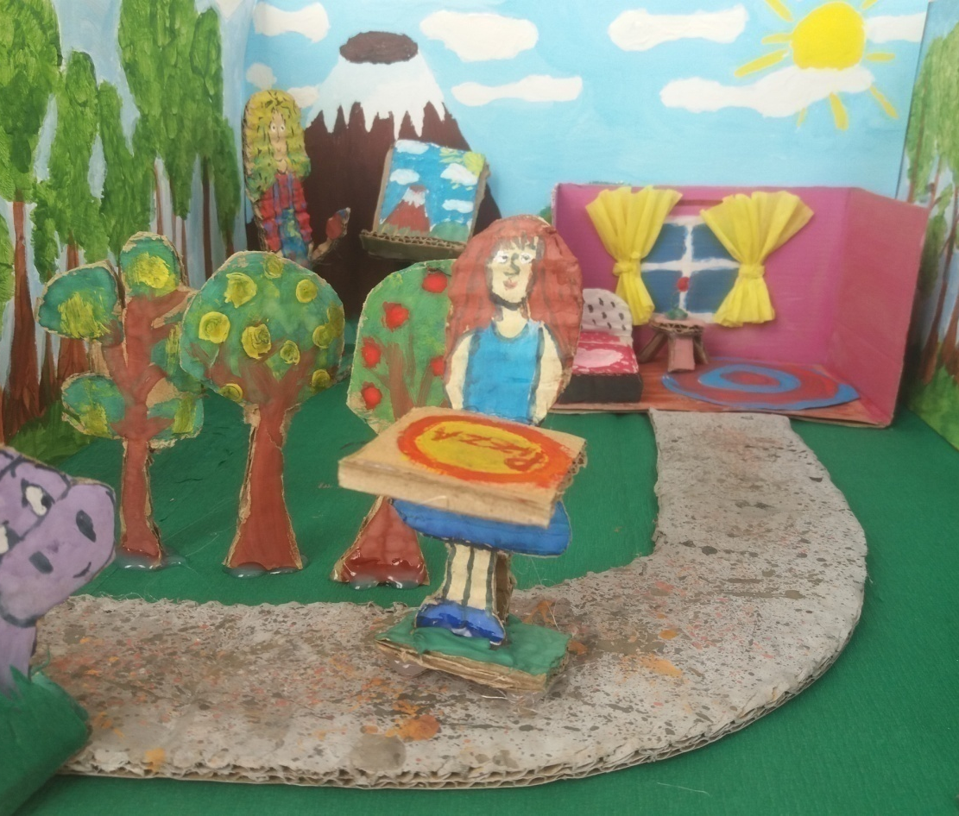
The Little Blue Riding hood was singing:
“Over the river and through the woods, to grandmother’s house!“
The Big Bad Hippo heard her singing and smelled that yummy pizza. He really wanted the pizza. The Big Bad Hippo stopped the girl.

Slide 5
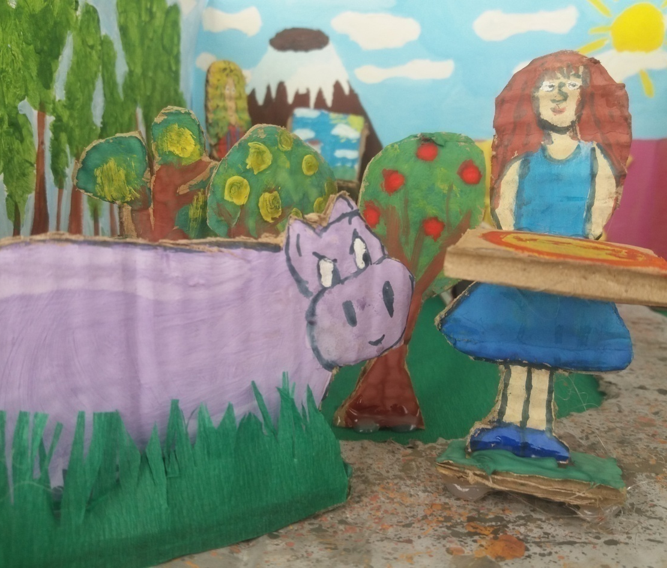
The Big Bad Hippo asked:
– Can I have some of your pizza, please?
The Little Blue Riding Hood said:
– No, It’s for my grandmother!

Slide 6
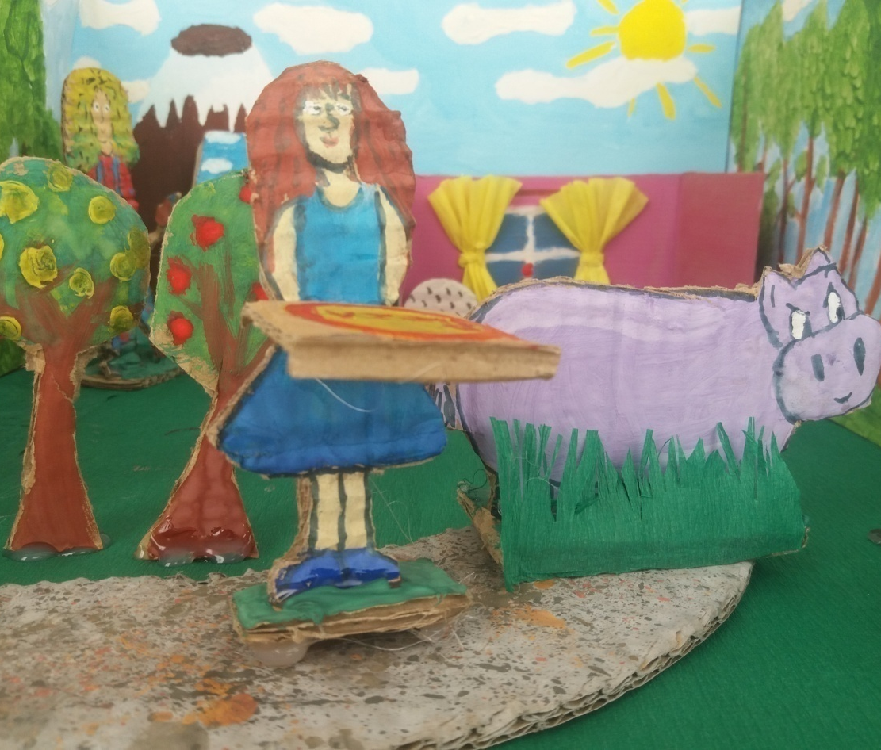
The Big Bad Hippo ran away, but he still wanted the pizza. So, he ran ahead to the grandmother’s house, but found it empty. He dressed up and waited for Little Blue Riding Hood.

Slide 7
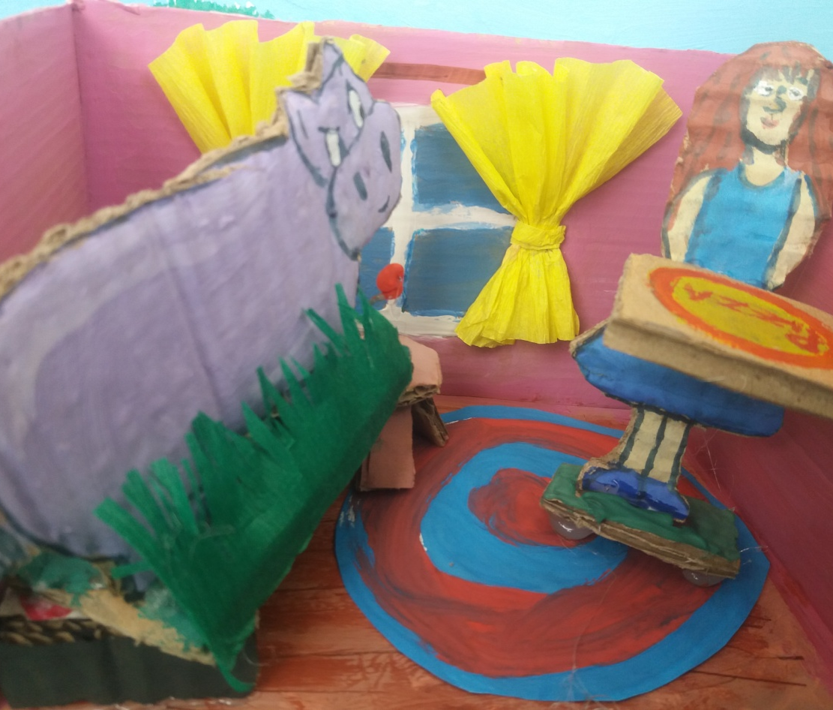
When Little Blue Riding hood arrived to the house, she found the Big Bad Hippo dressed as her grandmother, lying in the bed. She thought her grandmother was sick.
Little Blue Riding Hood asked:
– Why are your ears so small?

Slide 8
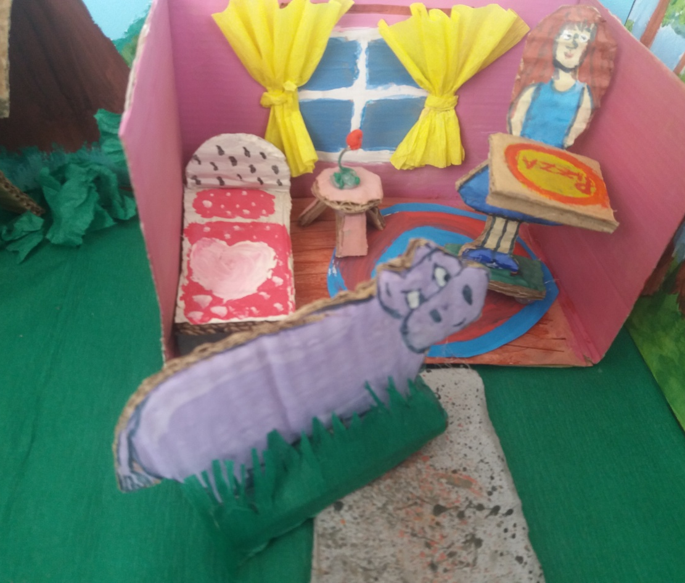
Well, the Big Bad Hippo was very sensitive about his ears.
This made him very angry and he decided to eat Little Blue Riding Hood.

Slide 9
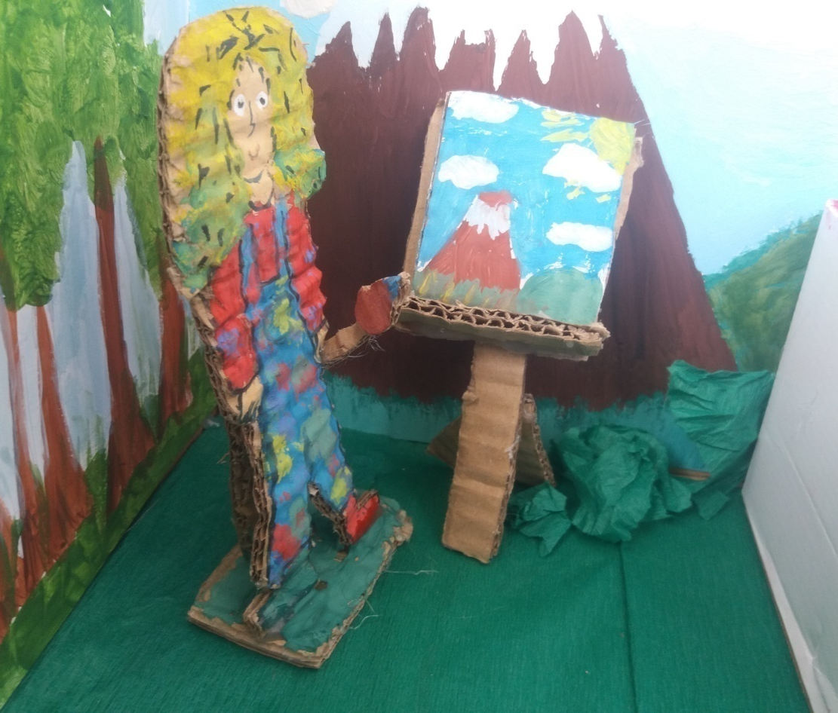
Accidentaly an artist was painting nearby and heard Little Blue Riding Hood’s scream. So, he headed over to help her.

Slide 10
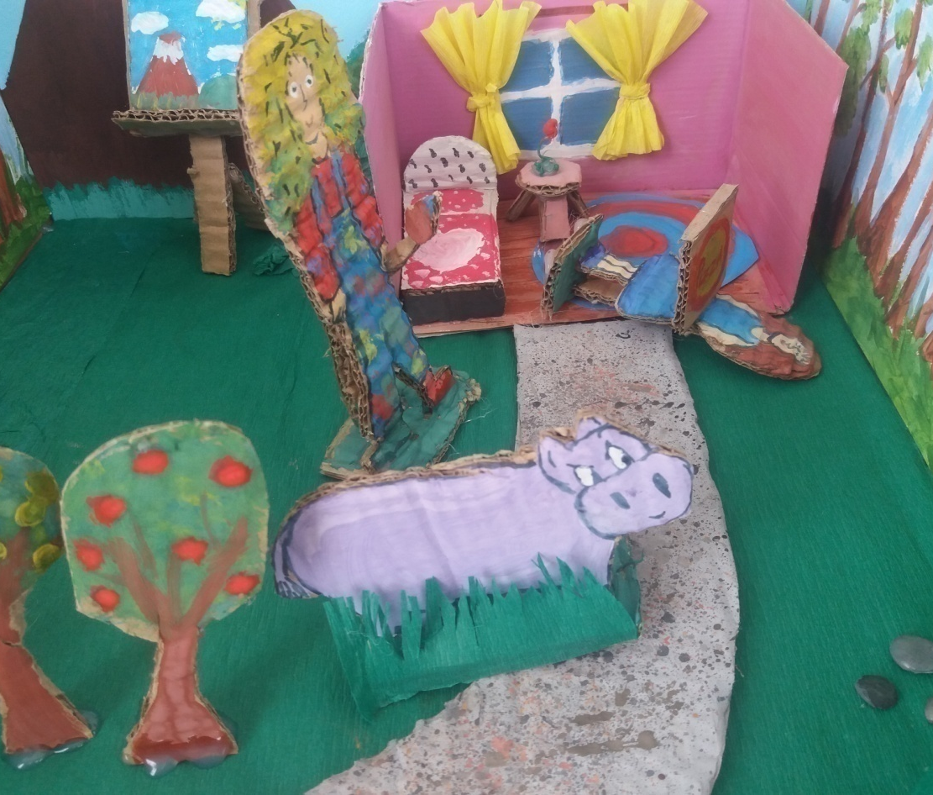
The artist chased away the Big Bad Hippo to the woods.

Slide 11
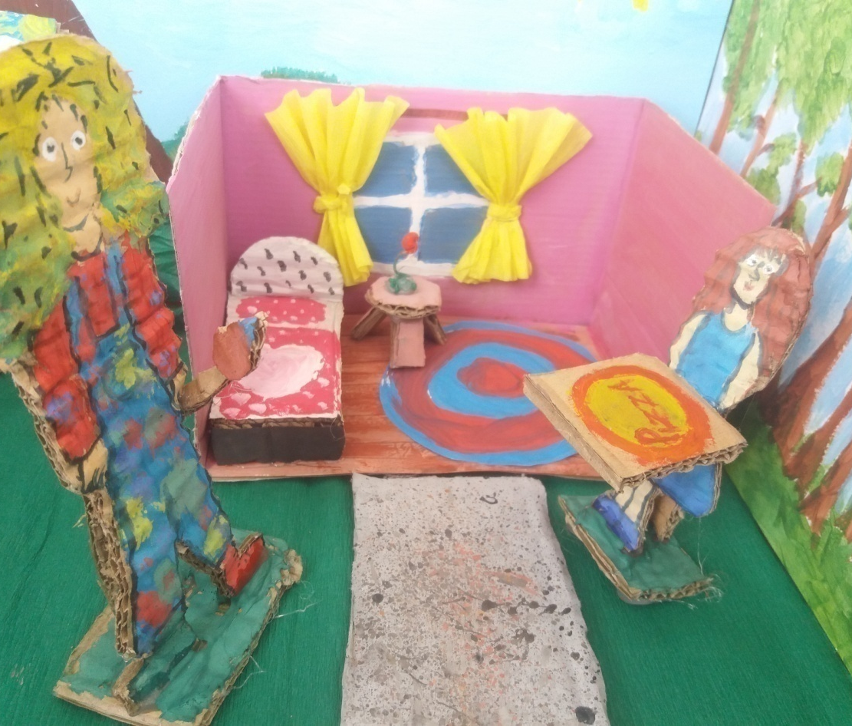
The Little Blue Riding Hood thanked the Honest man.

Slide 12
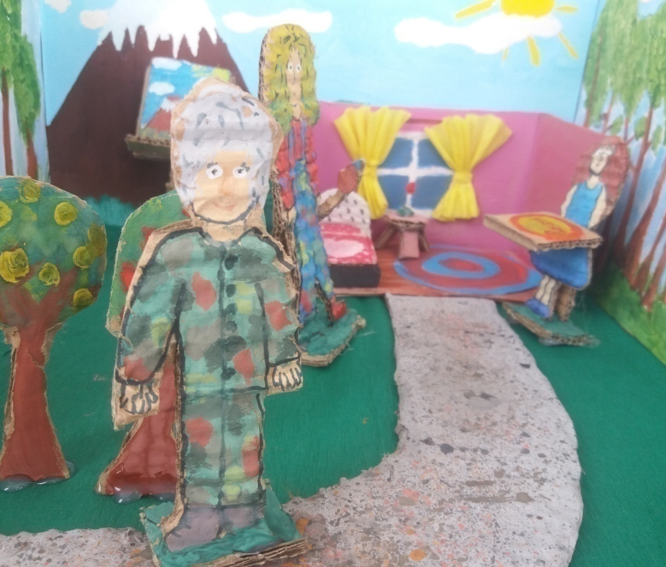
While they were talking they saw Little Blue Riding Hood’s Grandmother coming back home.

Slide 13
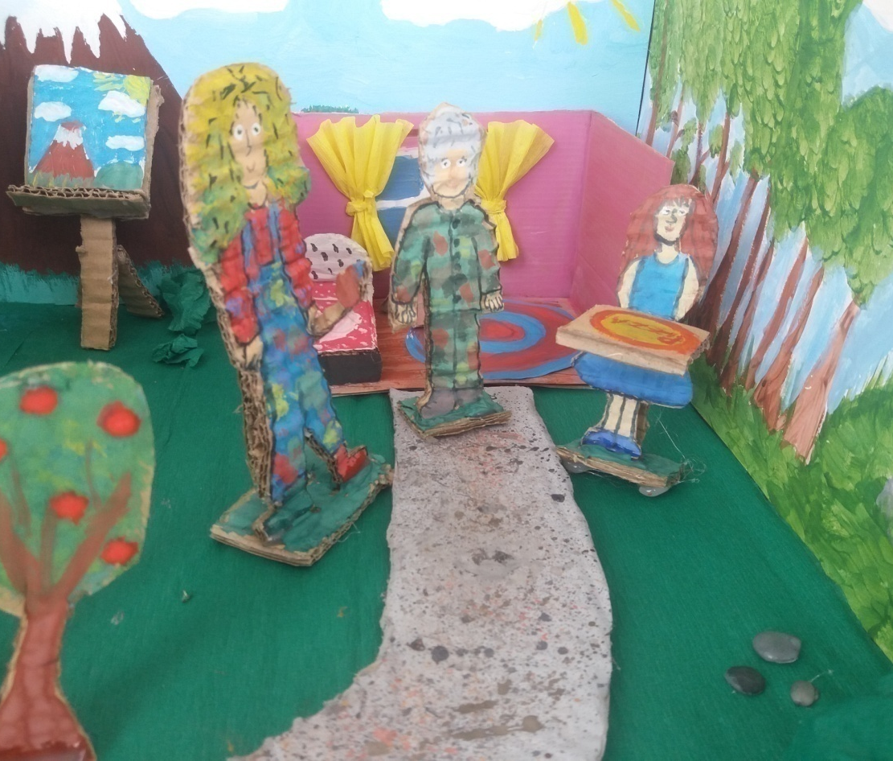
–Where have you been?– asked her Little Blue Riding hood.
– I was in a war! –answered her grandmother.

Slide 14
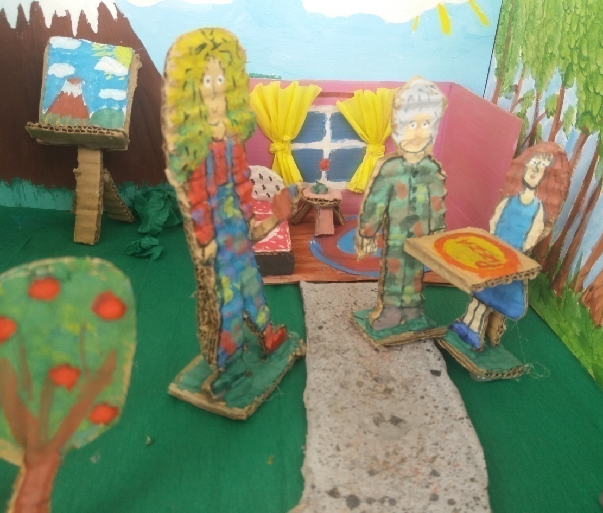
– Oh, dear! I brought you this pizza! – Little Blue Riding Hood said.
– Thank you! Who is this man? –grandmother asked.
– Little Blue Riding Hood answered:
– He saved me from the Big Bad Hippo!
– Oh dear! What did the Hippo want?
– He wanted this pizza!

Slide 15
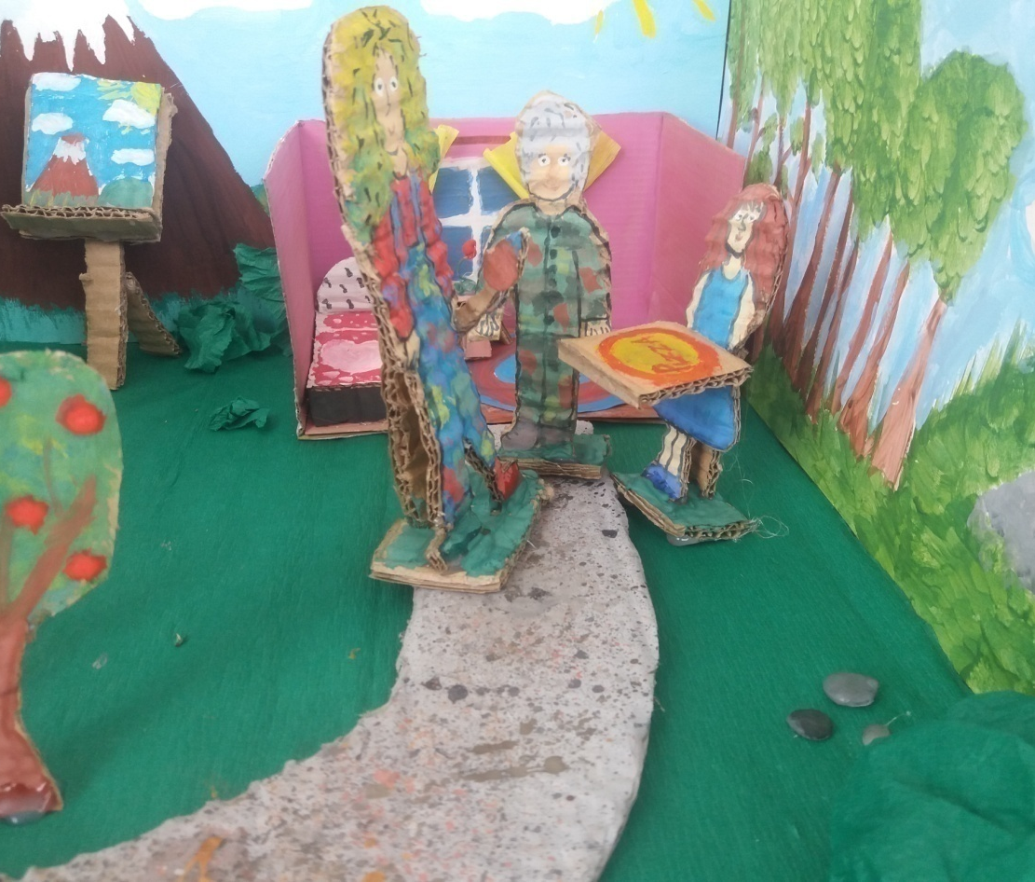
Grandmother said:
–Well, thank you, good man!
The artist replied:
– I just did what anyone would do... But also thank you for inspiration in my painting!

Slide 16
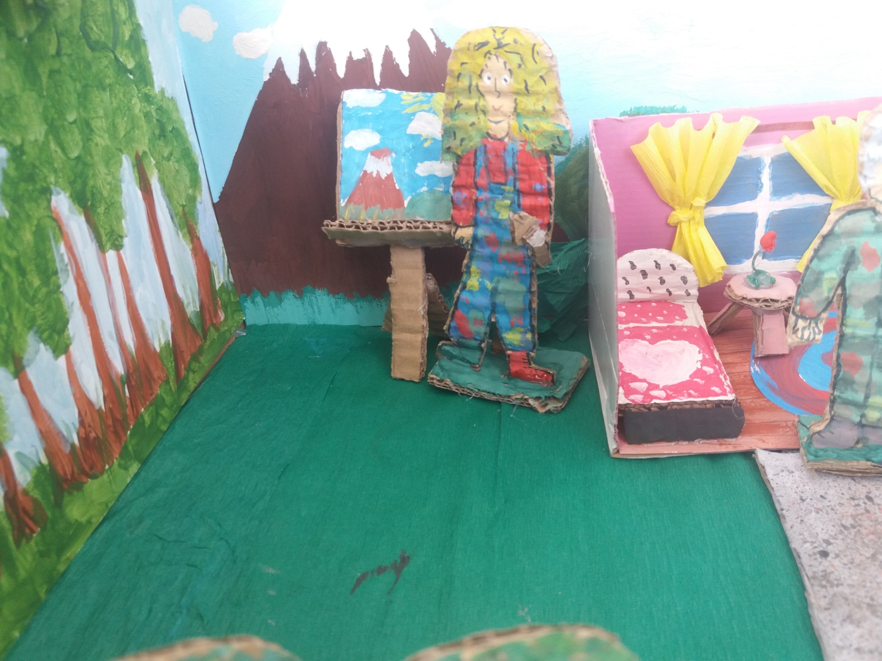

Slide 17
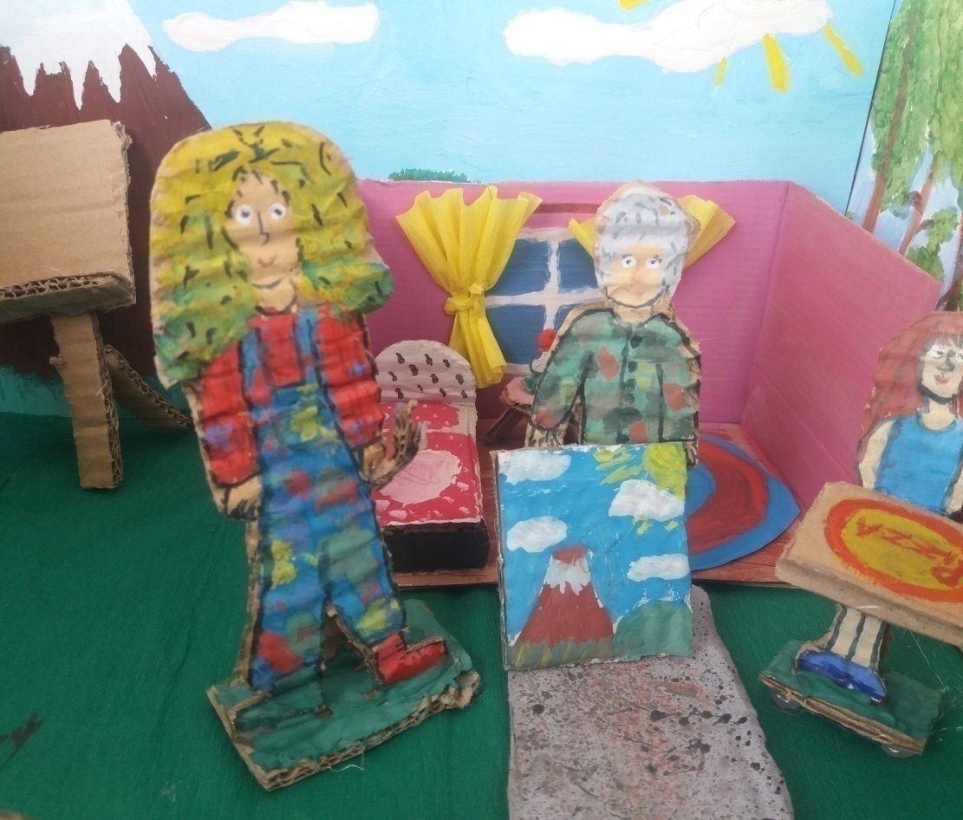
Artist said:
–Here’s a gift, this picture, for you!
–Thank you, I will put it in my room as a great memory! – said grandmother.

Slide 18

EPILOGUE
Little Blue Riding asked:
– What about Big Bad Hippo?
Grandmother said:
– He is still hungry and unhappy.
Artist suggested:
– Let’s invite him.

Slide 19
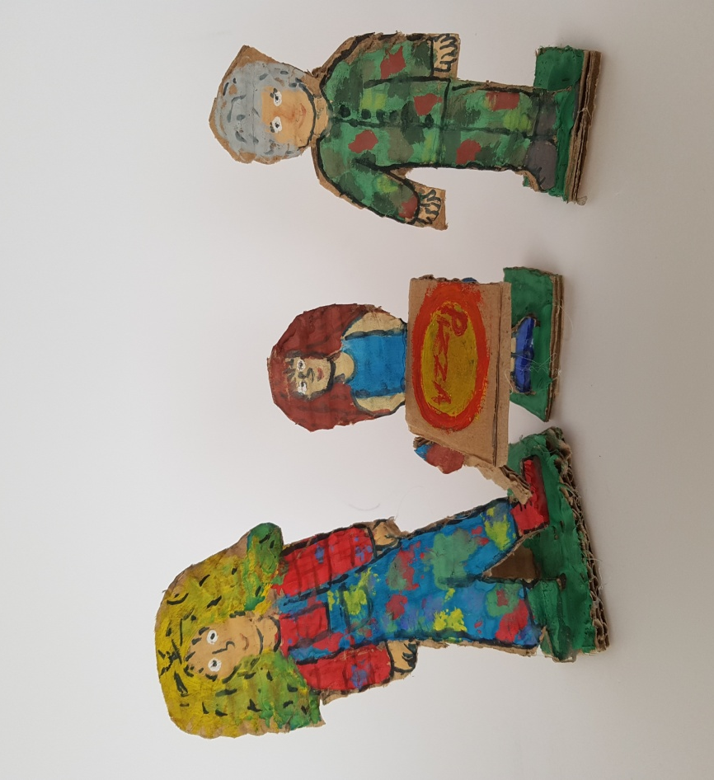
Artist remebered:
– But we have eaten our pizza.
Little Blue Riding Hood asked:
– What shall we do?
Artist asked:
– We need to go to town and find pizzeria.

Slide 20
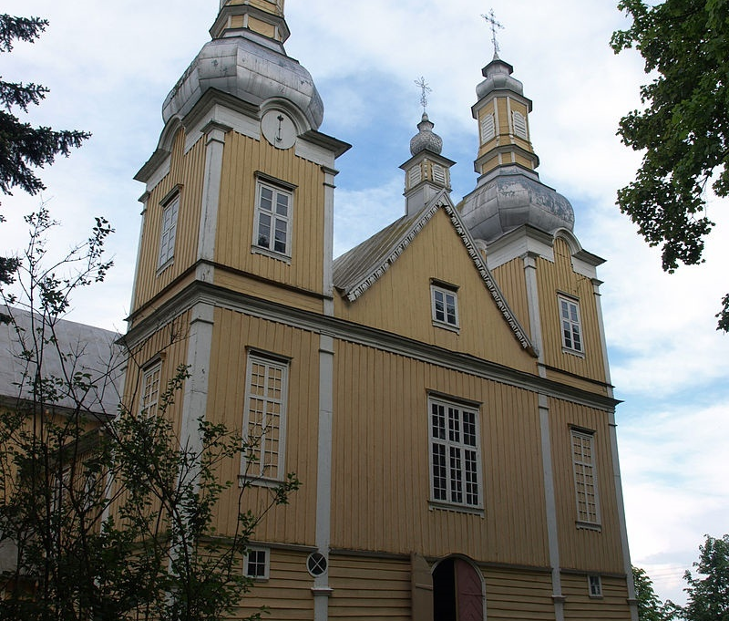
First of all we came to the church.
First of all, we came to the church.

Slide 21
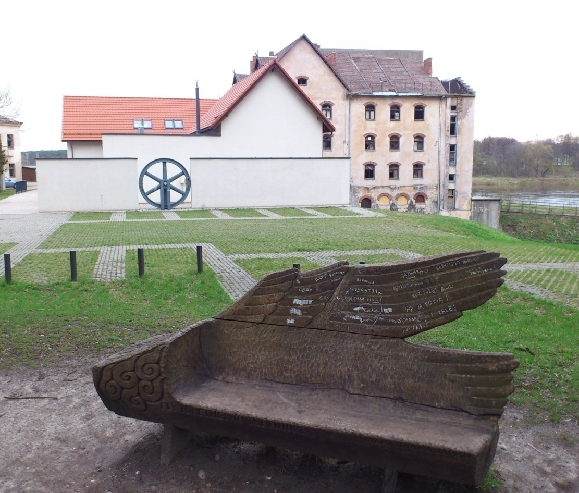
Then we found the old mill.

Slide 22
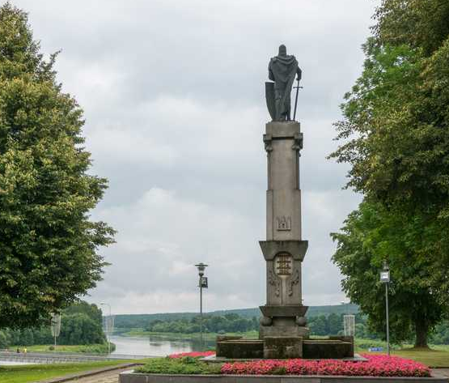
After that we saw a monument of Lithuanian Great Duke Kestutis,
but there weren’t any pizzerias around.

Slide 23
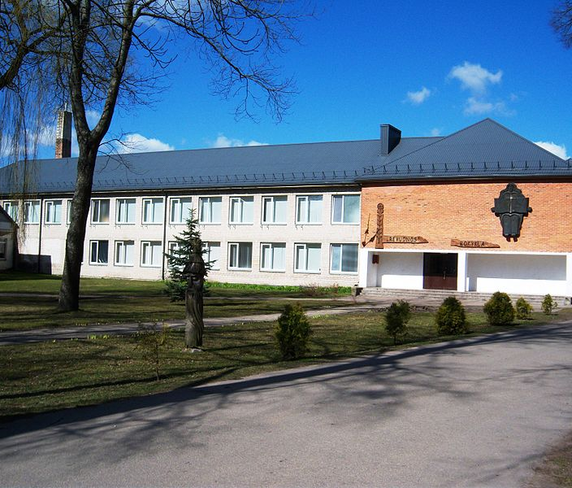
At last, we came back to our scool canteen.

Slide 24
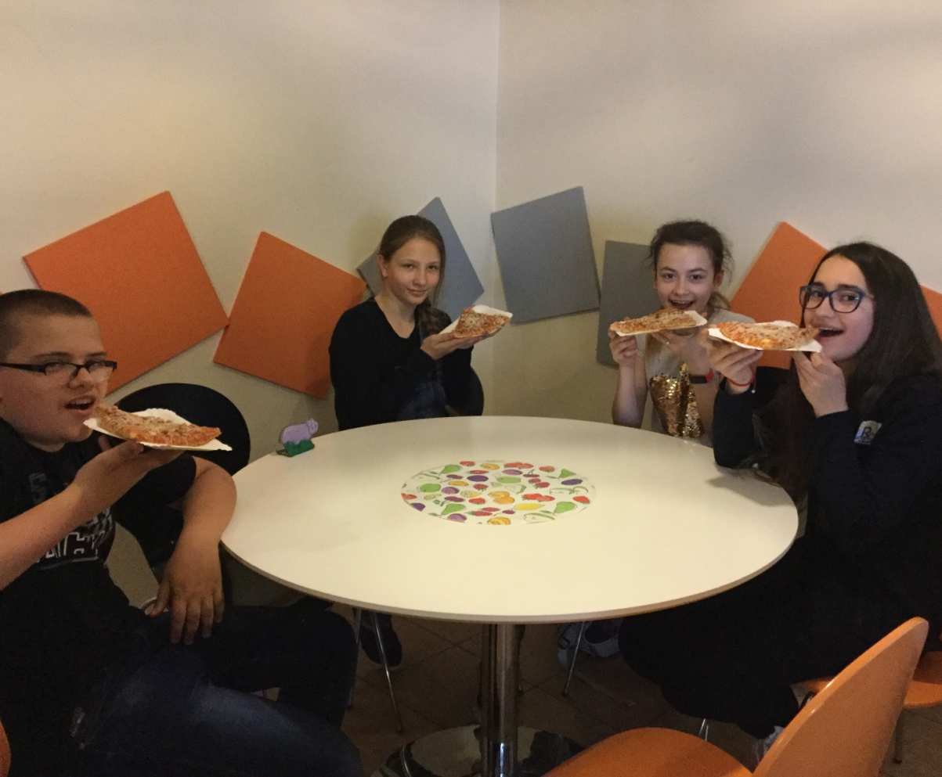
And wow!
They have tasty pizzas!

Slide 25
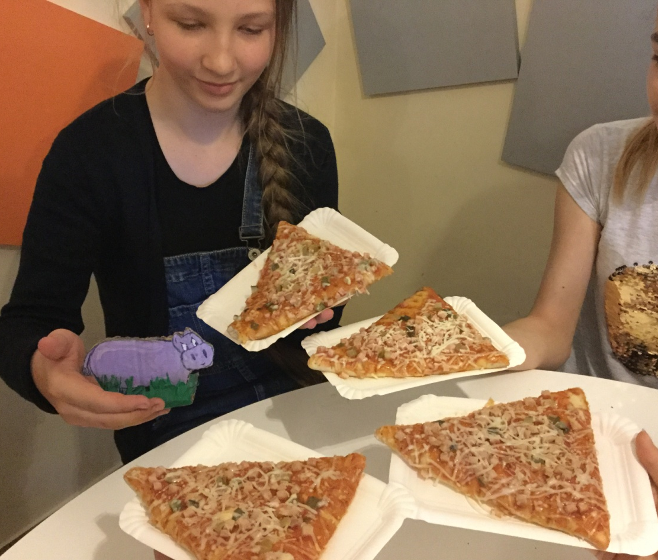
In the end we called the Big Bad Hippo to have pizza together.

Slide 26
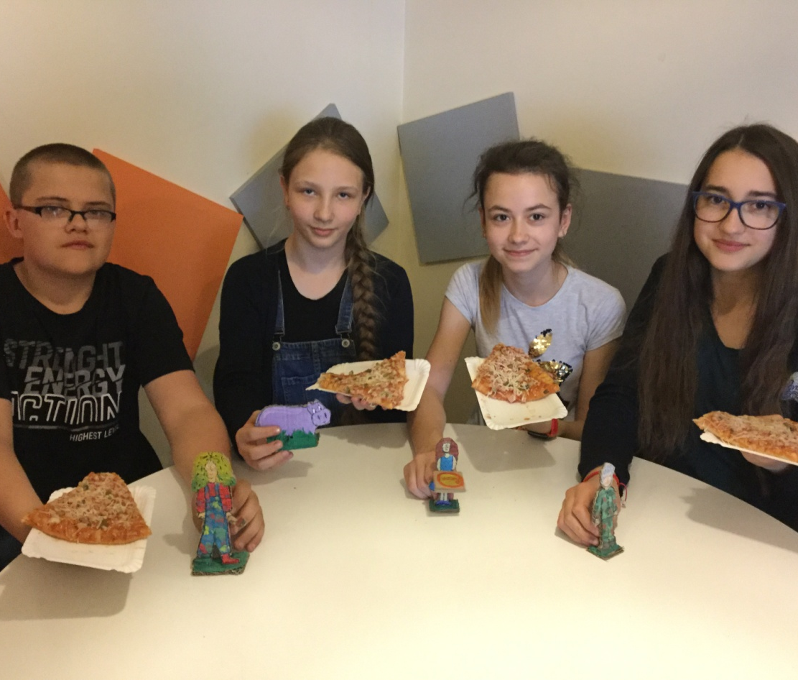
Please,
be kind to other people –that can be so rewarding.

Slide 27
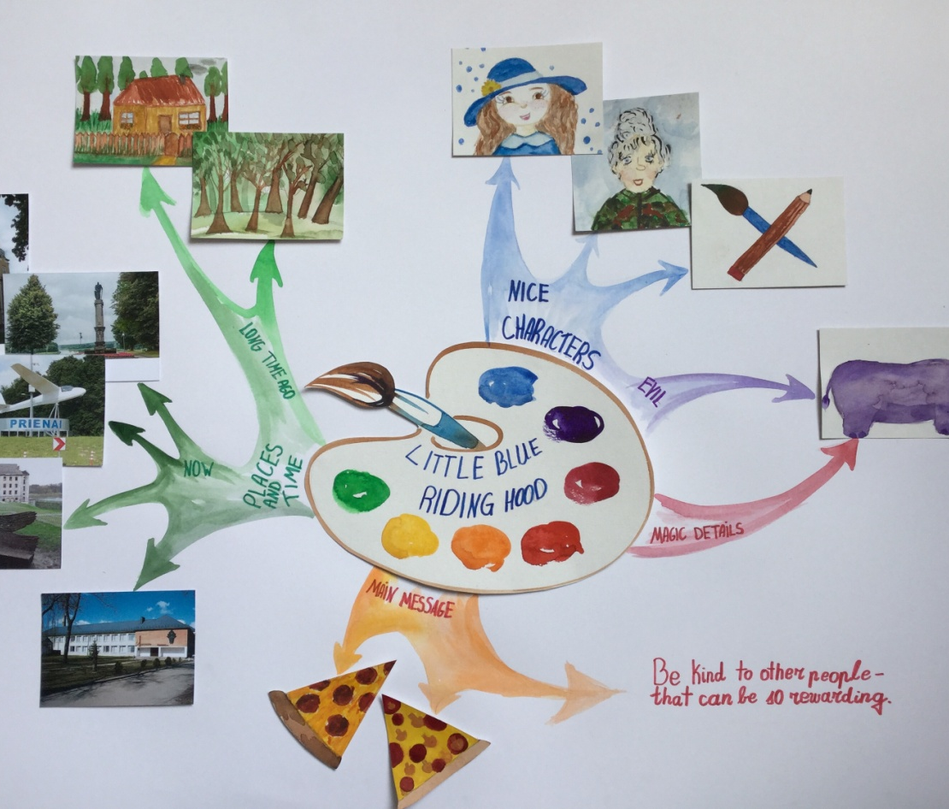
Here’ s
our Mind Map

Slide 28
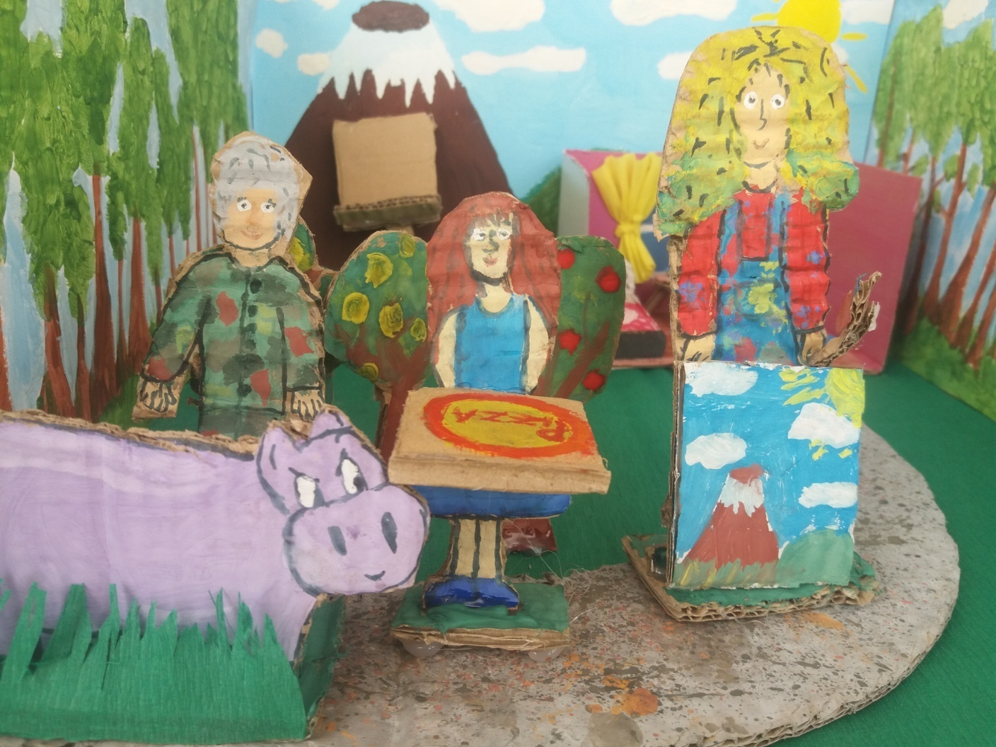
The end

Slide 29
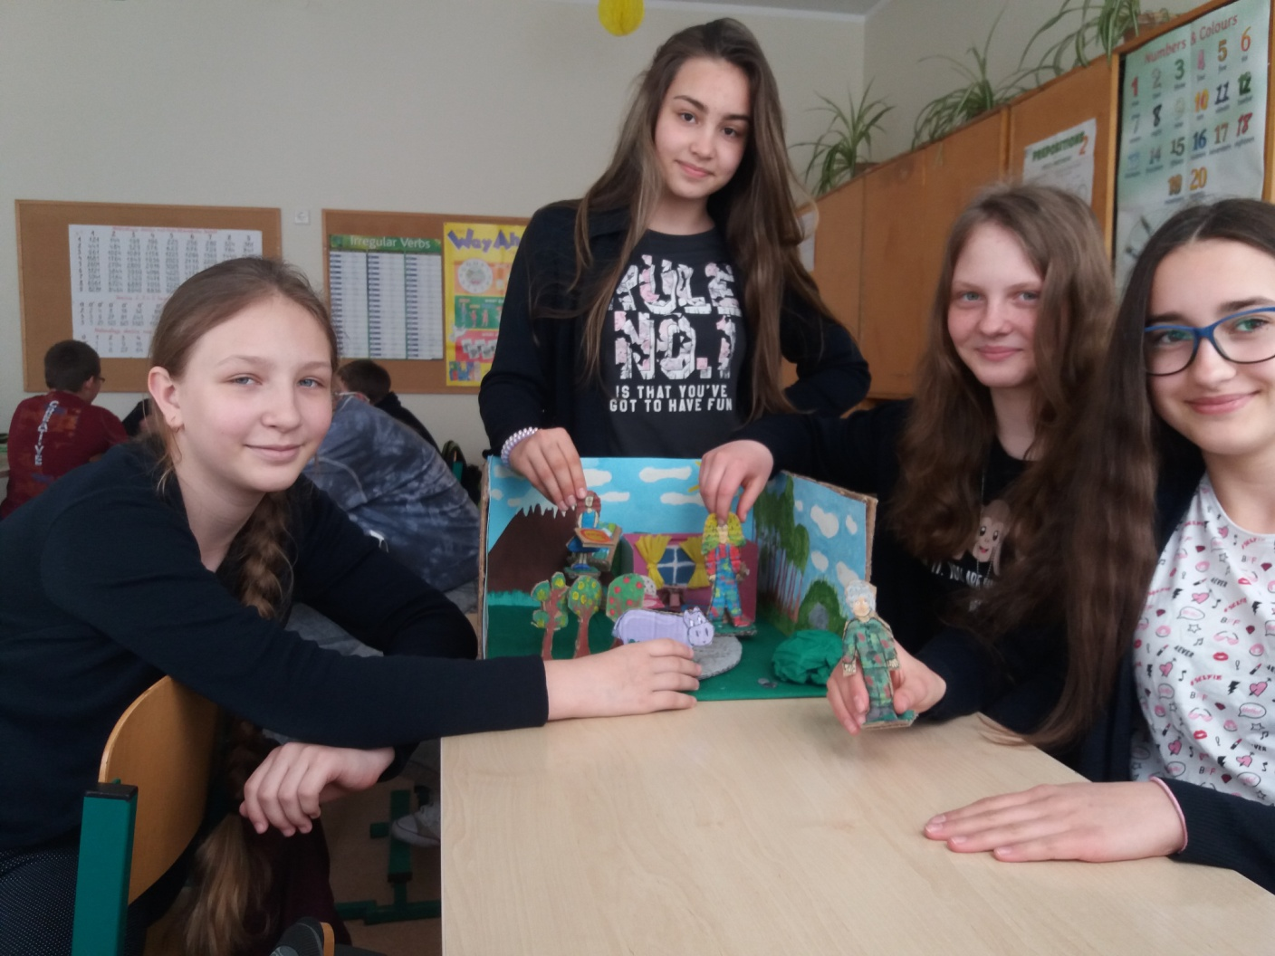
Project group who worked on the classical fairy tale. Pupils created and made puppets of the main characters and scenery of cardboard.

