Slide 1
„Maria Montessori” Special Secondary School Bacau, Romania
ROOTS AND WINGS
Erasmus+ project

Slide 2
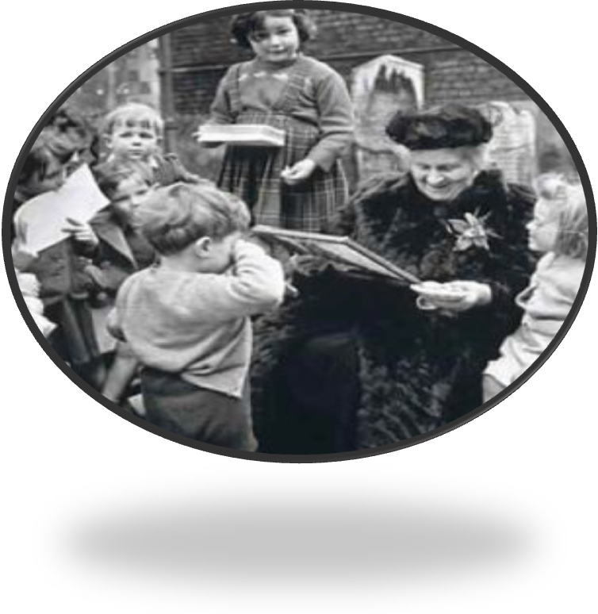
ROOTS AND WINGS
Erasmus+ project
„Education is a natural process carried out by the child and is not acquired by listening to words, but by experiences in the environment.”
Maria Montessori
(1870-1952)

Slide 3
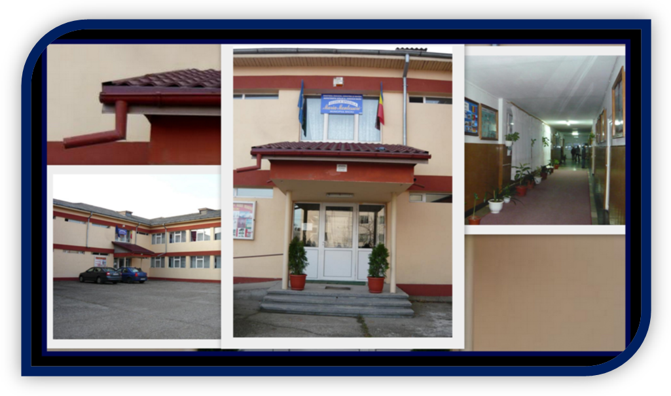
ROOTS AND WINGS Erasmus+ project

Slide 4
ROOTS AND WINGS Erasmus+ project
„Maria Montessori” Special Secondary School was founded in 1973, as a school unit meant to ensure the education of mentally deficient students. At first it was named „Special School for recoverable mental deficiencies”. Later on, in 1990 the school changed its name to „Special School Bacau”. In 2009, by applying the Montessori principles, the name of the school becomes „Maria Montessori” Special Secondary School.

Slide 5
ROOTS AND WINGS Erasmus+ project
In our school, we are educating 191 students with different degrees of mental deficiency (moderate and severe deficiency), children with autism and Down Syndrome. We are a state school unit for pupils with special educational needs , from Bacau, having the following levels of education:
Primary education- 10 classes;
Gymnasium- 20 classes, one of which is a class for students with sensory deficiencies.

Slide 6
OUR MISSION:
Training skills and abilities, in order to develop personal autonomy skills, professional training and social integration, for the children to become independent, active and efficient citizens.
Providing quality education for our pupils
Increasing individual performance by training and developing skills and abilities;
Providing a favorable environment for conducting learning activities for children with special educational needs;
Developing projects and extra-curricular programs, with the support of the local community.
OUR TARGETS:
ROOTS AND WINGS
Erasmus+ project

Slide 7
WHAT WE OFFER?
Curricular activities and self autonomy skills training;
Promoting quality education, focused on the child needs.
Individualized educational Plans (I.E.P)
Specific compensatory therapies:
Speech therapy;
Physical therapy;
Psychodiagnosis and psycho-pedagogical counseling;
Educational, complex and integrated therapy;
ROOTS AND WINGS
Erasmus+ project

Slide 8
Support services for students with special needs who learn in normal schools;
Caunseling and support for families with children with special educational needs;
Caunseling teachers from public schools who have integrated special needs students;
Programs , projects and extra-curricular activities;
Medical assistance;
Collaboration with the local community institutions;
Accommodation and free meals.

Slide 9
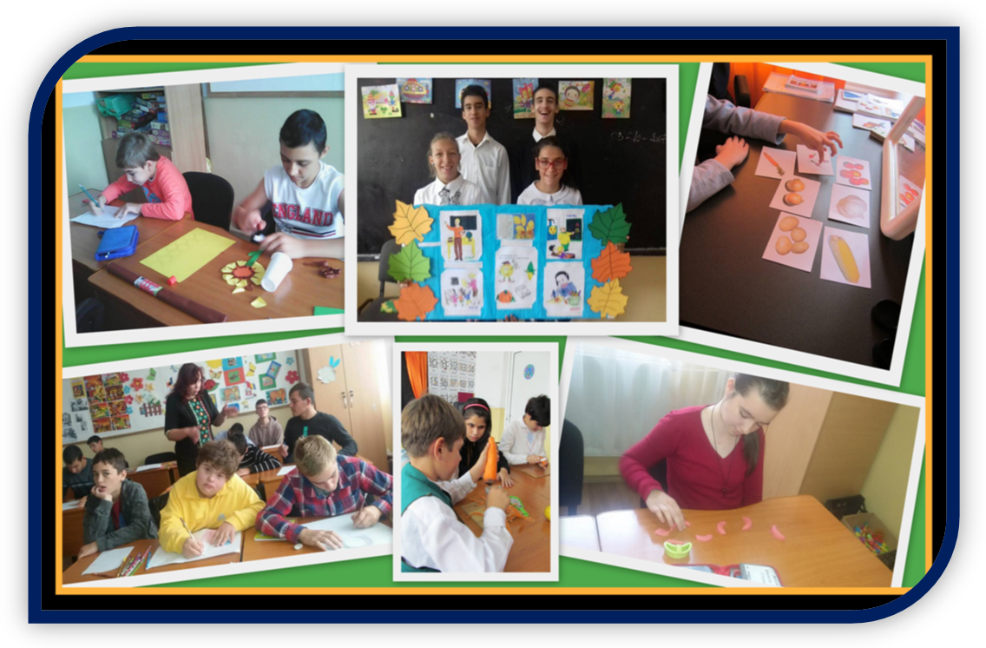
OUR FACILITIES:
30 Classrooms;
9 Speech therapy cabinets;
1 Psychodiagnosis cabinet;

Slide 10
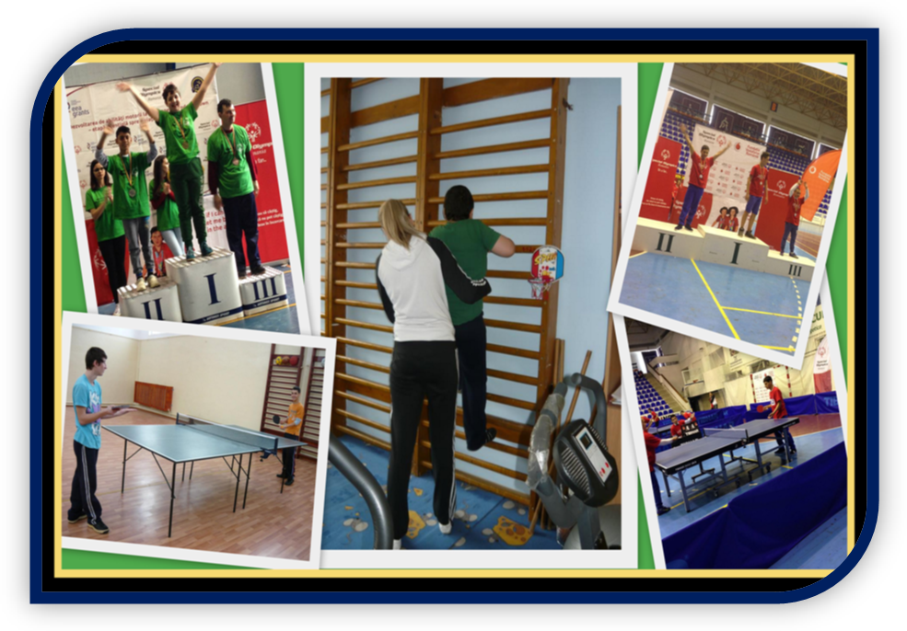
Physiotherapy cabinet;
1 gym hall;
ROOTS AND WINGS
Erasmus+ project

Slide 11
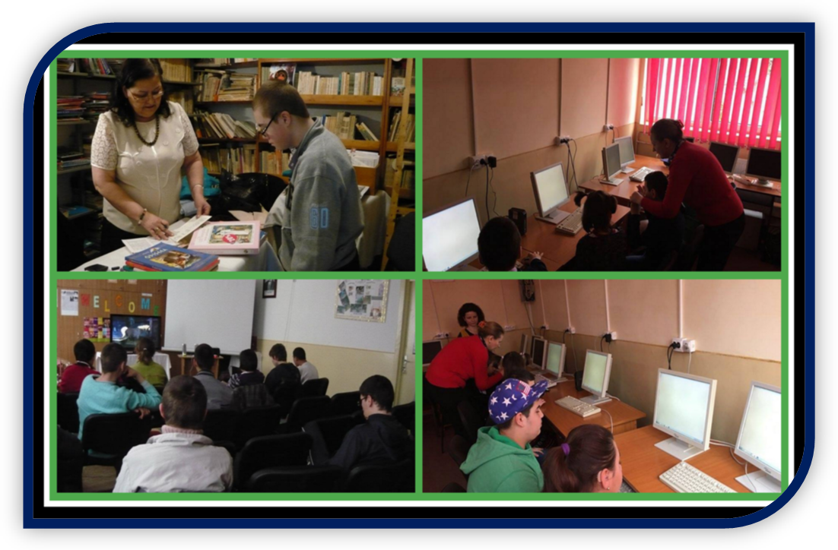
A library;
A computer room- 25 computers equipped with educational software for children with special needs;
ROOTS AND WINGS
Erasmus+ project

Slide 12
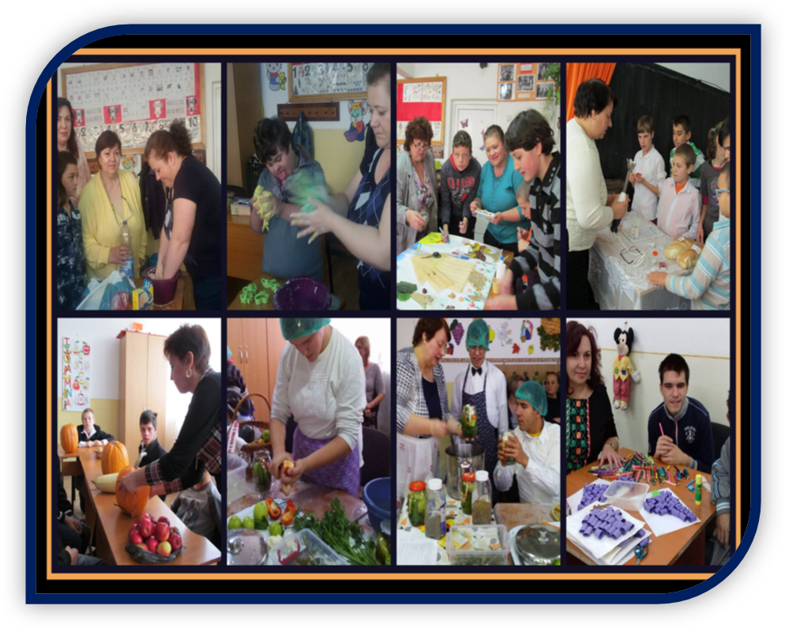
1 Social assistance office;
1 Workroom for pre-voctional and technological education;
2 Medical offices.
ROOTS AND WINGS
Erasmus+ project
ROOTS AND WINGS
Erasmus+ project
ROOTS AND WINGS
Erasmus+ project

Slide 13
OUR HUMAN RESOURCES:
27 Special psycho-pedagogy teachers;
14 Educators;
10 Speech therapists;
2 School counselors;
8 support teachers
3 Physiotherapists;
16 Auxiliary teaching staff;
5 Non-teaching staff.
ROOTS AND WINGS
Erasmus+ project

Slide 14
ROOTS AND WINGS
Erasmus+ project

