Slide 1
MEDITERRANEAN DIET
Josipa Poduje, prof.
Srednja škola Antun Matijašević Karamaneo Vis

Slide 2
01
What is Mediterranean diet?

Slide 3
The traditional Mediterranean diet is the heritage of a millennia of exchanges of people, cultures and foods from all the countries around the Mediterranean basin.
It has been the basis of food habits during the twentieth century in all of the countries of the region, originally based on Mediterranean agricultural and rural models.

Slide 4
In its fundamental components, the Mediterranean diet adjusts to seasonal rhythm, and includes the same basic ingredients (fish, green leafy vegetables, legumes, figs, olive oil, fresh herbs...) in a long period of history.

Slide 5
The Mediterranean diet involves a set of skills, knowledge, rituals, symbols and traditions that include crops, harvesting, fishing, conservation, processing, cooking, and particularly the sharing and consumption of food.
In 2013 the Mediterranean diet was inscribed onto the UNESCO List of Intangible Cultural Heritage of Cyprus, Croatia, Greece, Italy, Morocco, Portugal and Spain.

Slide 6
02
Why try the Mediterranean Diet?
https://youtu.be/o5aof7UI3yg

Slide 7
Fiber in whole grains, legumes, fruit, vegetables, and nuts — helps digestion and control blood sugar levels.
01
02
03
04
Monounsaturated fats in olive oil, nuts, and fish exert an anti-inflammatory effect that can protect against heart disease and improve both glucose metabolism and insulin sensitivity.
People who lived healthfully while following a Mediterranean diet had an 80% lower death rate than those who didn’t live healthfully or follow the diet
Following a Mediterranean-style diet is associated with a slower rate of mental decline and decreased risk of Alzheimer’s disease.

Slide 8
03
Mediterranean diet pyramid

Slide 9
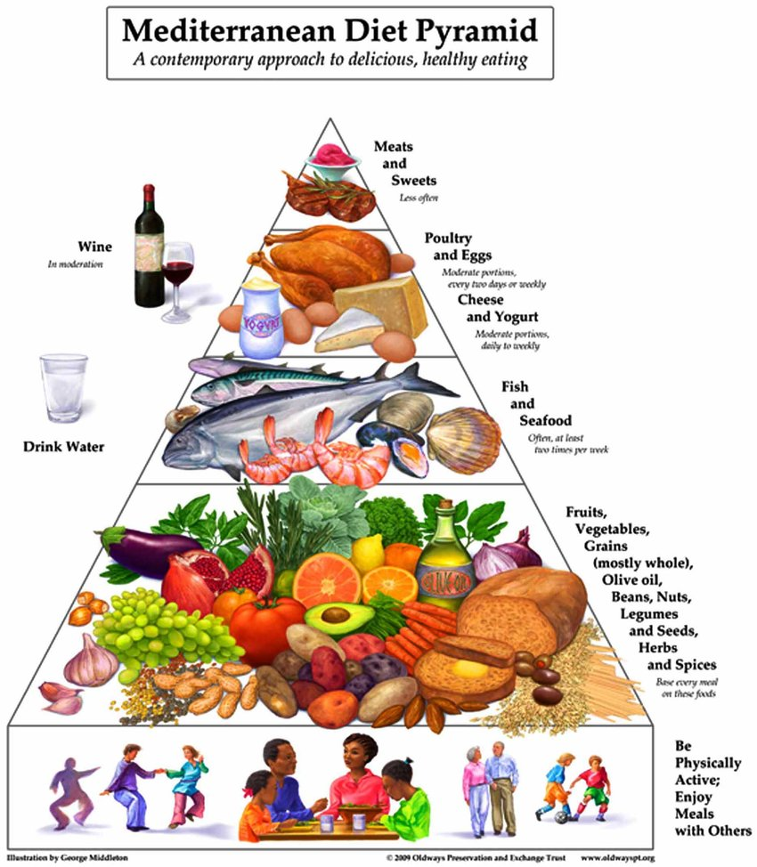
https://youtu.be/s7TS52IPyYg

Slide 10
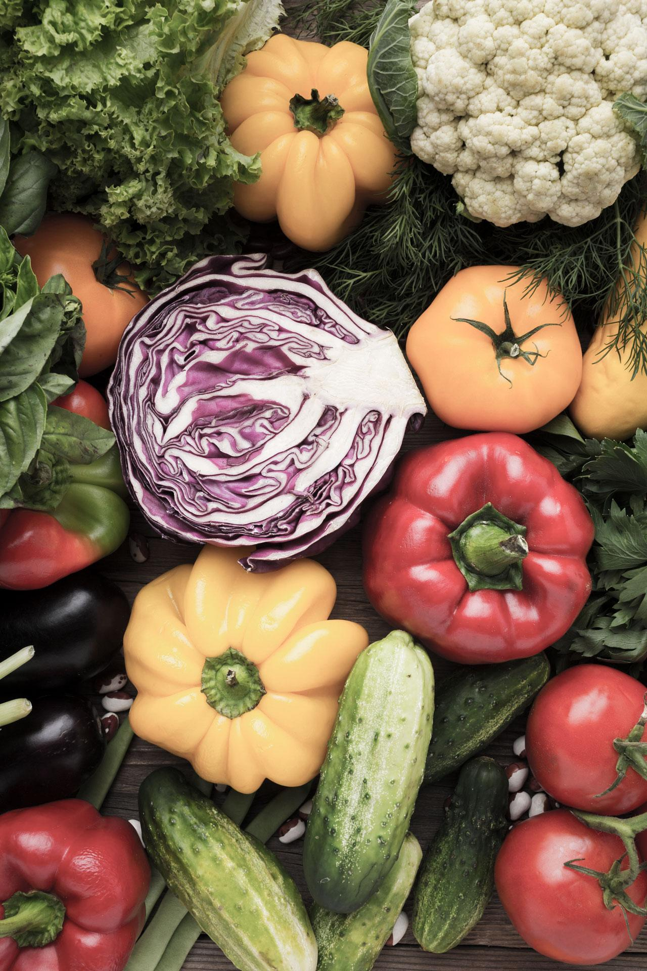
Every day

Slide 11
Main meals should contain three basic elements, which can also be found throughout the day: Cereals: one or two servings per meal in the form of bread, pasta, rice, couscous and others. Preferably whole grain, since processing normally removes fibre and some valuable nutrients (Mg, Fe, vitamins, etc)
01
02
03
Vegetables: two or more servings per meal. In order to ensure vitamin and mineral daily intakes, at least one of the servings should be consumed raw (one meal/d)
Fruit: one or two servings per meal, as the most frequently chosen dessert. The concept of ‘variety in colours and textures’ is highlighted, in the case of fruit and vegetables, in order to ensure a wide variety of antioxidants and protective compounds.

Slide 12
Weekly

Slide 13
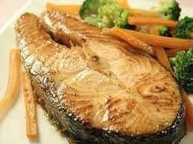
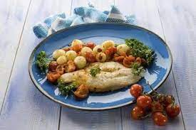
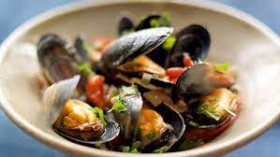
Consumption of a variety of plant- and animal-origin proteins is recommended. Traditional Mediterranean dishes do not usually have animal-origin protein foods as the main ingredient but rather as a source of flavor.
Fish and shellfish (two or more servings), white meat (two servings) and eggs (two to four servings) are good sources of animal protein.
Potatoes are also included on the weekly level (three or fewer servings per week), as they are a part of many traditional recipes with meat and fish

Slide 14
Occasionally

Slide 15
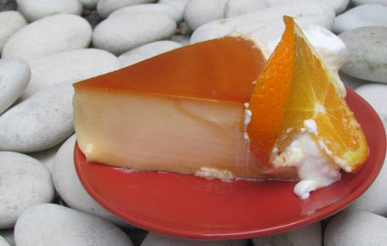
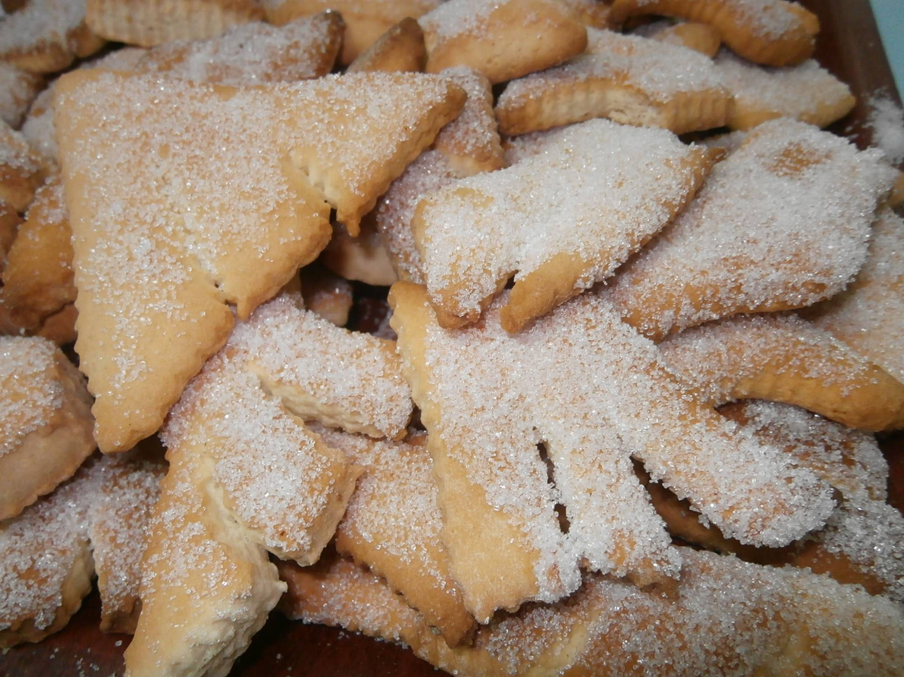
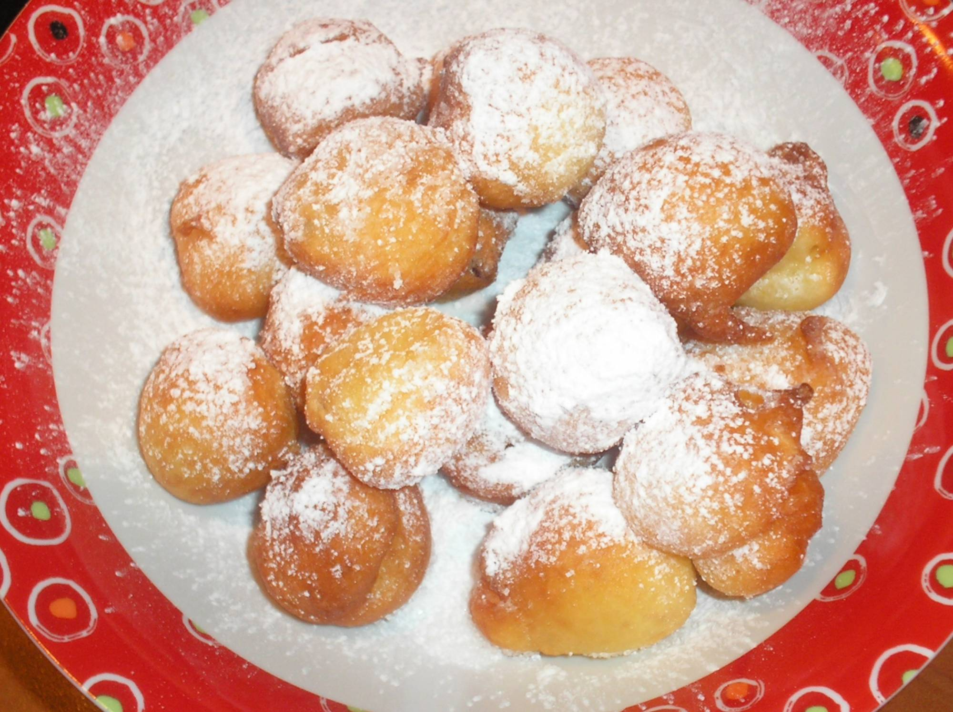
At the top of the pyramid are the foods rich in sugars and unhealthy fats (sweets). Sugar, candies, pastries and beverages such as sweetened fruit juices and soft drinks should be consumed in small amounts and set aside for special occasions.

Slide 16
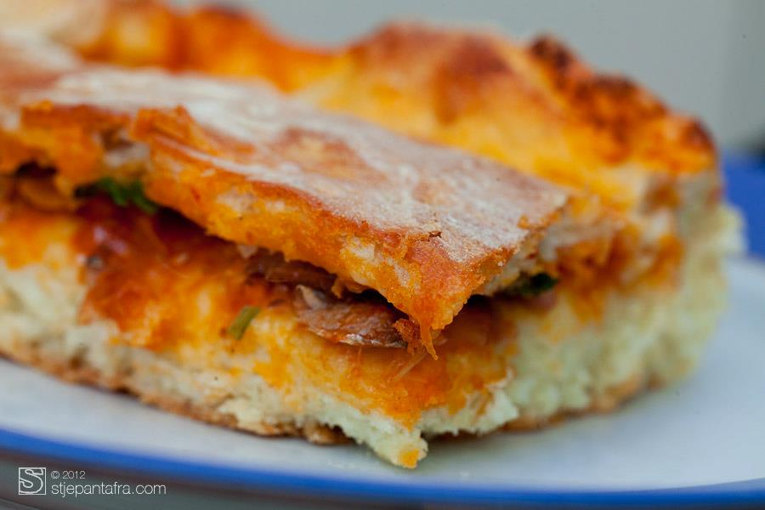
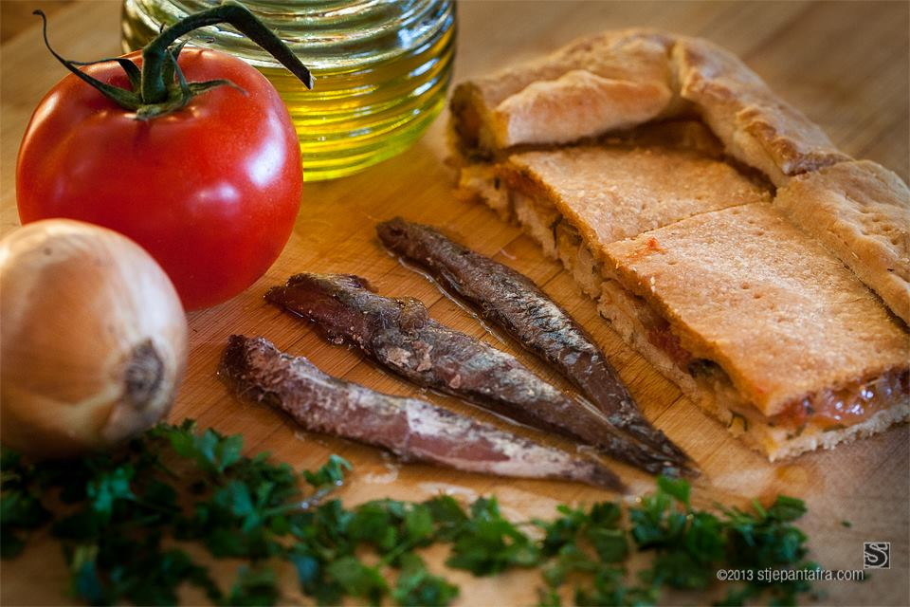
Komiška/viška pogača
The base of Komiža pogača – savoury filled pie is a leavened pastry which contains a combination of red onion, fresh or peeled tomatoes, salted fish such as anchovies or sardines, seasoning and capers to add taste.
Unlike the Komiža pogača, the Vis version has no tomatoes. The preparation of this dish is not complete without olive oil which gives it a special aroma.

Slide 17
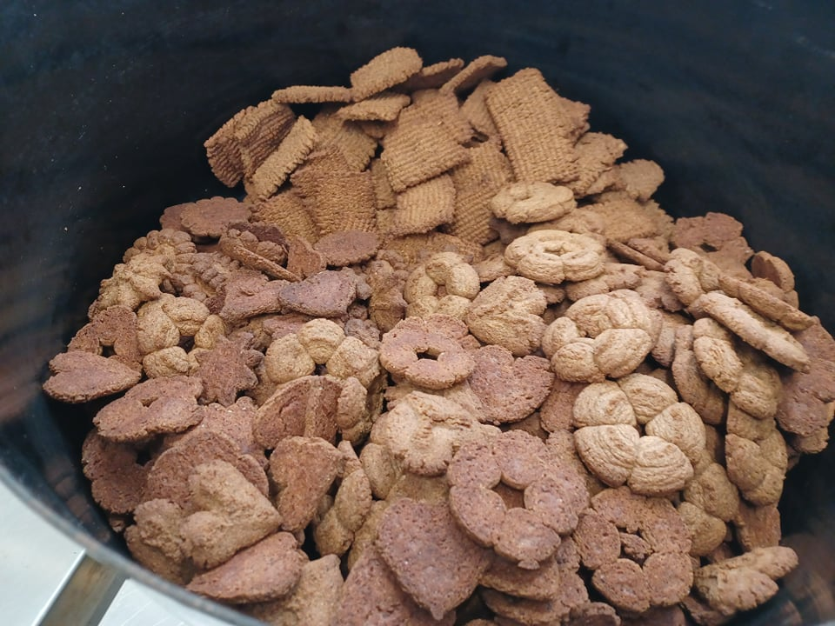
Cookies – corab biscuits
Corab bisciuts that are created at our school, are based on the nostalgic memory of our nona’s biscuits, are only enriched whit corab, wich makes them healthier and even more original.

Slide 18
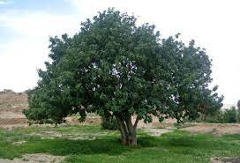
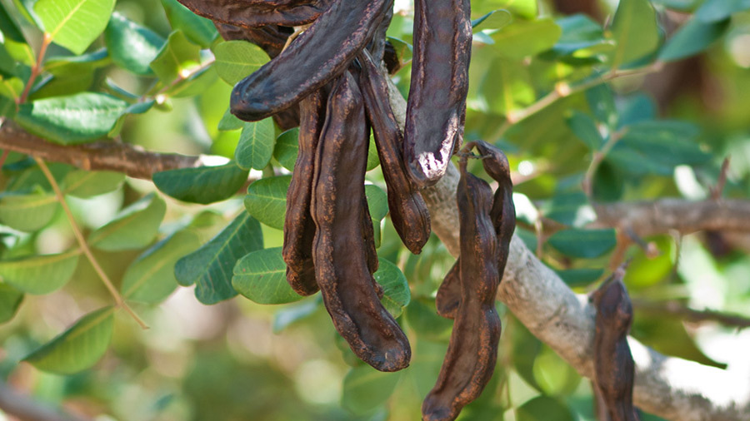
Corab – Ceratonia siliqua L.
evergreen long-life fruit tree
The corab fruit is shiny and dark red seedpod
big source of nutrients with vitamins, minerals and has low protein and fat content
healthy substitute for chocolate
has an important role in medicine
antioxidant, anti-allergic and antibacterial properties( diarrhoea, gastritis, gastroenteritis, anemia, diabetics, asthma, cardiovascular diseases…)
Notes:
Grinding in flour

Slide 19
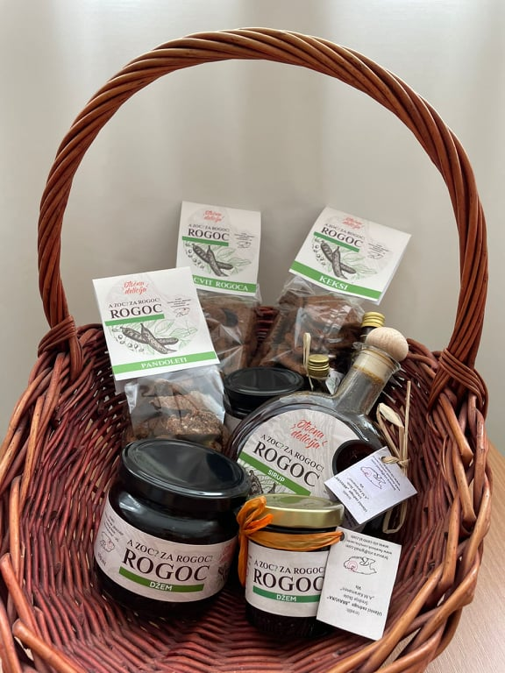
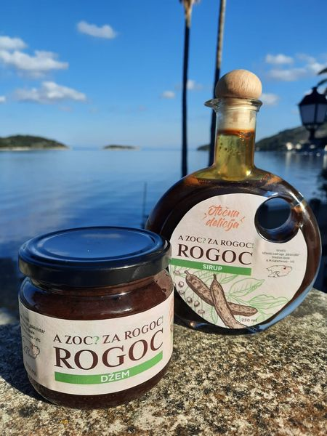

Slide 20
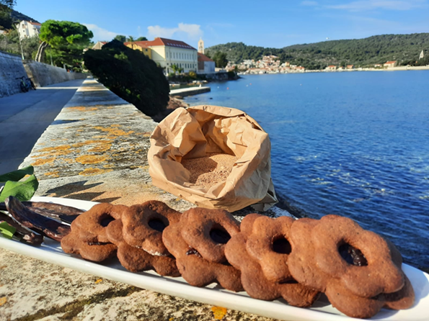
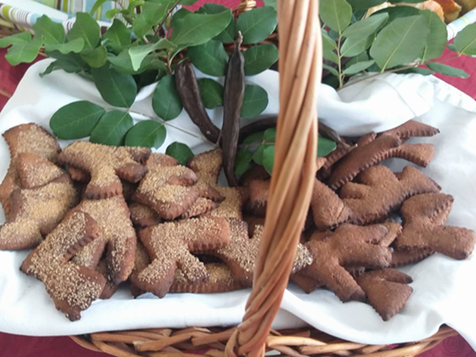
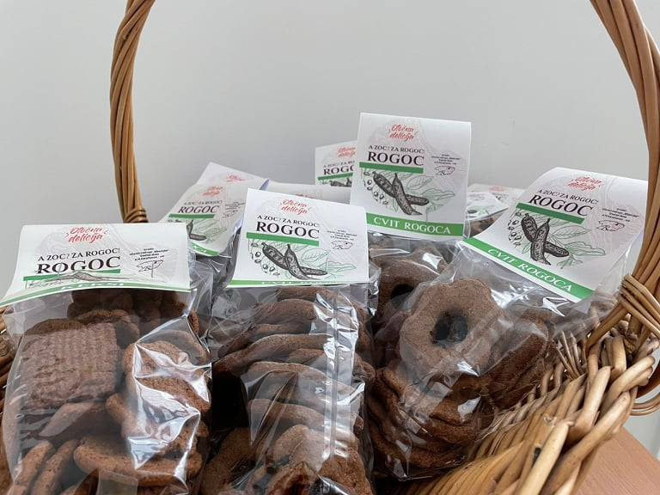
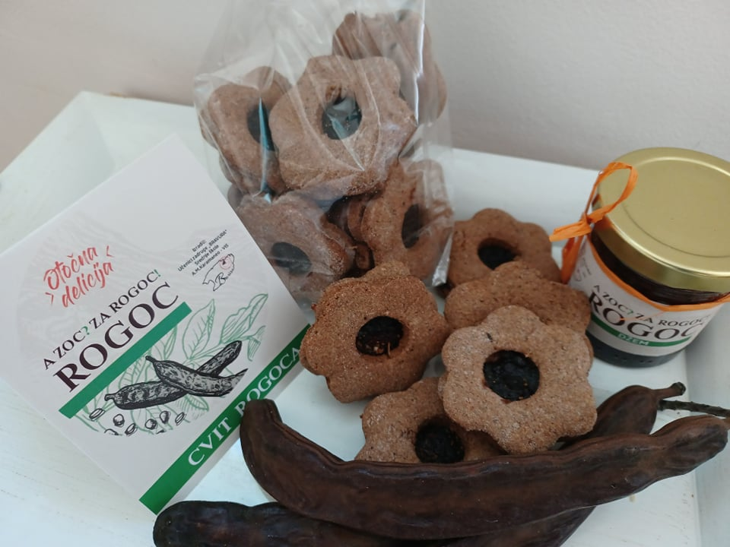

Slide 21
Hippocrates
„Our food should be our medicine and our medicine should be our food”

Slide 22
References
Bach-Faig, A., Berry, E., Lairon, D., Reguant, J., Trichopoulou, A., Dernini, S., . . . Serra-Majem, L. (2011). Mediterranean diet pyramid today. Science and cultural updates. Public Health Nutrition, 14(12A), 2274-2284. doi:10.1017/S1368980011002515
Oliviero, Francesca & Punzi, Leonardo & Spinella, Paolo. (2009). Mediterranean Food Pattern in Rheumatoid Arthritis. Current Rheumatology Reviews - CURR RHEUMATOL REV. 5. 10.2174/157339709790192486.
https://vis-central.com/gastronomija/recepti/pogaca-od-slane-srdele/

Slide 23
Kahoot

Slide 24
Evaluation
https://forms.office.com/r/s0C0UFKHxB

Slide 25
Thank you!

