Slide 1
CHEFS
ONLY GOOD PEOPLE WAS THERE

Slide 2
We were cooking pasta with tomato sauce

Slide 3
And we were cooking Vis and Komiža pogača

Slide 4
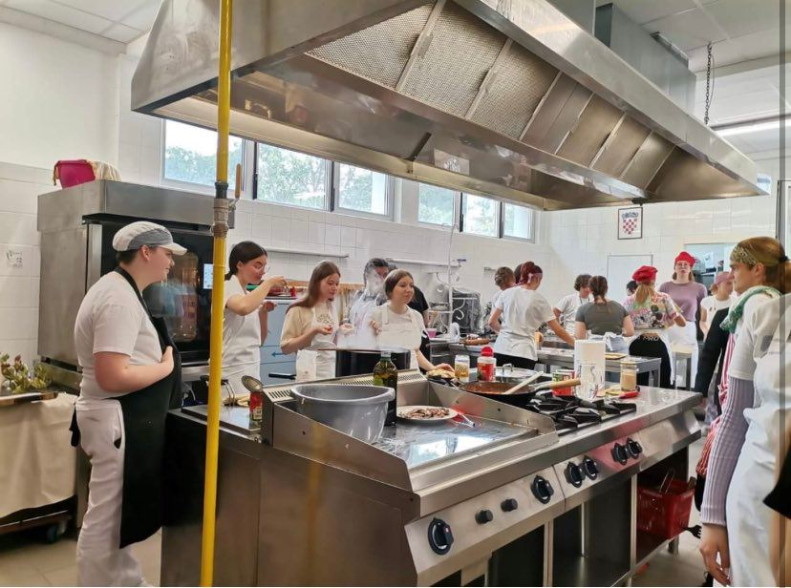
Our pasta ingredients
We have prepared tomato pasta. There were onions, garlic, wine, olives, fish and spaghetti

Slide 5
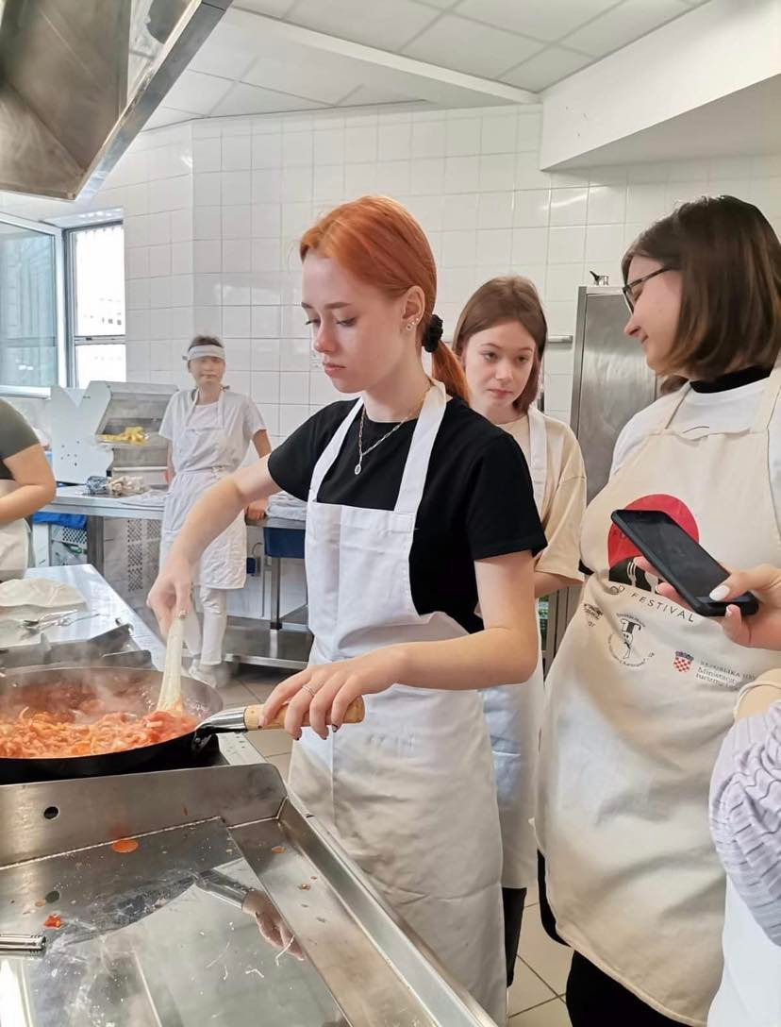
Our pogača ingredients
We have prepared pogača with onions and pogaća with fish and tomatoes. In the first pogača there are dough, olive oil and fried onions. In the second tomatoes, onions, fish and so one.

Slide 6
Is it delicious?
YESSSSSSSS

Slide 7
Why it is nutritive and healthy? What ingrediets make it healthy?
It is healthy, because it contains fish and olive oil and that is unsaturated fats, and also there are vegetables like onions, garlic and tomatoes.

Slide 8
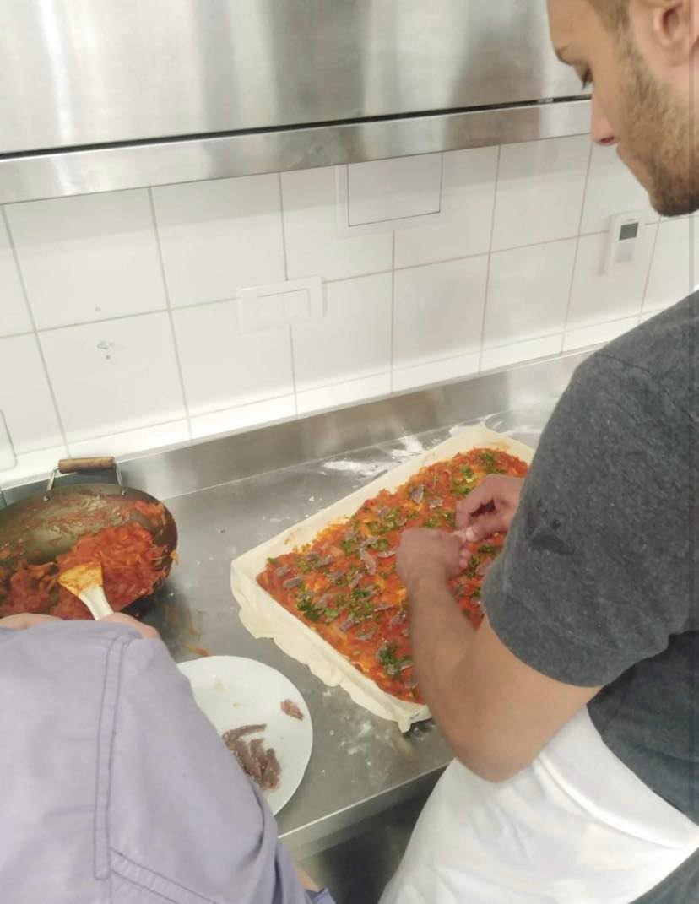
Is it a traditional Vis dish?
It is traditional Vis pie, but Komiža version contains tomatoes and Vis version don't.

Slide 9
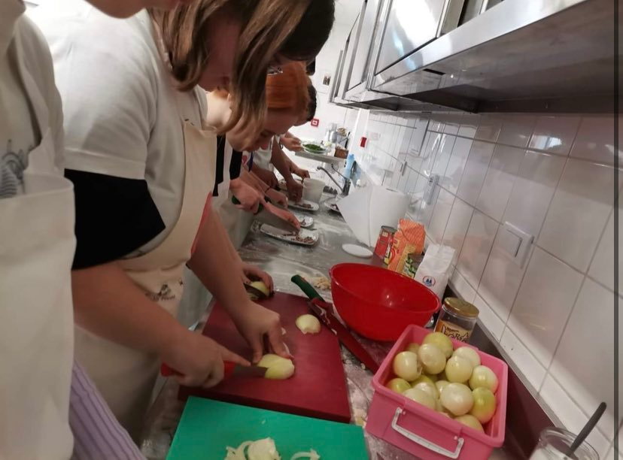
Recommend
We will definitely recommend it to people that like mediterranean or sea food, or to people who like lead a healthy lifestyle

Slide 10
Thank you for attention!
Limuni!!!!!!!!!!

