Slide 1
VANDUO
Erasmus + project ,,Busy Bee”
part Nr.1
Ginkūnai Sofija and Vladimiras
Zubovai school

Slide 2
,,Šiauliai water“
Our objective: to visit „Šiauliai water“ museum and to find out, how drinking water reaches our homes.
2019-12-06 kindergarten groups ,,Gudručiai“ and „Smalsučiai“ visited ,,Šiaulių vandenų” „Water management museum“ and found out how water ends up at our homes. The children learned that waste-water is processed in a device and that way electricity and energy are extracted.
They listened about our town’s water supply, waste-water and saw interesting gadgets. They were very surprised to find out that the water supply is 626 km long!

Slide 3
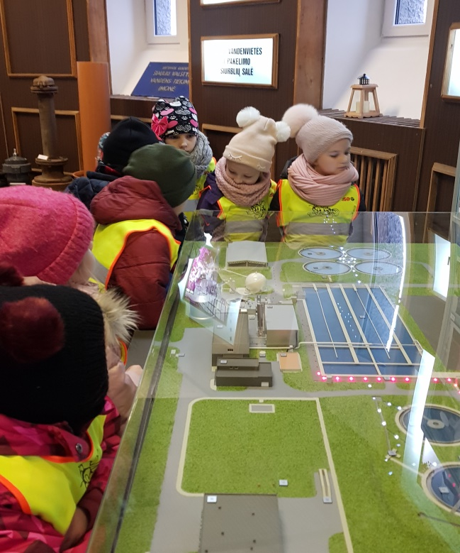
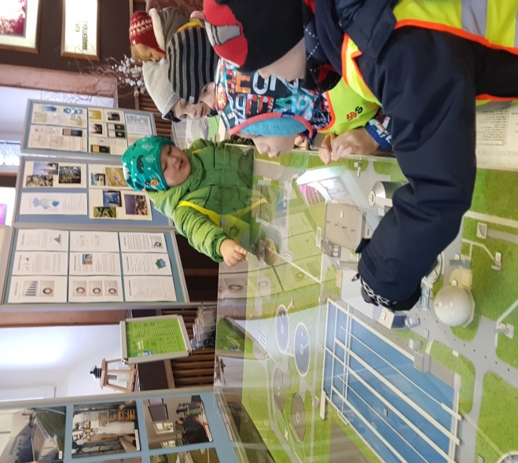
„How does water travel?“
Pre-schoolers in the „Šiauliai water“ museum explored different types of pipe, that help water travelling to our houses. They also analysed the scheme that shows how dirty water is recycled.

Slide 4
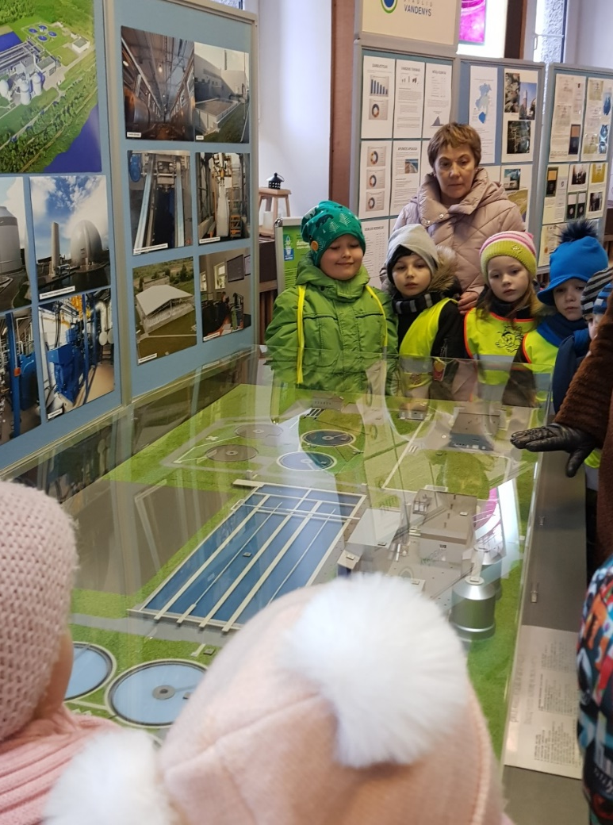
„Water cleaning system“
The children saw the model that presented the process of clean water reaching clean water reservoirs. They were surprised to found out how energy and electricity are being made out of extracted algae.

Slide 5
After a lot of incredible experiments the little ones understood that water can turn into: a cloud, rain, ice, dew, frost, fog and hail!

Slide 6
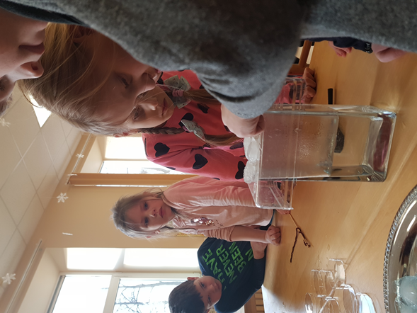
The “Rain drops“ Experiment
Pre-schoolers and their teachers did an experiment and understood how are rain drops formed. They poured hot water into a glass bowl and held it over steam with ice cubes. ,,We made a cloud!” The kids observed steam change into water drops which fell into the bowl. They compared naturaly formed rain and the rain they made themselves.

Slide 7
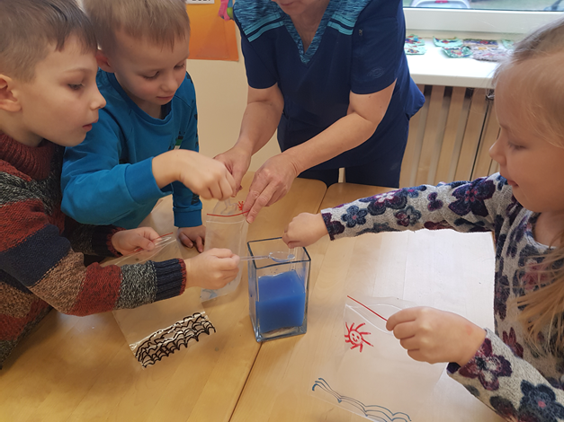
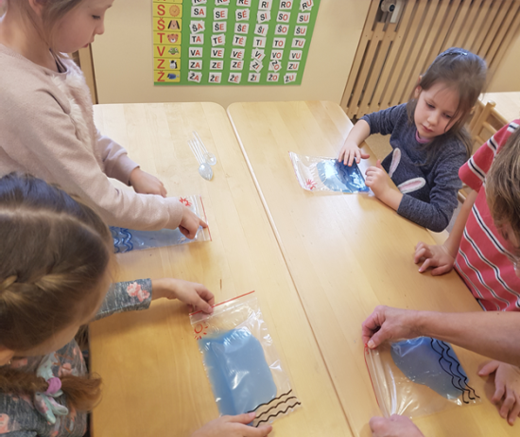
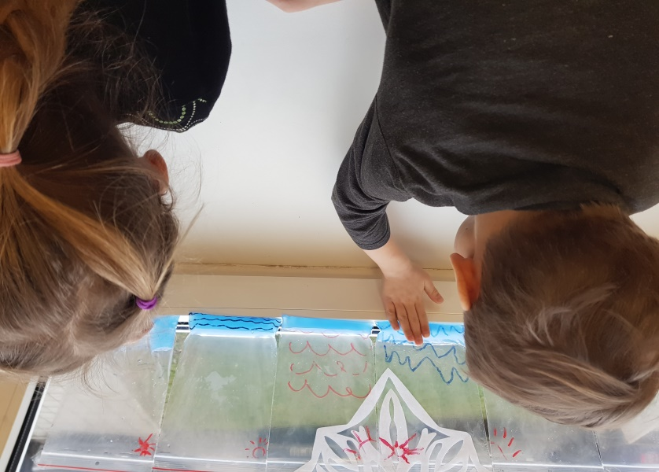
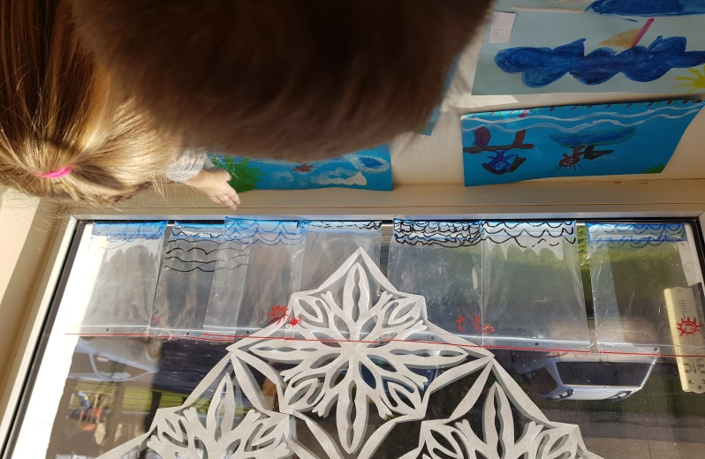
“Rain in a bag”
Objective: to find out water secrets. How does water turn into steam and returns into water again? When the sun warms up water, it steams up and turns into little clouds. When weather cools down, water drops come back to the “sea”. This process is called ,,the cycle of water” .

Slide 8
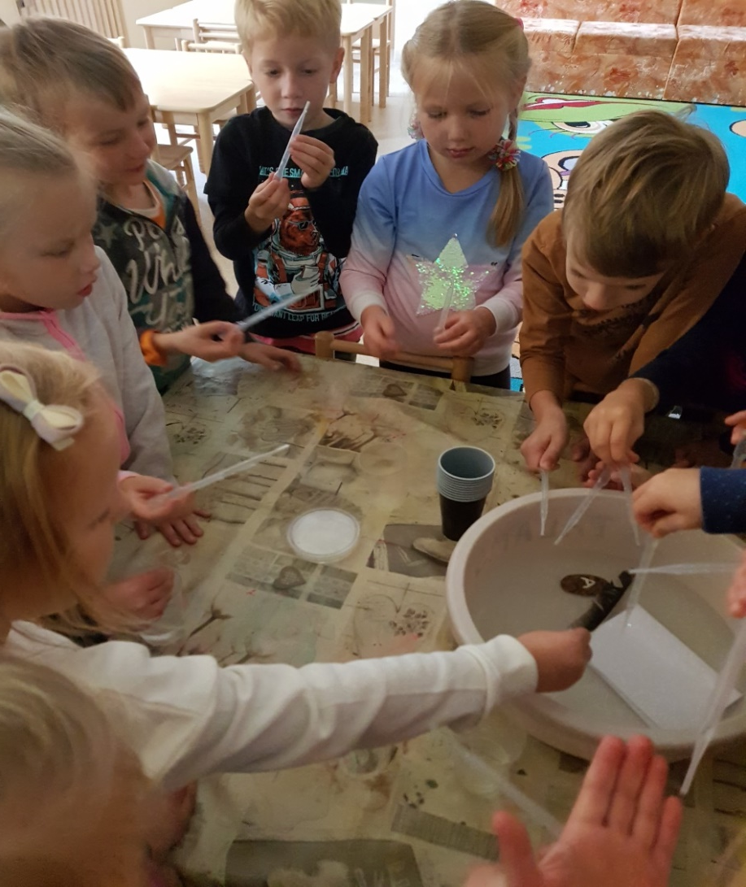
Children were “water drops” themselves and tried to find out if umbrella will get wet. Kids observed, how water runs down the umbrella.

Slide 9
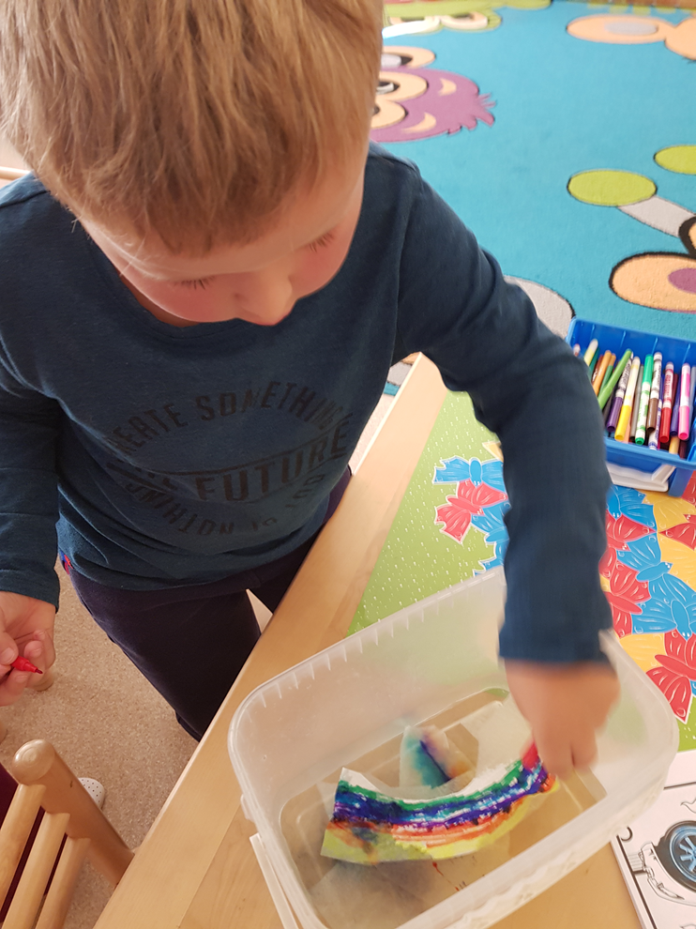
„Colours of the rainbow“
Objective: to find out the relationship between rain and rainbow. Students learned, that when sun shines through the water drops (after rain), it forms the rainbow. Children saw, how rainbow colours dissolve in the water and how water is important to the rainbow.

Slide 10
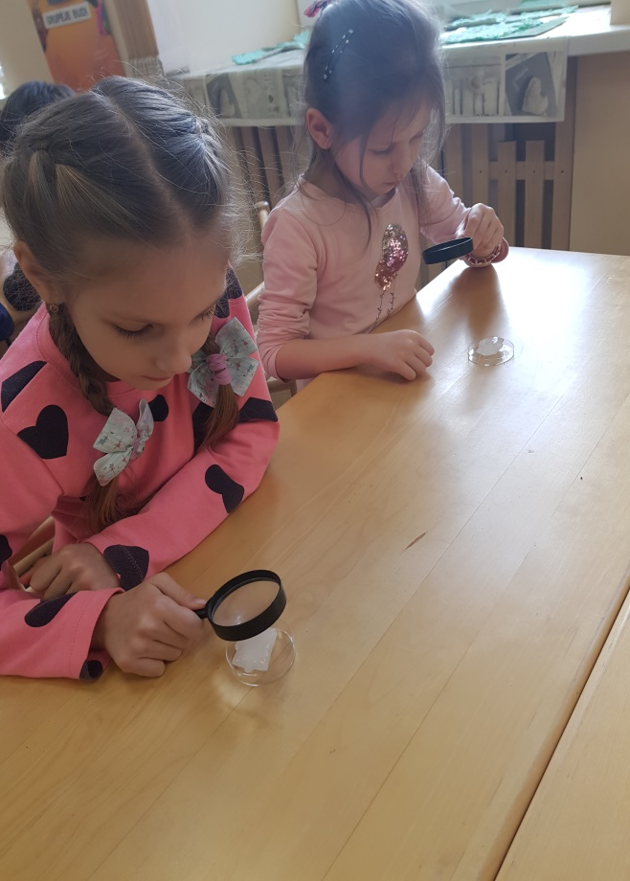
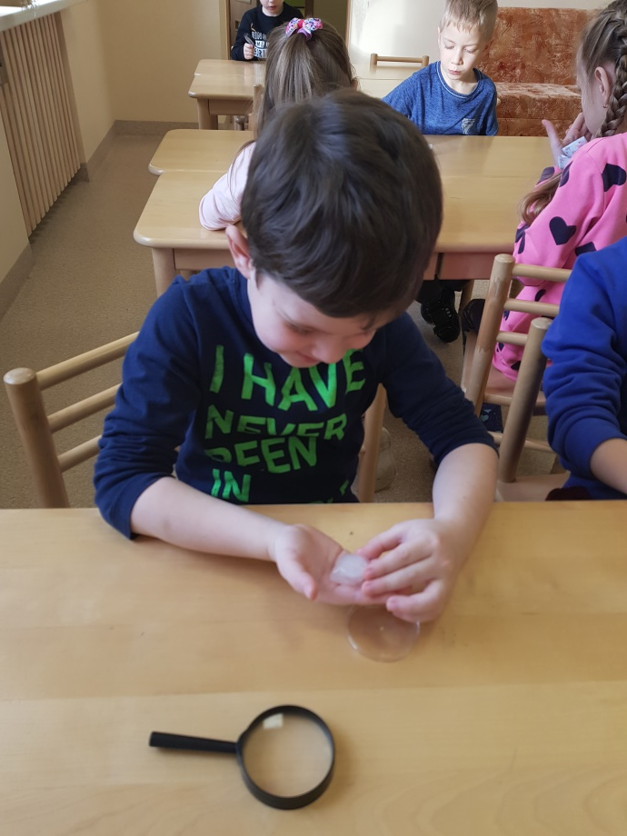
“Ice cubes”
Objective: to understand, that ice is also water. Students studied ice cubes and inspected how do they change the shape. They stated that ice is cold, hard and soluble.

Slide 11
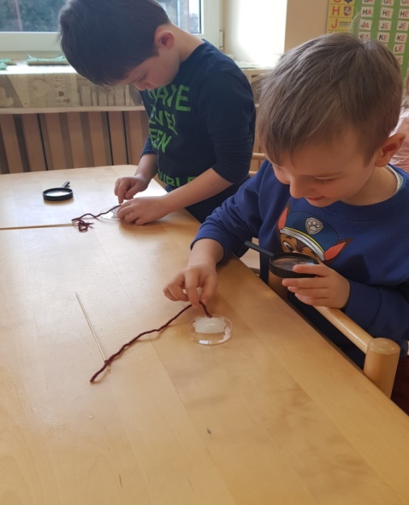
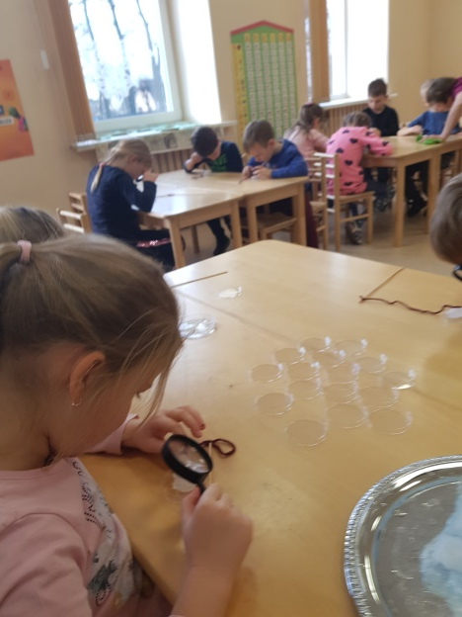
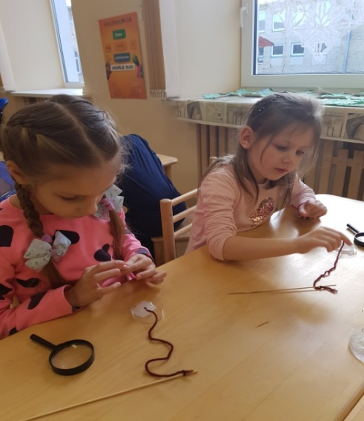
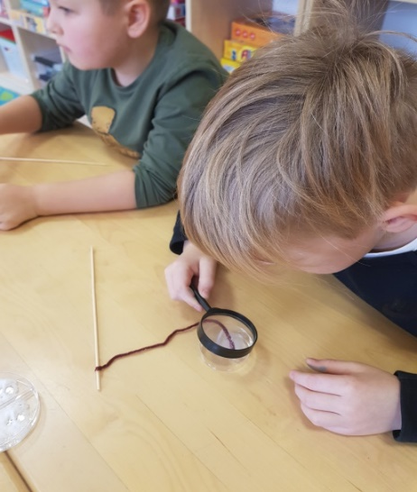
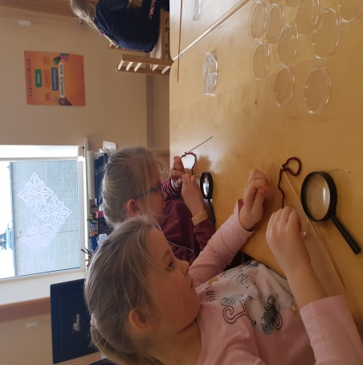
“Rod of ice”
Objective: to find out what happens, when you sprinkle salt on ice and how it changes the shape. Salt makes ice melt, but also it “eats” the cube. When you put salt on ice, the thread instantly sticks to ice cube. Students observed how fast ice cube melted and turned into water.

Slide 12
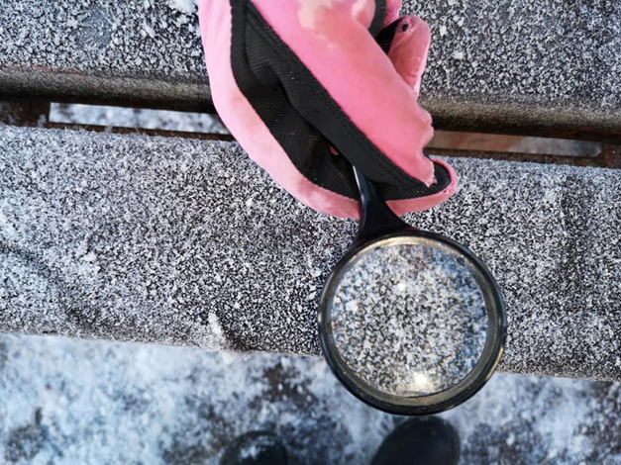
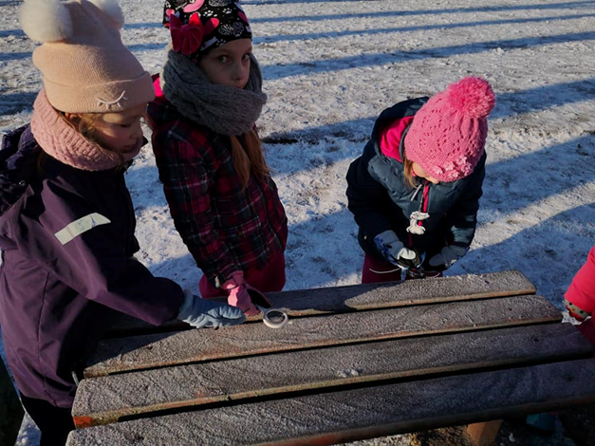
„Snow“
Objective: to investigate another state of water – snow. Children looked through the magnifier at snowflakes.

Slide 13
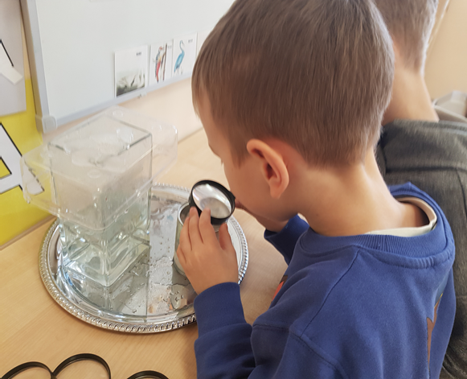
„Frost“
Objective: to understand frost forms. During the study frost appeard and with time was more and more visible. In about 30 minutes the entire can was covered by frost. Kids were interested in experiment: they enjoyed touching frost and understood, that frost is also water.

Slide 14
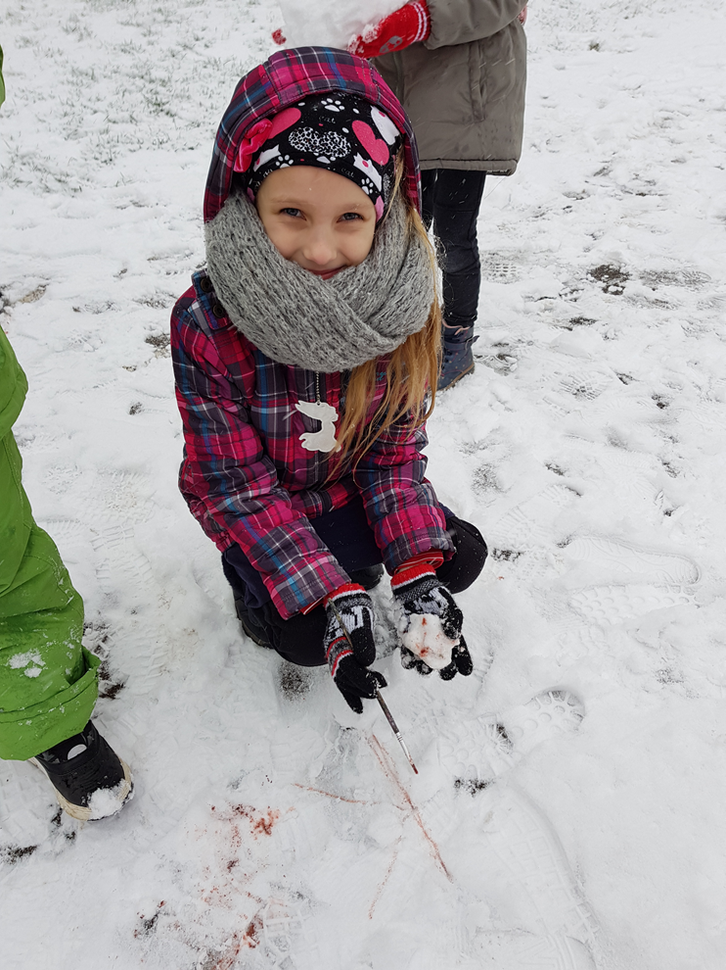
„Painting on snow“
Objective: to learn characteristics of snow. Children understood, that snow is wet, cold and it can be formed into a ball.

Slide 15
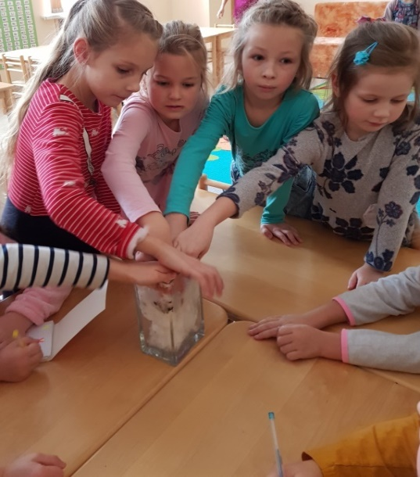
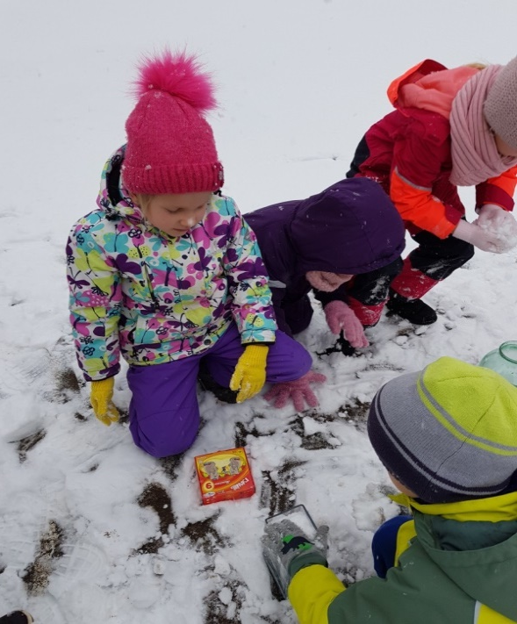
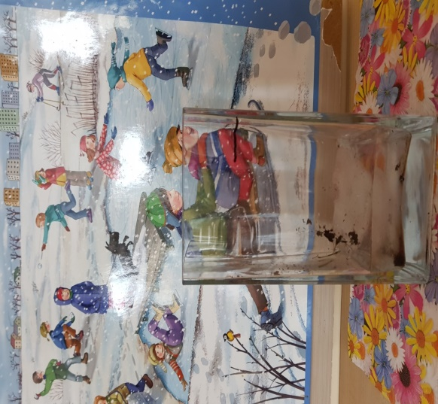
„Melting the snow“
Objective: to see how much water contains the snow. Children saw that there was more snow than water. Children brought snow from outside and put it in the bowl. Students saw how snow melted and how much time did it take. They also understood, that snow is one of the states of water.

Slide 16
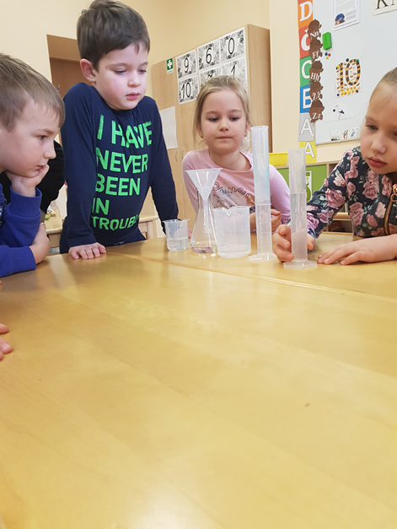
“Water”
Objective: to find out how does water look like when you put it into different containers. Children poured the same amount of water into different containers and saw, that the same amount of water may look completely different if you pour it in a high and narrow or in a wide and low tube.

