Slide 1
”DZĪPARIŅŠ” OGRE
LATVIA

Slide 2
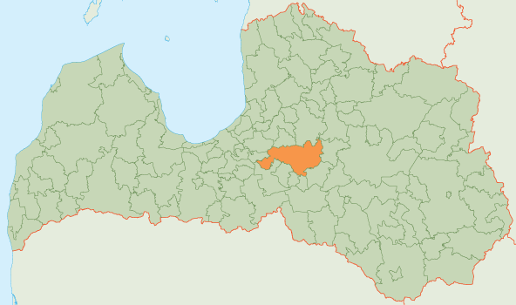
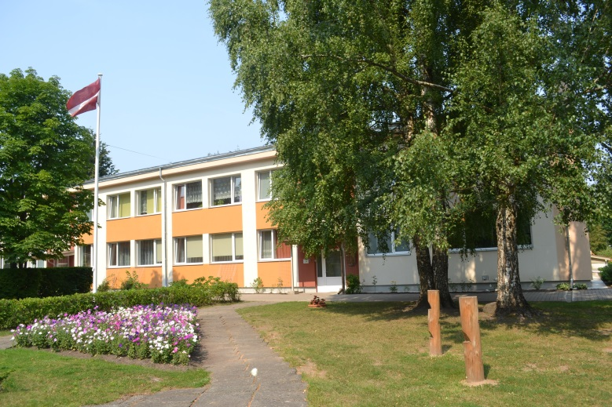
Town Ogre is situated 36km from the capital of Latvia Rīga. It is crossed by two rivers-Ogre and Daugava.
Ogre and municipality Ogre are marked orange on the map.
Kindergarden“Dzīpariņš” was established in August 1971. It is located next to the nature park «The Blue Hills of Ogre» which is a favourite place to relax for those who love an active lifestyle.

Slide 3
Educational programs in kindergarden
Since 2011 Ogre Kindergarden “Dzīpariņš” provides the general pre-school educational program, licence Nr. V- 3859, according to the decision of the Governmental organisation of the Quality of education Nr. 567 - v “About the issue of licence for realisation the general education program”. The licence was issued based on the example of program worked out of the Ministry of Education and Science to realise an appropriate educational program.

Slide 4
Educational programs | Code | Licence Nr. | Date
General pre-school educational program | 01011111 | V- 3859 | 2.02.2011.
There are 11 groups in the kindergarden with 230 children from age of 1,5 to 7. There work 30 teachers. All staff has an appropriate professional qualification. Teachers continue to develop their qualification, skills and knowledge.

Slide 5
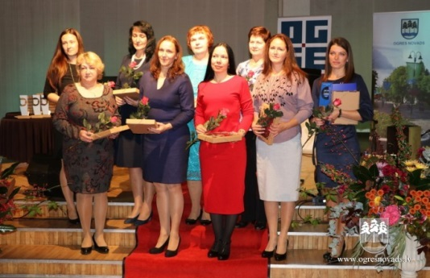
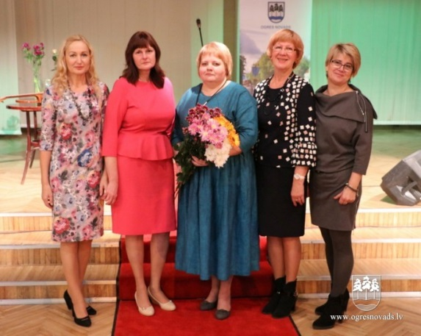
Teachers of the Year 2017 and 2018

Slide 6
Teachers distribution according to their work experience (in years)

Slide 7
THE MAIN AIM OF EDUCATIONAL INSTITUTION
Mission:
Professional, creative, efficient team- creating the kindergarden as a modern pre-school education institution where children acquire development of a personality, individuality, grow and learn in a multifunctional environment of games.
Vision:
Modern, efficient, democratic, human pre- school with game-oriented lessons, highly evaluated personality of each child to promote a positive self-awareness and respect to each other based on the cooperation.

Slide 8
SPECIAL OFFERS OF KINDERGARDEN
Ogre pre-school educational institution“Dzīpariņš” is the only pre-school institution in municipality Ogre, with a Waldorf pedagogical group since 2000, with children from age 3 to 7. Parents choose this group to educate a free, responsible and healthy human considering him/her as a intellectual, all the time in the development beeing creature.
Children have an opportunity to develop themselves in different afterschool clubs which can change every year depending on the demands and offers. In schoolyear 2017/2018 kindergarden offered such afterschool clubs:
Folk dances– attended by 36 children;
English–56 attended by children;
Gymnastic for children with elements of games and joga –attended by 64 children.

Slide 9
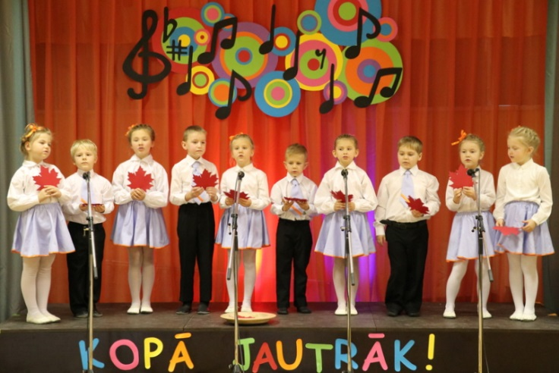
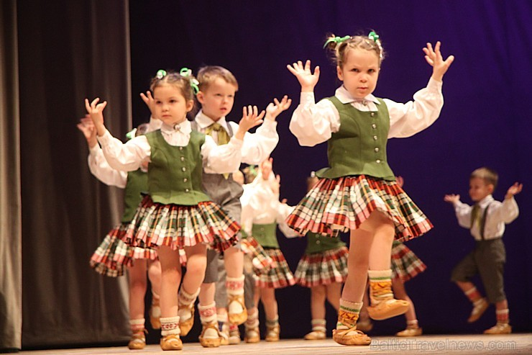
Those opportunities are very well evaluated by parents and children themselves.

Slide 10
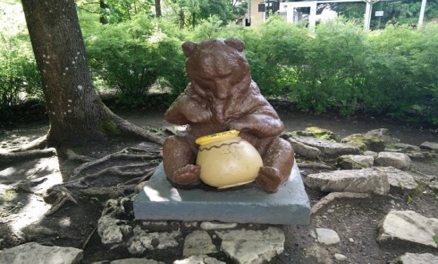
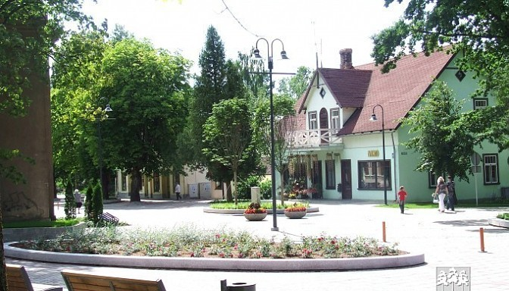
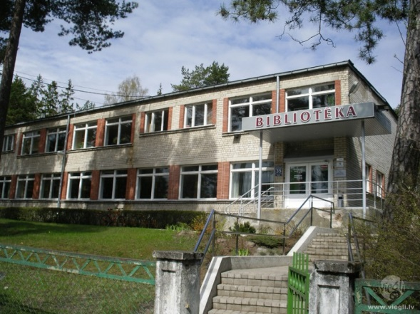
EVENTS IN OUR KINDERGARDEN
Excursions in the town
«The bear of Ogre»
Ogre town
Ogre library

Slide 11
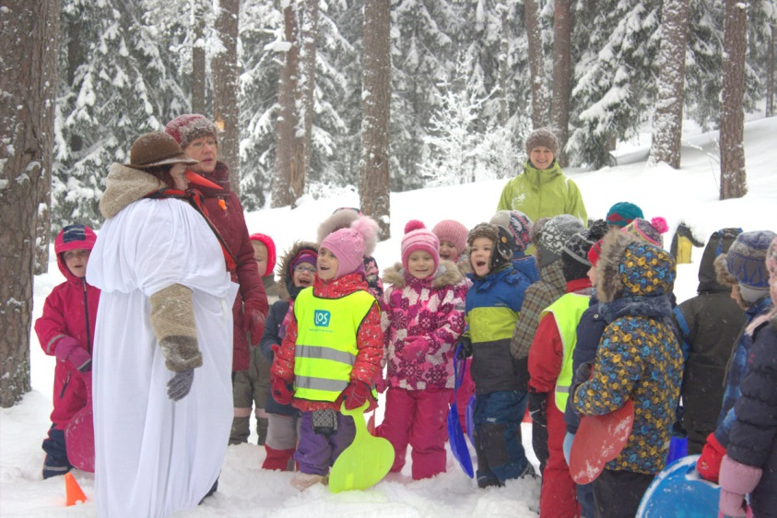
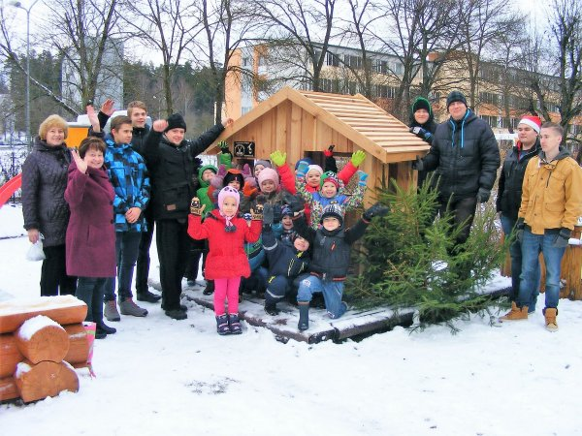
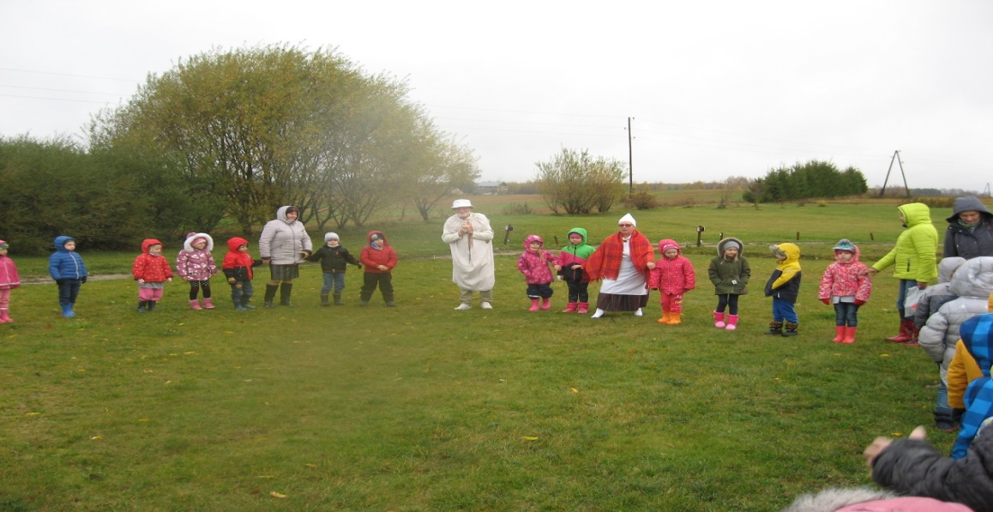
Trips, activities, lessons in the forest, in the nature park «The Blue Hills».

Slide 12
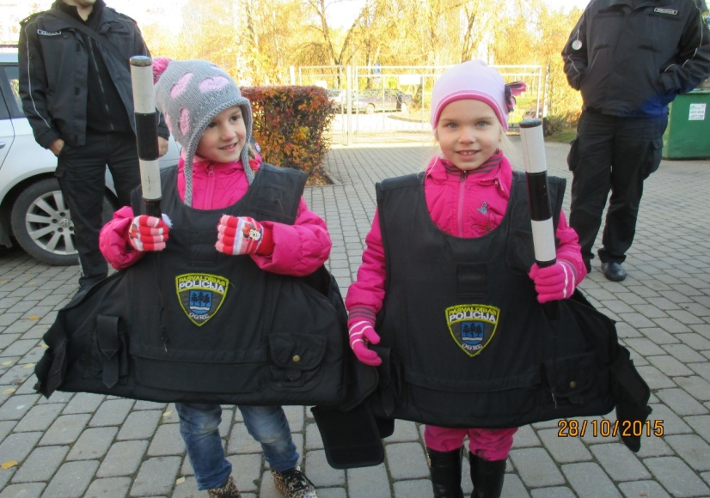
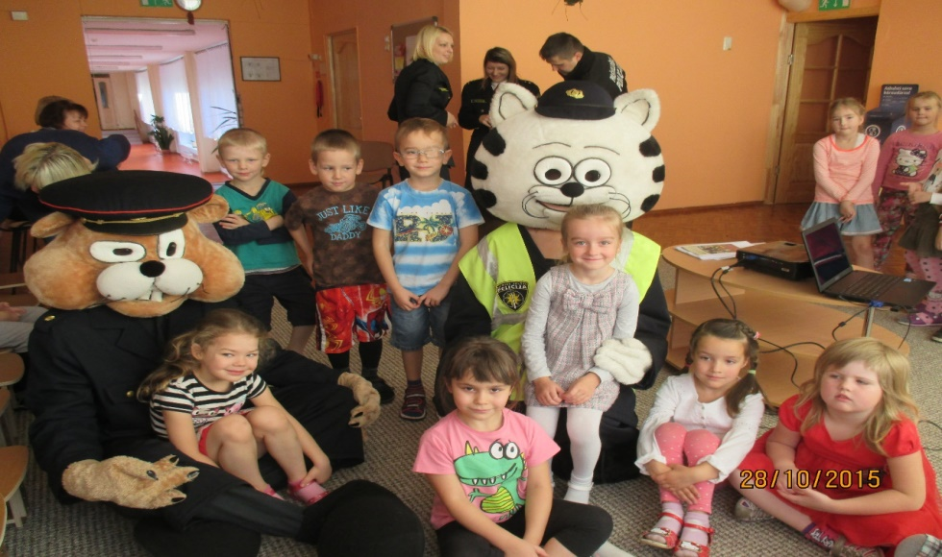
We learn about different jobs together with parents

Slide 13
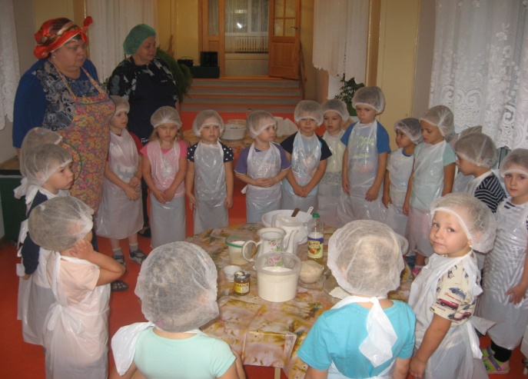
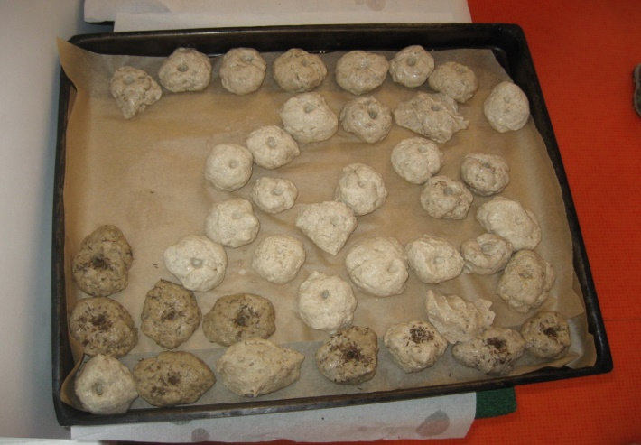
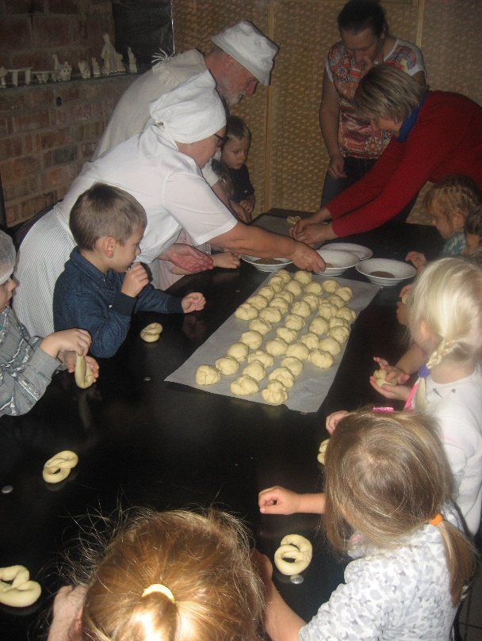
Creative workshops in kindergarden and in enterprises - “Let’s bake cookies together”, “A light flame of a candle”, “We are baking bread...”

Slide 14
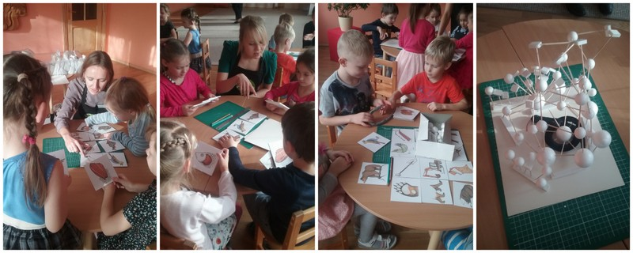
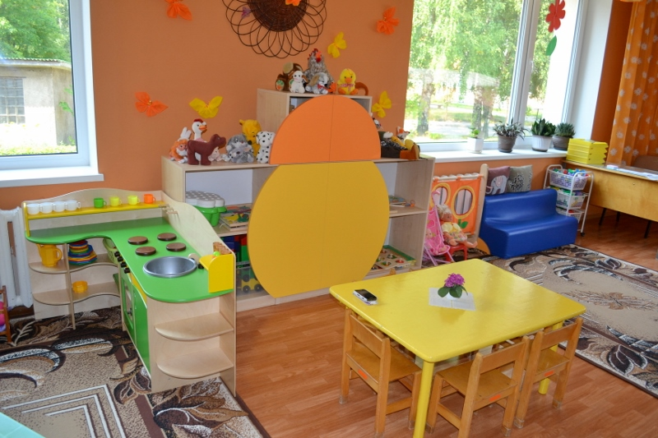
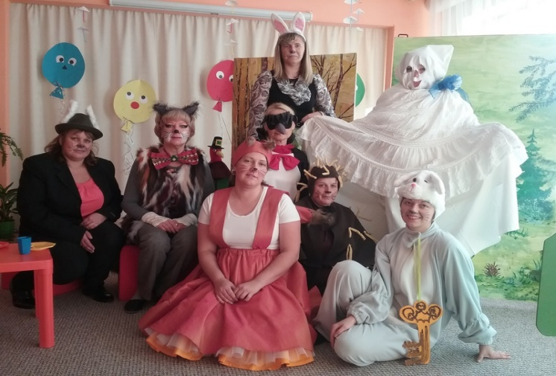
Activities to promote a healthy lifestyle- clean hands, teath, healthy food, safety
Parents cooperate with educational institution – help with materials, improve the environment and organise activities.

