Slide 1
Estonian traditional dances and instruments by Tarvastu Gymnasium

Slide 2
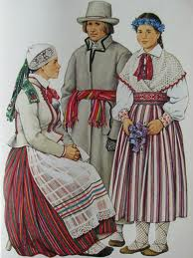
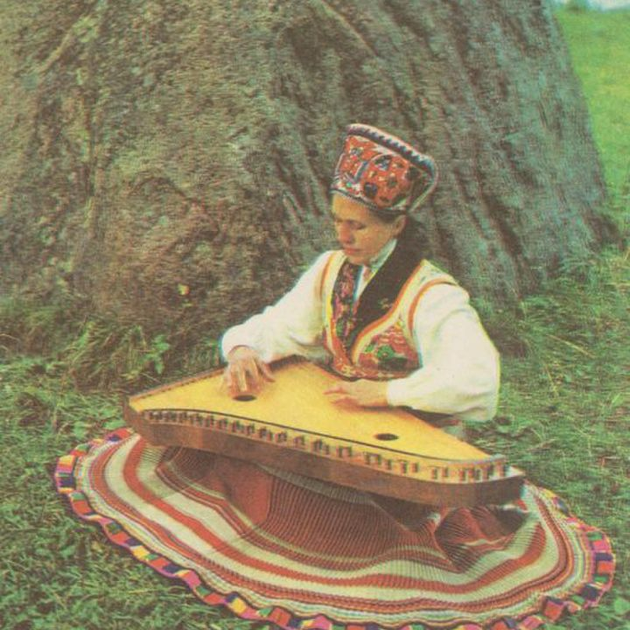
Nõianeitsi – Witch maiden
https://youtu.be/hHcpdPMgU0w
Kannel

Slide 3
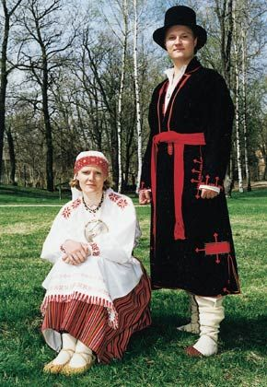
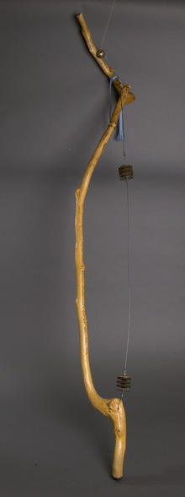
Mulgi polka – Mulk’s polka
https://youtu.be/eSw5T_i-AuY
Jauram –
A bow with
metal rattles

Slide 4
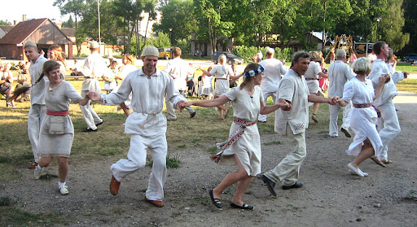
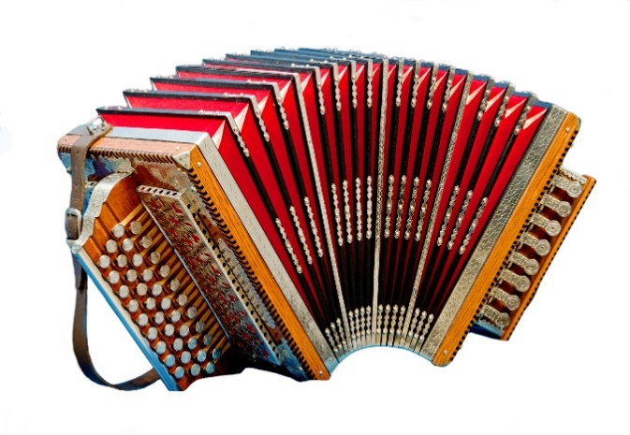
Reilender
https://youtu.be/7_TUcYutyyk
Button accordion

Slide 5
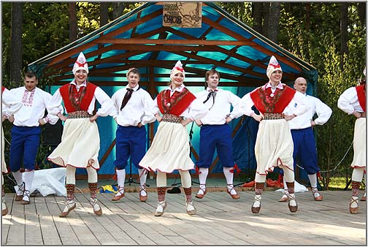
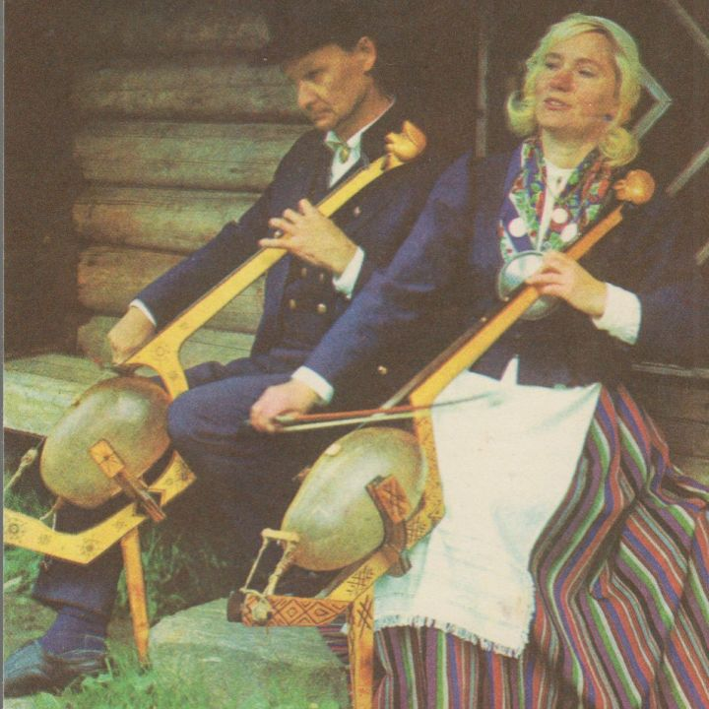
Kaera-Jaan
https://youtu.be/vovofImarg8
Bumbass

