Slide 1
Erasmus + Project
Read to Animate
EVALUATING RESULTS

Slide 2
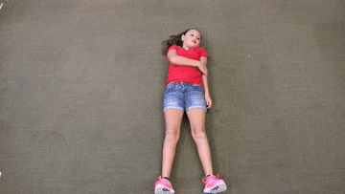
WINNERS
VOTES
For PIXILATION
PIXILATION
Category

Slide 3
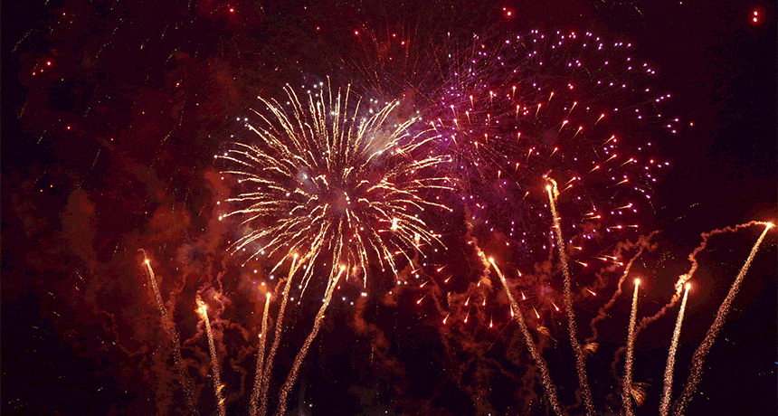

Slide 4
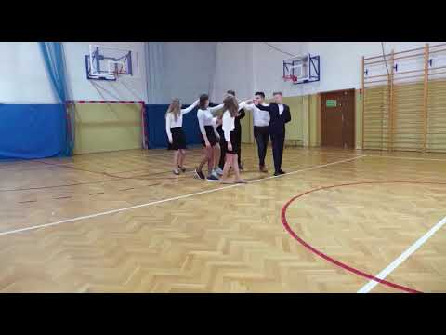
THIRD PLACE
440 POINTS
POLAND
POLONEZ

Slide 5
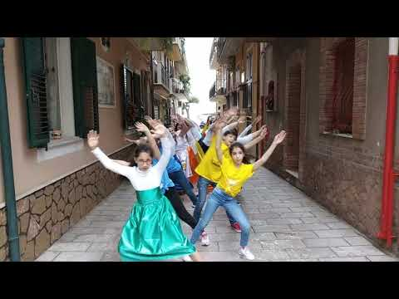
SECOND PLACE
476 POINTS
Italy
"Happy Sicily"

Slide 6
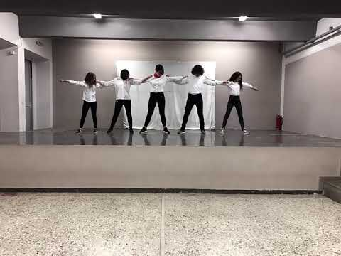
FIRST PLACE
497 POINTS
GREECE
"Sirtaki"

Slide 7
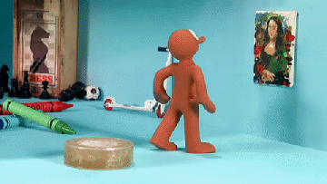
WINNERS
VOTES
For CLAY ANIMATION
CLAY ANIMATION
Category

Slide 9
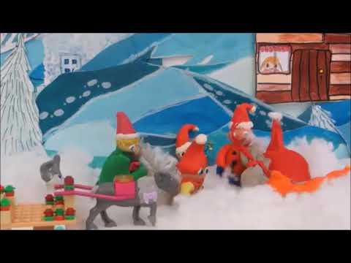
THIRD PLACE
453 POINTS
Estonia "PÄKAPIKUD"

Slide 10
SECOND PLACE
473 POINTS
Bulgaria
"The legend of Khan Kubrat"

Slide 11
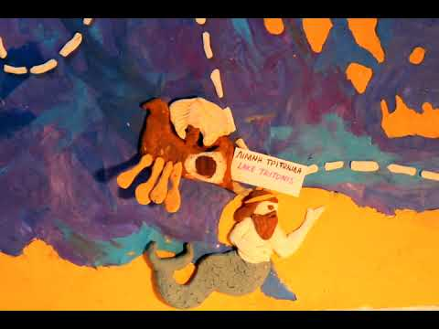
FIRST PLACE
496 POINTS
Greece "Argonautica"

Slide 12
WINNERS
VOTES
For BOOK TRAILER
BOOK TRAILER
Category

Slide 14
THIRD PLACE
459 POINTS
Greece "The difference makes no difference"

Slide 15
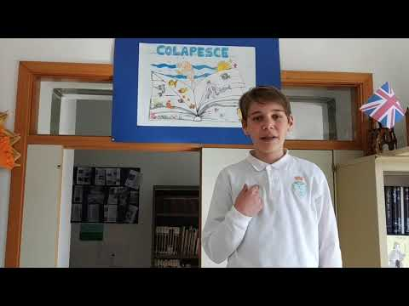
SECOND PLACE
469 POINTS
Italy "The History of Colapesce"

Slide 16
FIRST PLACE
499 POINTS
Italia "Pinocchio"

Slide 17
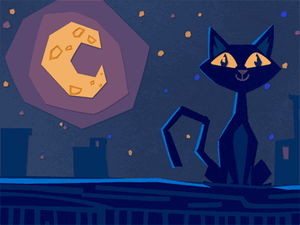
WINNERS
VOTES
For PAPER CUT-OUT
PAPER CUT-OUT
Category

Slide 19
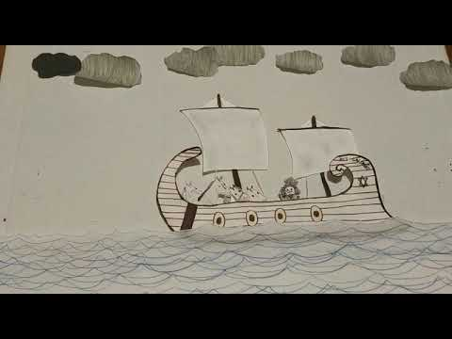
THIRD PLACE
450 POINTS
Portugal "A Lenda dos Cavalos de Fão"

Slide 20
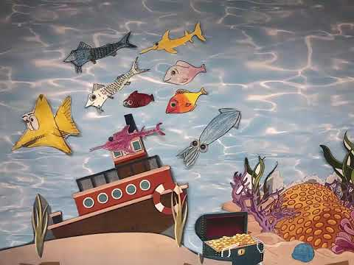
SECOND PLACE
463 POINTS
Greece
"The Trianglefish"

Slide 21
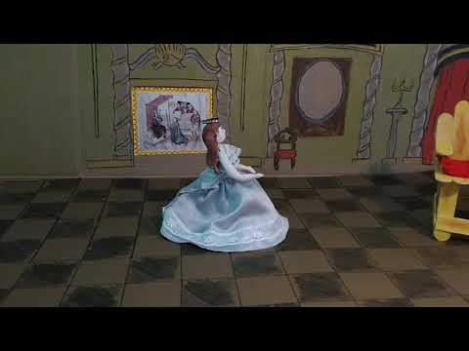
FIRST PLACE
483 POINTS
Italy
"Pizza Margherita"

Slide 22
COUNTRY
WINNERS
ANIMAION
THE BEST ANIMATION FROM EACH COUNTRY

Slide 24
POLAND - “Polonez” - 440 ♥
PORTUGAL - Portugal "A Lenda dos Cavalos de Fão" - 450 ♥
ESTONIA - "PÄKAPIKUD" - 453 ♥
BULGARIA - The legend of Khan Kubrat - 473 ♥
GREECE "Sirtaki" - 497 ♥
ITALY - "Pinocchio" - 499 ♥

