Slide 1
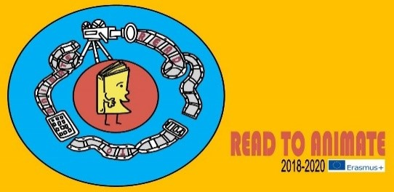
Estonian animators The first and latest
Tarvastu, May 2021

Slide 2
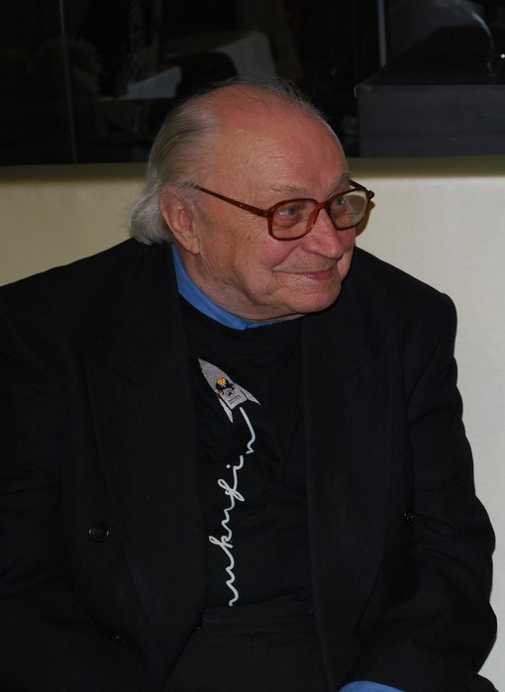
HEINO PARS
Estonian animation
GRAND OLD MAN
Notes:
Everybody knows his legendary animation character Operator Kõps. Almost all his animations he made for children.
Heino pars was very fascinated with the life of insects when he was a child.

Slide 3
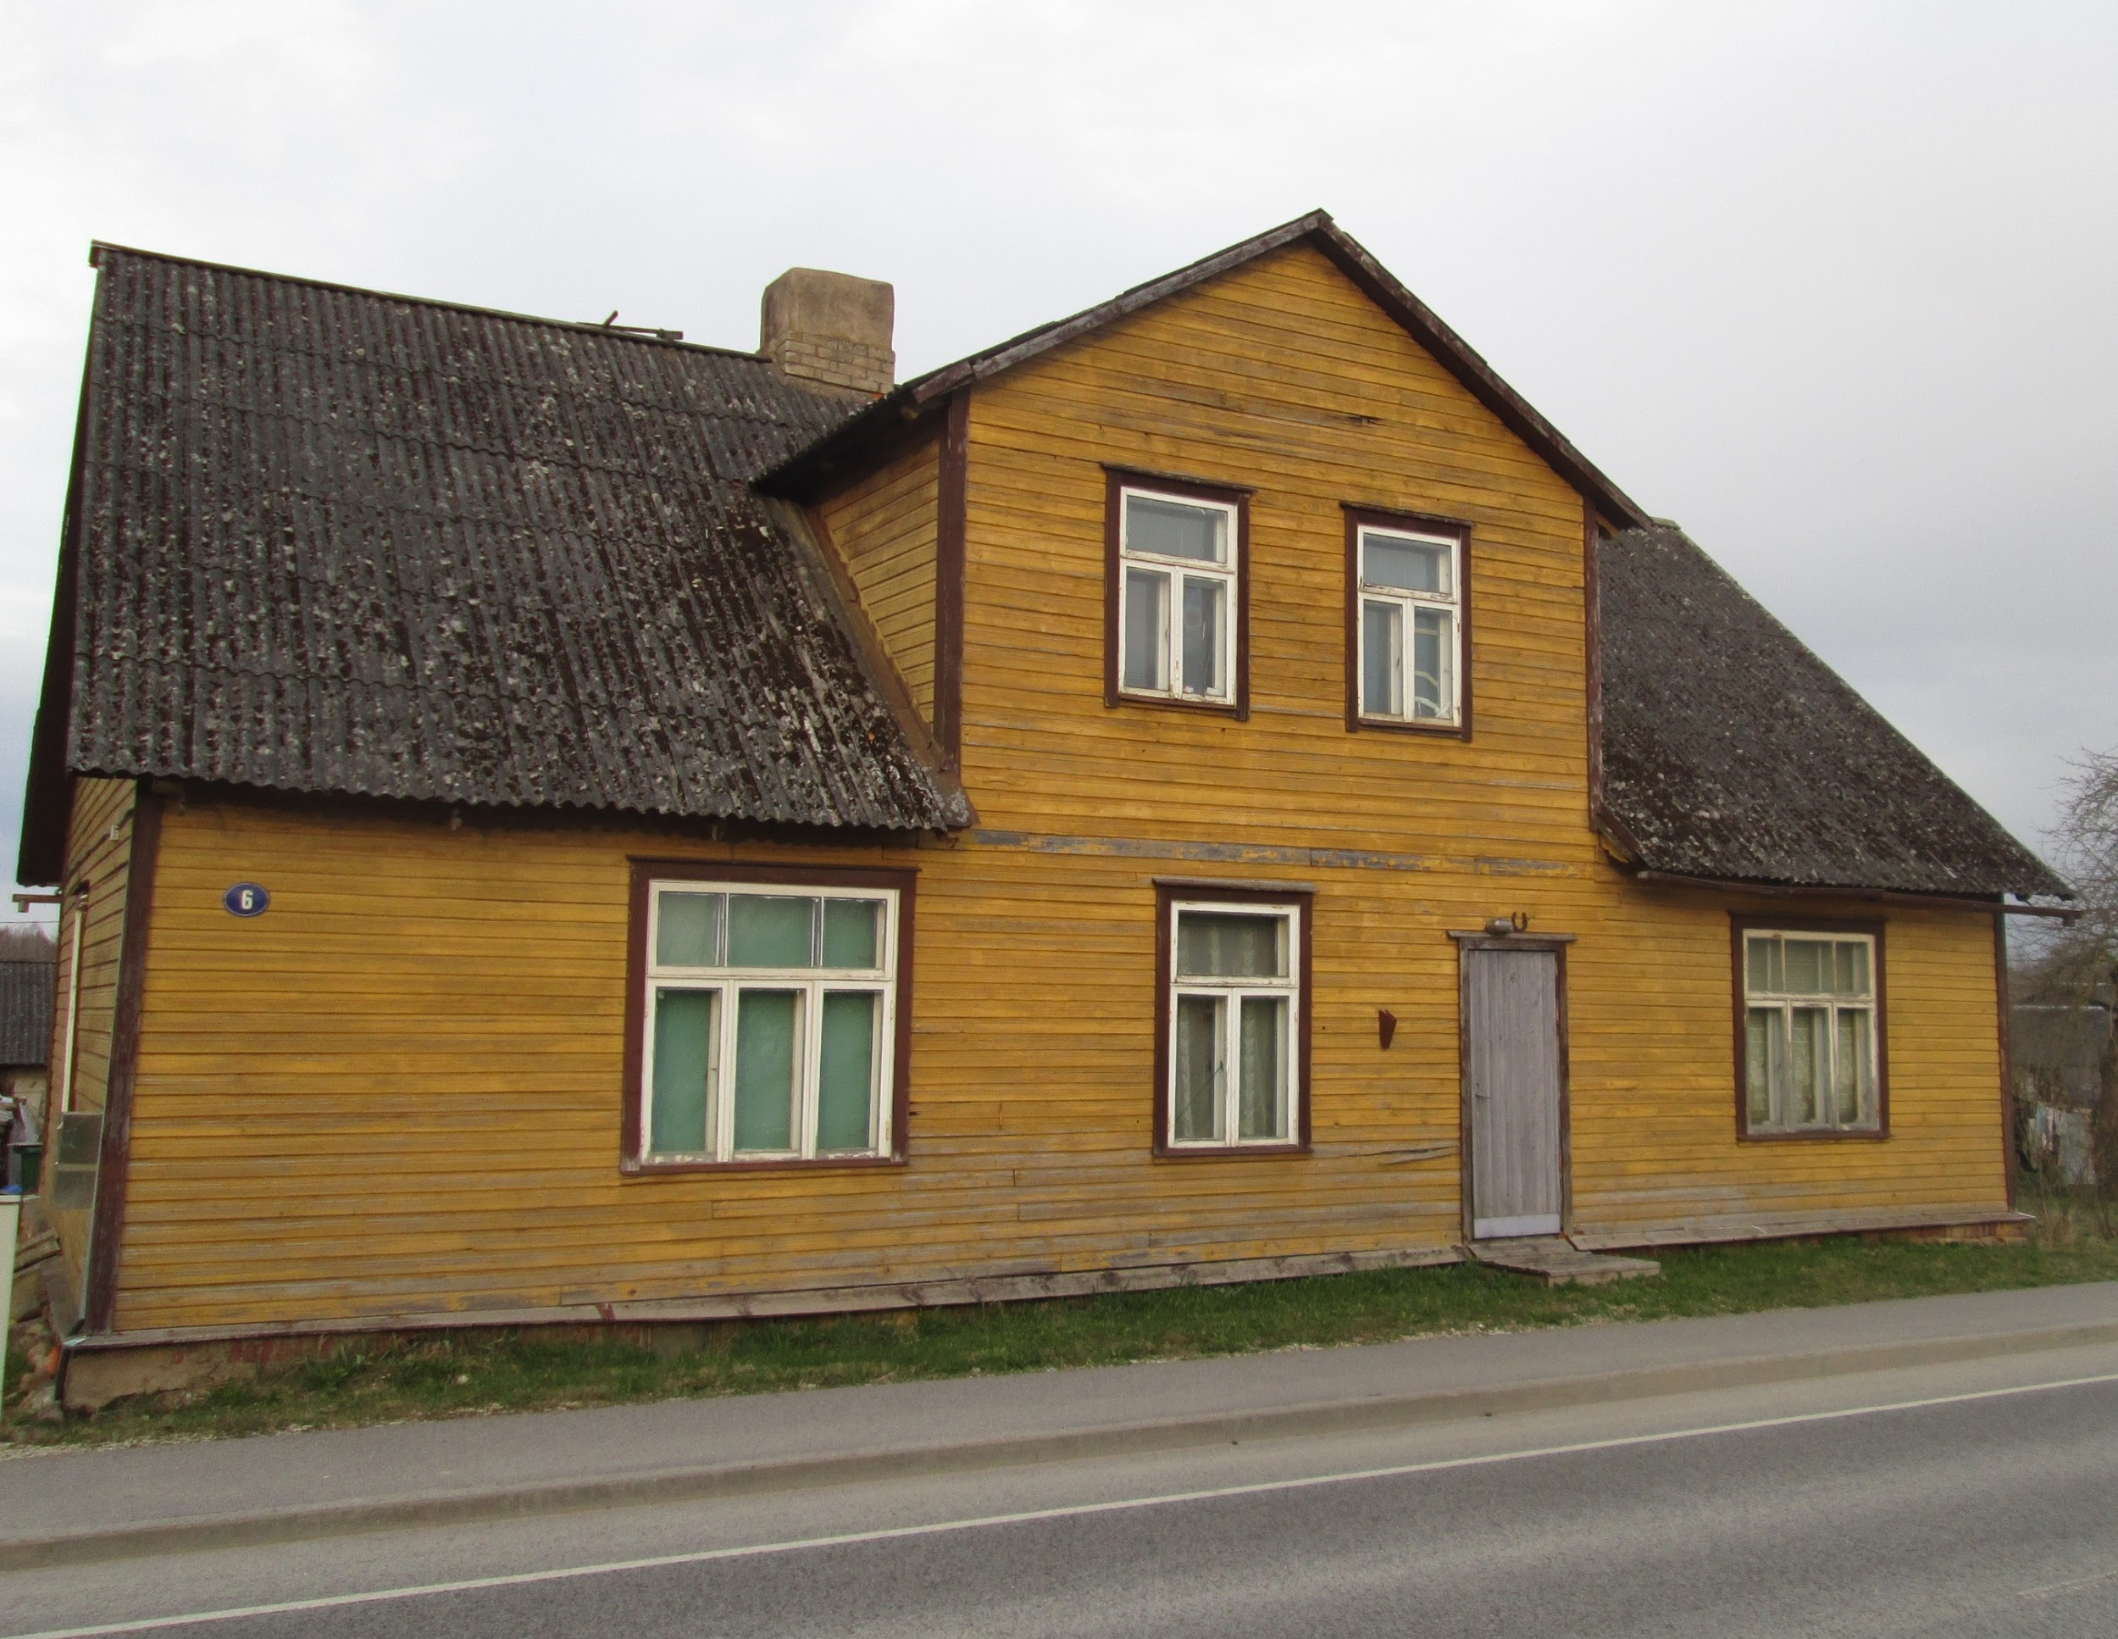
HE WAS BORN IN TARVASTU
He lived in Mustla in the childhood. It’s where our school is. His childhood home was a huge inspiration for his future creative work.
He was very interested in nature.
Notes:
He lived in Mustla in his childhood. His childhood home was an inspiration for his future creative work.
Heino Pars is the man, who turned insects into actors..

Slide 4
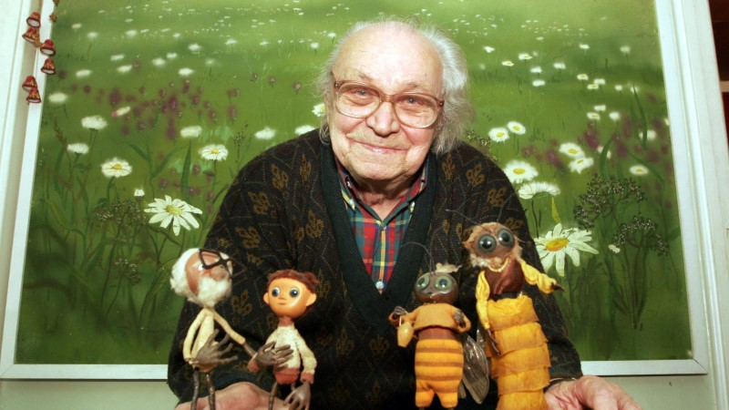
Heino Pars is the man, who turned insects into actors.
He was the first director of animafilms in the world who bonded wildlife with animation. His films speak about nature in their own warm and funny way.
Notes:
Heino Pars was the first director of anima films in the world who bonded wildlife with animation.. His films speak about nature in their own warm and funny way.

Slide 5
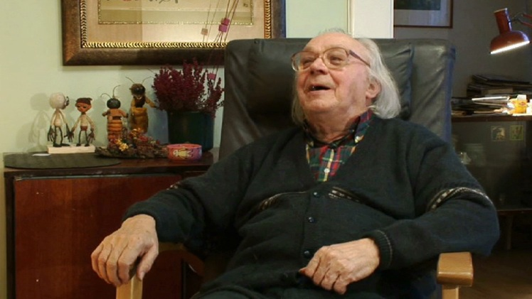
Creating animation films for children was his hobby and work, which he loved very much.
Notes:
Creating animation films for children was his hobby and work, which he loved very much.

Slide 6
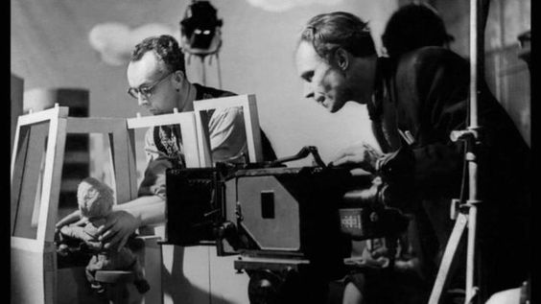
Heino Pars has said: “It’s amazingly exciting to knee down on the grass and see the miracles of living nature inside it. I just have to put it into animations so the children can see it, too“
Notes:
Heino Pars has said: “It’s amazingly ecxiting to knee down on the grass and see the miracles of living nature inside it. I just have to put it into animations so the children can see it, too“

Slide 7
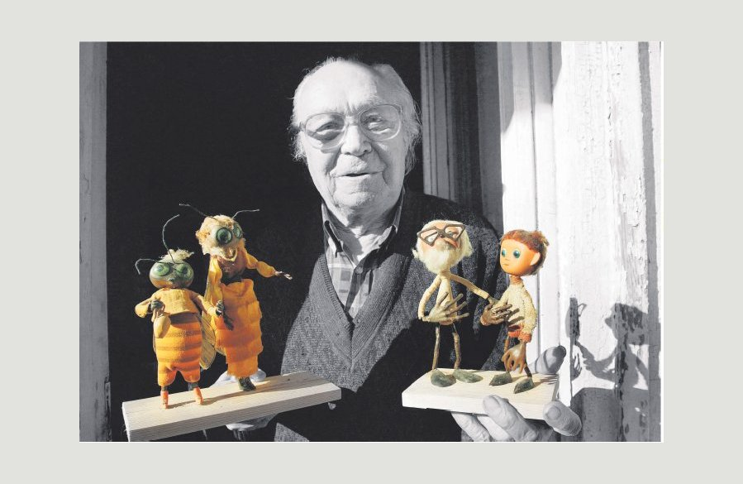
Children love his films very much and teachers use them in school natural science classes.

Slide 8
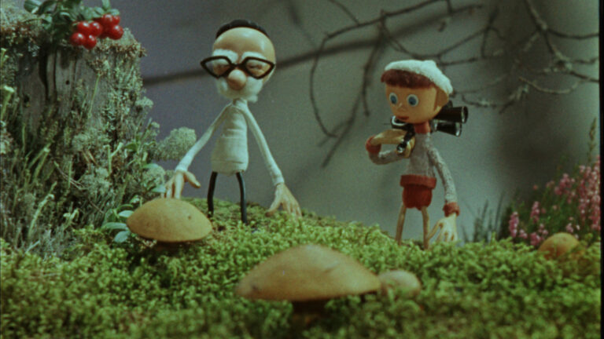
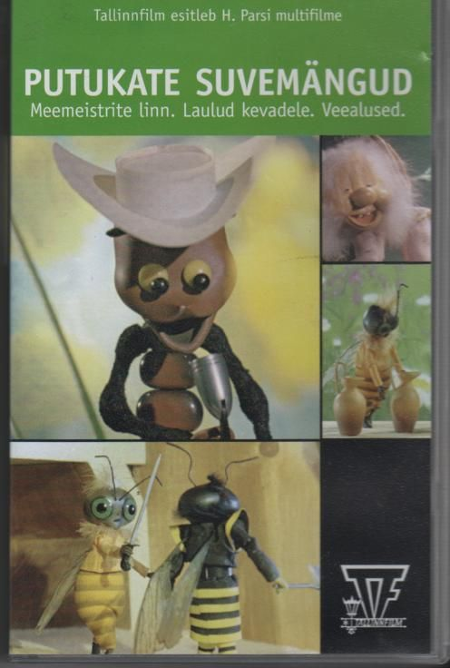
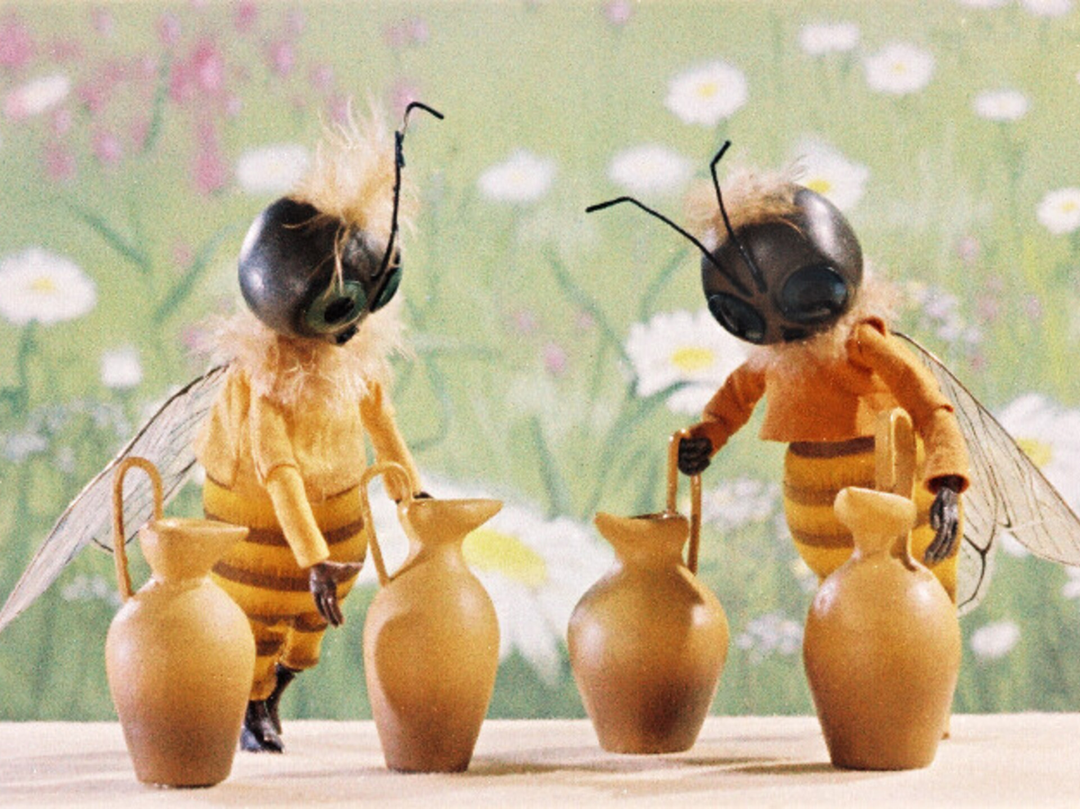

Slide 9
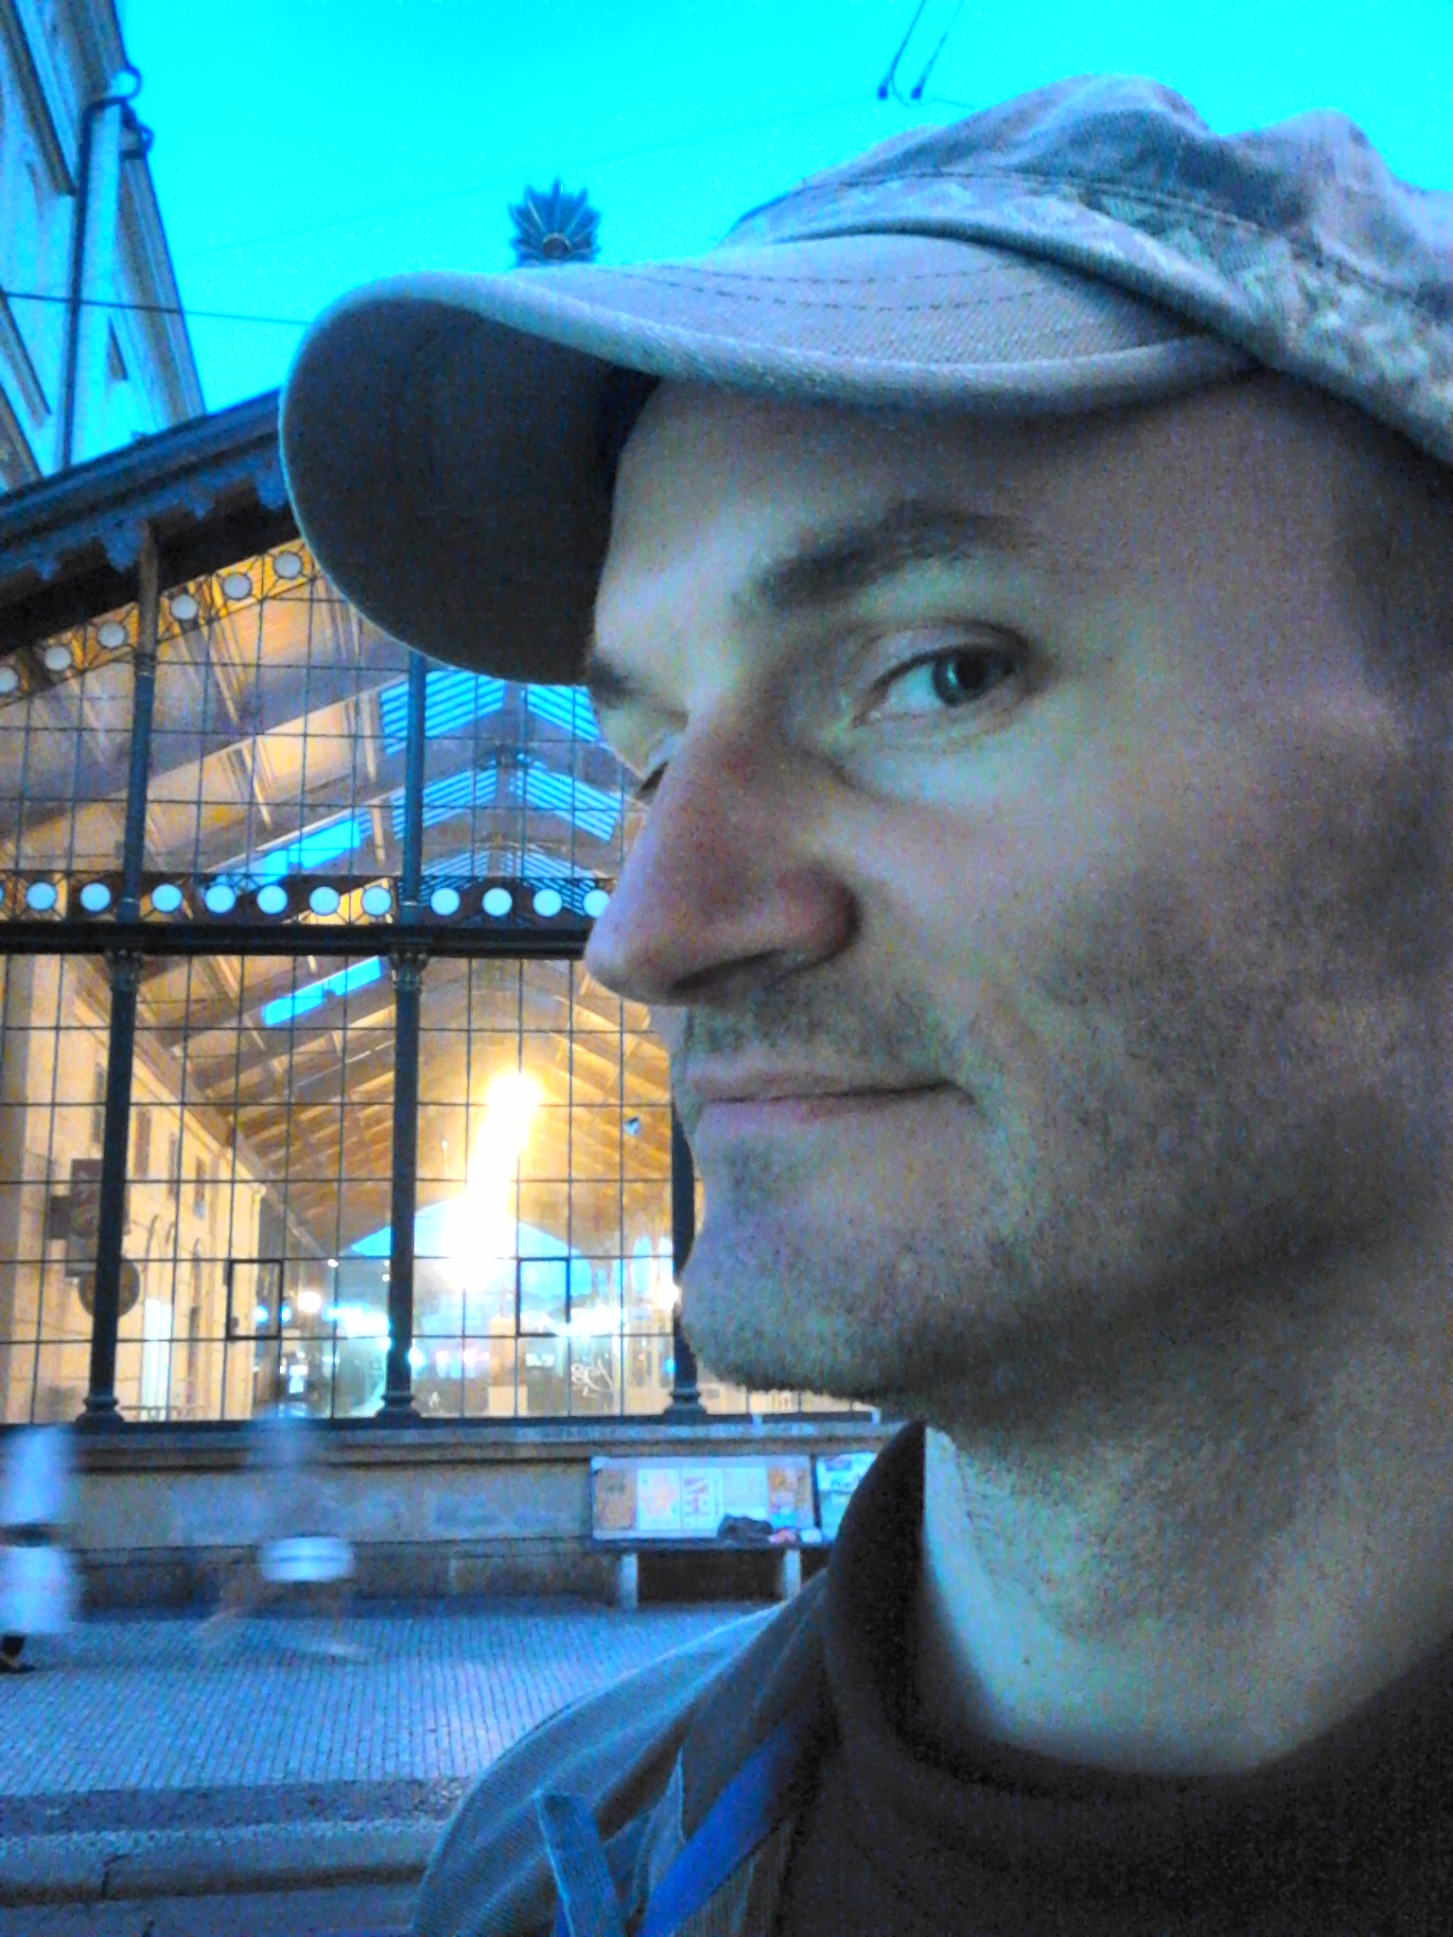
Pärtel Tall
A modern day animator

Slide 10
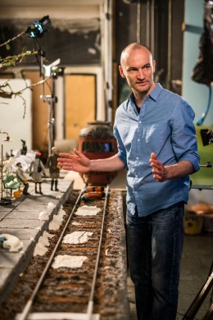
Pärtel Tall is a famous Estonian modern day animator.
He mostly uses clay in his animations because it’s natural.
His animations are for both children and grown-ups.

Slide 11
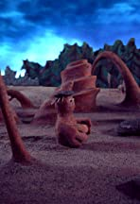
He began making animations with sand and was very successful.
But then he tried clay animations and loved it much more.

Slide 12
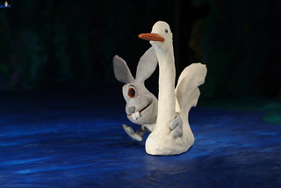
Why clay? Because as a child he loved playing with plasticine because he could make his own toys with it. Now he can play when working

Slide 13
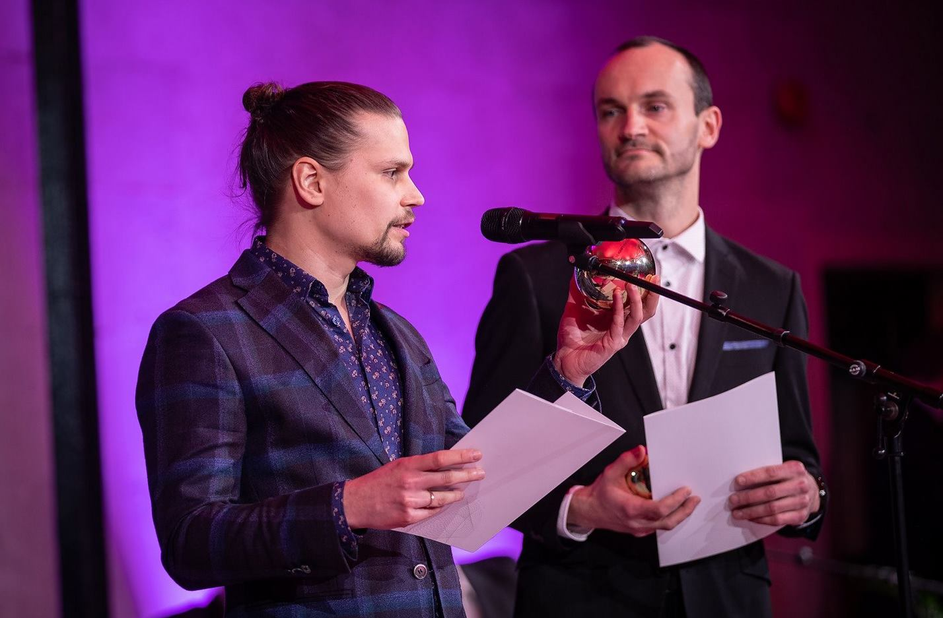
He has won a lot of awards in Estonia and at international festivals.

Slide 14
Thank you!

