Slide 1
Bulgarian virtual meeting
May 2021

Slide 2
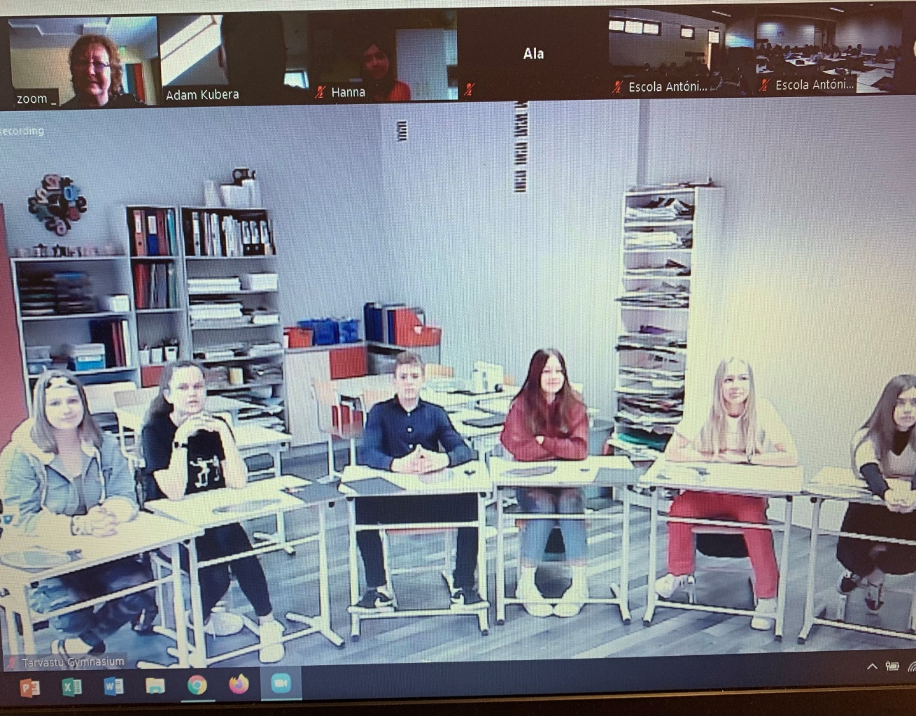
Ready and excited

Slide 3
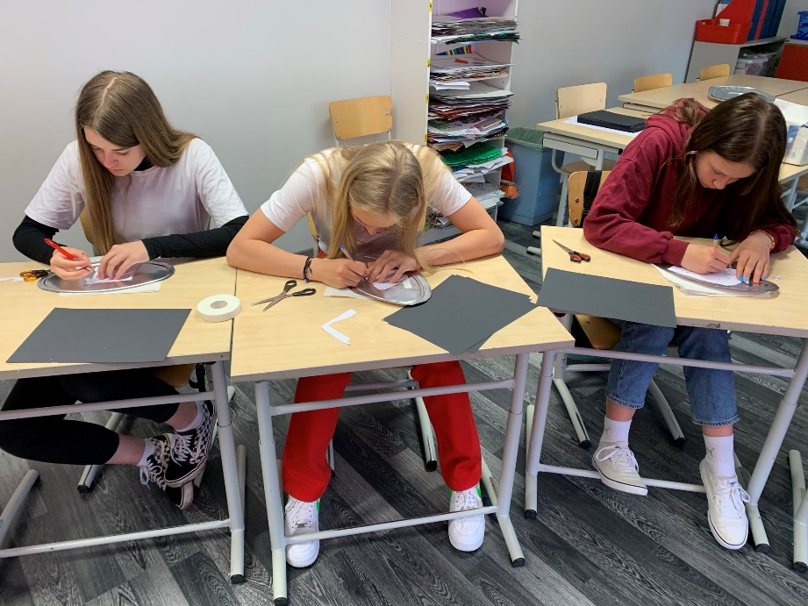
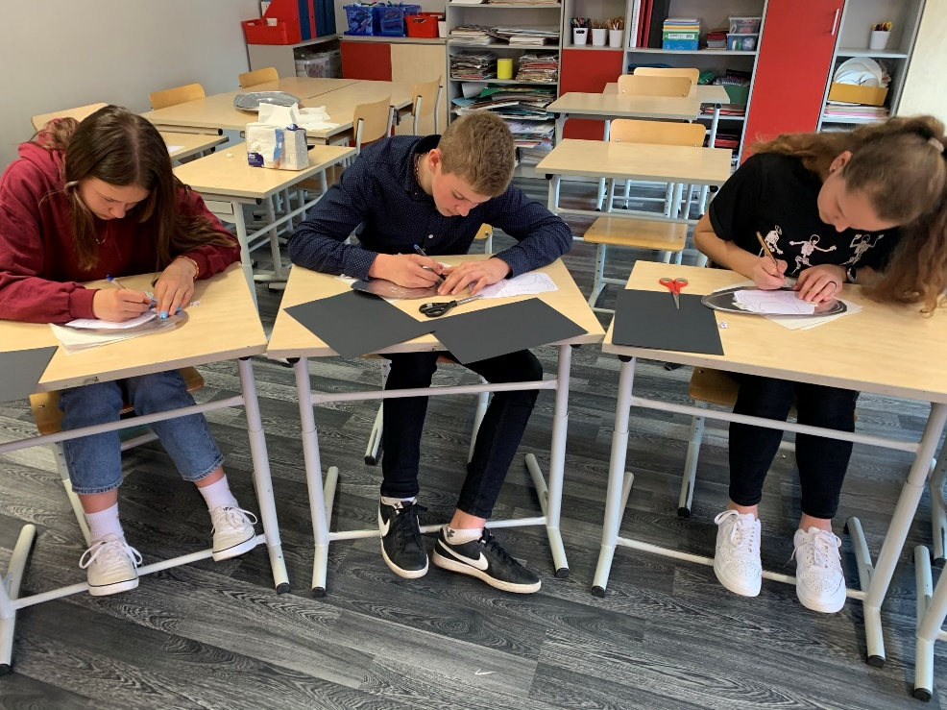
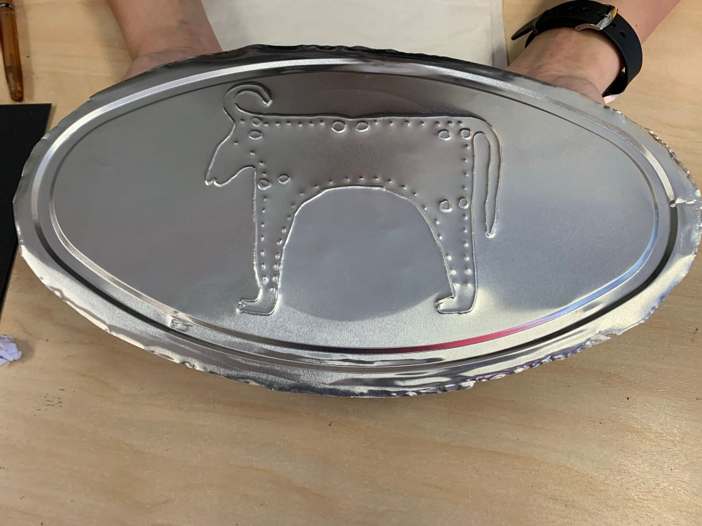
In action with the Bulgarian bull. Trip to culture.

Slide 4
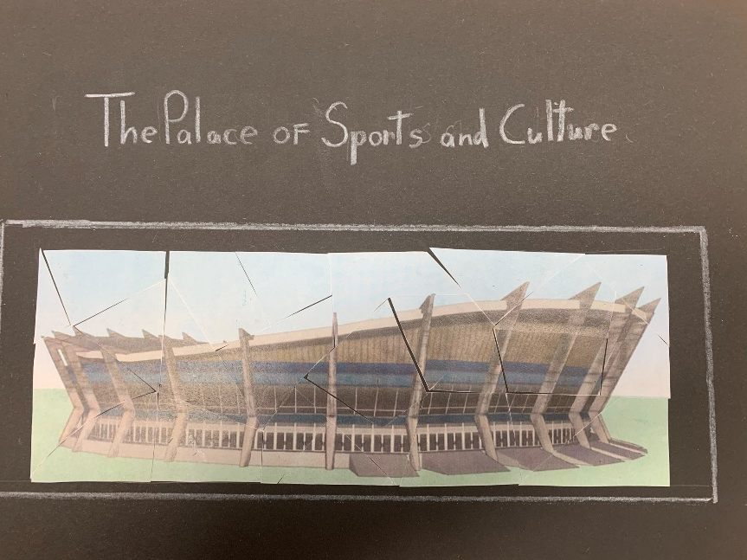
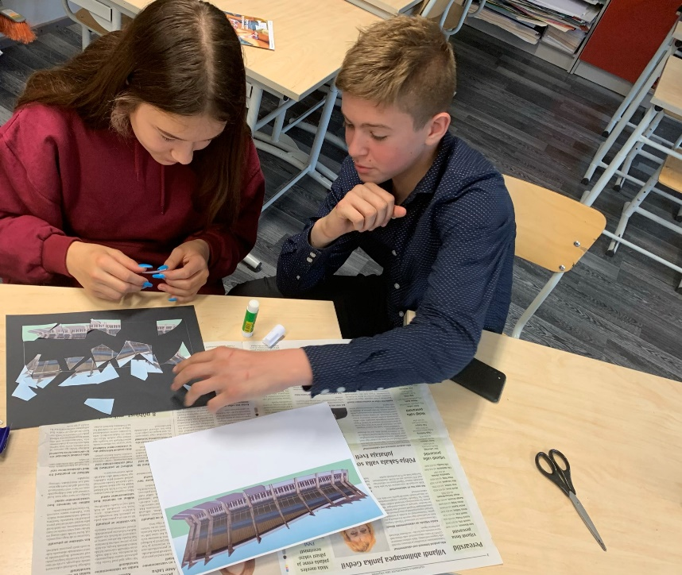
A „trip“ to Varna Culture Center

Slide 5
Lego animation. Fun-fun!

Slide 6
We made Bulgarian national salad!

