Slide 1
Donyo Donev
Bulgarian animator, director, art director, comics artist and cartoonist.

Slide 2
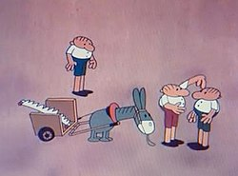
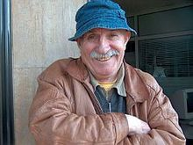
He is best known as the "father of The Three Fools" – an animated humorous sequence whose short episodes were continuously released during the 1970s and 1980s. His biting satirical caricatures were published in the most of the Bulgarian newspapers.
Donev's works are characterized with the simplified lines and at the same time plasticity of the motion and vivid expressiveness. He was the first who used deformed manner of speaking and interjections as a sound image of a second plan together with drum' and bagpipe' sounds.

Slide 3
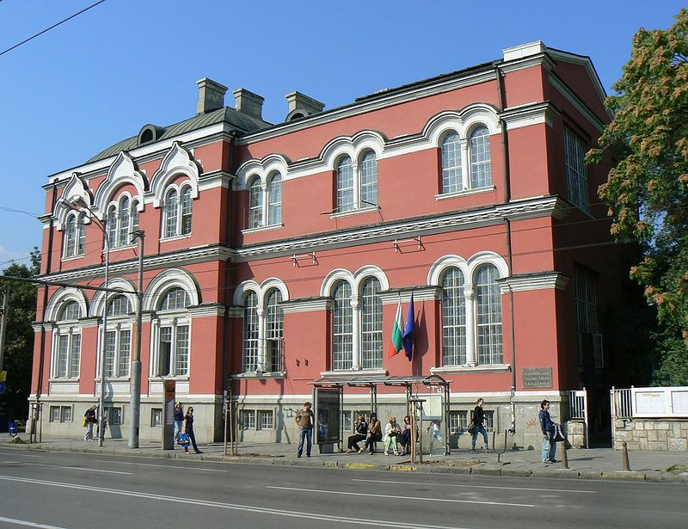
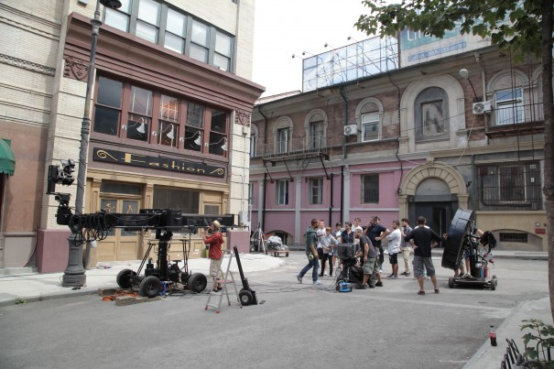
Biography and Career
Donyo Donev was born on 27 June 1929 in Berkovitsa, a small town in the northwest part of Bulgaria. He enrolled at the National Academy of Arts in Sofia, where he studied graphic art in 1949–1954 under the eminent Bulgarian artist Ilia Beshkov. After graduating in the academy he attended a postgraduate course in 1959 in the Moscow's Soyuzmultfilm.
National academy of arts in Sofia
During the period 1956–1970 Donev was an animator and director in the department of animation in the Studio of Featured Films (SFF), Sofia. Since 1970 he was a head of a film unit in the Studio of Animated Films (SAF), Sofia where he stayed until 1993. In 1970 was released the first short episode of The Three Fools.
Nu Boyana Film Studios

Slide 4
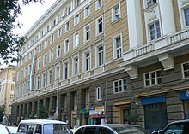
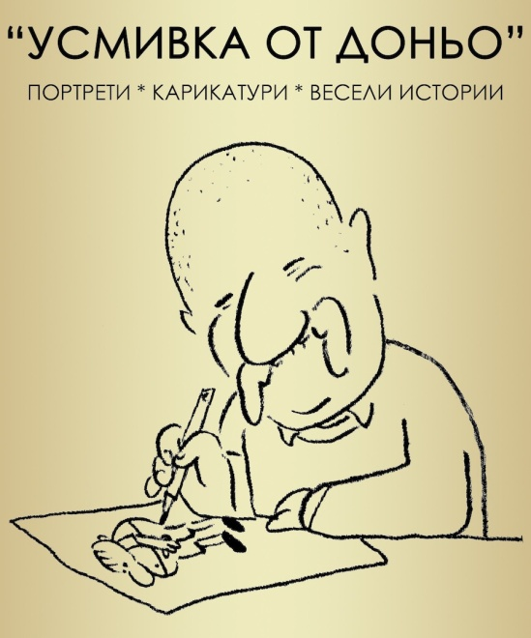
This animated caricature became popular throughout the country. Subsequently, it were released nine more episodes in the 1970s and 1980s. The sequence turned into a badge of Donev' creative works. There are not a single episode of them that was not awarded at the foreign film festivals. Some of his other notable works are Happy End (1969), Clever Village (1972), De Facto (1973) and Causa Perduta (1977). There are also numerous awards he received for his other animated films through the years.
NATFA in Sofia, Bulgaria
As a cartoonist he constantly took part in exhibitions in Bulgaria and abroad.
Donev has been a professor at the National Academy for Theatre and Film Arts for years, where he taught directing of animation.He was decorated with the high government prize the Order Of Saint Cyril And Saint Methodius.
Donyo Donev died in 2007 at the age of 78.

Slide 5
Selected filmography
The Three Fools sequence
1970 – The Three Fools / Trimata glupatsi
1972 – Three Fools as Hunters / Trimata glupatsi – lovtsi
1974 – The Three Fools and the Cow / Trimata glupatsi i kravata
1977 – The Three Fools and the Tree / Trimata glupatsi i darvoto
1978 – The Three Fools and the Fool Woman / Trimata glupatsi i glupachkata
1979 – Three Fools as Athletes / Trimata glupatsi – atleti
1980 – Three Fools as Pedagogues / Trimata glupatsi – pedagozi
1982 – Three Fools as Fishermen / Trimata glupatsi – ribari
1989 – The Three Fools in the Restaurant / Trimata glupatsi v restoranta
1990 – Three Fools Non-stop / Trimata glupatzi non-stop

Slide 6
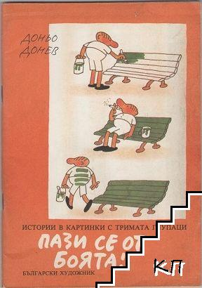
Other
1969 – Happy End / Hepi End
1972 – Clever Village / Umno selo
1973 – De Facto / De fakto
1977 – Causa Perduta / Kauza perduta
1985 – We Called Them Montagues and Capulets / Narekohme gi Monteki i Kapuleti
1988 – Wolf's Suite / Valcha syuita
One of the antique books from the sequence “The Three Fools”
Some Awards
1988 – Golden Mikeldi for Wolf's Suite – Bilbao International Festival of Documentary and Short Films
1989 – Silver Dragon for Wolf's Suite – Cracow Film Festival

