Slide 1
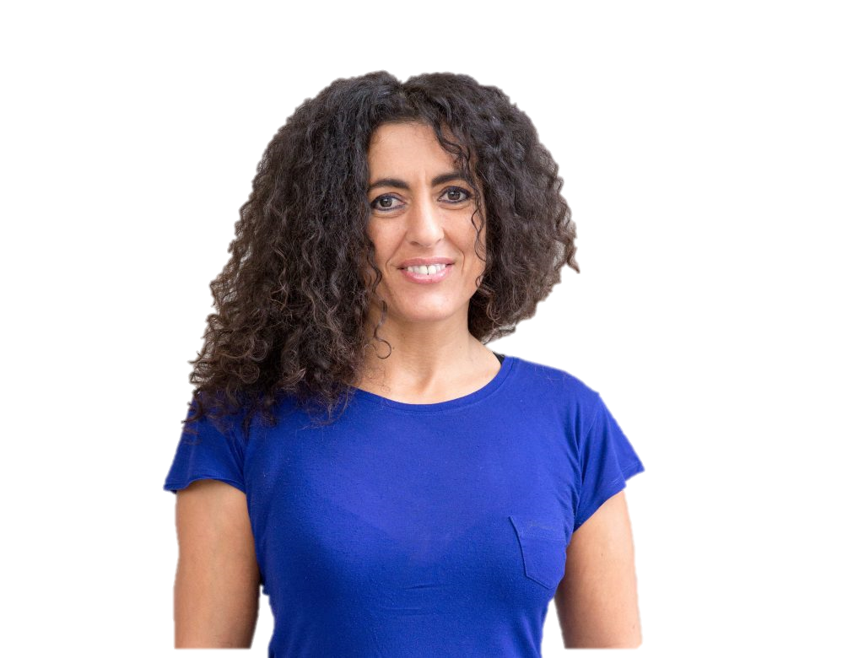
Regina Pessoa
A Portuguese Animation Film Director

Slide 2
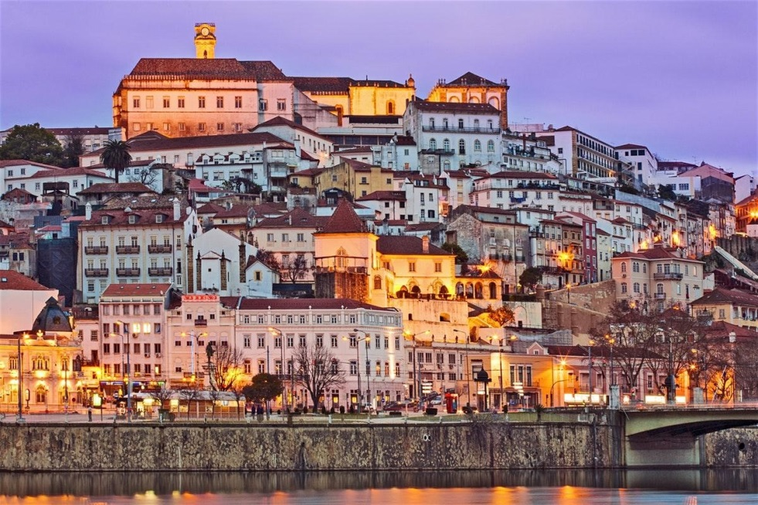
Regina Maria Póvoa Pessoa Martins is a Portuguese animation film director.
She was born on 16th December 1969, in Coimbra, but she lived in a village near the city until she was seventeen. Her mother had a mental disease.
Her family didn´t have a television, so she spent her time reading, listening to the older ones telling stories and also painting her grandmother's house doors and walls using charcoal, encouraged by her uncle.
She studied Painting and graduated from Oporto's Fine Art's School, in 1998.
Coimbra - Portugal

Slide 3
Her films obtained a vast recognition, winning countless awards.
All her films are in the Portuguese National Cinema Plan, being studied by young people in schools, in Portugal.
Her films are based on the technique of engraving animation on plates of plaster.

Slide 4
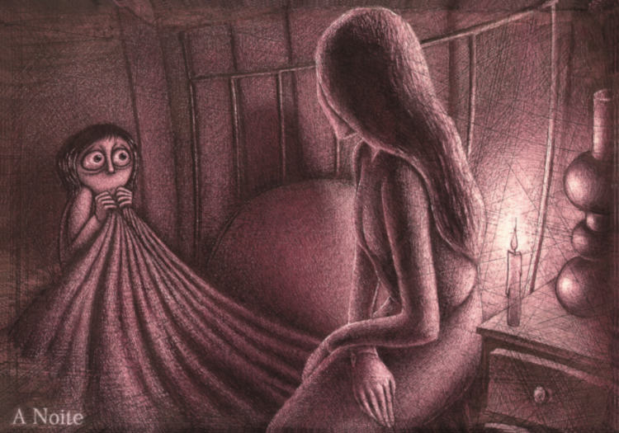
In 1999, she animated and directed her first independent film “A Noite” (The Night), engraving in plaster plates and won 9 awards.
It's the story of a child and her mother, two lives that don't communicate with each other. Is that loneliness that sometimes reaches the size of the night. Dark is the night. Dark is the mother. And dark becomes the entire Universe when you are alone and abandoned.

Slide 5
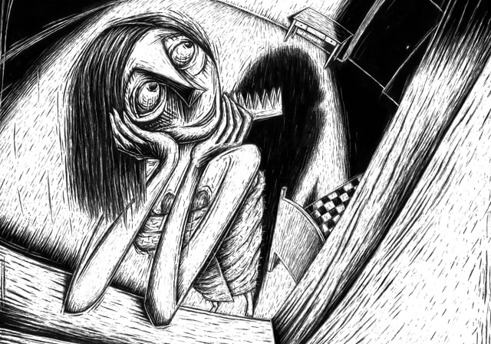
In 2005 she animated and directed her second short animation film “Tragic Story with Happy Ending”. It´s the most awarded Portuguese film ever.

Slide 6
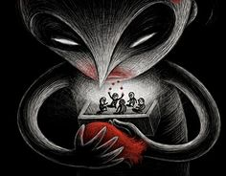
In 2012, she directed Kali the little vampire, that was considered a world heritage site by UNESCO.

Slide 7
In 2018 she became member of the Academy of Motion Picture Arts and Sciences by invitation of the organization.

Slide 8
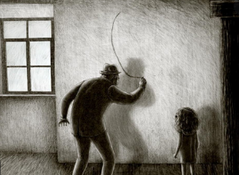
The short Uncle Thomas, Accounting for the Days received international acclaim in 2019 and it won the Annie Awards for best Animated Short Film.
It´s about the special relationship between Regina and her uncle and it played a key role in her becoming a filmmaker.
https://www.youtube.com/watch?v=CCAxVIq8cOc

