Slide 1
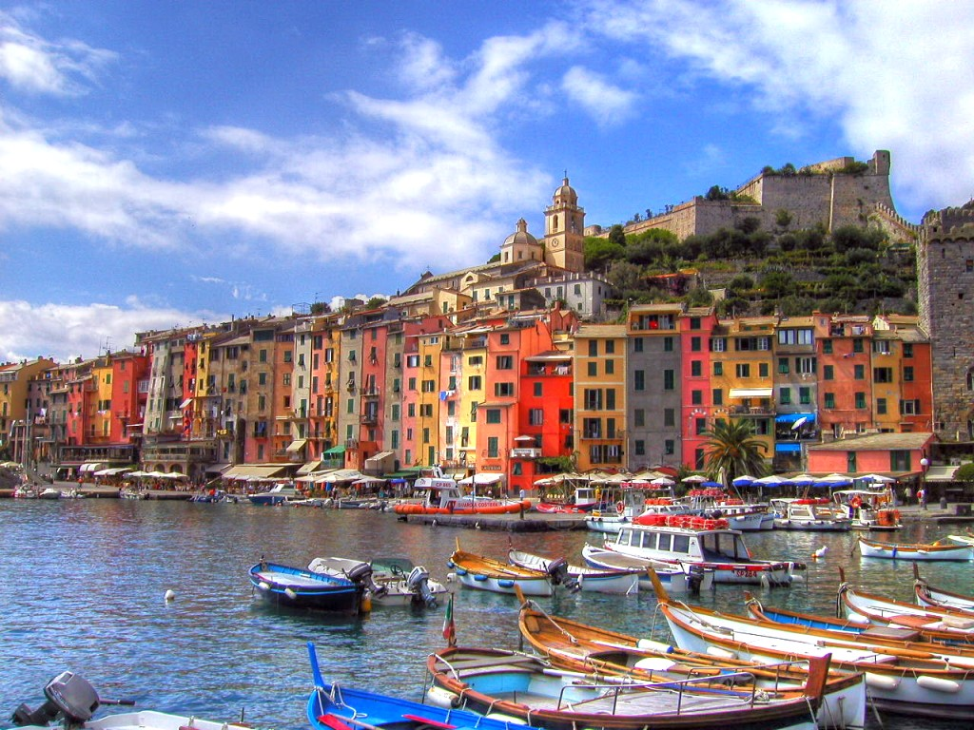
Portugal

Slide 2
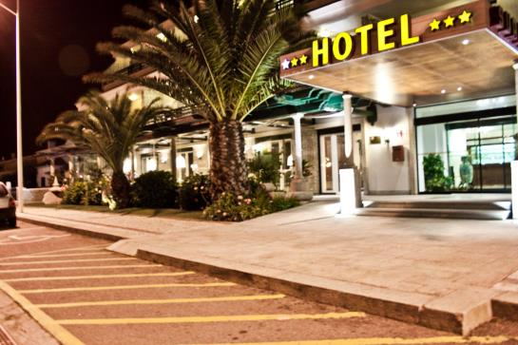
In program Erasmus+ we were in Portugal in the period 23.11.2018-1.12.2018
When we arrived there, we stayed at hotel ,,Suave de mar”-Esposende.

Slide 3
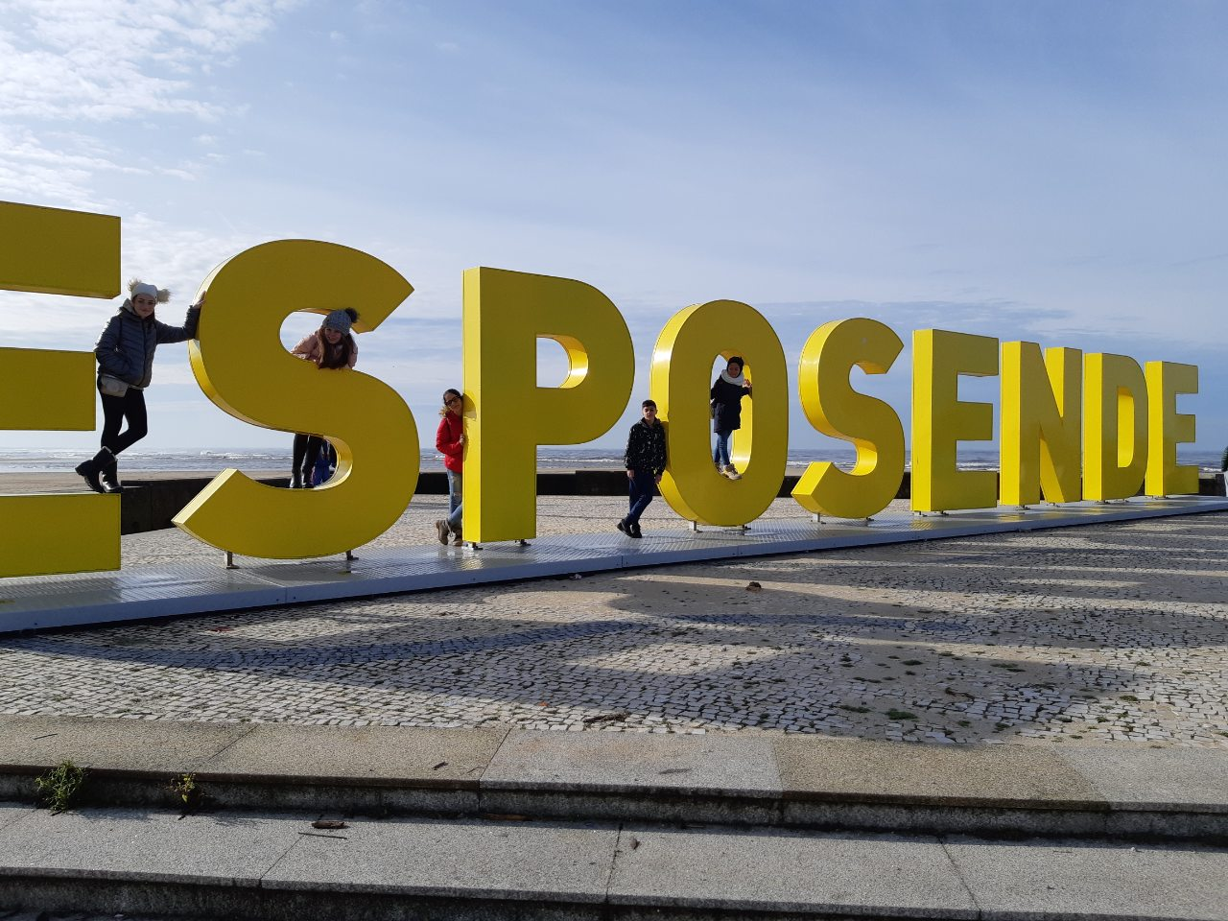
The town is amazing. Located on Atlantic coast.

Slide 4
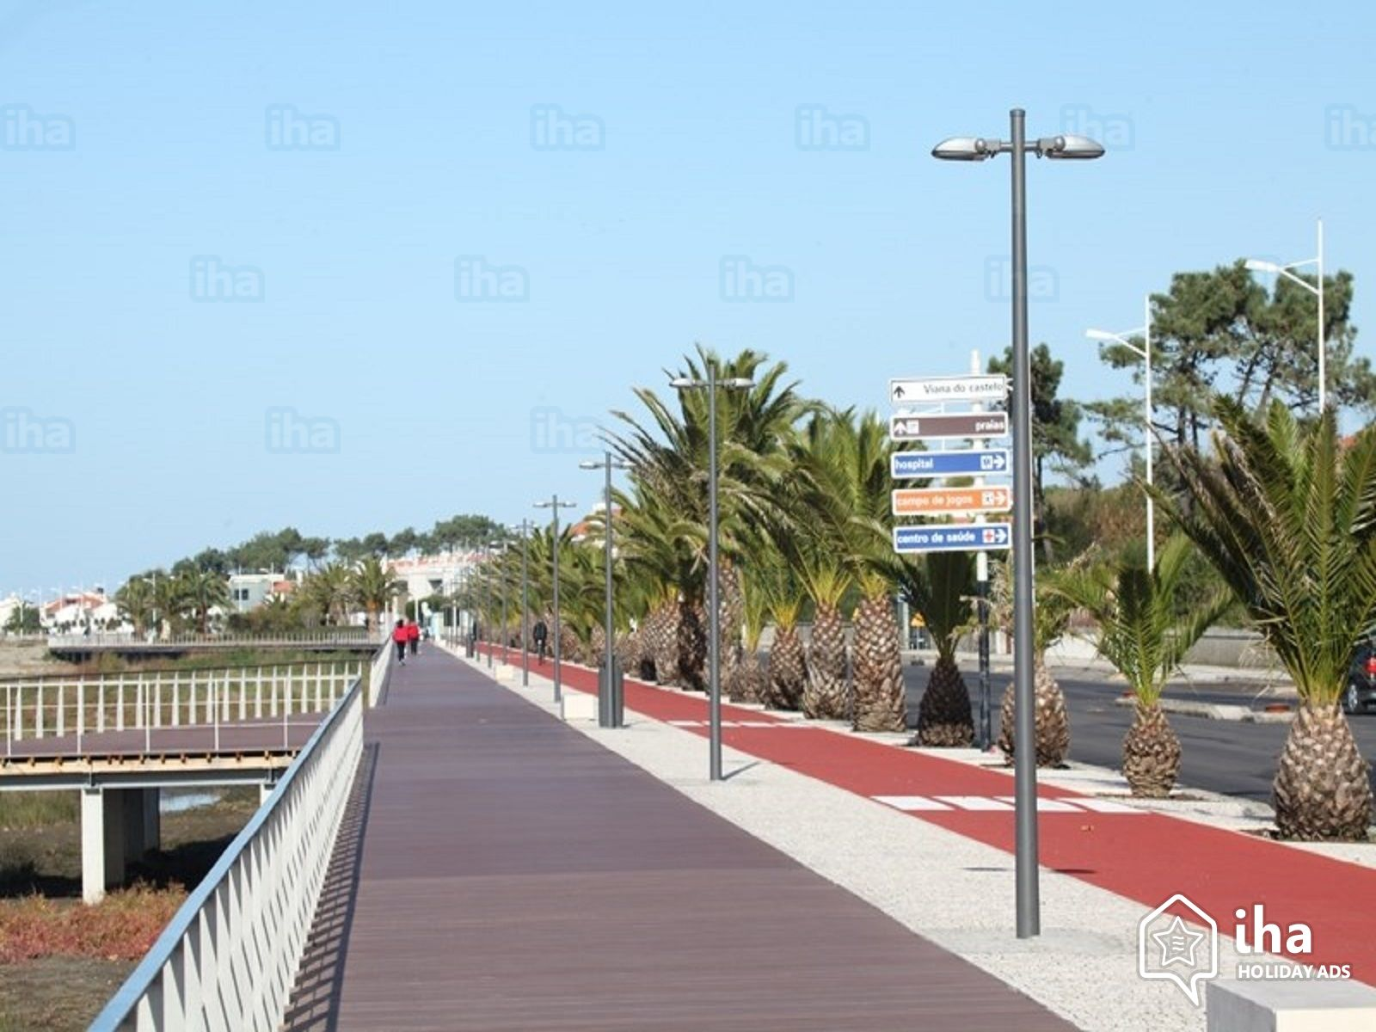
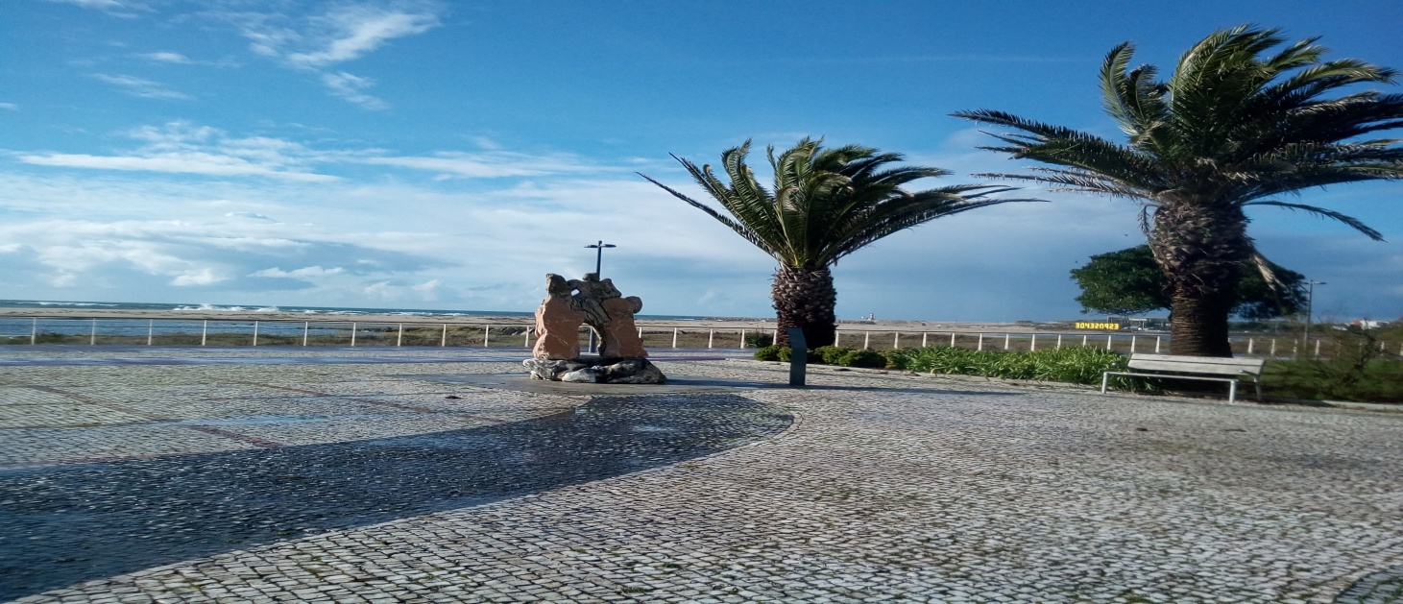

Slide 5
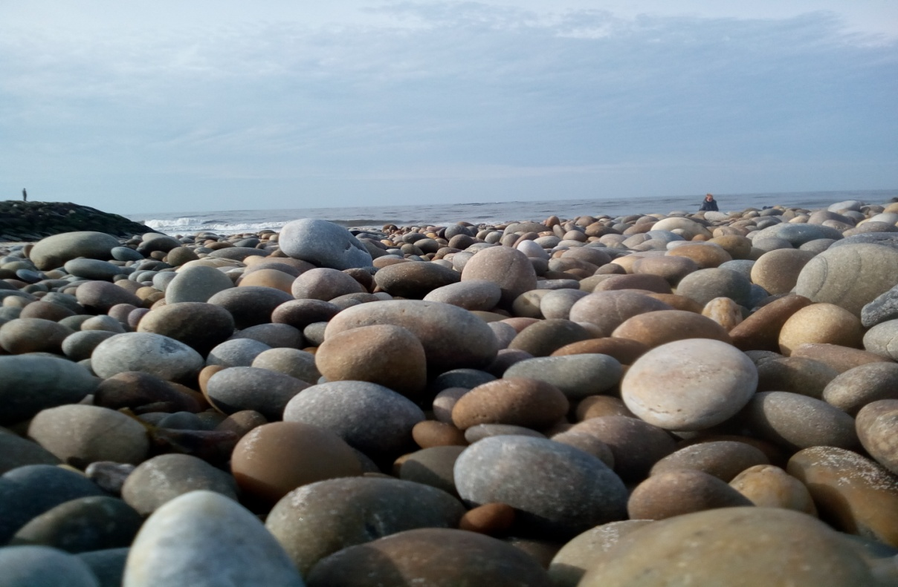
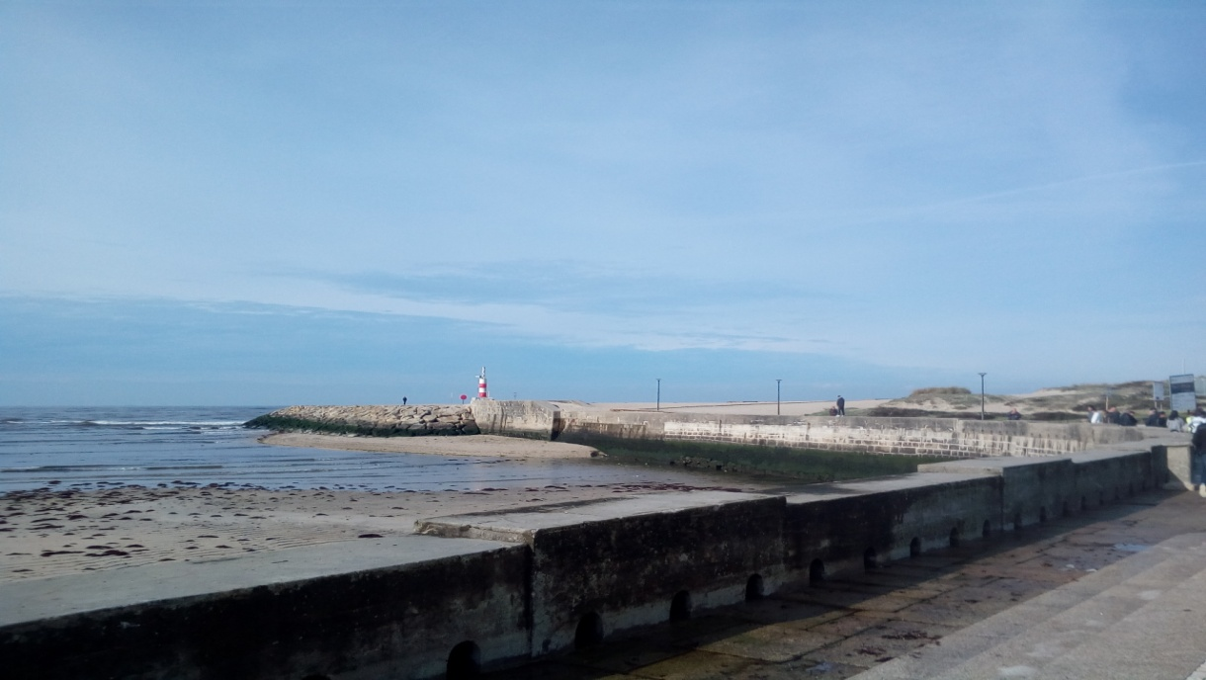

Slide 6
Esposende is fishing village.

Slide 7
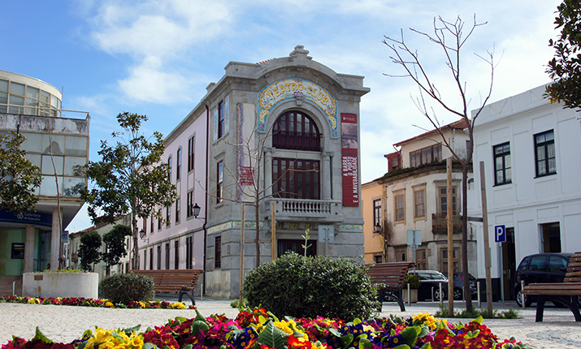
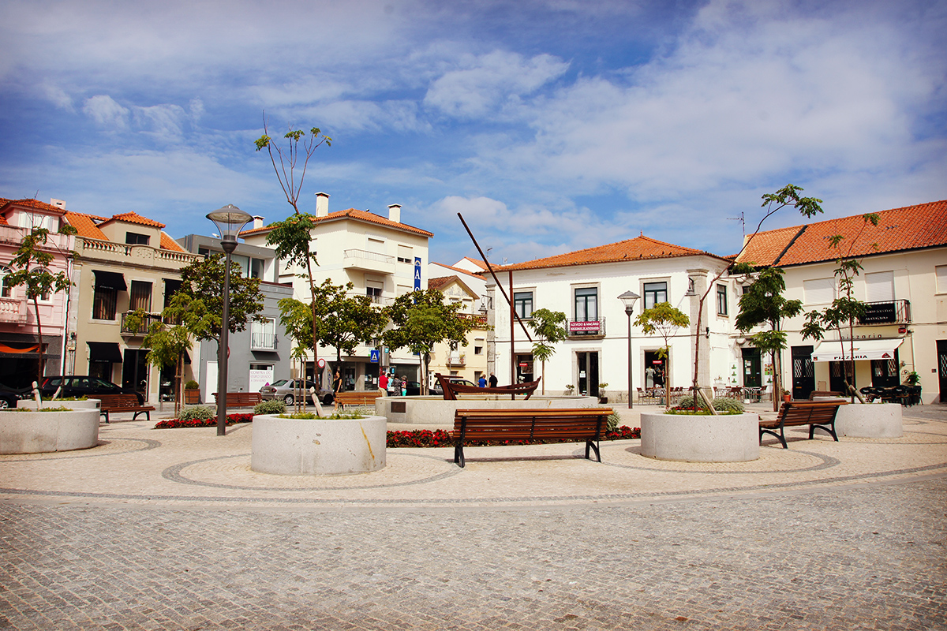

Slide 8
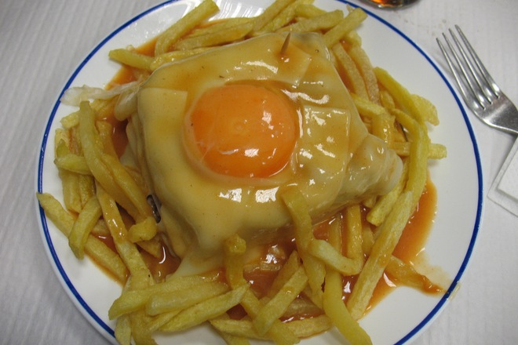
One of traditional portuguese foo is francesinha

Slide 9
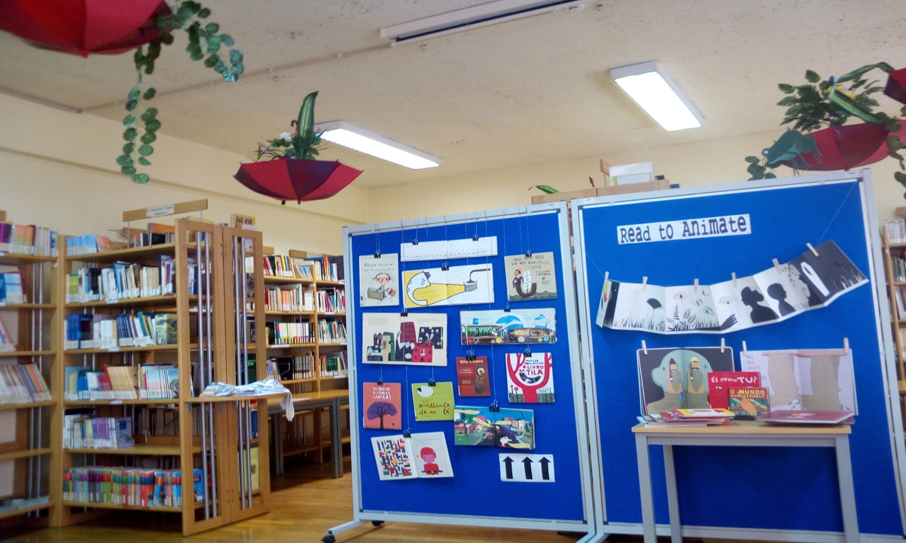
In Sunday evening we went to a families in which we lived until the end of week. Every day we went at school–,,Escola Basica Antonio Correia de Oliveira”
Most of the time we stayed in the big library.

Slide 10
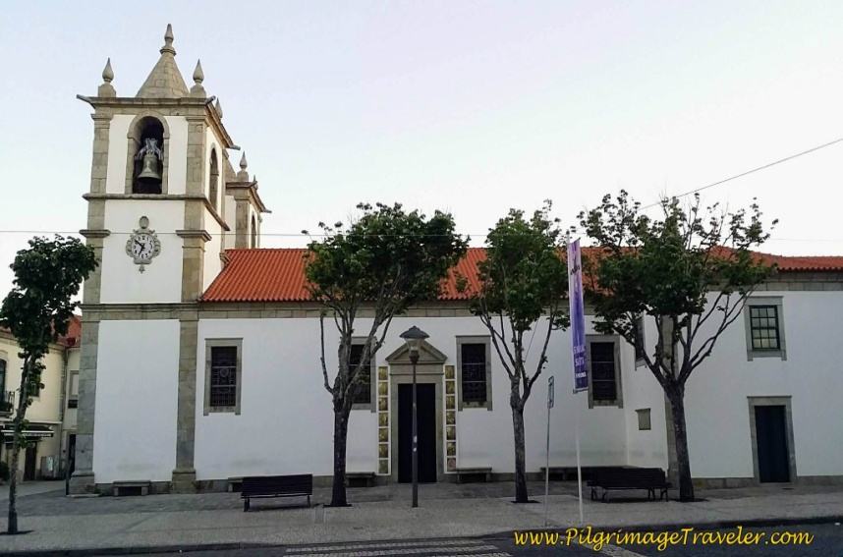
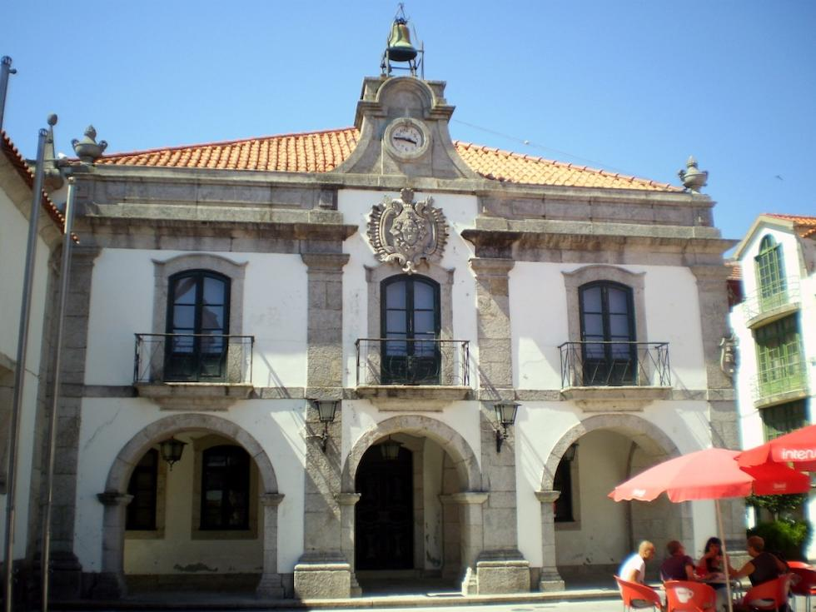
We had lunch in the canteen of the school . In the evening we had a party.
The first day we were in groups. We walked around the town. We had to find different things and write what we have seen.
Then this we went to the City Hall. There we watched presentation about the town.

Slide 11
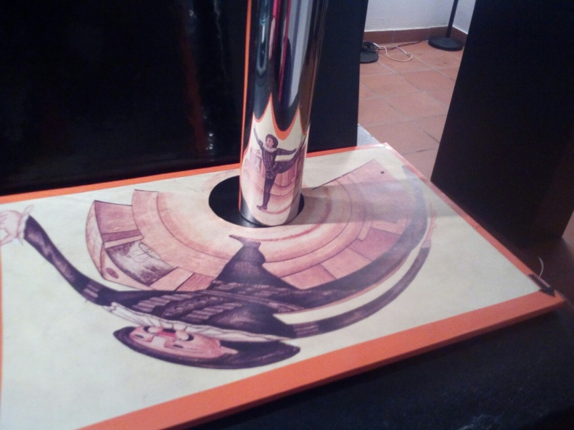
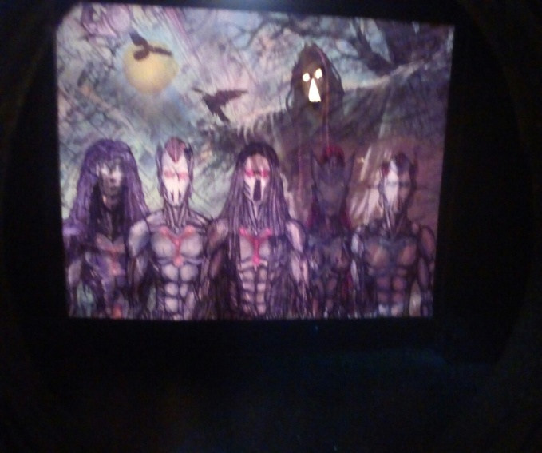
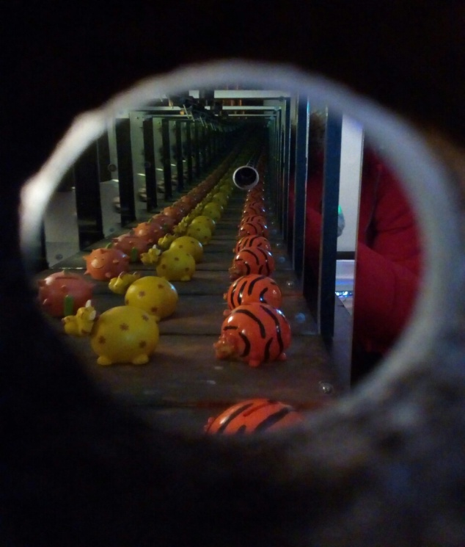
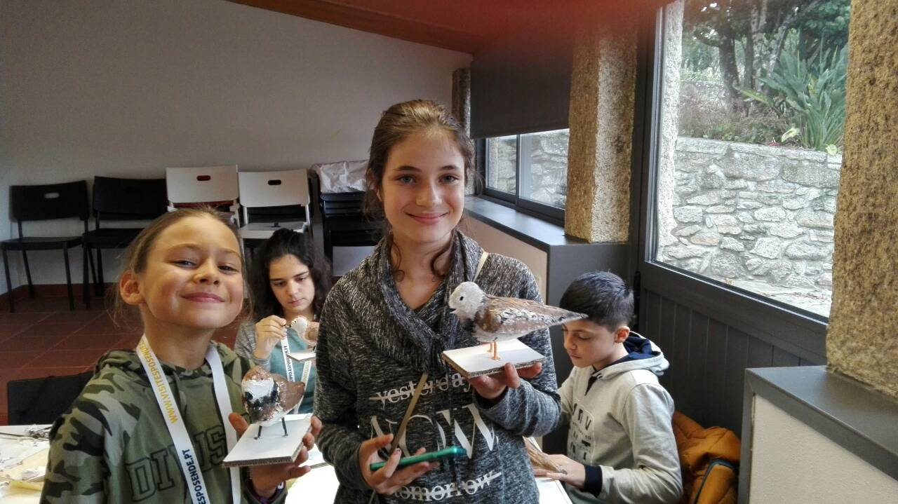
In the week we went to the museums about the cinema and animations and Environmental Educatаion center .

Slide 12
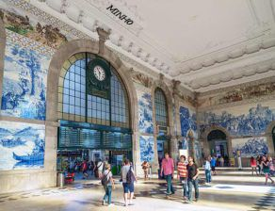
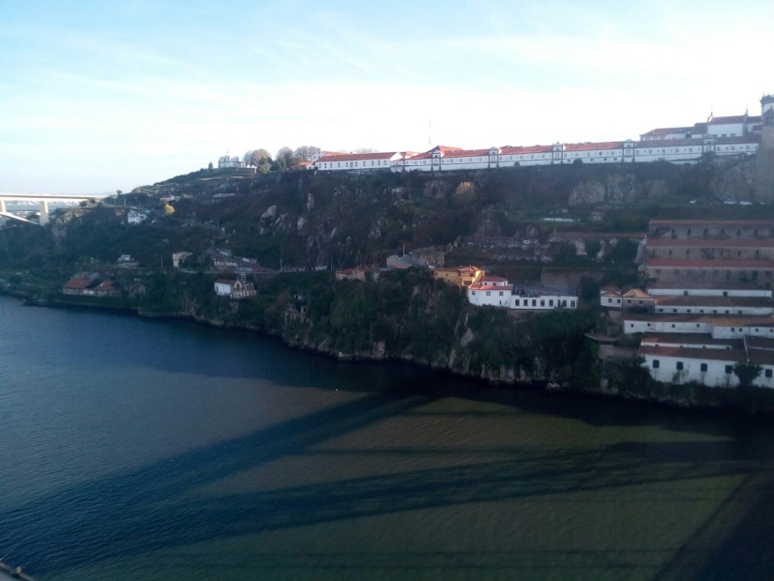
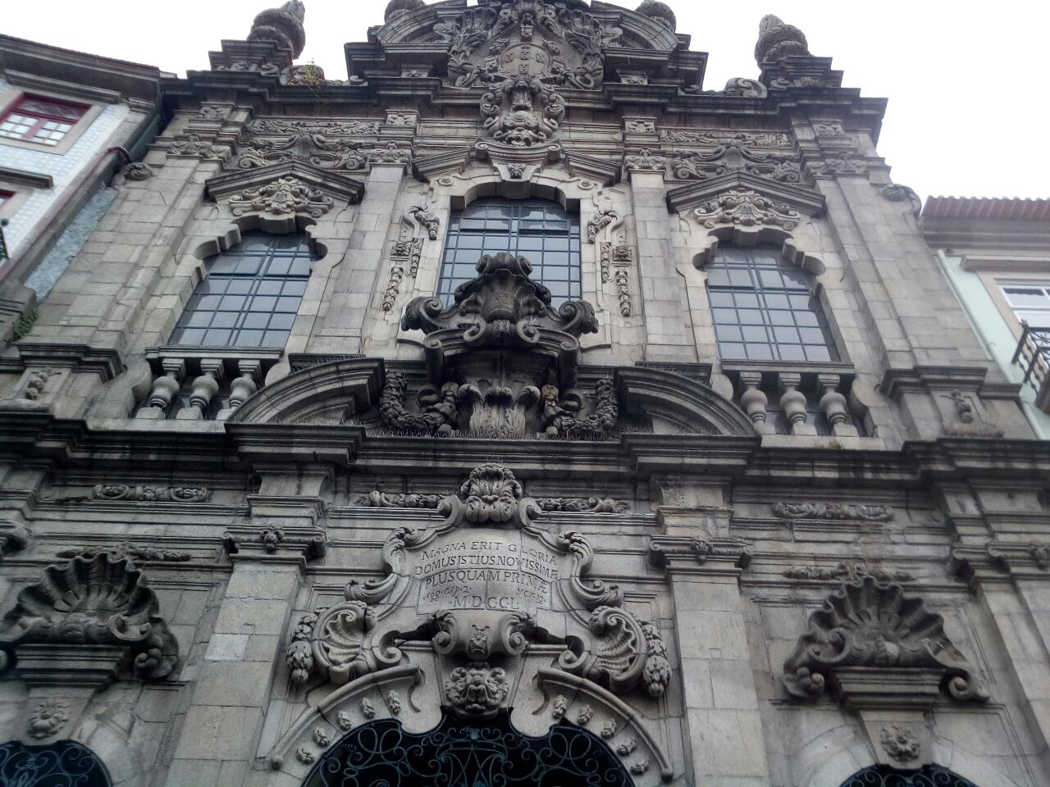
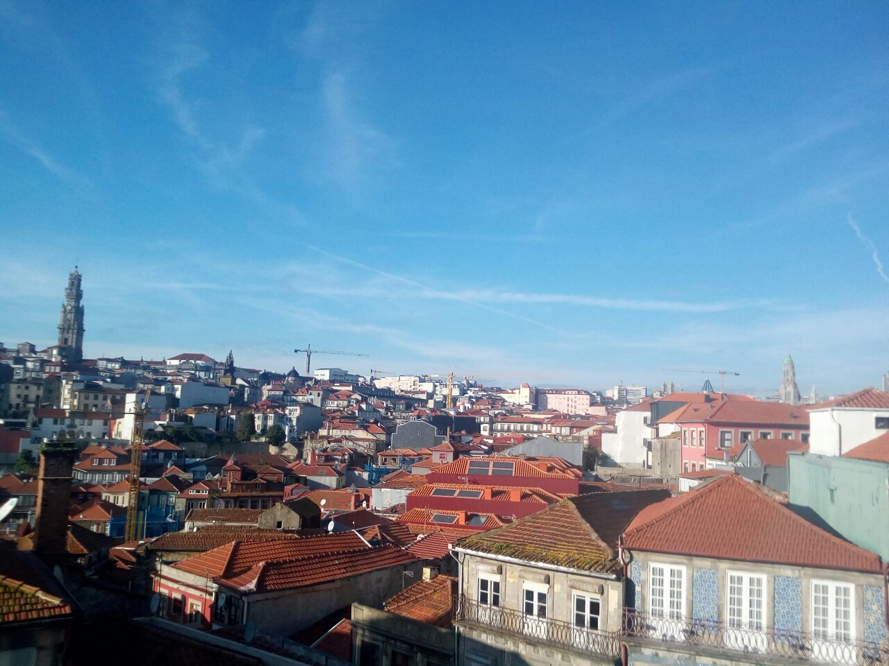
We went to Porto, Vila do Conde and Viana do Castelo

Slide 13
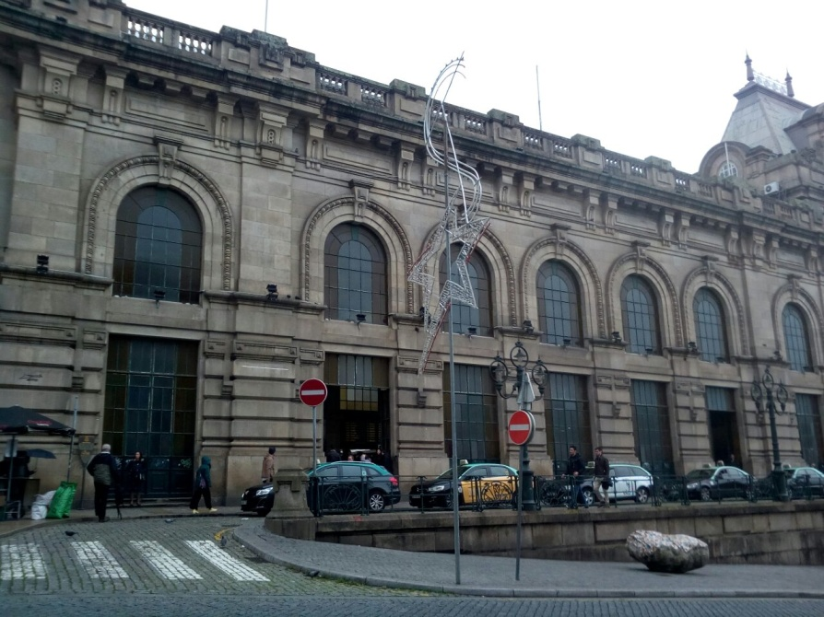
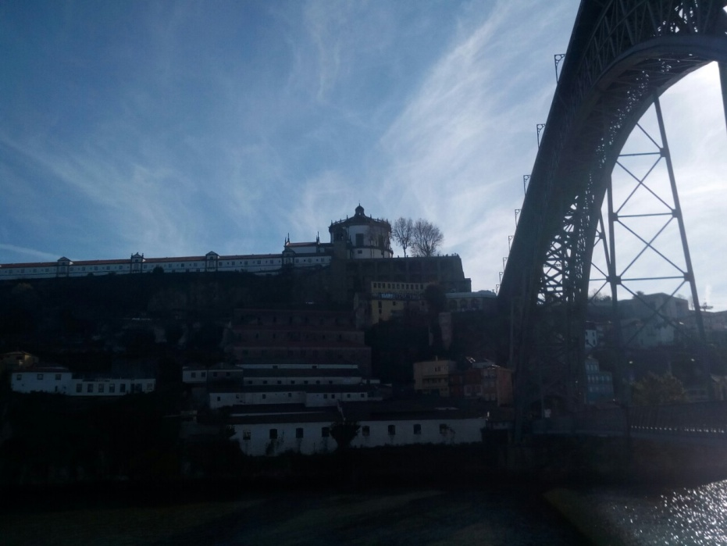
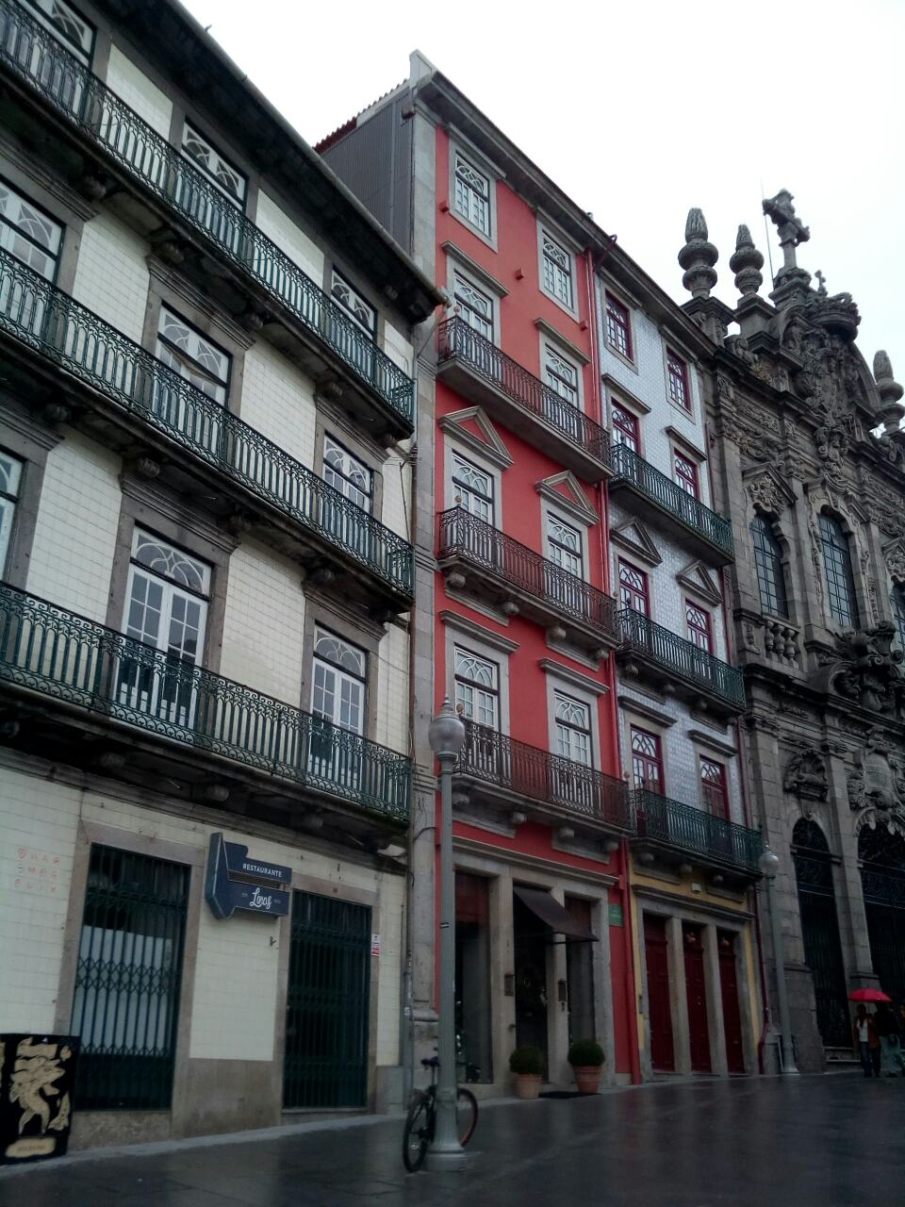
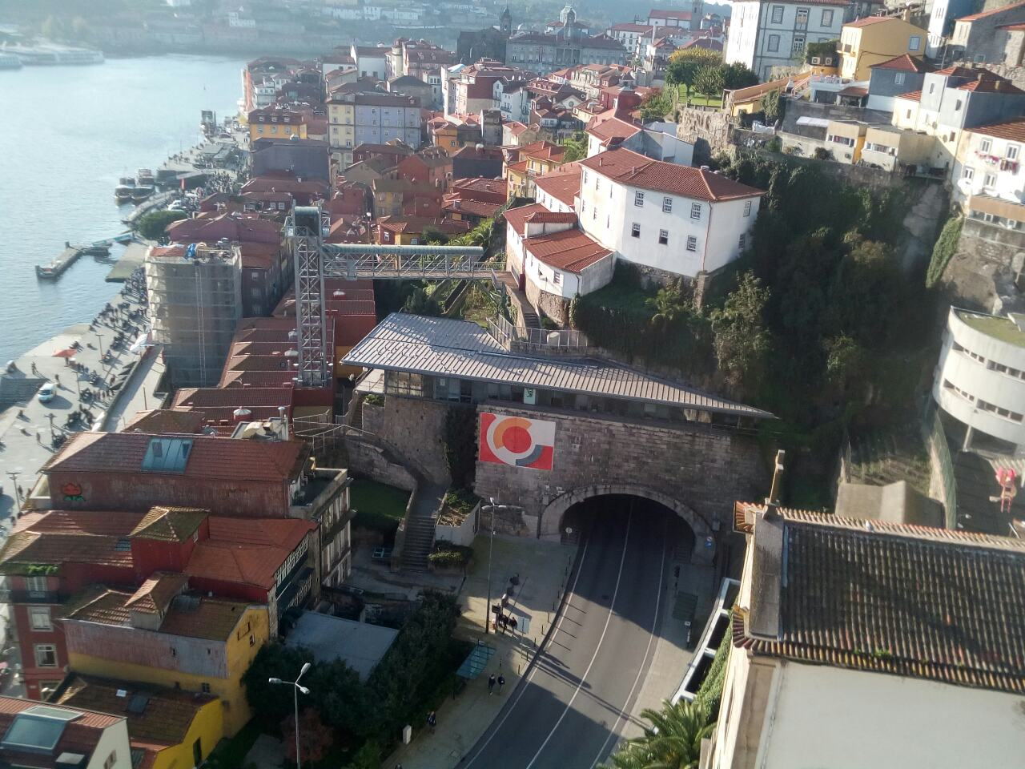

Slide 14
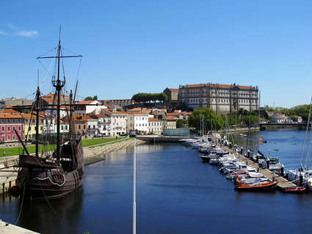
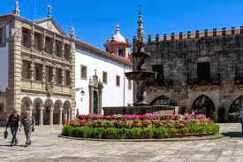

Slide 15
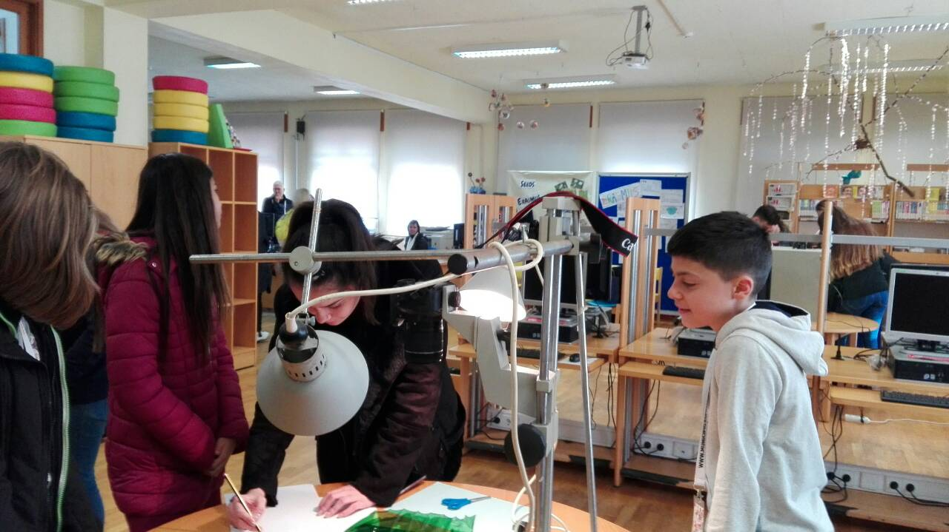
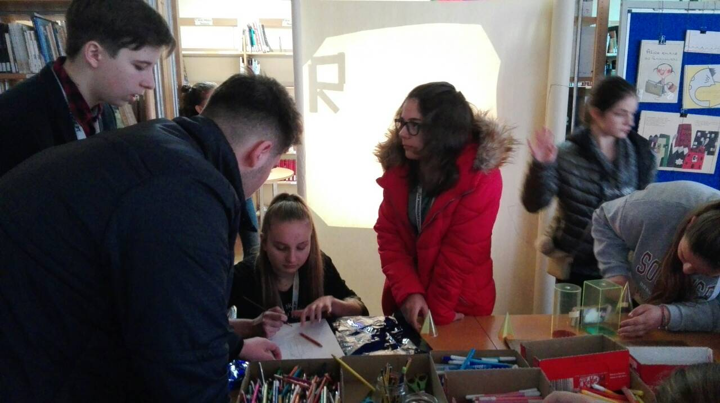
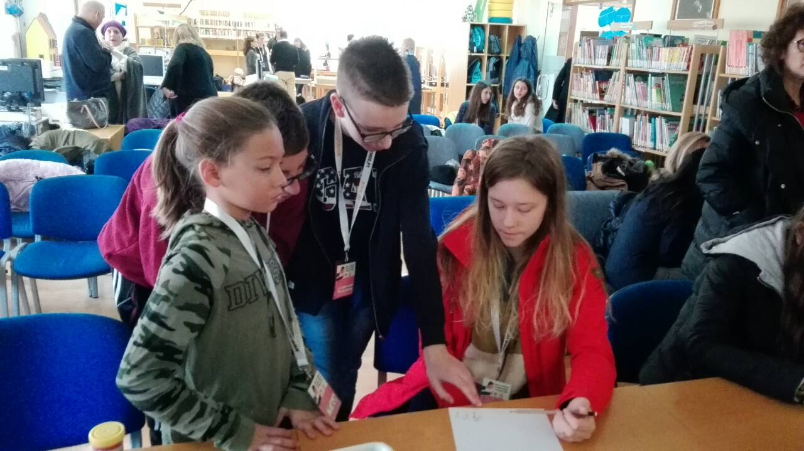
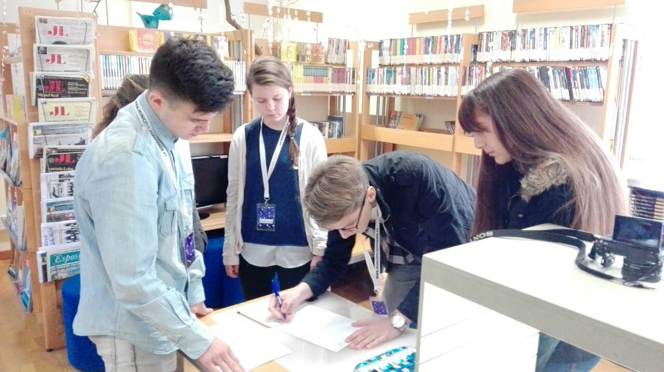
We learned how to make different kinds of animations.

Slide 16
First we had to have an idea from the movie, then take a photo to every moment. We edited with Imovie.
We needed from two or three hours to made one movie.

Slide 17
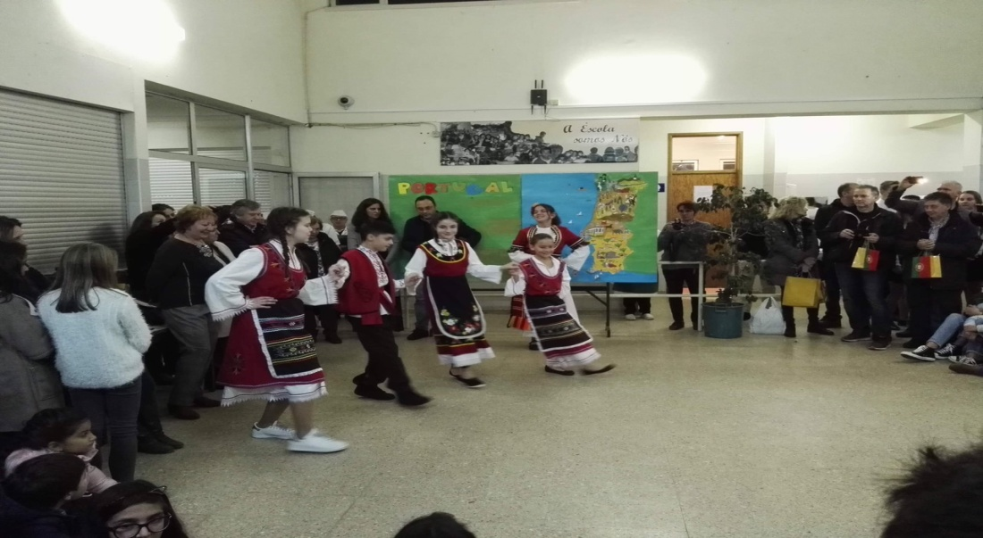
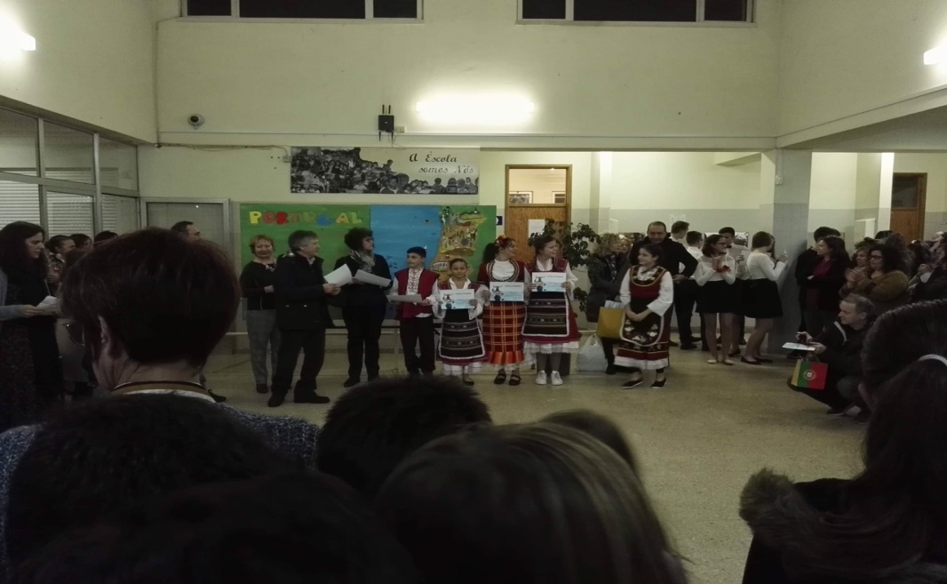
The last evening all presented their country. There was a party.

