Slide 2
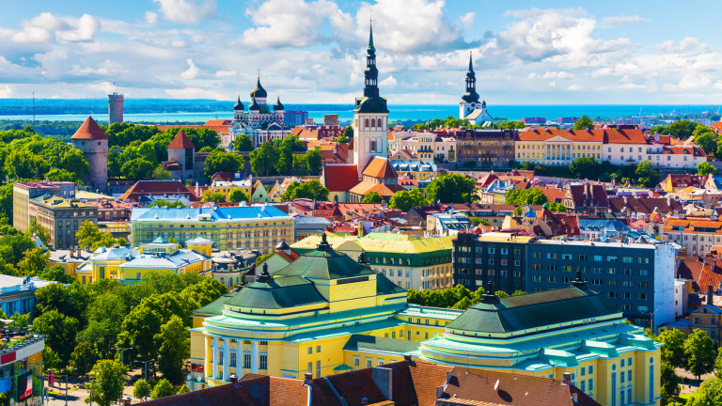
About the country
Estonia is a very green and beautiful country, which shares borders with Latvia, Russia and the Baltic sea. It’s capital is the city of Talin. Another big cities are Viliandji and Tartu.

Slide 3
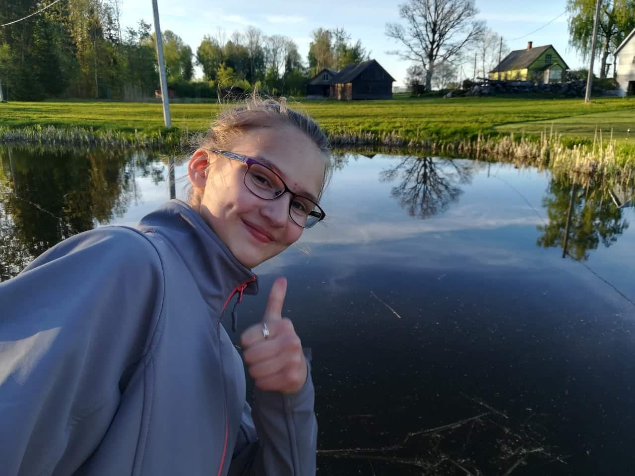
,,Our” house
Our host was a very kind teacher. Her name was Kersty Vunder. The house was big, very beautiful and with a huge backyard. I was sharing my room with Kersty`s grand daughter - Helina.

Slide 4
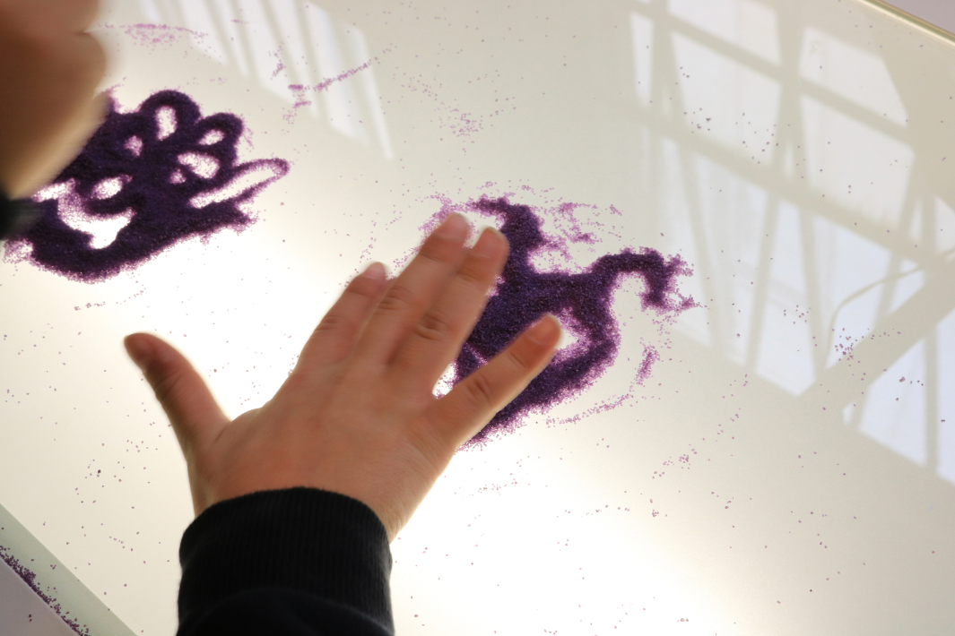
The first day – the 13th of May
The day after our arrival, we were welcomed in the school with national folk dances and songs. Right after this we started with our first cartoon job. We created pictures with colorful sand. After a little tour of near by house we went back to “our house”.

Slide 5
Tuesday – the 14th of May
This turned out to be one of my favorite days from my stay, the day we went to Tartu. We had lunch at one of the national museums of Estonia. After this we made dolls the old fashioned way and wood toys. Then we went to the science museum ,, AHHAA”. This was the most interesting and funny museum I've ever seen. It was like a small amusement park. After a short tour of Tartu we went back to “our house”.

Slide 6
Wednesday – the 15th of May
On Wednesday, we made cartoons based on fairy-tales using the dolls we did the day before. After lunch in the canteen , we created sounds for our animation. Later that day, we went to Viljandi and met the mayor of the Viljandi County Council and then we had dinner in this beautiful city.

Slide 7
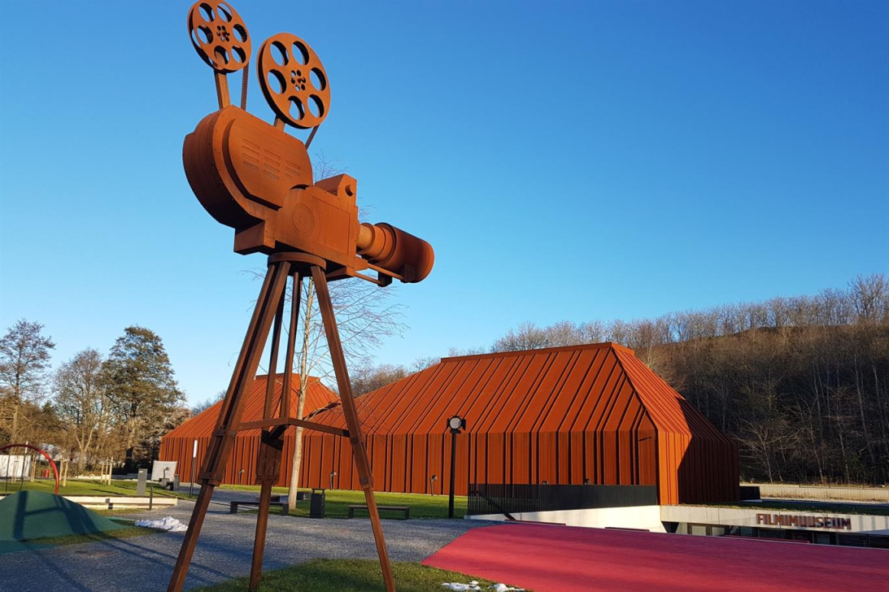
Thursday – the 16th of May
This was my second favorite day. On this day, we went to the city of Tallinn - the capital city. When we arrived there, we had lunch and then visited the film museum and the digital art museum. After looking at both of them we went for a walk around the old town. It was almost like the Middle Ages, even the locals who gave us brochures were in costumes.

Slide 8
Friday – the 17th of May
On Friday, the day of the cartoon festival, we went to a hall, where Estonian students danced a traditional dance and told us about the animation. In the afternoon, “the Oscars” started - our guides told us that in Estonia, the cartoon awards are something like the Oscars in Hollywood. We won two of the prices. Later on we had a good-bye party.

Slide 9
Saturday – the 18th of May
We spent the Saturday in Helen's house and went to a music festival. There, the children from the school danced, as well as some other people.

Slide 10
Sunday – the 19th of May
On Sunday we left. It was very hard for me and I wanted to stay there some more time.

Slide 11
Leisure time
Estonian-English Vocabulary:
I was spending my free time( which was not that much) with Helina, playing at the back yard or studying Estonian. I learned how to play a game, which they play in their gym class – something similar to what we call “Frisbee”.
Muna - Egg
Теrе - Hello
Vabandust – I do apologize
Kuu – Moon
Paber – Paper
Loom – Animal
Trepp – Stairs
Maja – House
Aitäh – Thank you

Slide 12
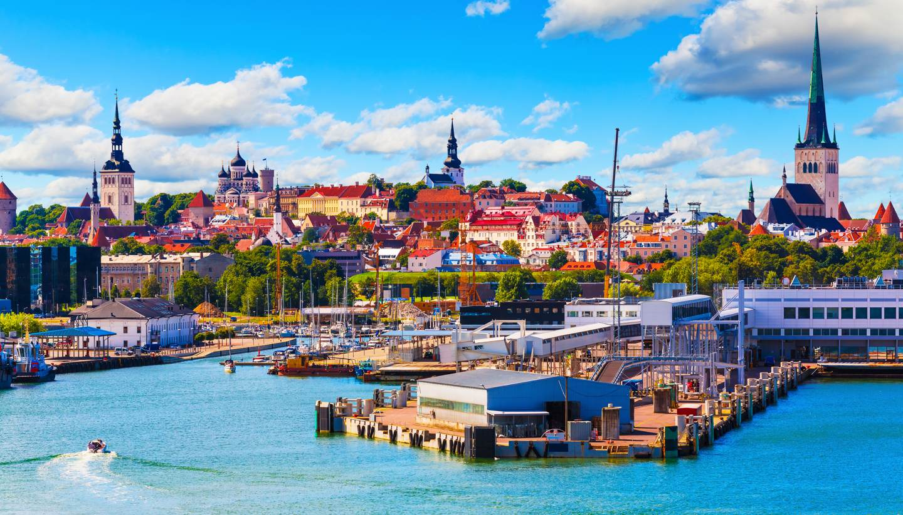
Thank you very much for your attention and if you wonder where to go during the summer, Estonia is the place to be.

