Slide 1
Fortes Lyceum EcoSchool
SECEA Teacher’s Meeting August 2021

Slide 2
How did we become an Eco-School?
What is an Eco-School?
Social Changes
Practical Changes
How to become an Eco-School internationally

Slide 3
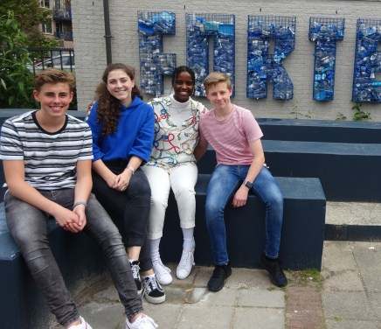
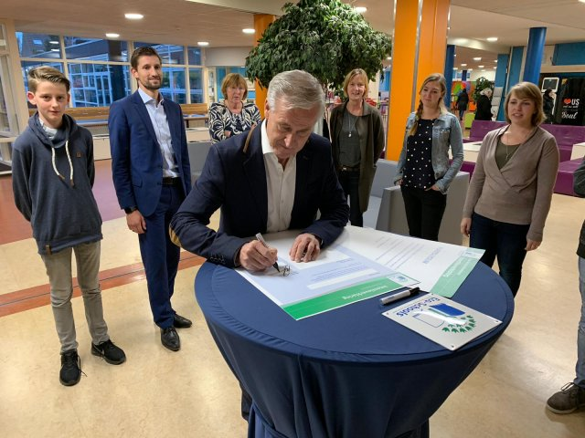
Green Flag
New Logo
Covenant

Slide 4
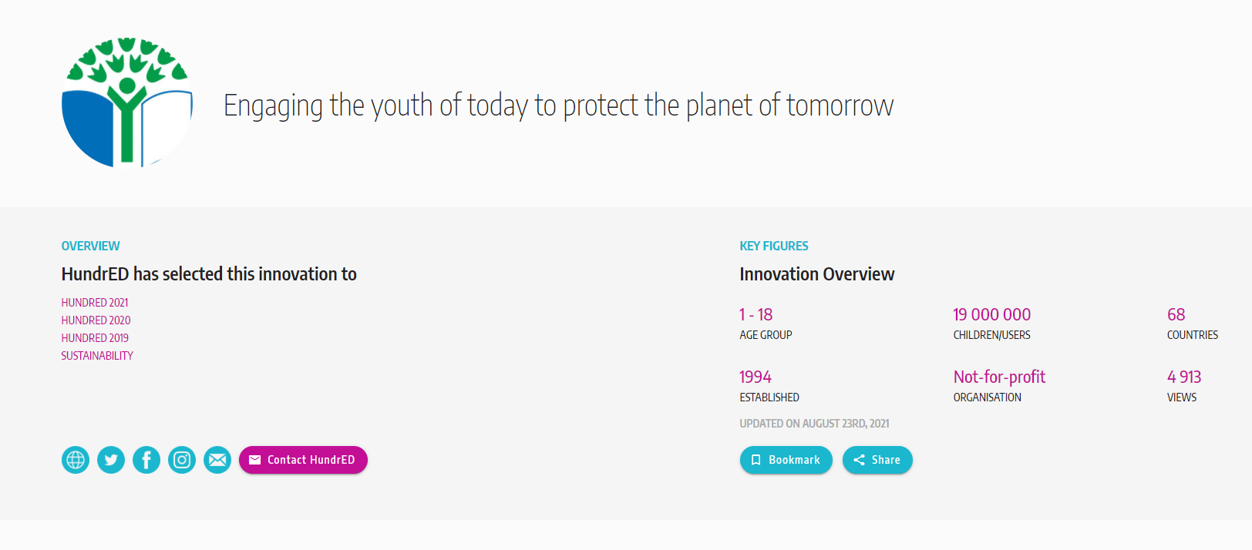
What is an Eco-School?

Slide 5
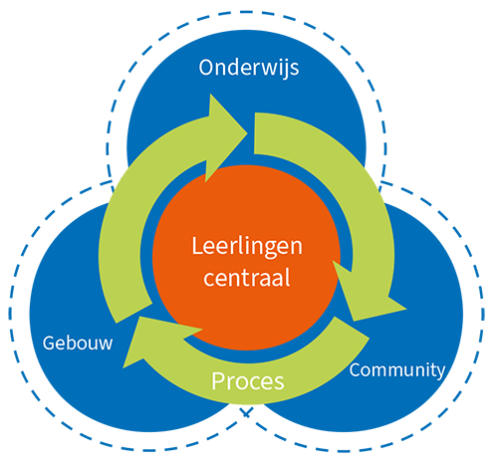
What are Eco-Schools?
Central position of students (ORANGE)
Sustainable Steps (GREEN: proces)
Sustainability as part of the educational programme (TOP BLUE: onderwijs)
Sustainability as part of the building (LEFT BLUE: gebouw)
Everybody is involved (RIGHT BLUE: community)

Slide 6
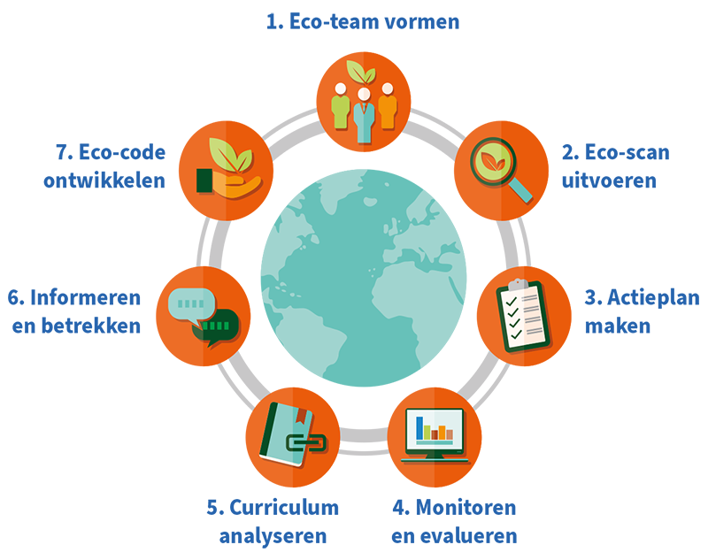
Steps to undertake
Form an eco-team
Execute an eco-scan
Make a to-do list
Monitor and evaluate
Analyze the school curriculum
Inform and Involve
Develop Eco-code

Slide 7
Central themes to consider

Slide 8
Climate
Nature
Water
Energy
Transport
Food
Waste
Possessions
Money
People

Slide 9
Changes in our School

Slide 10
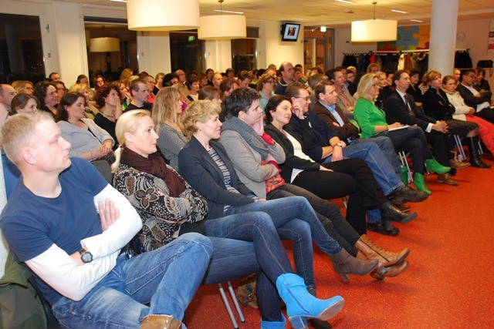
Social Changes
Regular teacher-parent-student conferences
Extra attention on social media
Sponsor runs and other (extra) curricular activities

Slide 11
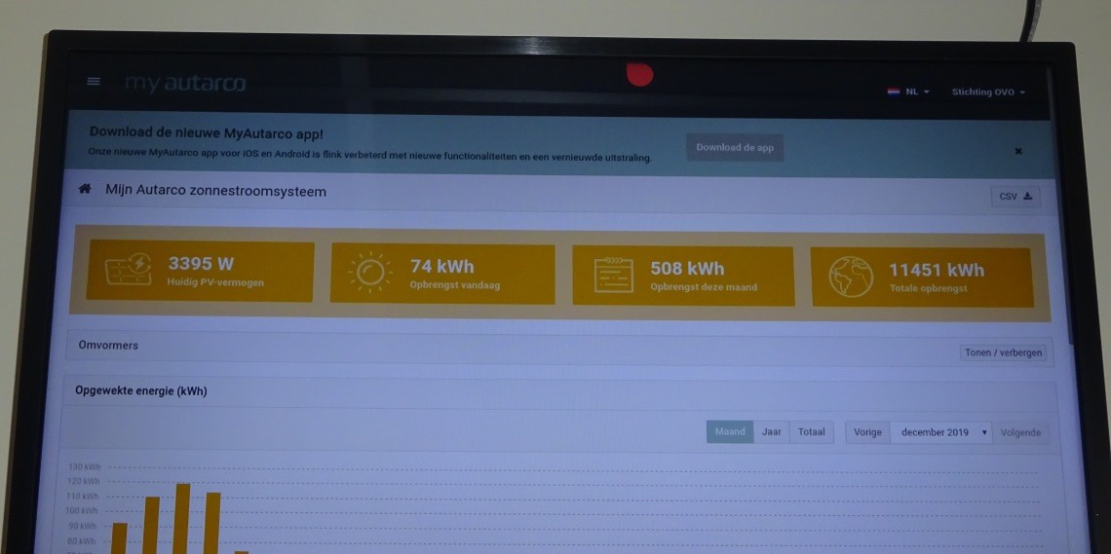
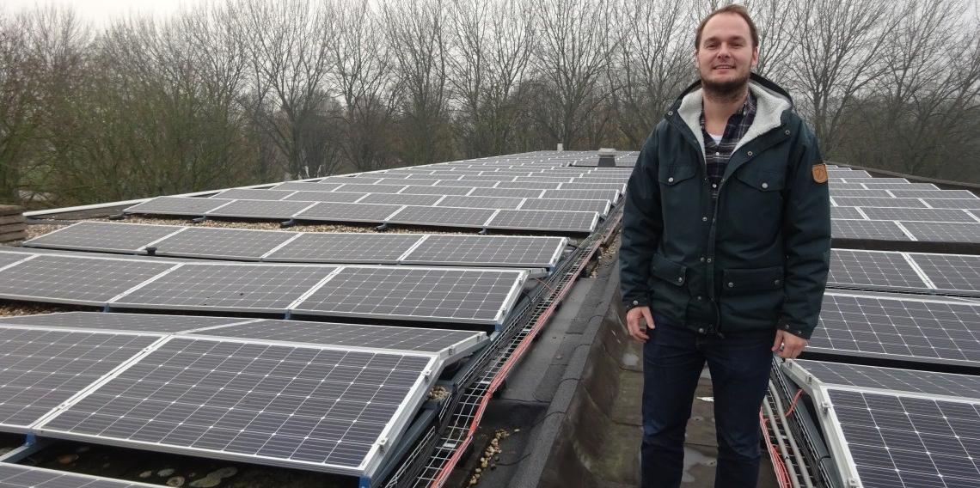
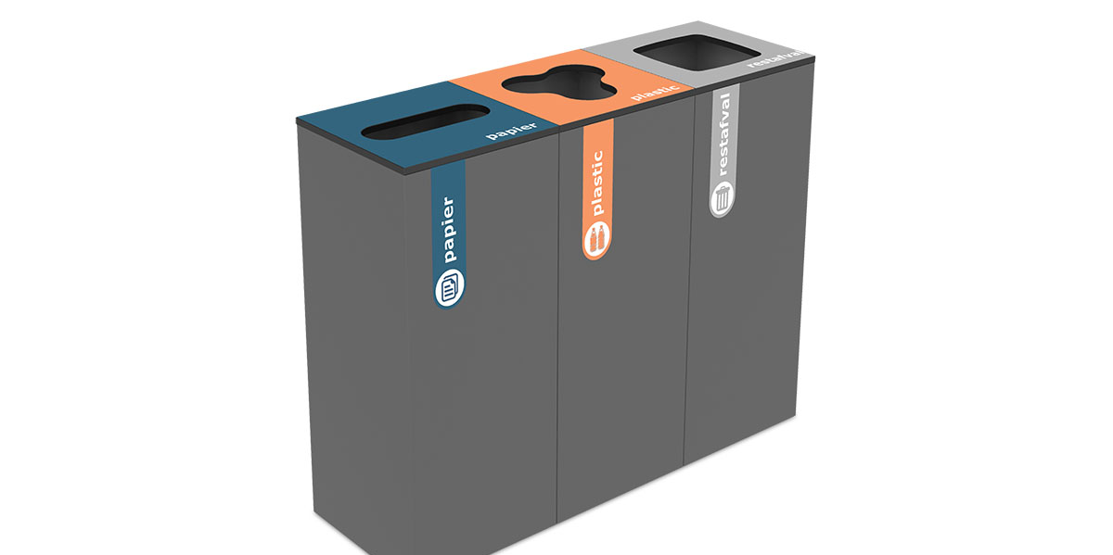
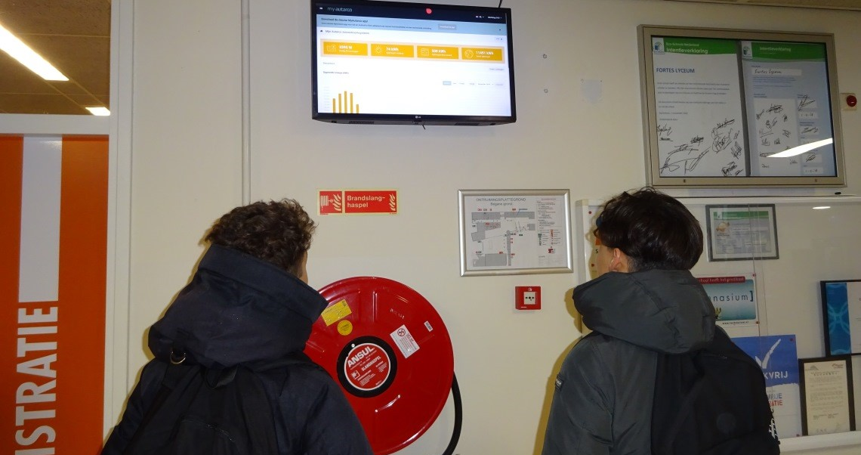
Practical Changes
Solar panels
Directly put into the school
Surplus towards local area
Direct display of energy output
Separating Waste
No single-use plastics
Personal cups
Working with canteen

Slide 12
How to become an eco-school yourself
(Dutch) Eco-Schools are part of FEE: Foundation for Environmental Education
https://www.fee.global/
ES: Asociación de Educación Ambiental y del Consumidor
IT: FEE Italy
MT: Nature Trust Malta
RO: ?
Sustainable Development Goals
https://ec.europa.eu/international-partnerships/sustainable-development-goals_en

