Slide 1
Erasmusplus
Sustain European Enviroment and Culture In an App.
2018 - 2021

Slide 2
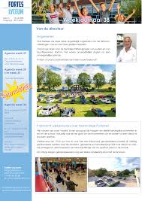
The beginning
Approval of the project.
Selecting students.

Slide 3
Teachers meeting.
August 2018

Slide 4
Letters of application September 2018

Slide 5
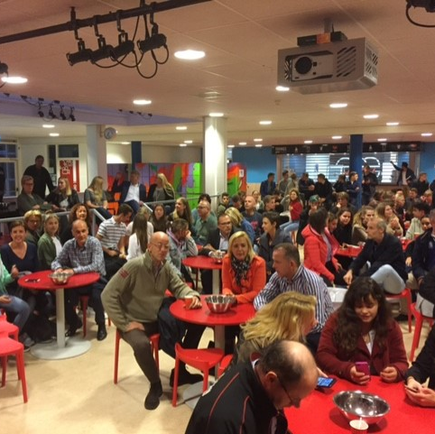
Parents information evening.
September 2018

Slide 6
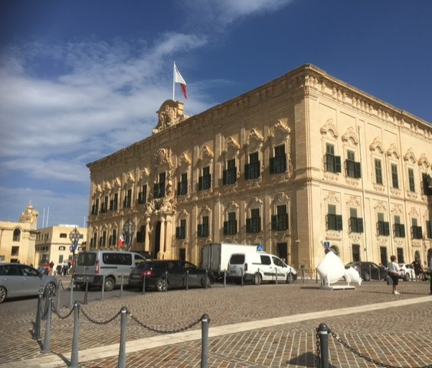
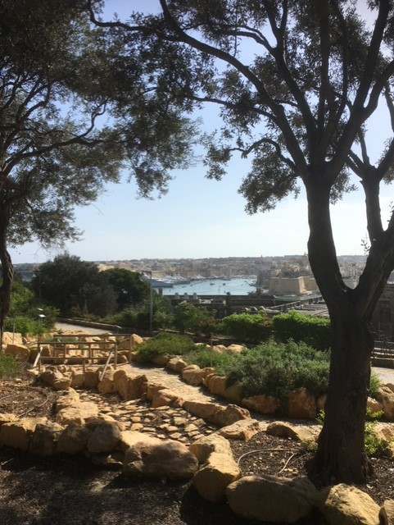
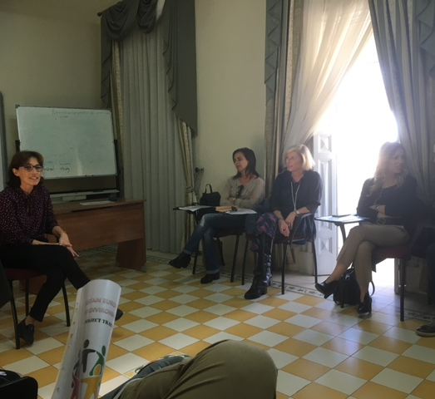
Malta.
First Mobility.
22-10-2018/26-10-2018

Slide 7
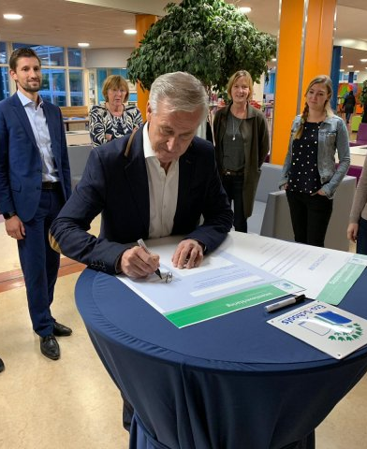
Green school November 2018

Slide 8
Green School

Slide 9
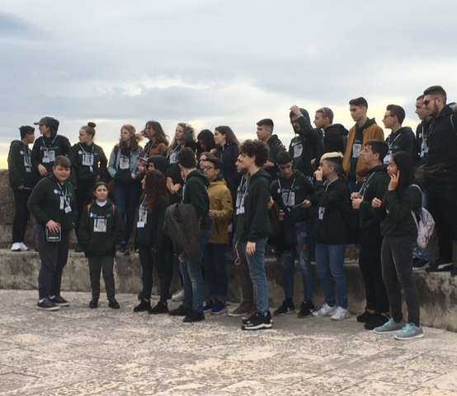
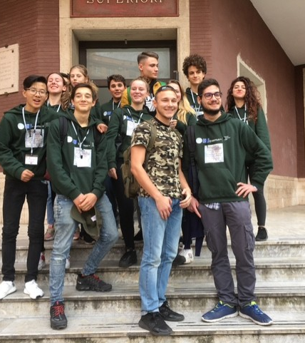
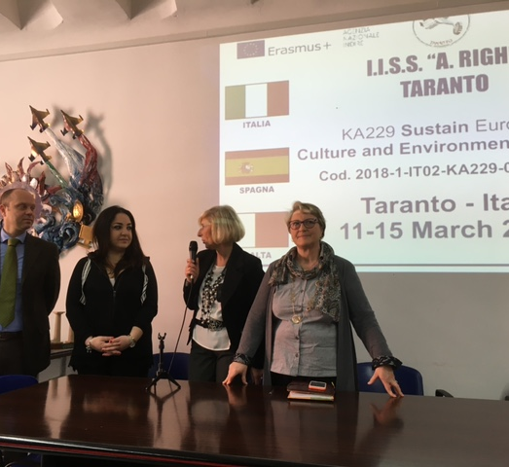
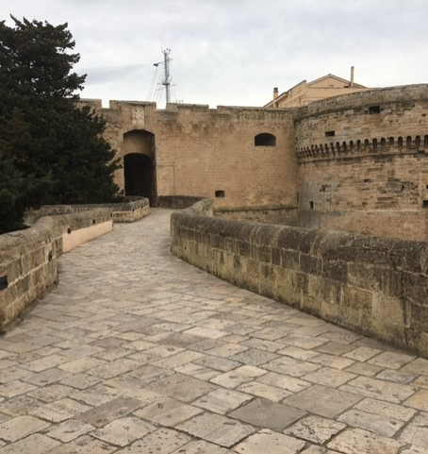
Taranto
Second Mobility.
11-03-2019/15-03-2019

Slide 10
Climate Run 398 km June 2019

Slide 11
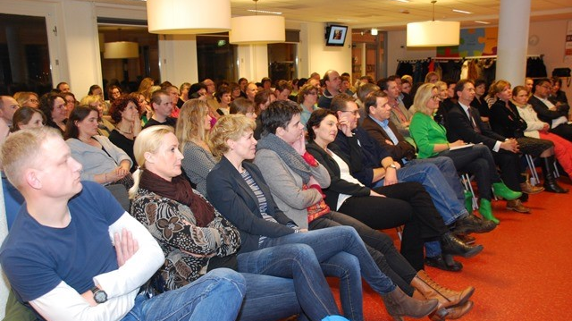
Presentation
Presenting the results.
November 2019

Slide 12
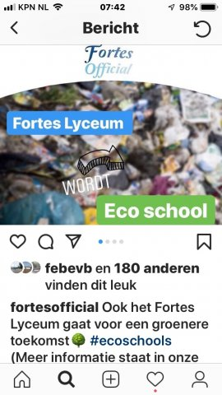
Eco school
December 2019

Slide 13
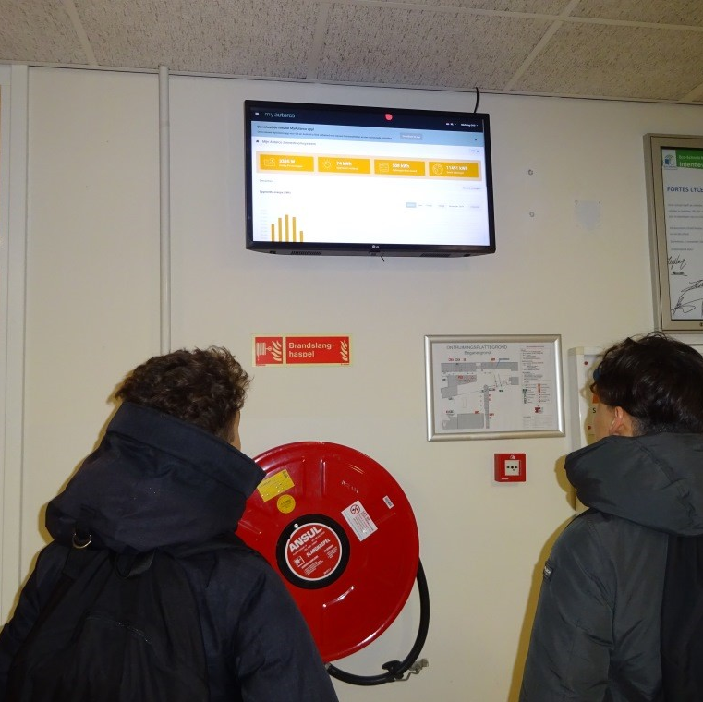
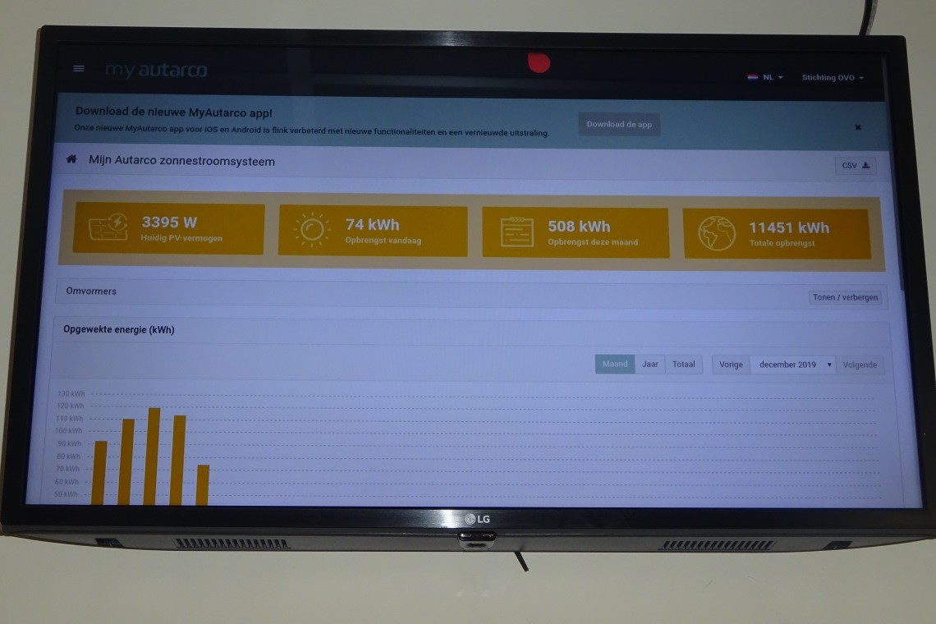
Eco school

Slide 14
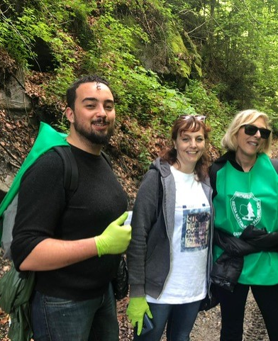
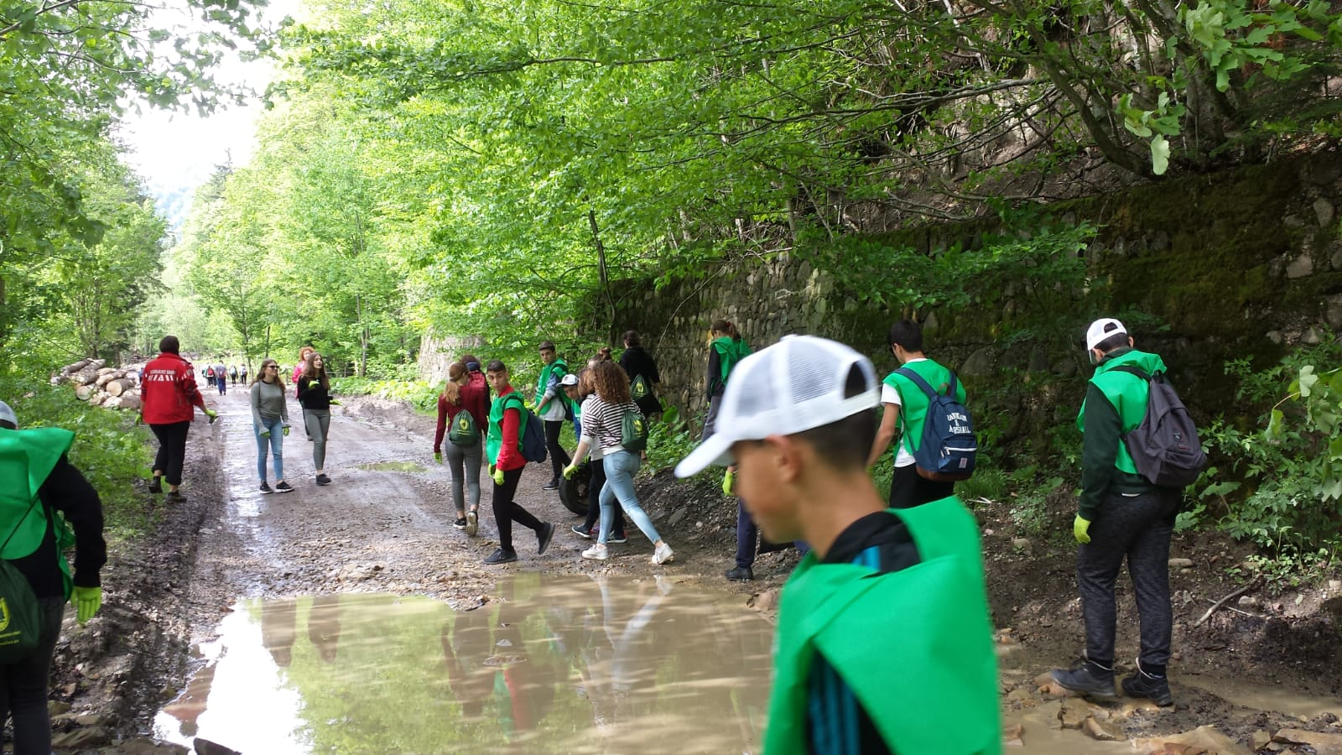
Bacau 3th Mobility 20-05-2019/24-05-2019

Slide 15
Gorinchem
4th Mobility
04-11-2019/08-11-2019

Slide 16
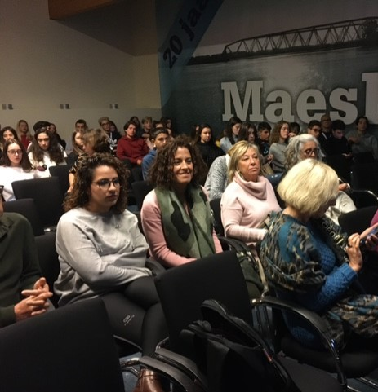
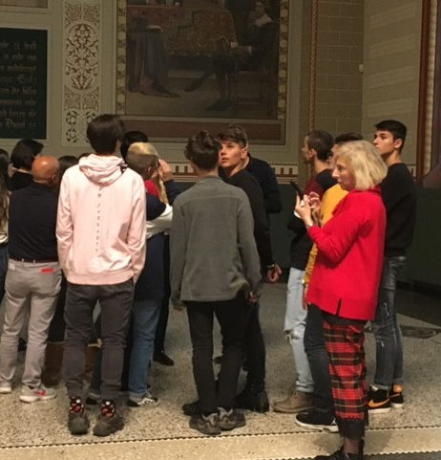
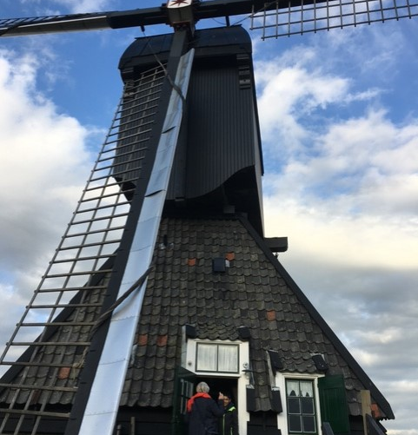
Gorinchem

Slide 17
Newspaper

Slide 18
Stichting OVO
10 primary schools
5 secondary schools

Slide 19
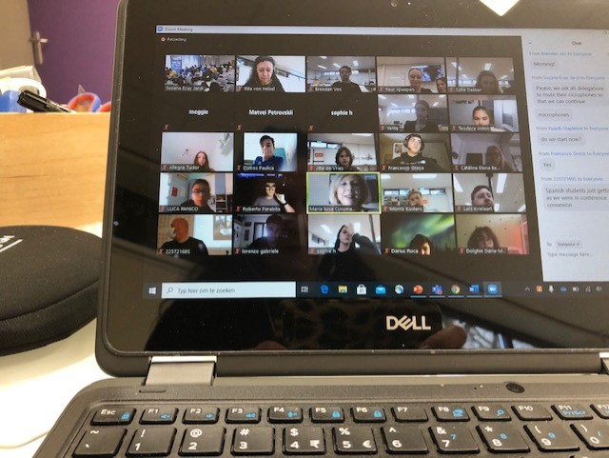
El Vendrell Online 22-03-2021/24-03-2021

Slide 20
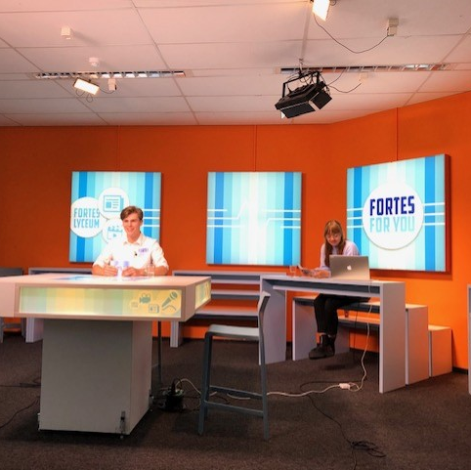
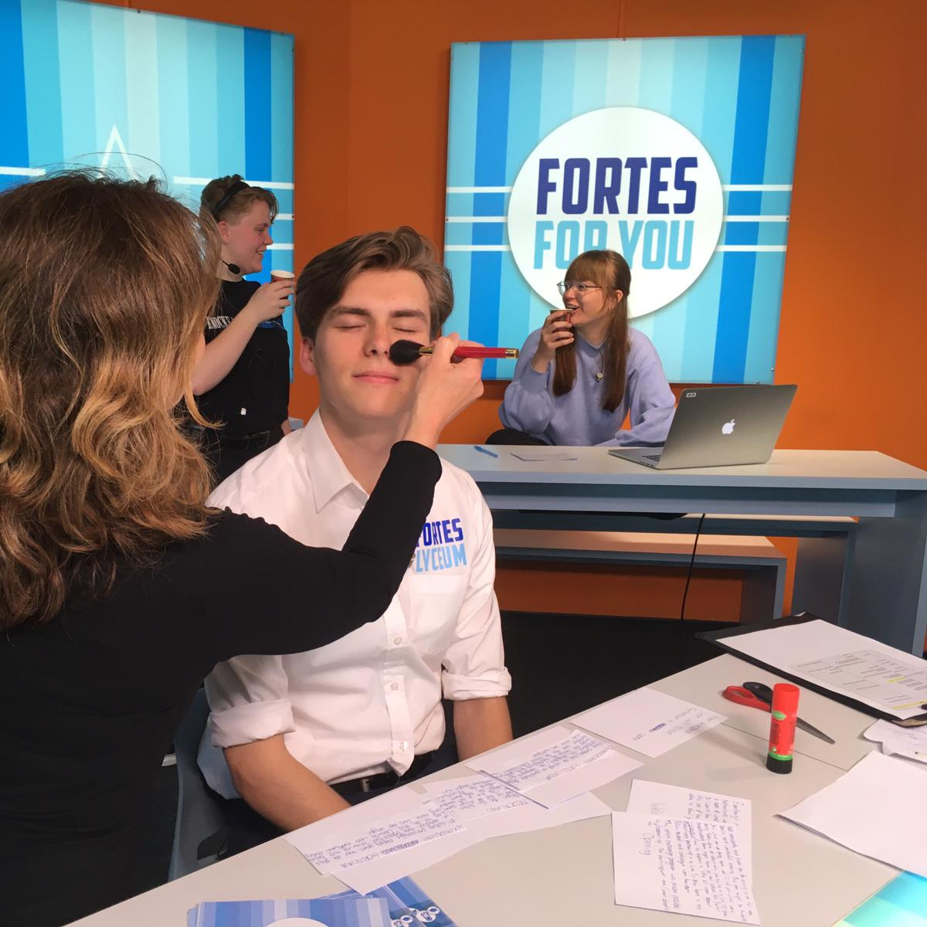
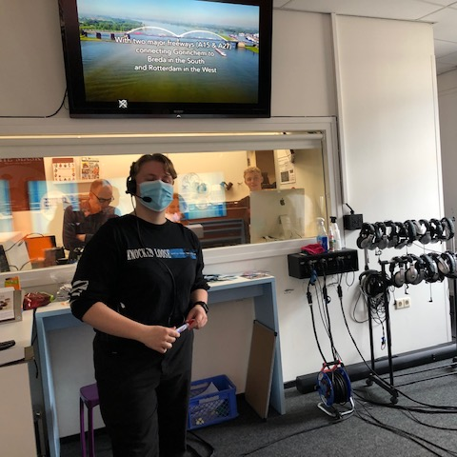
Talkshow
26-03-2021

Slide 21
Weekjournaal

