Slide 2
The Netherland poem for S.E.C.E.A
Next was Romania in the wood
Did lots of walking, all on foot
Nature’s important, keeping it clean
In this mobility we have seen
We love travelling
We love traveling, we’re not dumb.
Meeting people, having fun.
Started the project two years ago
Taking a plane to Taranto
Welcome we felt with Italian friends
Walking the city with all its bends
Eating the pizza’s, visiting school
Doing the football, we’re no fool
Then it was our turn to host you all
We tried very hard and we had a ball
Visiting Amsterdam, museum and boat
Rotterdam, Waterworks, deep in our coat
Then came corona we could not go out
Online we are meeting, here’s our shout
Hurray for Erasmus again we have fun
We love traveling, we’re not dumb.

Slide 3
MALTA
POEMS

Slide 6
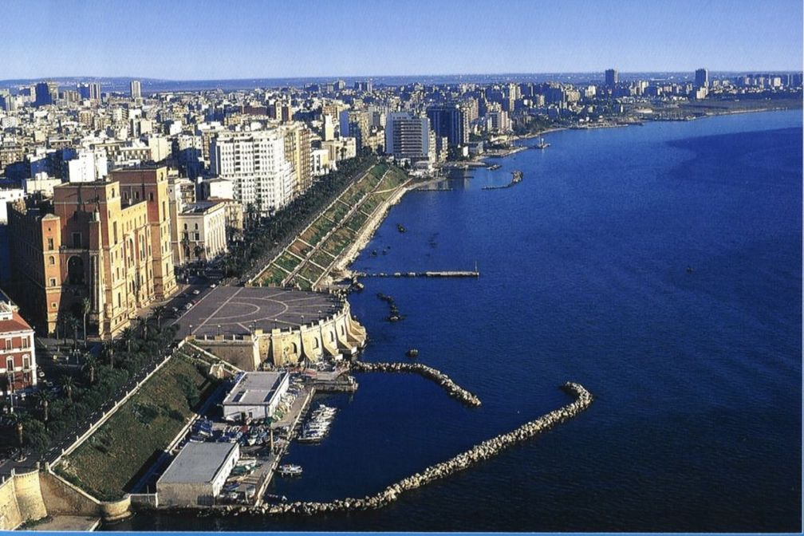
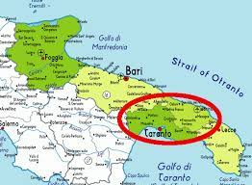
TARANTO
TARANTO
poems

Slide 11
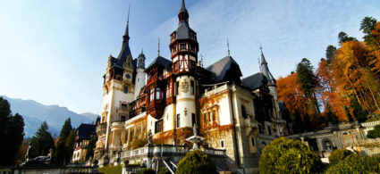
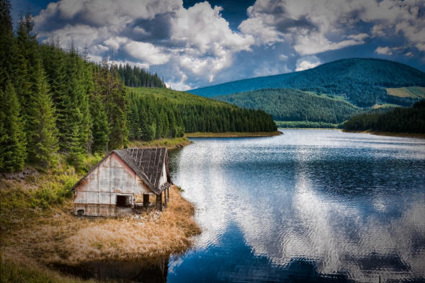
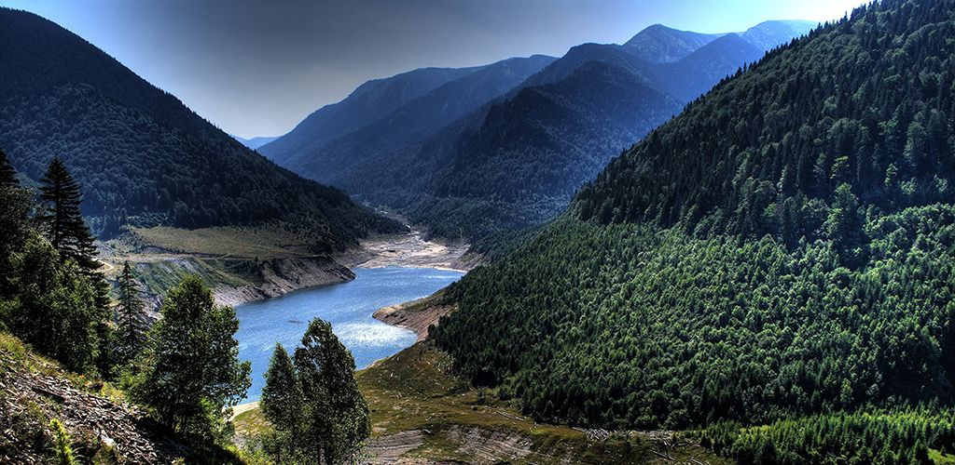
POEMS

Slide 19
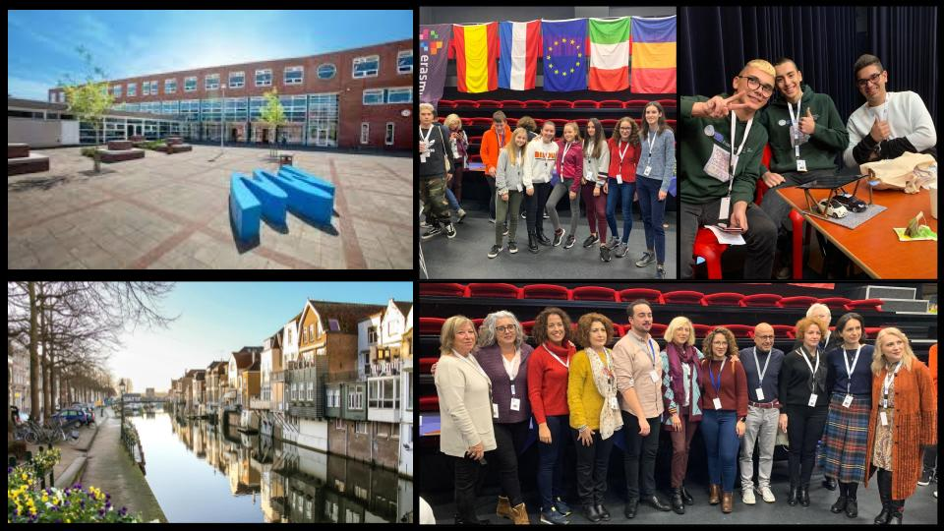

Slide 20
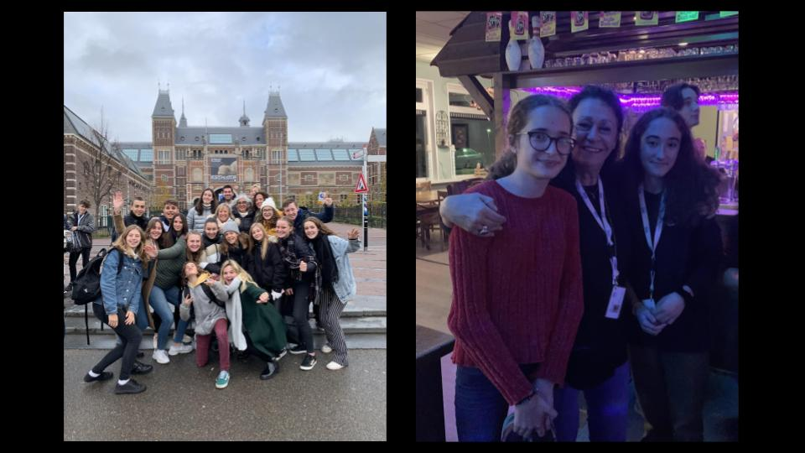

Slide 21
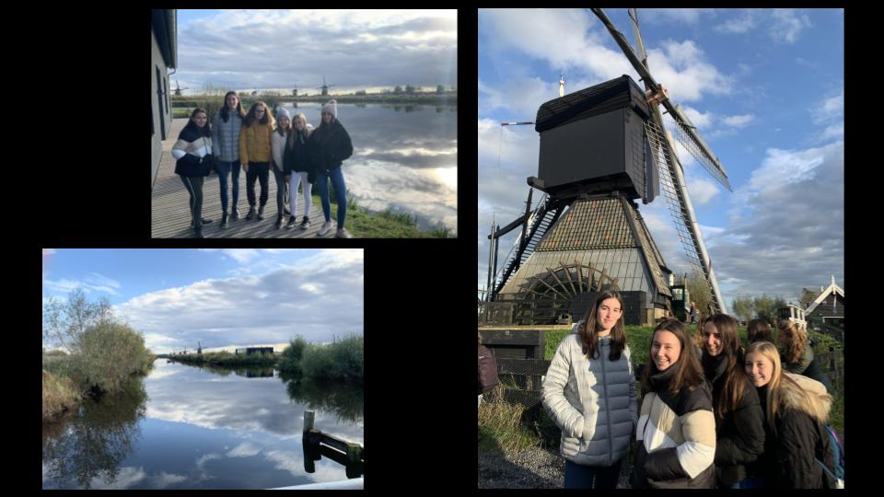

Slide 22
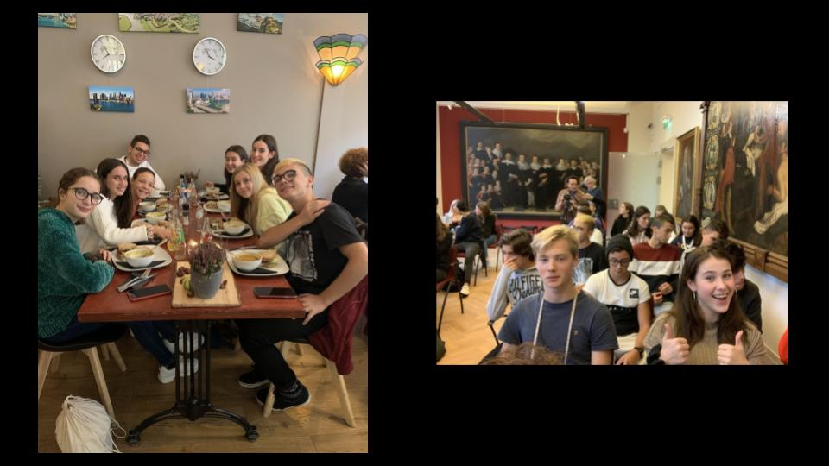

Slide 23
THANK YOU

