Slide 1
Optional subject presentation: green schools
2nd ESO

Slide 2
CONTENTS PAGE
Recycling paper
Recycling batteries
Recycling plastic
Recycling stoppers

Slide 3
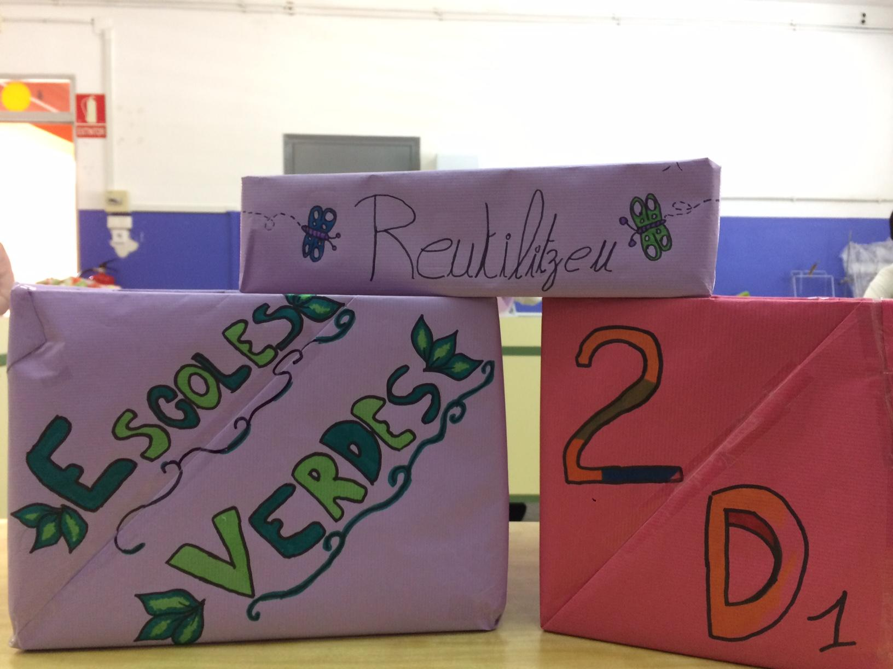
1.Recycling paper
Each classroom will have two bins.
The smaller one will be for reusing paper.
The bigger one will be for papers we can not reuse, that is recycling paper.

Slide 4
2. CONTEST
The students of optional green schools subject are going to pass for each classroom on Tuesdays. They are going to review the recycling bins.
They are going to score : the paper bin, the big one and the small one.
If everything is right, they are going to give it 1 point, otherwise the class is not going to receive any point.
At the end of the course, the class with more points will win a prize.

Slide 5
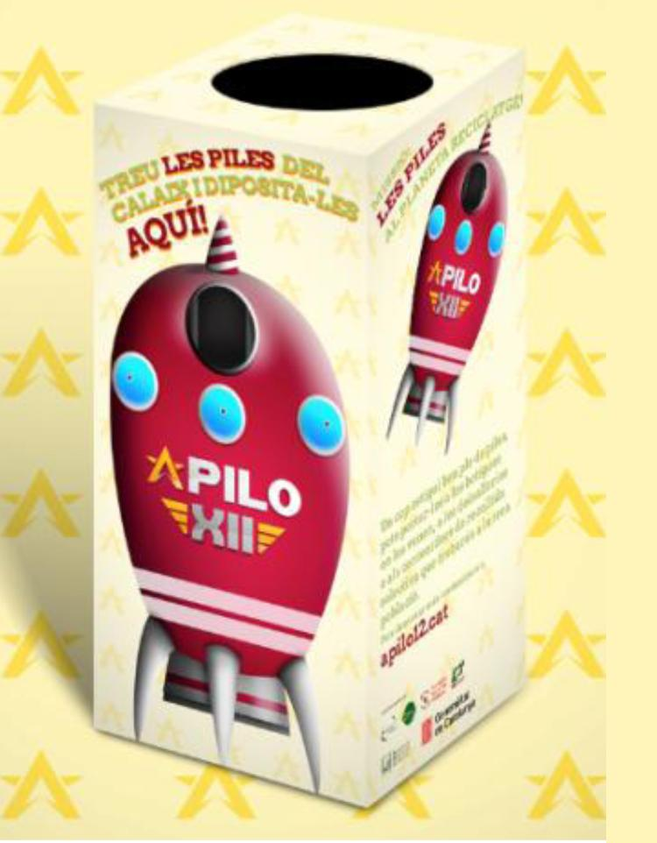
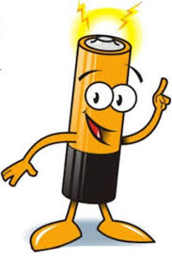
3. Recycling batteries
There are two small boxes to recycle batteries in each classroom.
You can take your used batteries and throw them away, inside the boxes.

Slide 6
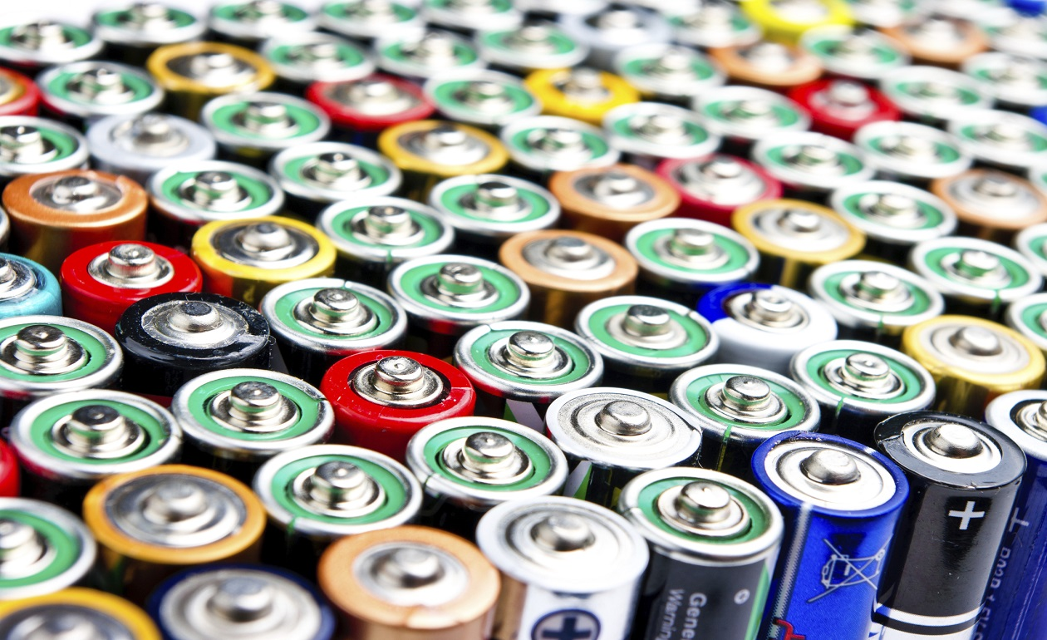
4. BATTERIES CONTEST
Every two or three weeks, the students are going to review the batteries boxes.
They will weigh the batteries on a scale.
The classroom with more batteries will win the contest, because it will be the best recycling.

Slide 7
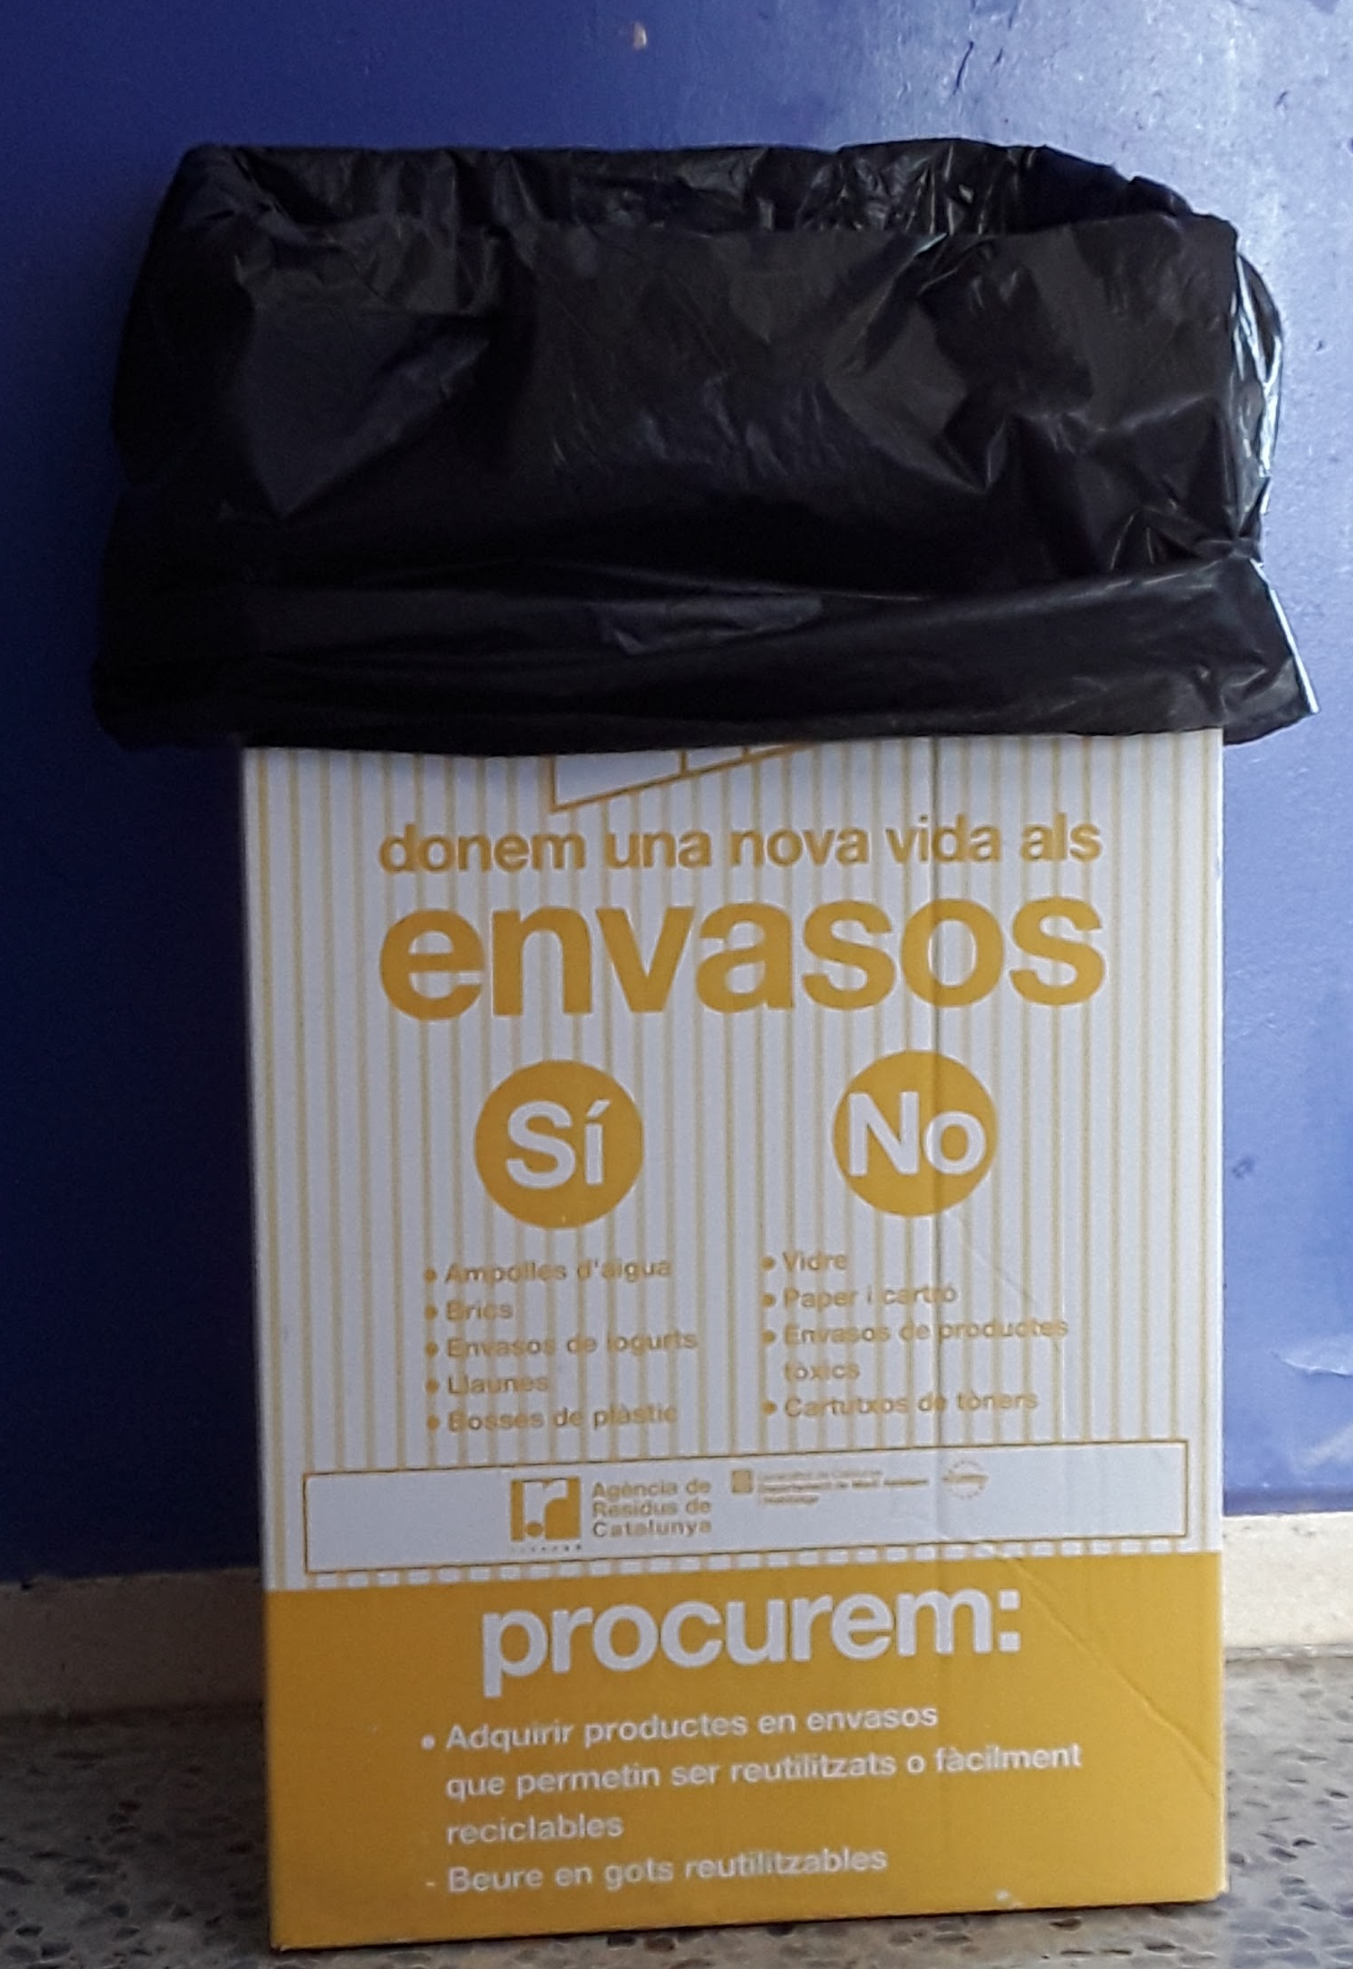
5. RECYCLING PLASTIC
On the first and second floor hall there is a big, cardboard and yellow box. On the first floor is in front of C-14 class, on the second floor is next to C-21 class.
You can recycle plastic paper, plastic bottles, bricks, cartons, plastic bags and aluminium paper.

Slide 8
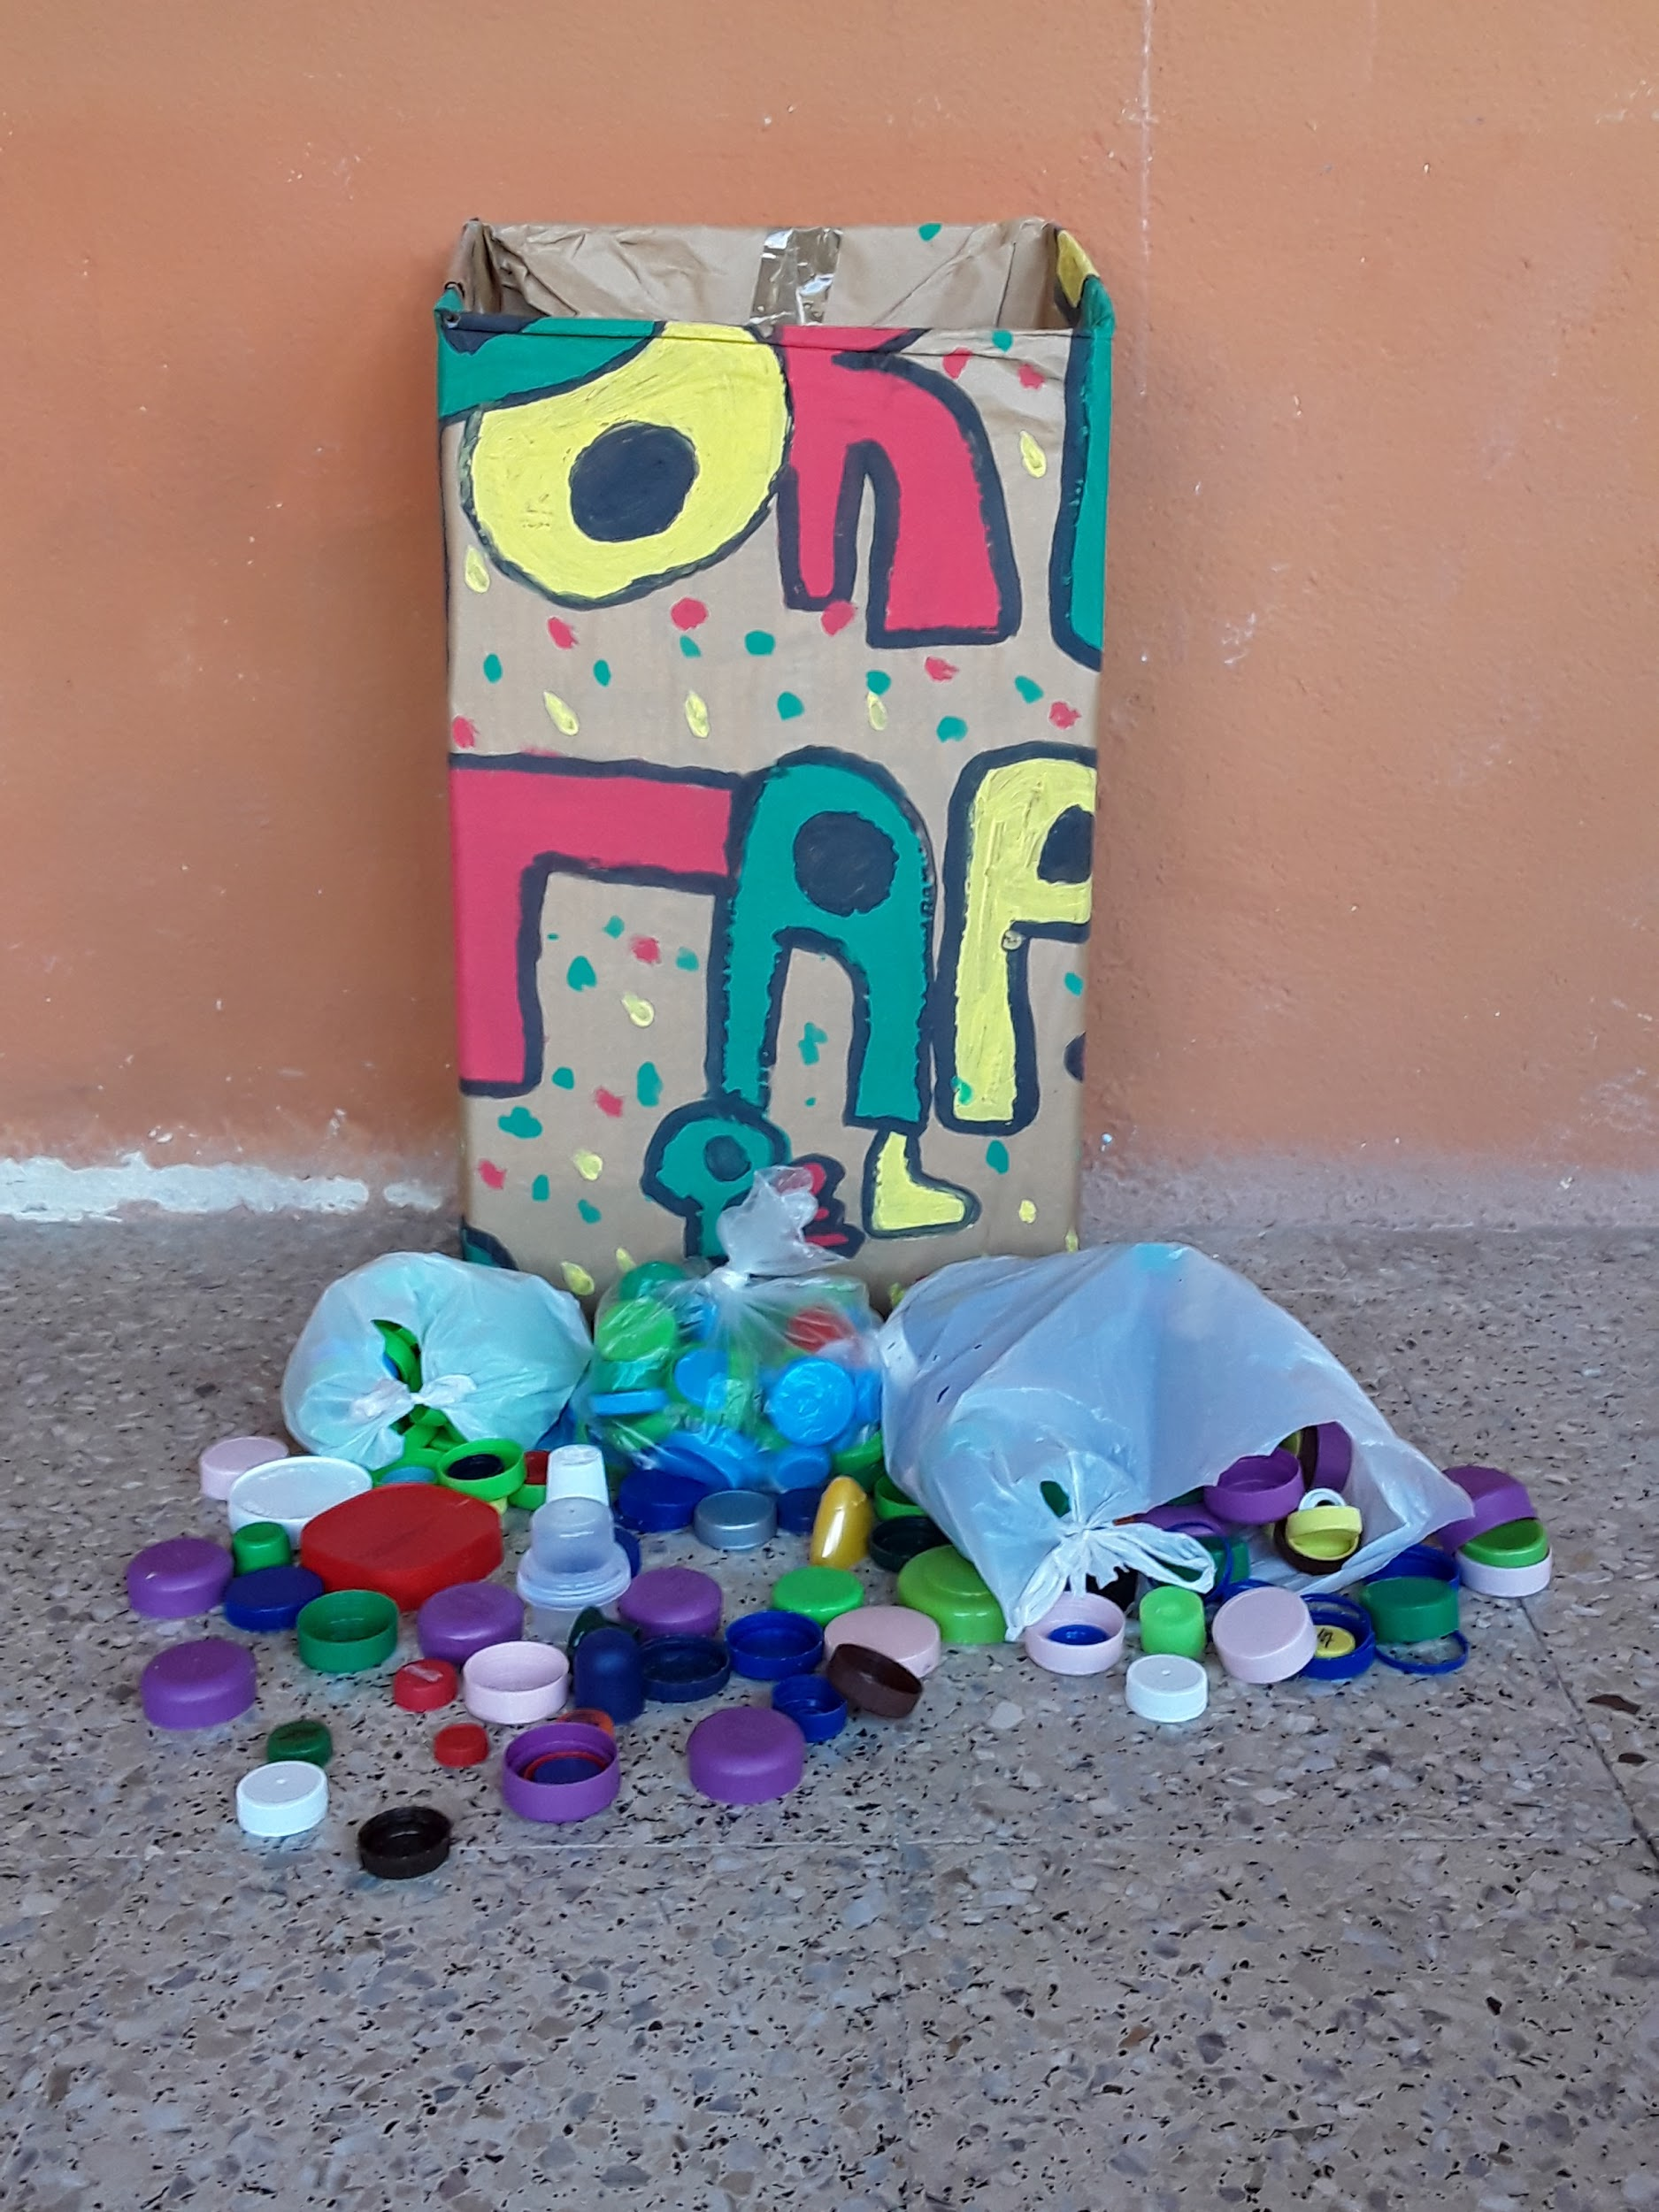
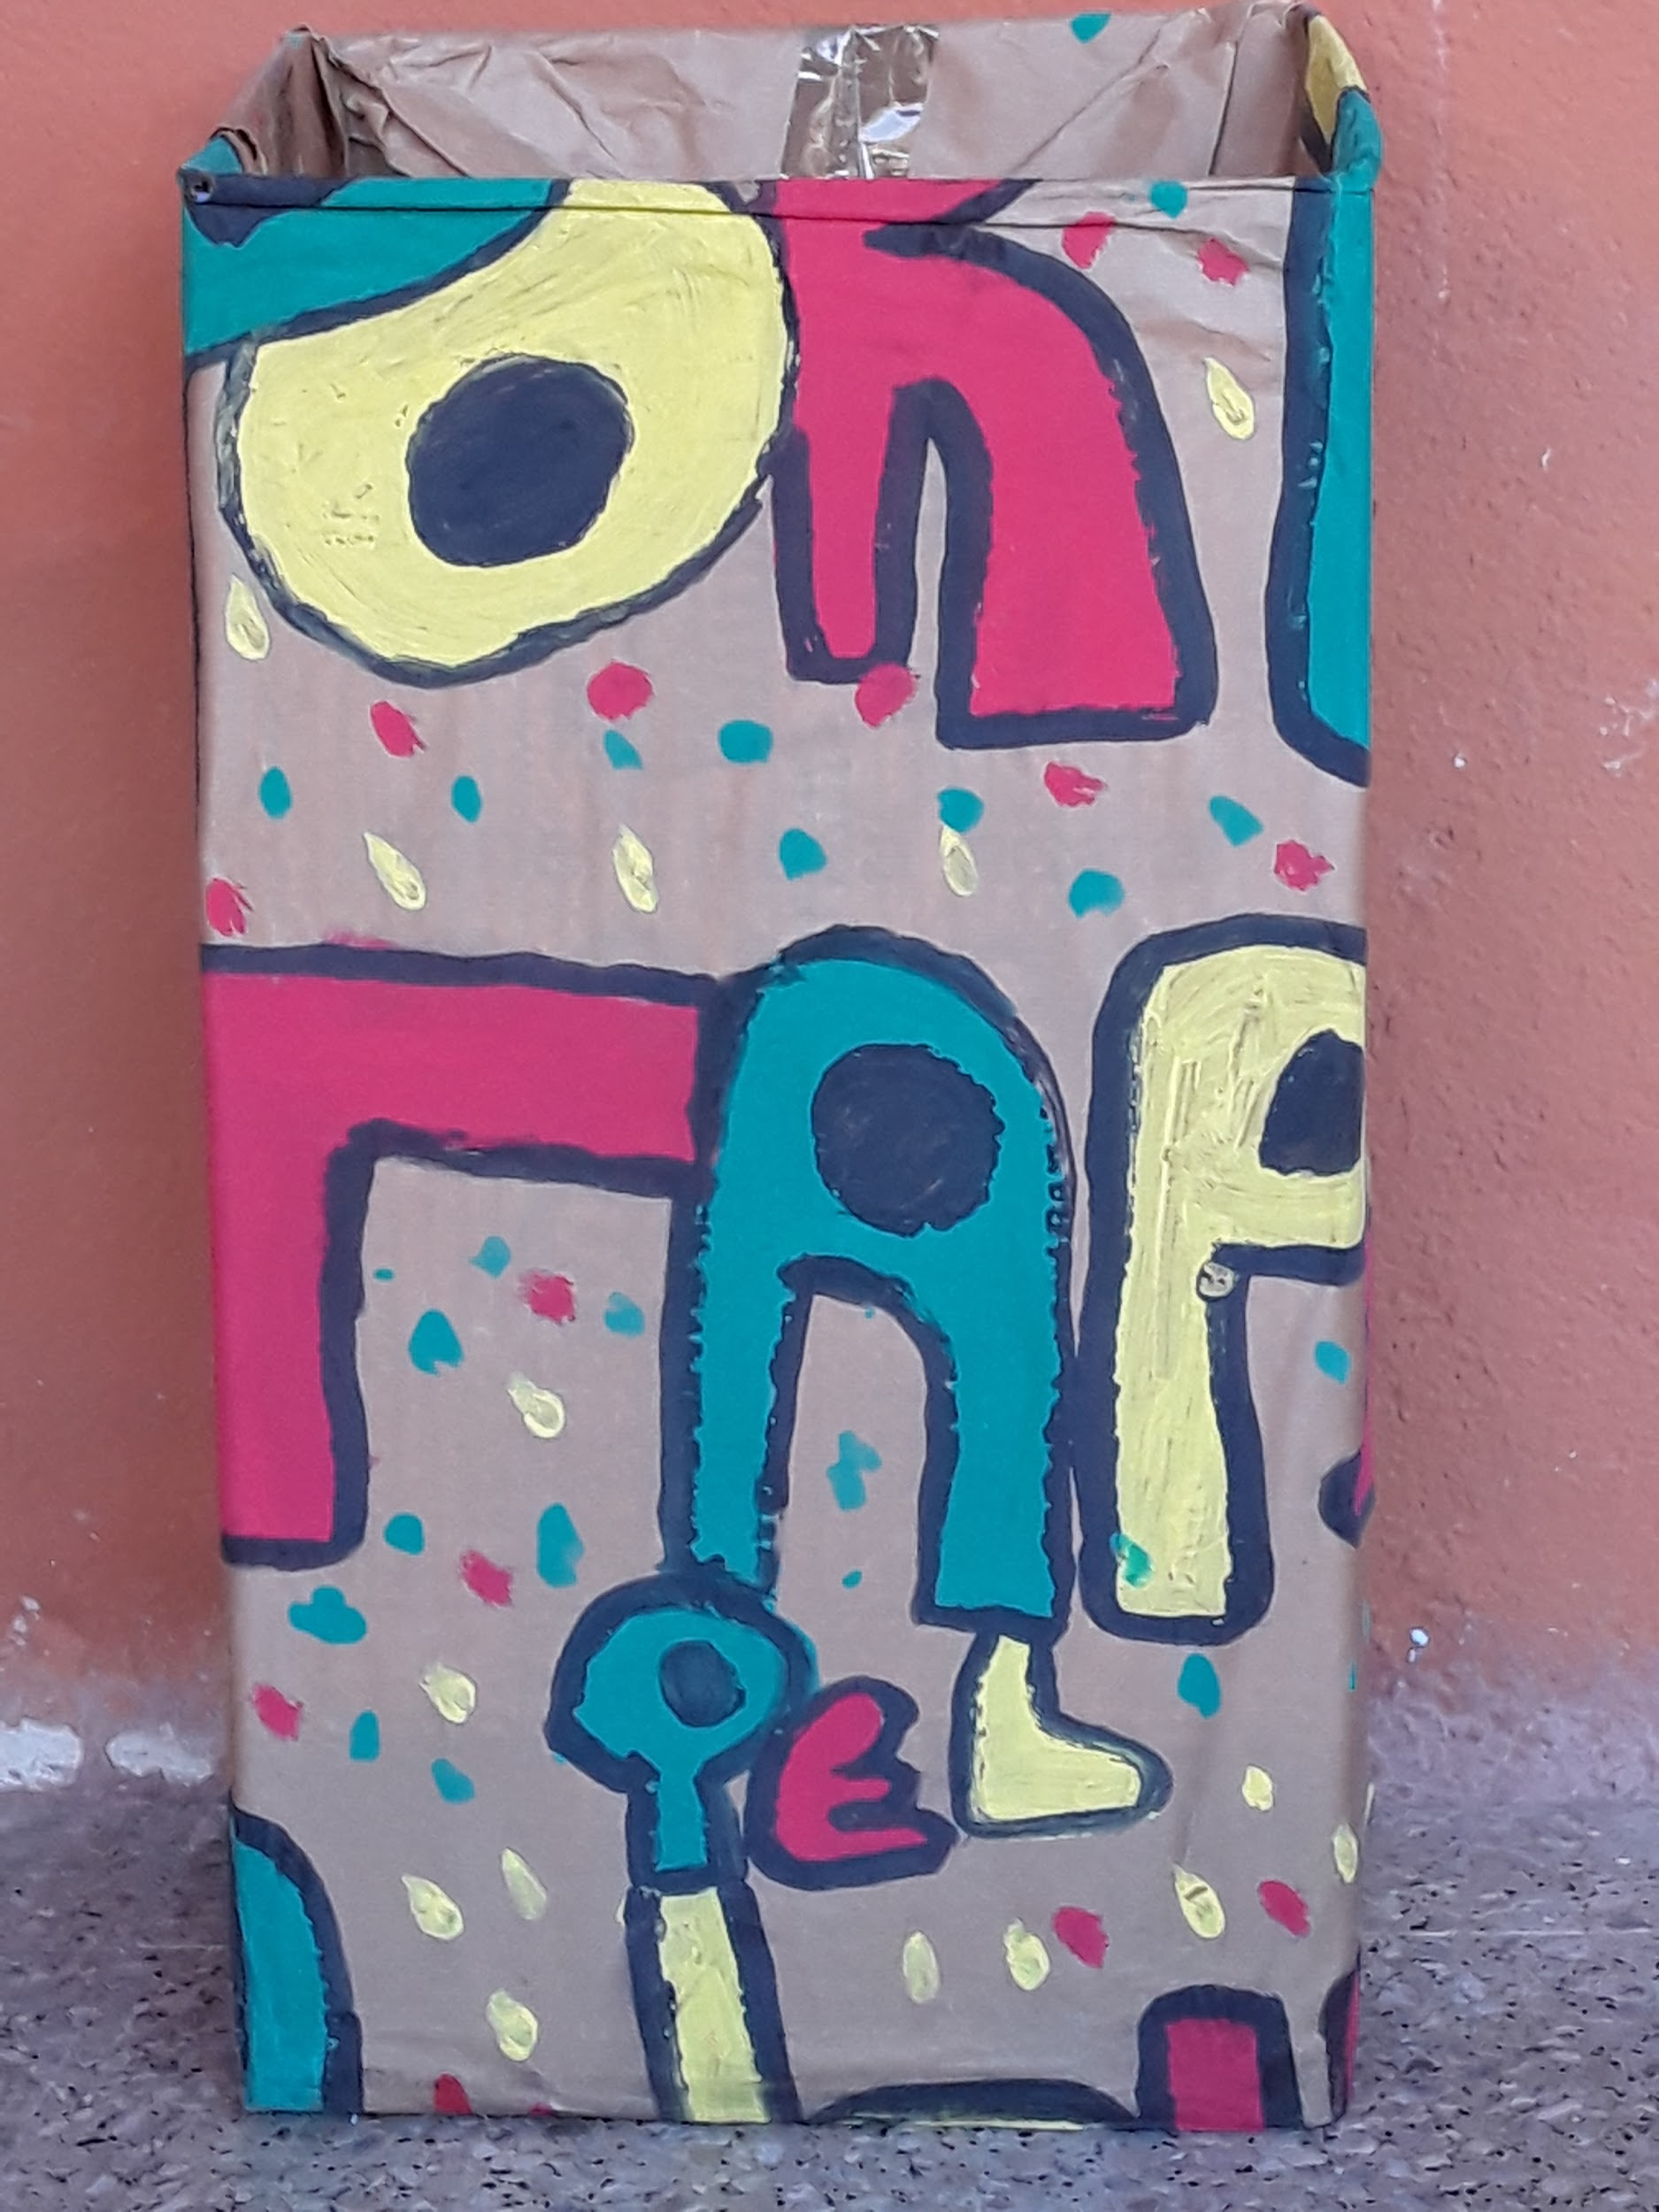
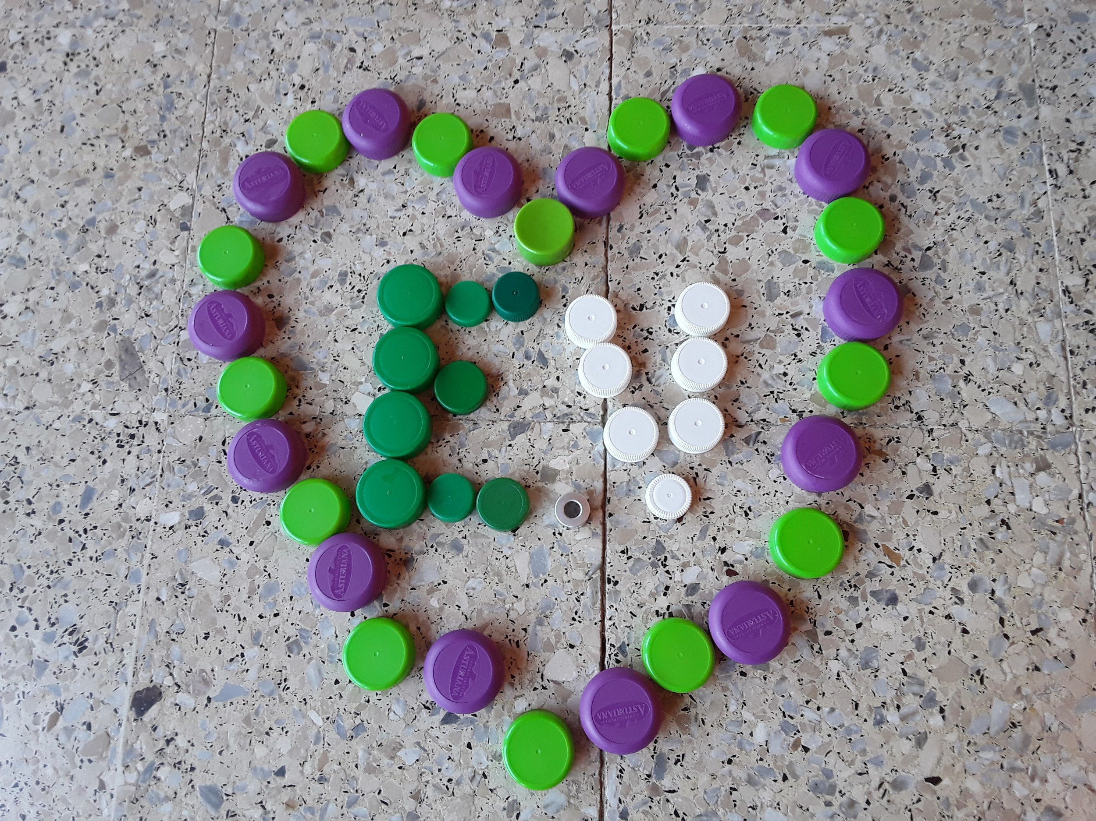
6. RECYCLING STOPPERS/PLUGS
On the ground floor, in the office room, there is a big decorated box where you can recycle stoppers. You can bring your plugs!!! The company that collects them is called Cel Rogent.

Slide 9
WE WISH YOUR PARTICIPATION IN OUR RECYCLING PROJECT!!!

Slide 10
THANKS FOR YOUR ATTENTION!!!

