Slide 1
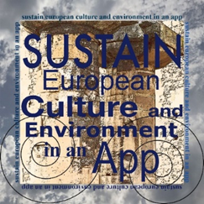
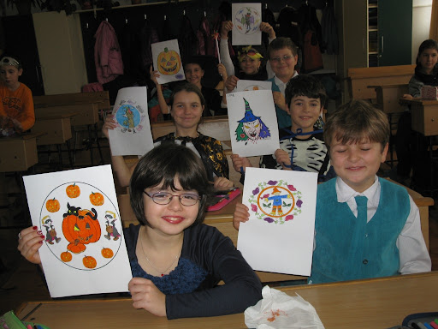
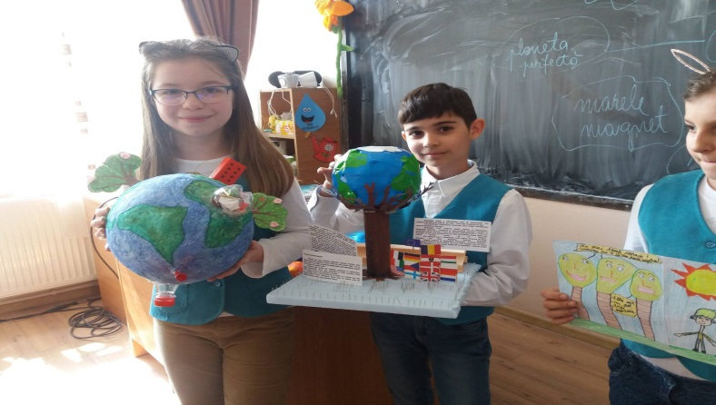
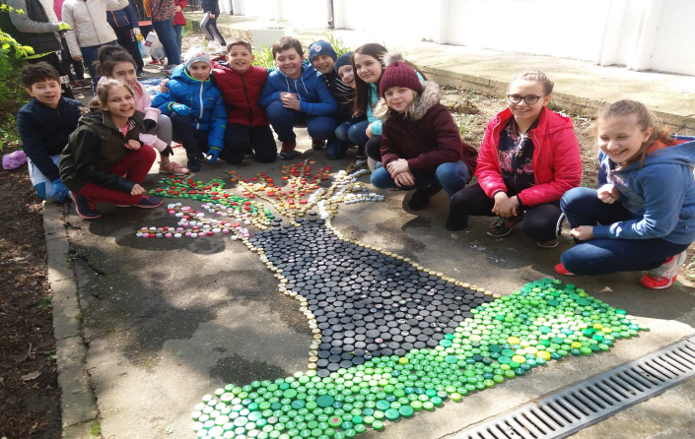
Direct and indirect beneficiaries
There are 3 categories of direct beneficiaries: students in secondary education, teachers involved in the project, partner institutions.
There are 4 categories of indirect beneficiaries:
family members of students involved in the project;
fellow students involved in the project;
all teachers from the schools involved in the project;
local community.

Slide 2
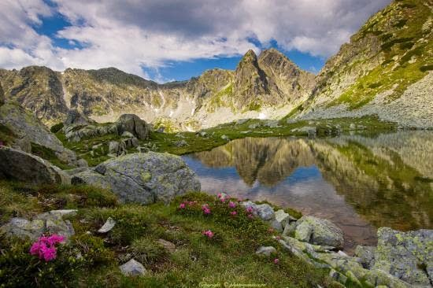
Return to Mother Nature ""
EDUCATIONAL PROJECT
2018-2019

Slide 3
Activities, in the order in which they will take place
I. Project preparation and launch - November 15, 2018
II. Thematic activity "Save the forest!" - March 2019
III Thematic contest "Green Detectives" - April 2019
IV. Thematic activity "Return to Mother Nature" - May 2019

Slide 4
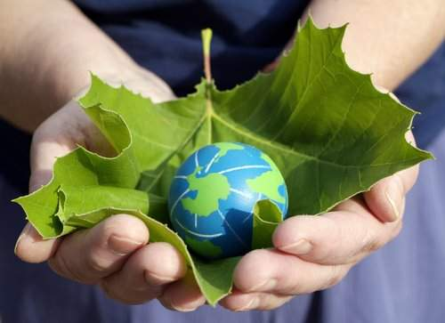
Description of the main activity
Activity title - "Return to Mother Nature"
Date / period of development - May 20-26, 2019
Place of development - Pralea locality, Căiuți commune, Bacău county;
Participants - students from “Miron Costin” Bacău Secondary School, teachers, parents, representatives of Bacău Forestry Department and the local community.

Slide 5
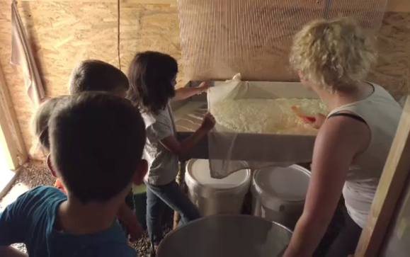
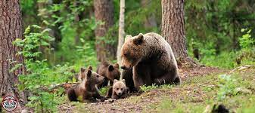
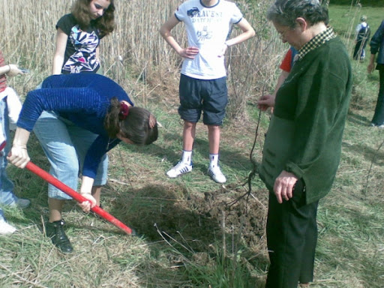
Briefly describing the activity
Teams of students greened the Pralea - Căiuți area, planted trees, learned techniques of forest survival and orientation. They also went to a sheepfold to see how the traditional products are prepared and visited the bear observatories in the area. For a true history lesson, they were accommodated at the hunting lodge in Pralea, which belonged to the dictator Nicolae Ceaușescu.

Slide 6
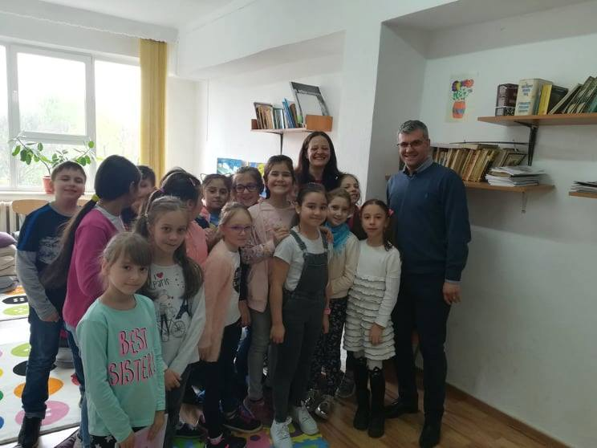
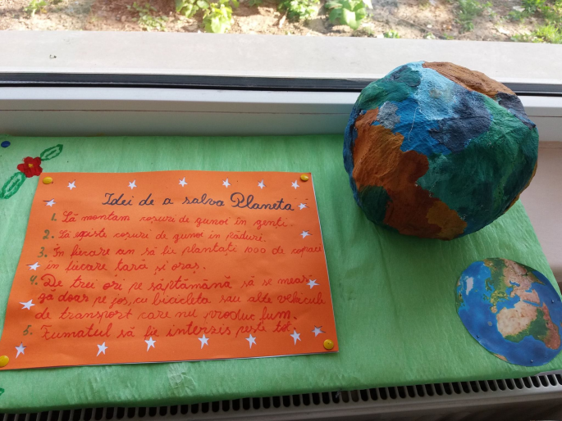
Estimated educational impact on the target group
Through activities of all kinds, through involvement, dedication and conviction, the participants will be able to develop their spirit of initiative, to learn to take responsibility, to integrate into a team.
The fact that the project also includes activities that take place in a rural area of ​​Romania, again is a beneficial thing for participants, who will learn to cope in a seemingly hostile environment, will stay away from the tumult of civilization, will see and will feel the true face of nature, they will try to adapt and integrate into it. All the activities included in the project will have an active but also an attractive character, and the objective to be achieved is to teach young people to overcome difficulties, to develop personally, to improve their social relations, to know and understand everything related to nature, natural phenomena, to form an attitude of respect and protection for the environment.

Slide 7
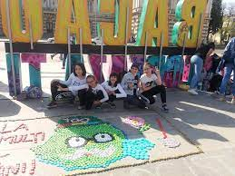
Estimated educational impact on the target group
About the school:
- positive changes in the behavior of students and teachers, who will learn to know and respect the environment;
-positive changes in children's behavior, which will interact much better with colleagues and teachers, which leads to increased self-confidence;
- increasing the prestige of the school, by popularizing educational activities;
- The innovative models promoted by the project team will be transmitted to other schools, thus becoming a model of good practices;
- The possibility of establishing partnerships with other schools in the country and abroad.

Slide 8
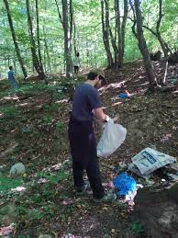
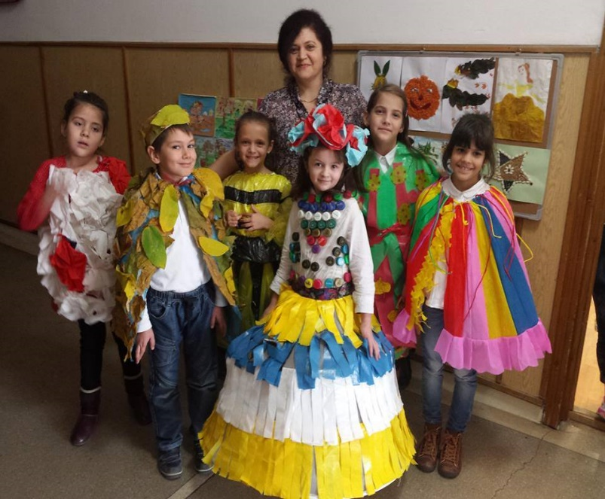
Activity title – “Save the forest!”
Date - March 21, 2019
Venue - "Miron Costin" Gymnasium School, Bacau, Valea Trotușului.
Participants - students, teachers.
Briefly describing the activity
In March, on the International Day of Forest Protection, 10 children from “Miron Costin” Gymnasium School will go to Valea Trotușului, where, with the support of Bacău Forestry Department, they will participate in an afforestation action. At the same time, the younger middle school students will make an exhibition of drawings on ecological themes, participate in an ecology seminar and will hold a fashion contest with clothing made from recycled products.
Beneficiaries - students participating in the project, teachers, invitations, parents, local community.
Evaluation methods - exhibition, debates, direct discussions, satisfaction questionnaires, observation.

Slide 9
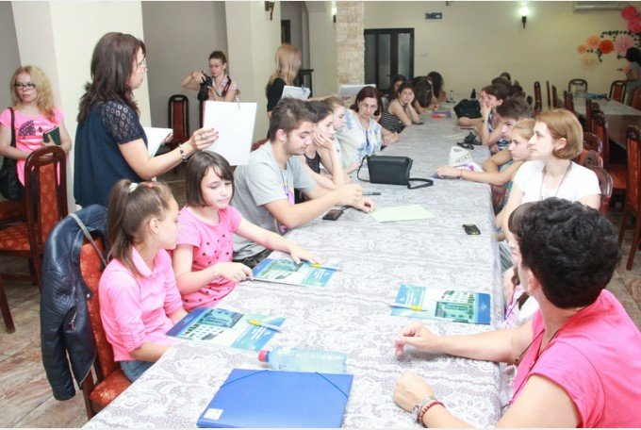
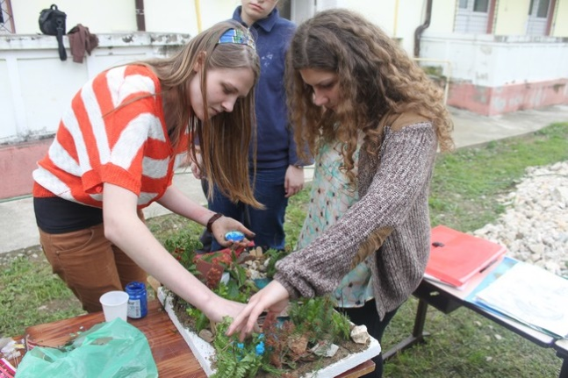
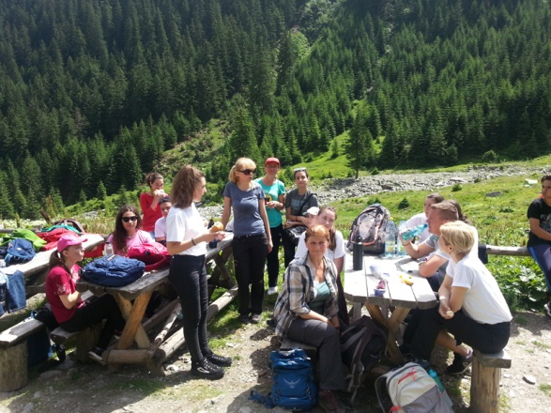
Activity title - "Green detectives"
Date / period of development - April 15, 2019
Venue - "Miron Costin" High School Bacau and Bistrita Valley.
Participants - students, teachers, representatives of Bacău Forestry Department, of the local community.
Briefly describing the activity
A competition on ecological topics was held at the school among primary school children. The winners were declared "Green Detectives" and were awarded.
Beneficiaries - students participating in the project, teachers, parents, guests, local community.

Slide 10
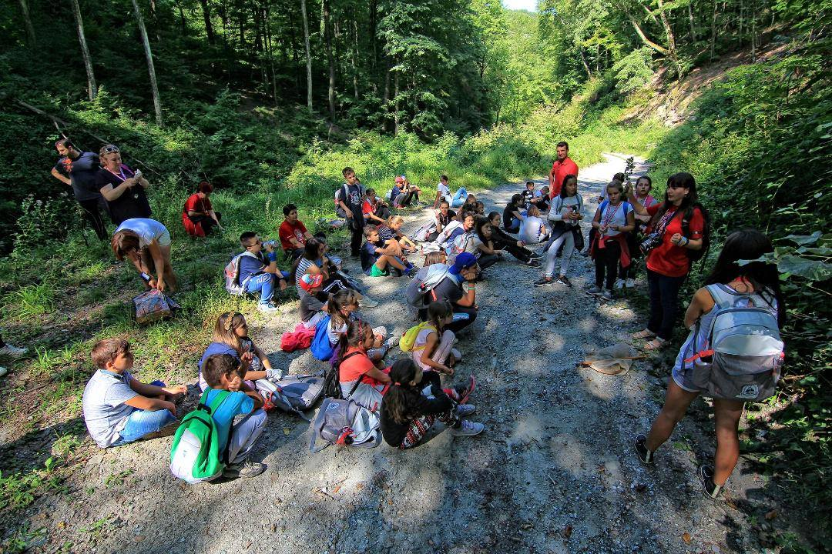
Activity title - "Return to Mother Nature"
Date / period of development - May 20-26, 2019
Venue - The forest from Pralea locality, Căiuți commune.
Participants - students, teachers, representatives of the Bacău Forestry Department, volunteers.

Slide 11
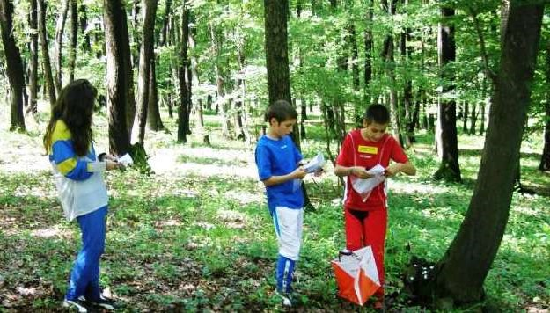
First day
During the ecotourism test, the participants traveled on a marked two-hour route with checkpoints and used the map and compass. The crews were checked on the individual equipment being mandatory backpack, boots, raincoat, tracksuit, hat / hat, sunglasses, flashlight, water bottle, whistle, matches, knife, cold food, solution - spray mosquitoes, different types of needles and relon for making fishing rods, thick sweater, and the collective equipment contained the medical kit, compass, binoculars, area map. Also during the ecotourism test, the young people had to show that they know how to handle first aid. Also, each crew received a household bag and disposable gloves and sanitized the area that was covered. The amount of waste collected was scored. Also during the ecotourism test, the competitors had to prove that they have knowledge about flora and fauna, but also about fishing and hunting gear.

Slide 12
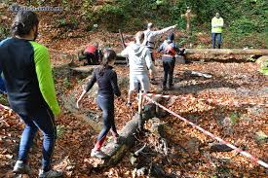
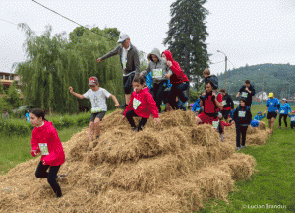
The next day
An application test was held in which all crew members participated, a test that consisted of completing a route with obstacles (crossing in balance, overcoming obstacles, climbing, weightlifting). Also, during the survival test, the crews had to participate in setting up the tents, gathering firewood and preparing food with the ingredients they received from the organizers. Each crew brought a kettle and received a deadline for food preparation (an hour and a half). Also, the young participants had to prove that they know how to make a fishing rod, traps, a spear for hunting and to improvise a shelter, in case of need. The artistic rehearsal was mandatory and consisted of the presentation of an artistic moment by each crew or a cottage game.

Slide 13
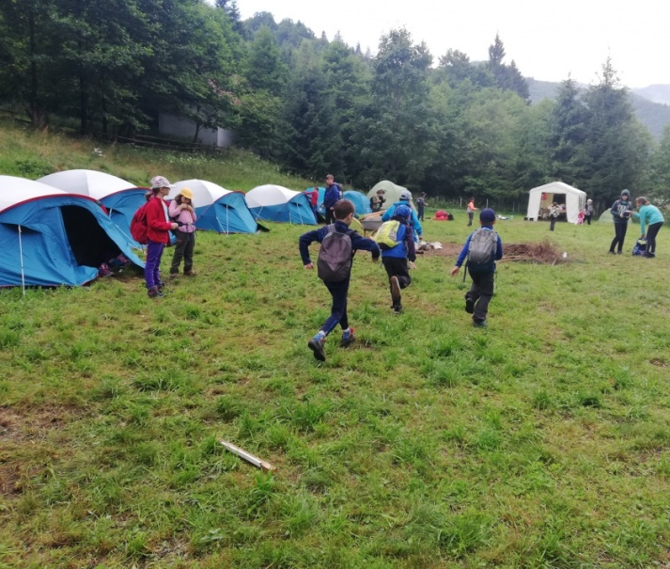
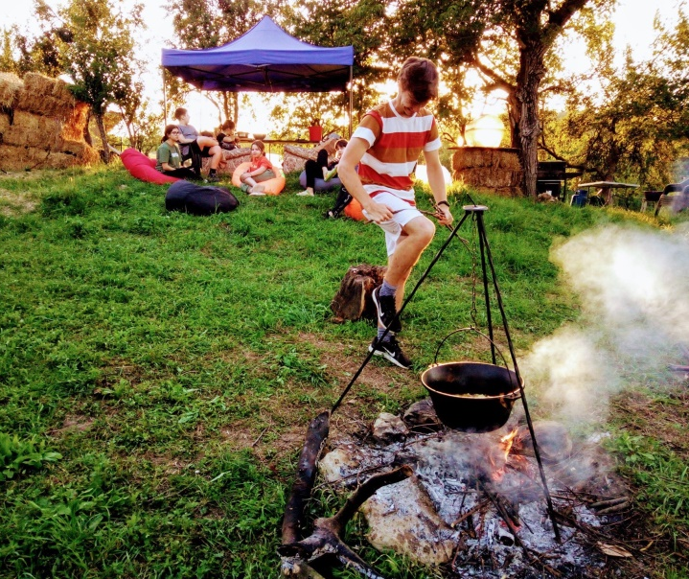
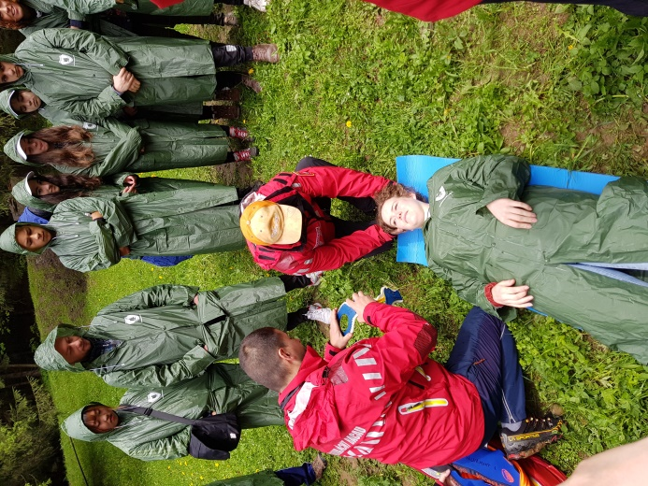
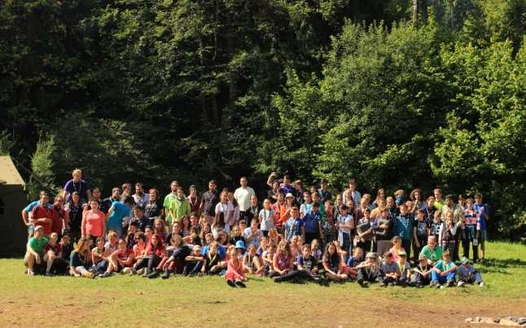
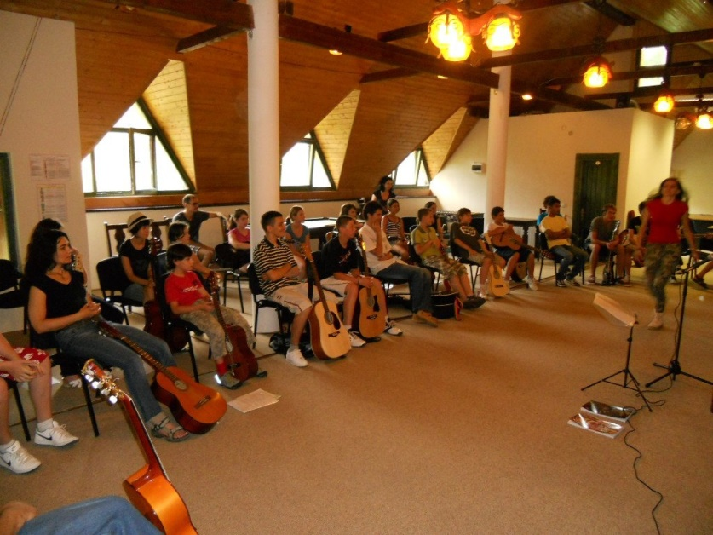

Slide 14
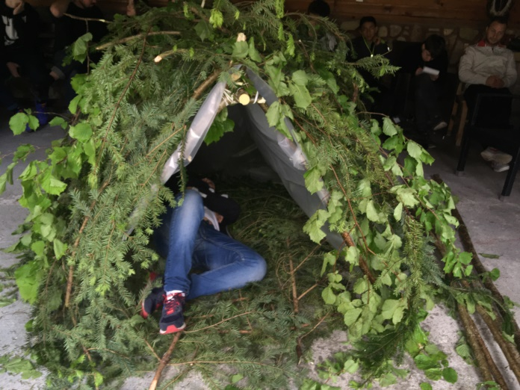
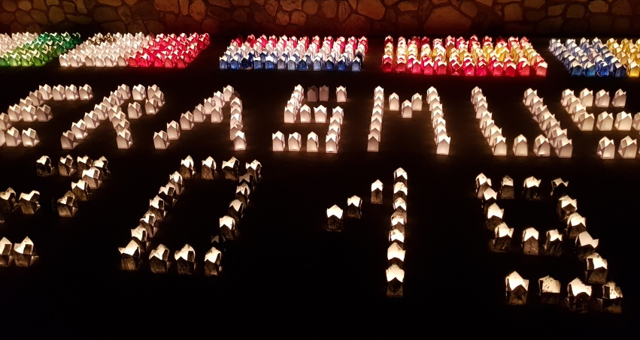
Ways to ensure the continuity / sustainability of the project
Financial aspect: Taking into account the fact that the project was carried out in partnership with Bacău Forestry Department, it can be continued in the coming years, in the same formula.
Institutional aspect: The project coordinator and partners will continue their current activity, after the completion of the project, with improved performances as a result of the experience gained and the results developed during the project implementation. The project also contributes to the improvement of the participants' experience, regarding the implementation of national educational projects, determining an addition of institutional value.

