Slide 1
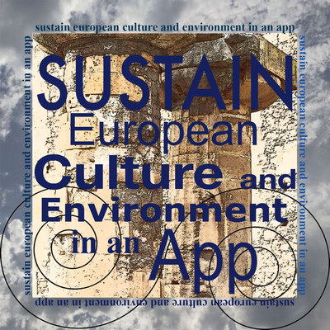
El Vendrell
The landscape of the geniuses
Let us discover the essence of the landscape that inspired the works and influenced the personalities of Antonio Gaudí, Joan Miró, Pau Casals and Pablo Picasso.

Slide 2
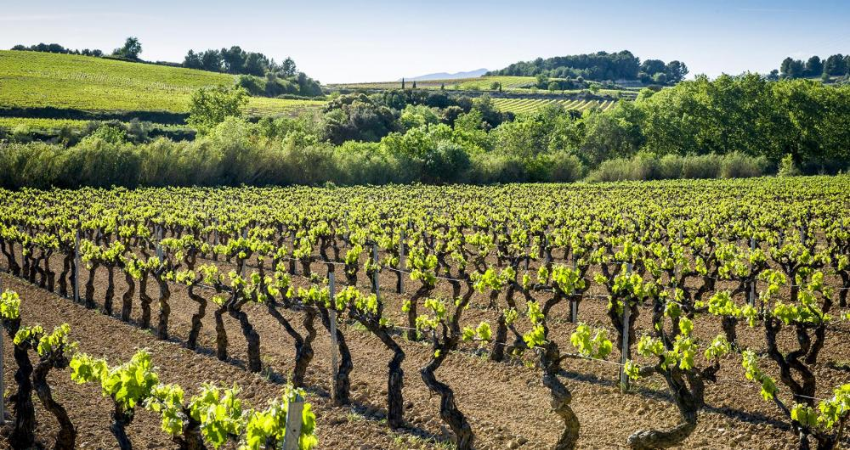
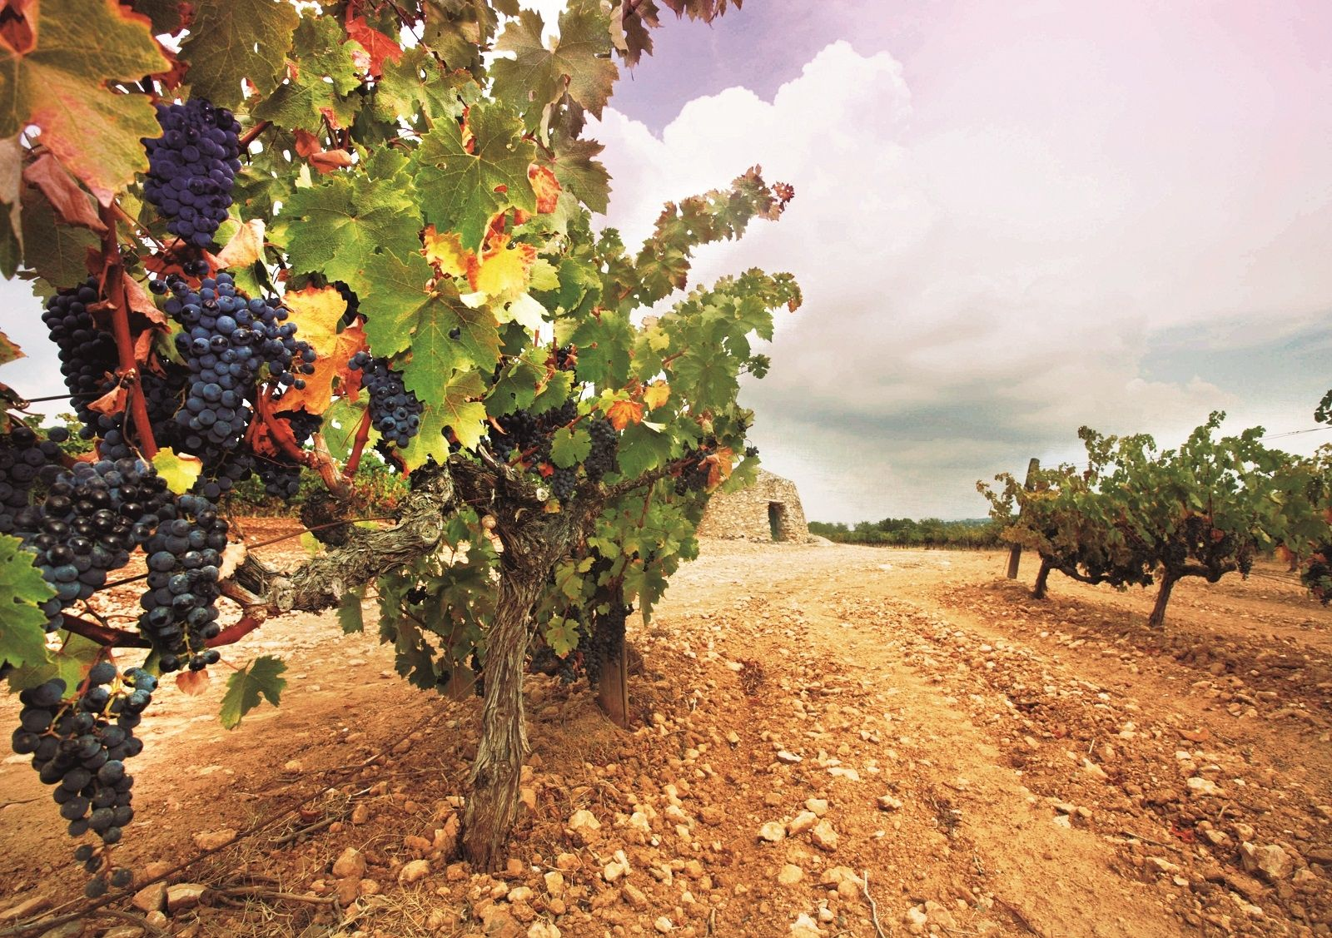
Vineyards
Just an hour south of Barcelona lie the sheltered valleys and rolling hills of the picturesque Penedes region, one of Spain’s most famous wine regions, where the vast majority of the wines are produced.

Slide 3
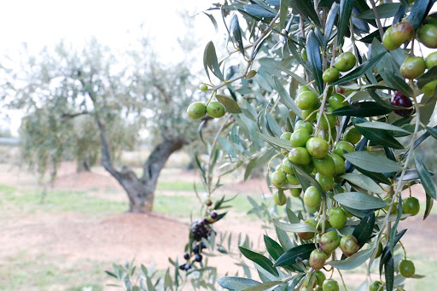
Olive trees
Since time immemorial, our region has been a fertile land, exploited by its inhabitants to harvest its fruits. This traditional farming continues today offering typical Mediterranean products such as the golden elixir: extra virgin olive oil.
The climate, with its mild temperatures marked by north-westerly winds, and the soil, rich in nutrients, are key to its products and produce, whose quality is renowned.

Slide 4
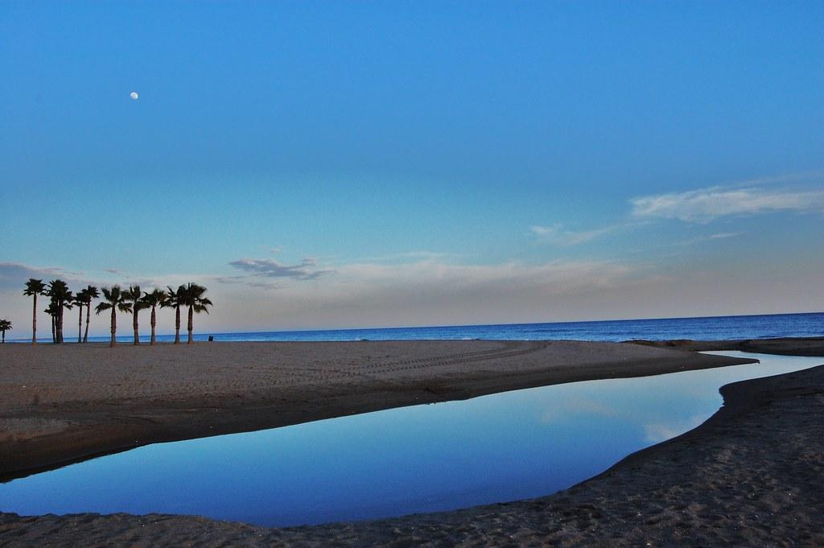
Les Madrigueres
Les Madrigueres is a 30-hectares littoral space, located in the maritime centre of Sant Salvador in El Vendrell, which encompasses a damp area of high environmental and scenic interest, because of its unique nature in a completely urbanized littoral environment, and for its role as an ecological passage between the sea, the fields and the interior mountains.

Slide 5
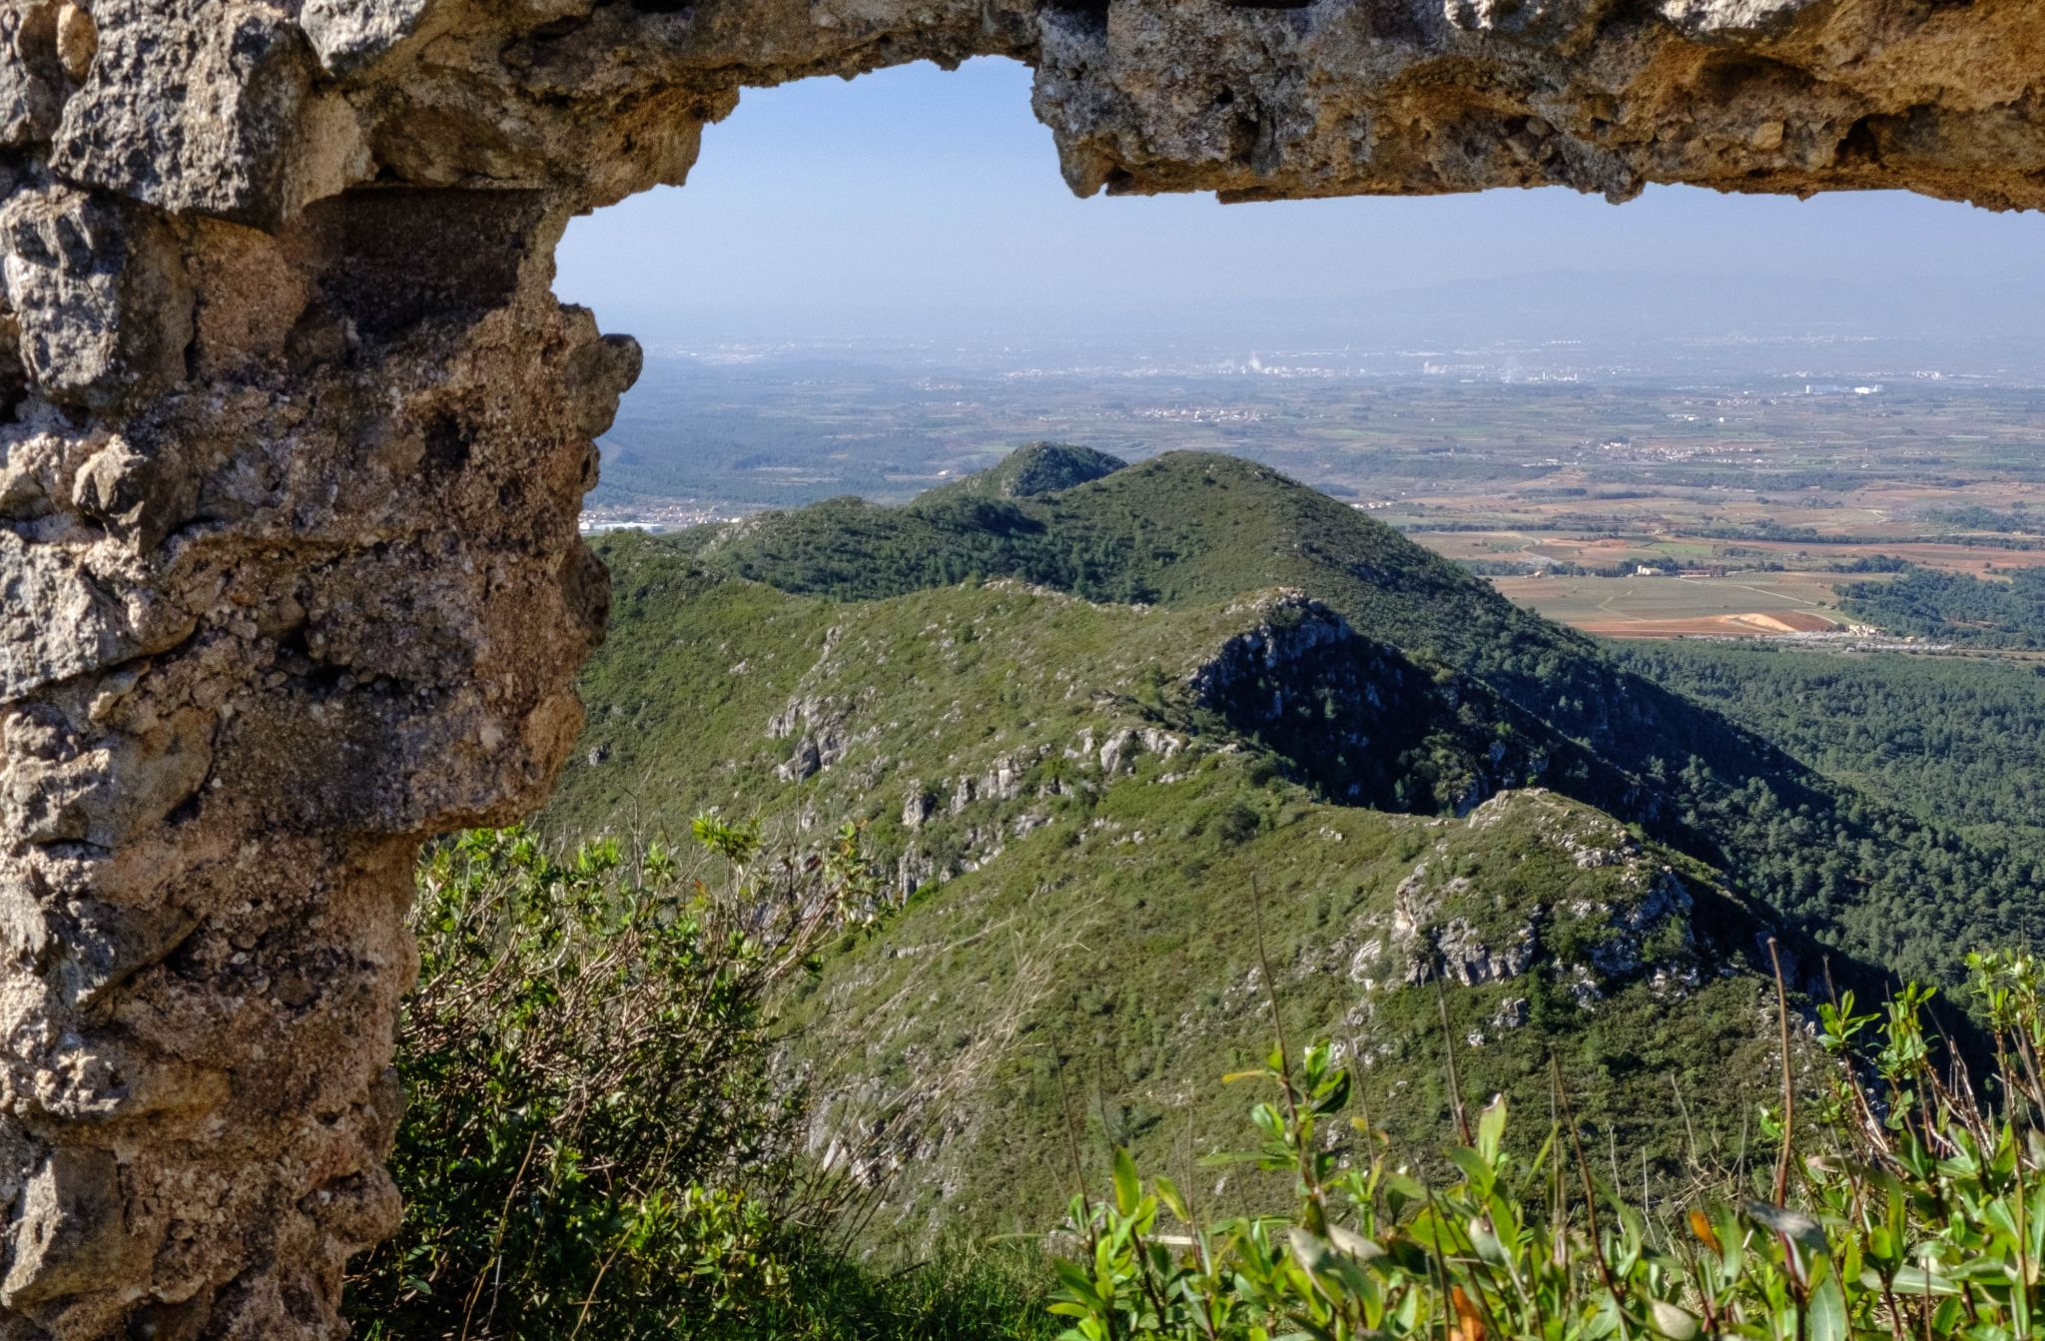
Montmell mountain range
This natural area is currently characterised by large extensions of scrubland, wildflowers, bushes, white pine groves and dry meadows. In the mountains you can practise several outdoor adventure sports such as mountain biking and climbing. There are also various hiking routes on which to visit the remains of ancient medieval castles, Romanesque chapels and dry stone structures, clear examples of the extensive cultural heritage of the Serra de Montmell and Penedès natural areas.

Slide 6
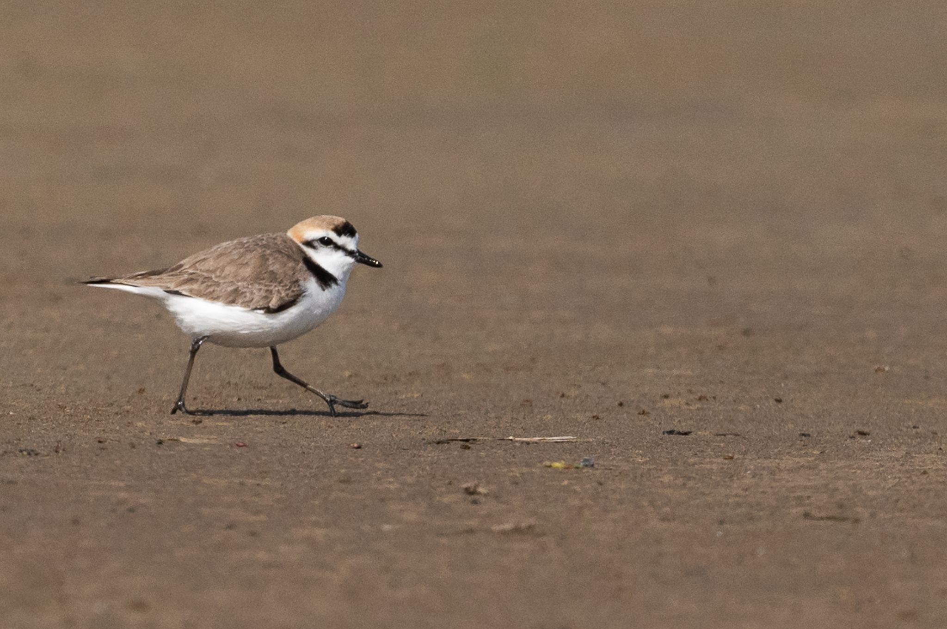
Kentish plover
Our area has a lot of diverse habitats: sand beaches and dunes, littoral lagoons with reed beds and sugar cane plantations, and Mediterranean thickets and maquis with holm oaks. One prominent example of wildlife is the Kentish plover, a bird declining in numbers.

Slide 7
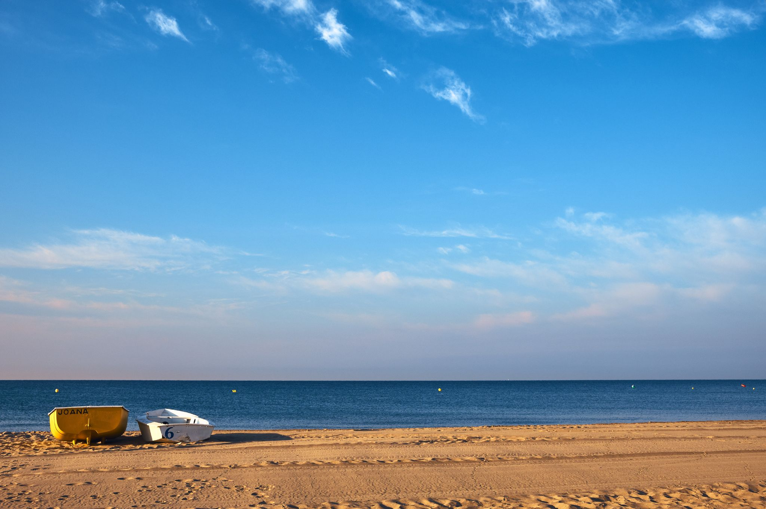
Masia Blanca marine reserve
The marine reserve known as Masia Blanca, an underwater area that is typical of these sloping sandy beaches. The fauna and flora that the township aims to protect represent roughly half of the species found along the Catalan coastline.

