Slide 1
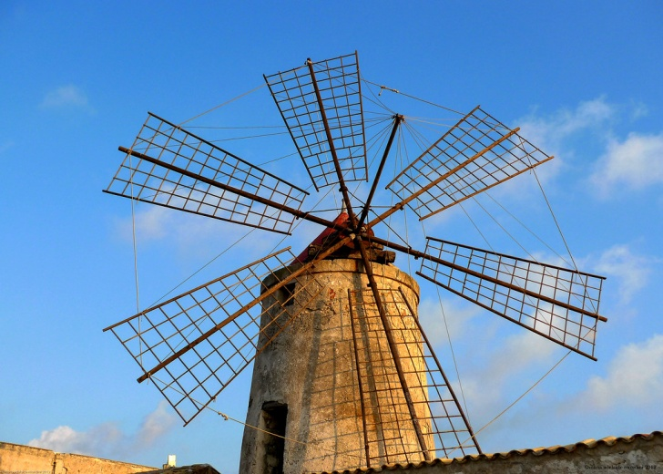
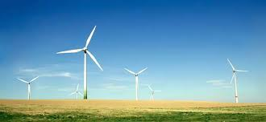
WIND ENERGY
Wind energy is a form of free, inexhaustible, distributed "fuel". Producing wind energy means to exploit the kinetic energy of wind by transforming it into electric energy, using a wind turbine. A wind turbine is a structure consisting mainly of a support called a tower (latticed or tubular steel), a nacelle and rotor blades. When moved by the wind, the blades rotate and spin a shaft that is connected to a generator that produces electric energy.
Traditional use
Modern use

Slide 2
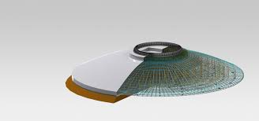
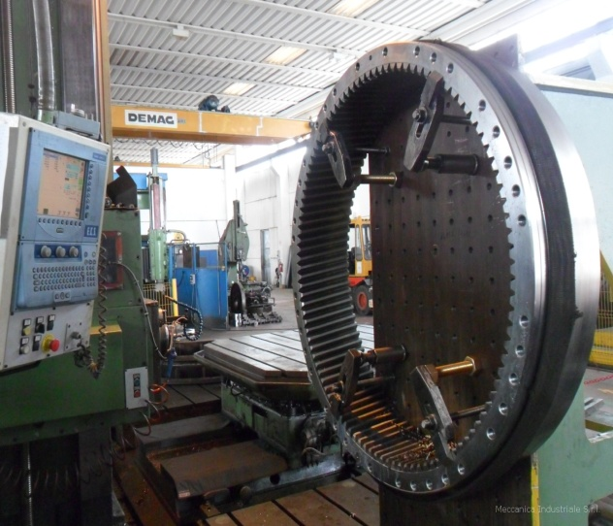
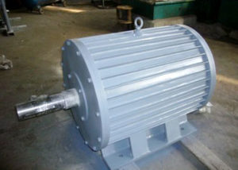
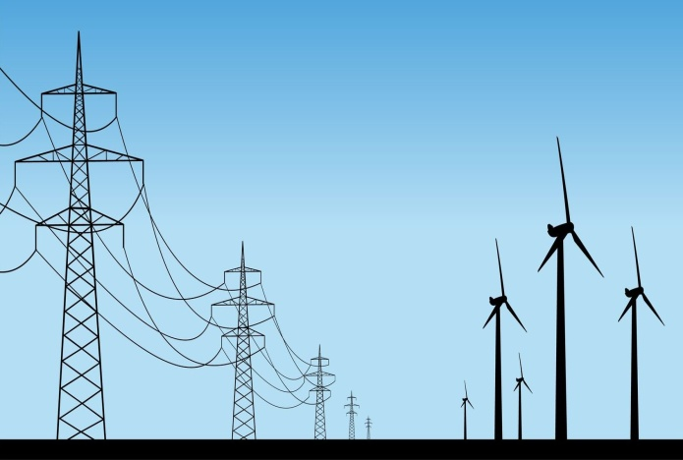
HOW A WIND TURBINE IS MADE
BEDROCK
SUPPORT TOWER
SHOWELS
ROTOR: hub in which are fixed the showels
SPEED MULTIPLER: commutes showels’ slow rotation in a quick one in order to make the alternator turn
ALTERNATOR: commutes the mechanical power in electric power
TRASFORMER:
converts the middle voltage current in a high voltage one to introduce it in the electric trasmission network

Slide 3
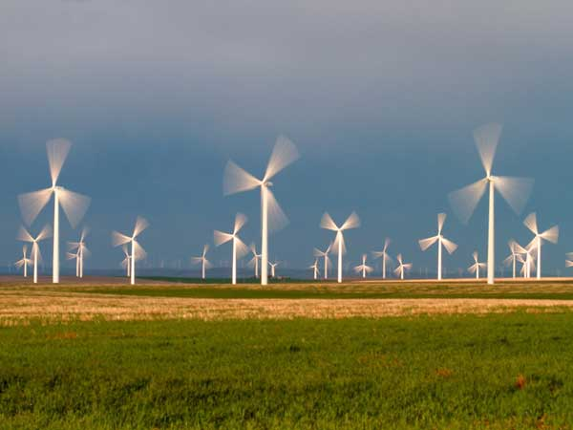
WIND TURBINES
WIND FARMS
Many wind turbines connected to an electric power transmission make up a wind farm

Slide 4
ON SHORE WIND ENERGY ADVANTAGES & DISADVANTAGES
IT IS:
CLEAR, it is a sustainable and renewable alternative to burning fossils fuels
INSUFFICIENT, wind is an intermittent energy source so it has to be used together with other electric power sources
A DAMAGE FOR THE LAND SCAPE, onshore wind farms have to be build in rural or wild areas

Slide 5
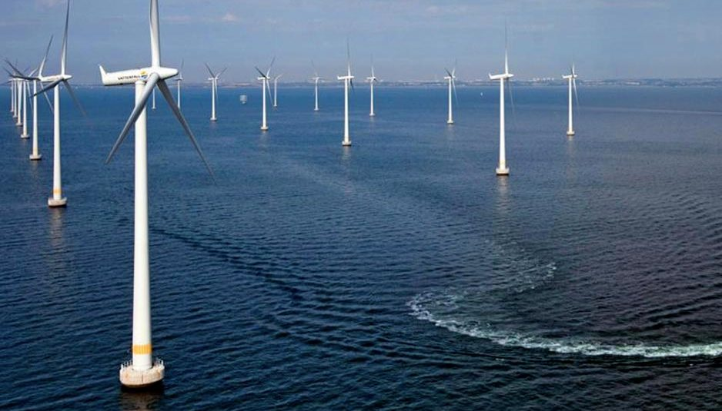
OFFSHORE WIND FARMS
DISADVANTAGES
the wind turbine generators (WTGs) have, on average, larger diameters and rated power,
the plant can be diﬃcult to access in periods with high winds, the installation and the maintenance are more expensive.
ADVANTAGES oﬀ-shore applications allow an increased energy eﬃciency, due to the higher average wind speeds and the reduction of the siting and environmental issues, particularly with regards to noise, visual constraints and space limitations

Slide 6
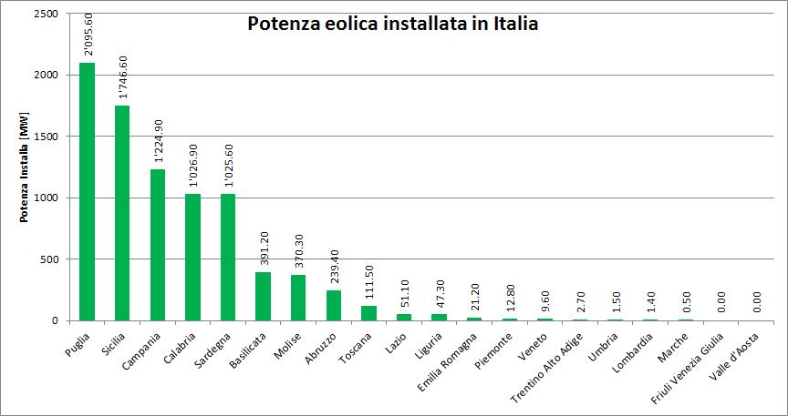
WIND POWER IN PUGLIA
Italy is the fifth european wind energy producer. Almost the 29% of this power comes from Puglia

Slide 7
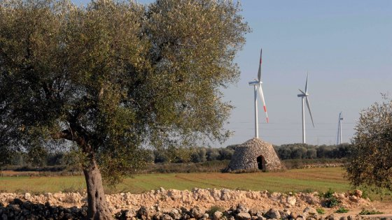
WIND POWER IN PUGLIA
The presence of a favourable climatic condition for wind power in the Apulia Region in Southern Italy has pushed towards the development of one of the greatest on-shore areas in the country and Europe. In this region there are 5 wind farms and overall there are 180 wind turbines that provide to 90% of the electric requirement.
Nonetheless, the high concentration of on-shore wind farms on the territory of the Apulia Region has posed serious problems over time. Despite the undoubted advantages of wind energy in terms of carbon and fossil fuel savings, there has been an increasing public awareness for landscape preservation. The majority of people living nearby on-shore wind farms seem to suffer from the change of ‘their’ landscape. /source:Althesis/

Slide 8
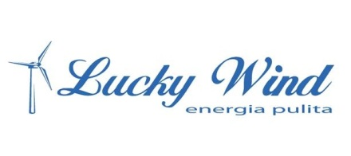
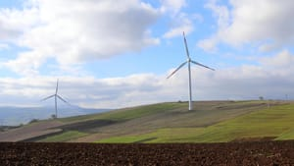
MAIN COMPANIES OPERATING IN PUGLIA
LUCKY WIND: founded in 1990 by Giuseppe Pasqualicchio, this company works in the Foggia’s territory. At the beginning of ‘90s the founder presented the project for a wind farms in Accadia; this one is the first wind farm in Italy
«LIGHT A CLEAN FUTURE»

Slide 9
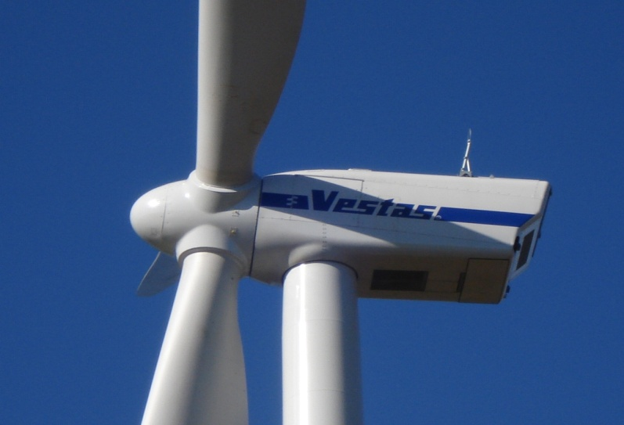
VESTAS: is a Danish company that desings builds and sells wind turbines. It was founded in 1945 with the name “Vestjysk Stalteknik” by Peder Hansen and it produces electric appliance.
It started building wind turbines in 1979. In 2003 it melted with NEG Micon making the greatest wind turbines’ factory in the world with the name “Vestas Wind System”.
Vestas has built his wind turbines in 60 countries and has got more than 21000 workers.
Vestas Italia is the Vestas responsible in Italy, Northern Africa and Greece. It is located in Taranto

Slide 10
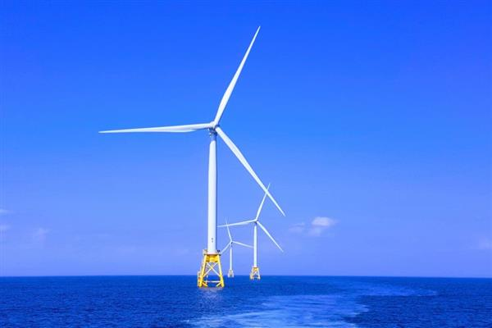
THE FIRST ITALIAN OFFSHORE WIND FARM IS IN TARANTO
SEVION will build the first offshore wind farm in the Mediterranean Sea. The farm will be composed by two turbine groups for a total of 10 wind turbines a 30MW development located in front of Taranto harbour in the Apulia region in southern Italy.
https://www.youtube.com/watch?v=Wg22wIG9WRg

Slide 11
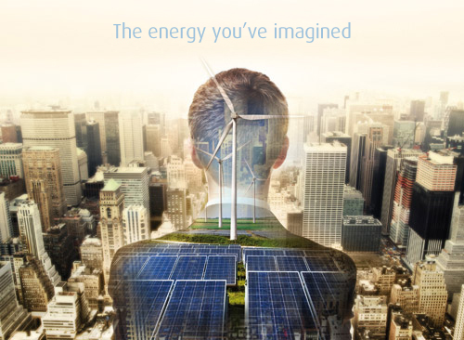
INERGIA S.P.A
it started his activity in 2003 and now it operates in different sectors of renewable energy.
Inergia is totally concerned with green activities and green economy;
it doesn’t design, build and run only wind farms but also photovoltaic systems
it is engaged in the biomasses’ recycling and bio-constructin industry too.
The “20-20-20” european target is completely supported by Inergia; it consist in trying to reach the 20% reduction of energy consumption, reduction of gasses that implement greenhouse effect and the 20% of renewable sources use all over the world.

Slide 12
LECCE 3 Wind Farm
Municipality: Lecce
Province: Lecce
Region: Puglia
WTG (Wind Turbine Generators): Vestas V90
Power: 2 MW
Dimensions: 80 m (hub height), 90 m (motor diameter)
No. of WTG: 18
Total Installed Power: 36 MW
Equivalent Hours: 2.100
Annual Production: 75.600 MWh
CO₂ Saved: 40.000 t/year
Requirement Satisfied: 21.000 households
The "Lecce 3" wind farm is located in Santa Maria D'Aurio, an area of 247 hectares, 7 km north-west of Lecce. The plant is part of Lecce's "hybrid energy hub", the first location in Italy to host both wind and solar plants at a single installation. Construction began in September 2006 and on April 23, 2007 the plant was connected to the grid.

Slide 13
STUDY VISIT TO THE WIND AND SOLAR PARK
INERGIA LECCE3
Tuesday, Octobre 29 , 2019
Inergia S.p.A., a Santarelli Group company, gave a lecture on renewable energy devoted to the students of IISS AUGUSTO RIGHI Taranto participating in the Erasmus plus project S.E.C.E.A. Dr Micelli , Head of Technology, illustrated to the young students the different types of renewable sources, explaining how these are used and their ecological advantages, putting into context their growing importance in the Italian energy panorama, with particular reference to the objectives set by the international Kyoto Agreement. Finally, the issue of Energy Conservation was stressed along with individual responsibility in helping to make the planet a better place, not only for today but, more importantly, for future generations.
Video of the experience

