Slide 1
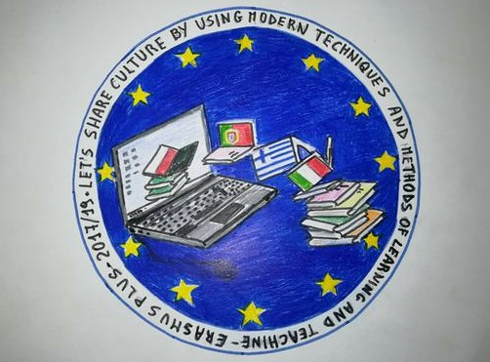
Learning about our countries….
“Let’s share culture and history using modern techniques and methods of learning teaching”
35th Primary school of Patras, GREECE
November, 2017

Slide 2
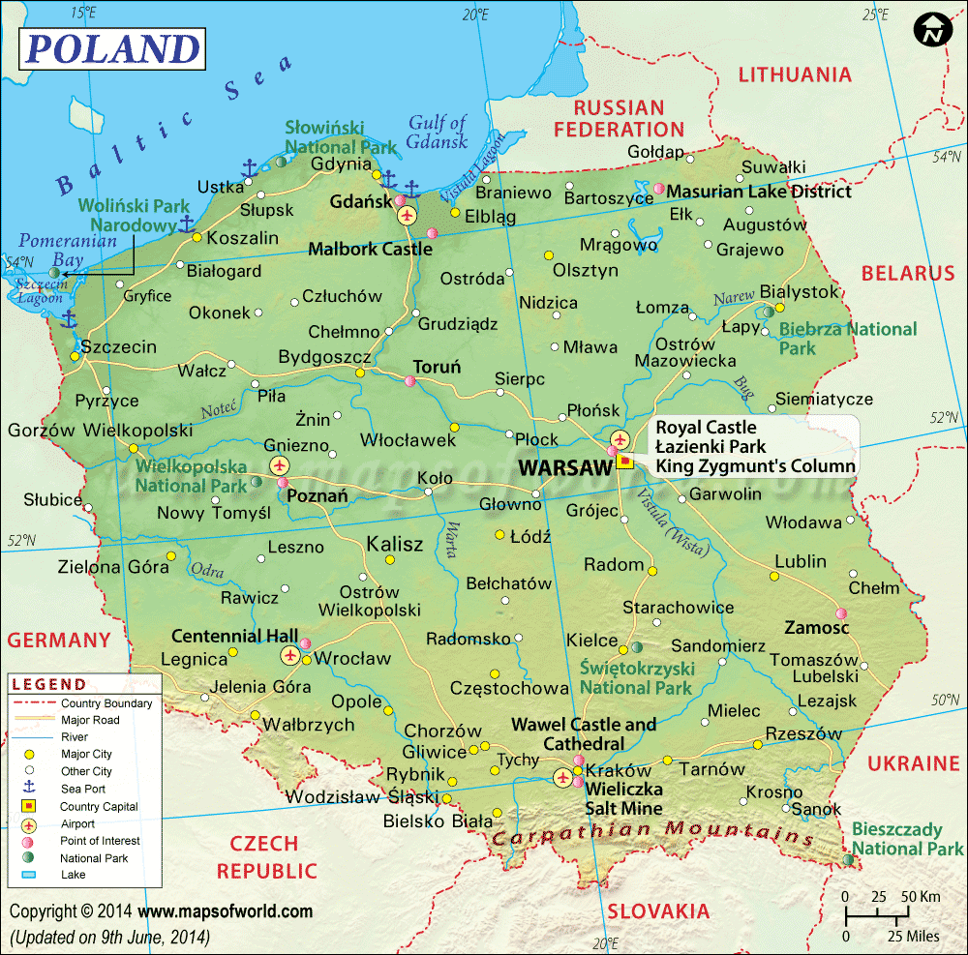
Republic of Poland
“Let’s share culture and history using modern techniques and methods of learning teaching”
Area: 312,679 km²
Population: 38,634,007 (2017)
Capital: Warsaw
Language: Polish
Religion: Roman Catholicism
Flag:

Slide 3
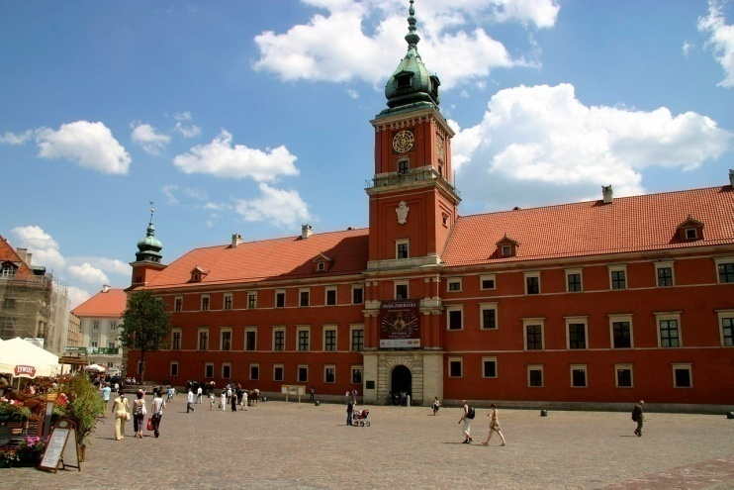
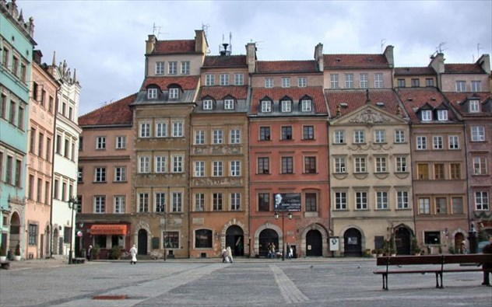
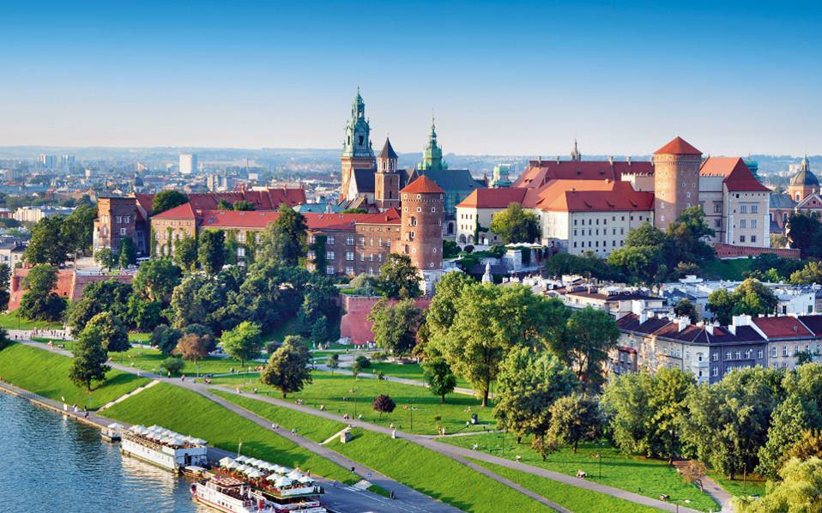
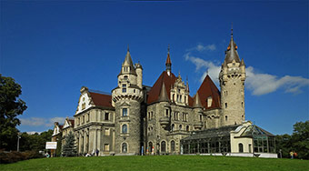
Landmarks of Poland
“Let’s share culture and history using modern techniques and methods of learning teaching”

Slide 4
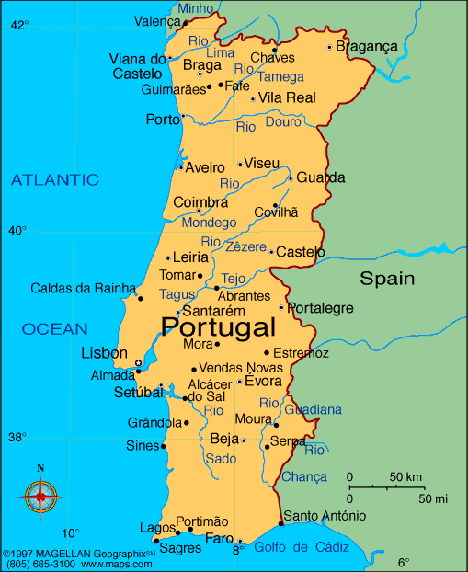
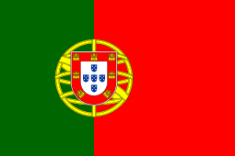
Portuguese Republic
“Let’s share culture and history using modern techniques and methods of learning teaching”
Area: 92,212 km²
Population: 10,309,573 (2016)
Capital: Lisbon
Language: Portuguese
Religion: Roman Catholicism
Flag:

Slide 5
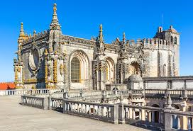
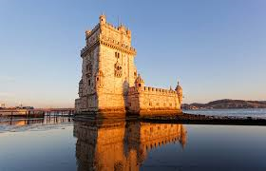
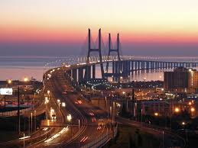
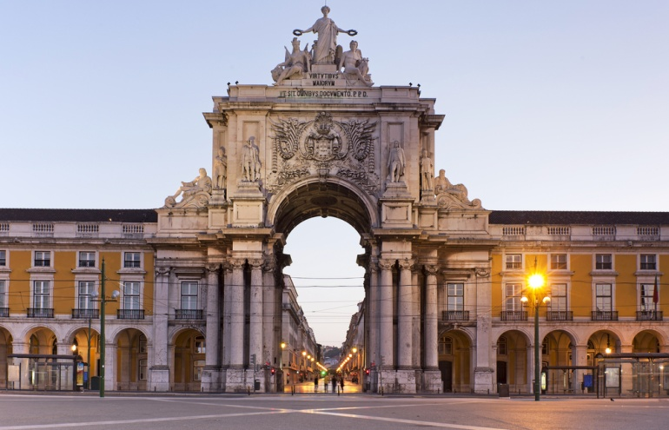
Landmarks of Portugal
“Let’s share culture and history using modern techniques and methods of learning teaching”

Slide 6
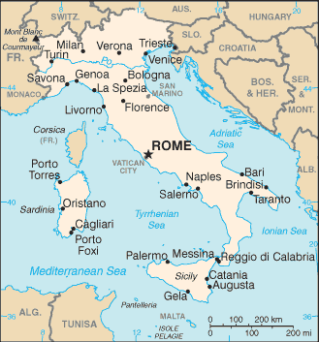
Italian Republic
“Let’s share culture and history using modern techniques and methods of learning teaching”
Area: 301,338 km²
Population: 60,589,445 (2016)
Capital: Rome
Language: Italian
Religion: Roman Catholicism
Flag:

Slide 7
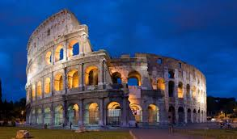
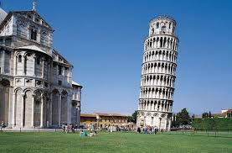
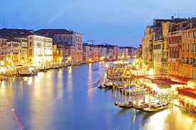
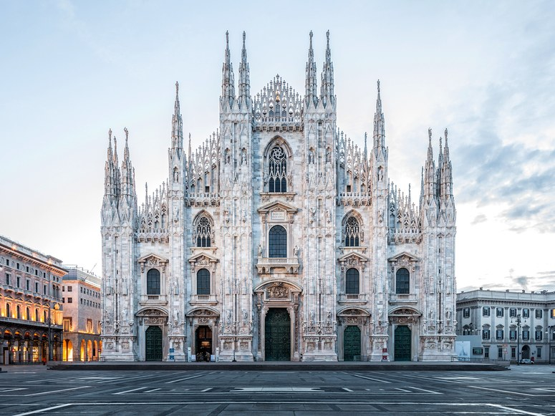
Landmarks of Italy
“Let’s share culture and history using modern techniques and methods of learning teaching”

Slide 8
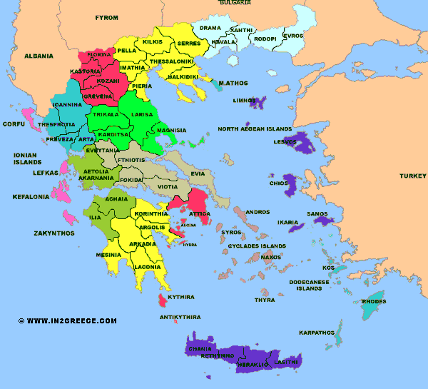
Hellenic Republic
“Let’s share culture and history using modern techniques and methods of learning teaching”
Area: 131,957 km²
Population: 11,183,716 (2016)
Capital: Athens
Language: Greek
Religion: Eastern Orthodoxy
Flag:

Slide 9
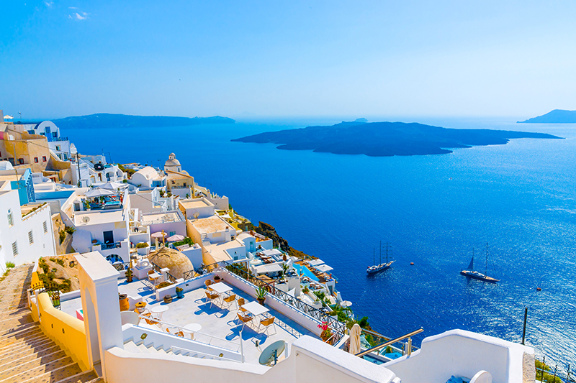
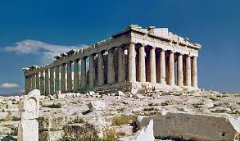
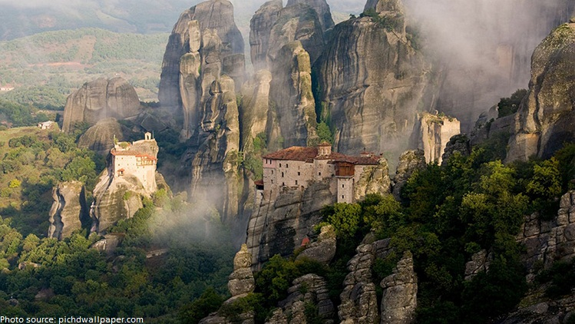
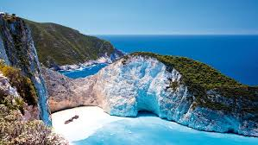
Landmarks of Greece
“Let’s share culture and history using modern techniques and methods of learning teaching”

Slide 10
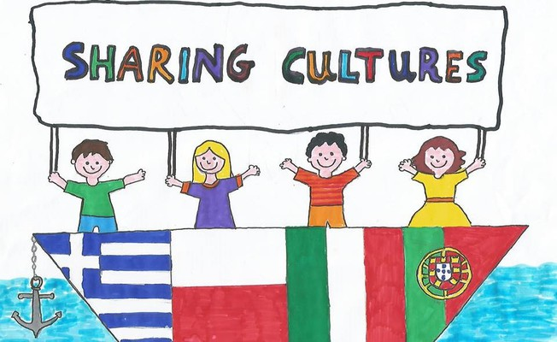
References
“Let’s share culture and history using modern techniques and methods of learning teaching”
https://en.wikipedia.org/wiki/Poland
https://en.wikipedia.org/wiki/Portugal
https://en.wikipedia.org/wiki/Italy
https://en.wikipedia.org/wiki/Greece
This work was created by pupils of the 6th grade of our school

