Slide 1
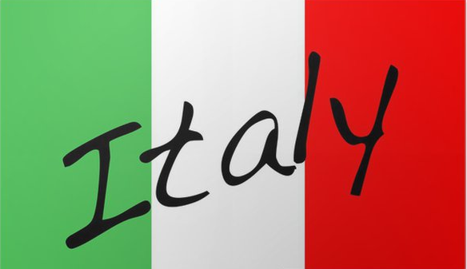
Food in daily life

Slide 2
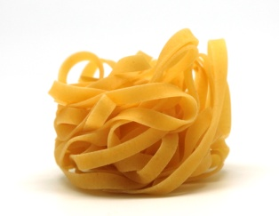
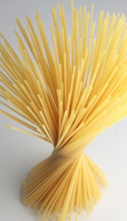
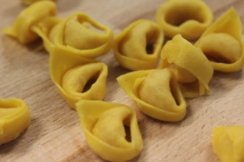
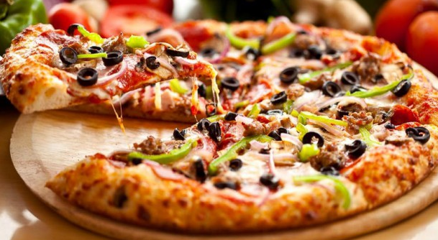
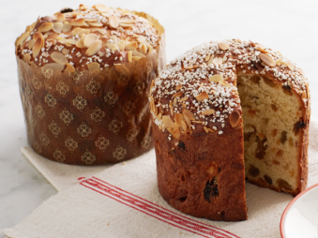
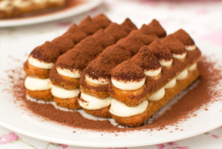
Italian food customs
In Italy people usually eat pastas, pizzas and some desserts.
Pastas – They use many tips of pasta:
Tagliatelle
Spaguetti
Tortellini
Pizzas – There are many varieties of pizza made in Italy. Topped with tomatoes, cheese, and various other ingredients
Pizza Margherita
Pizza Capricciosa
Pizza Carbonara
Four season pizza
Desserts
Panettone
Tiramisu

Slide 3
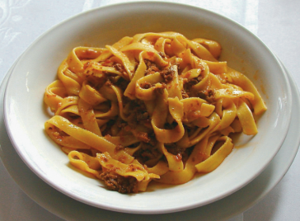
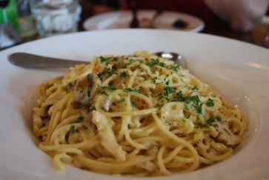
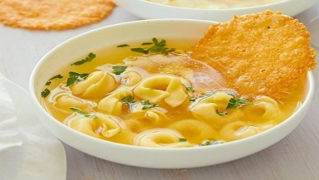
Pastas
Tagliatelle - is a traditional type of pasta from the Emilia-Romagna and Marche regions of Italy. Tagliatelle can be served with a variety of sauces, but the classic is Bolognese.
Spaguetti- is a long, thin, solid, cylindrical pasta. Spaghetti is made of milled wheat and water.
Tortellini- They are typically stuffed with a mix of meat and Parmigiano reggiano cheese. Tortellini is originally from Emilia.

Slide 4
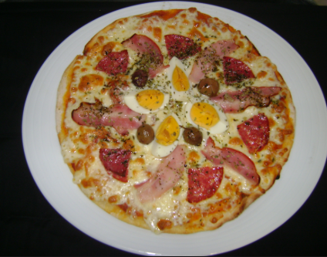
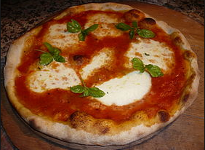
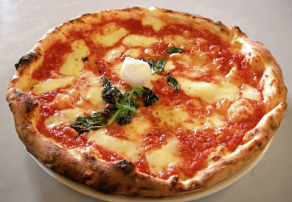
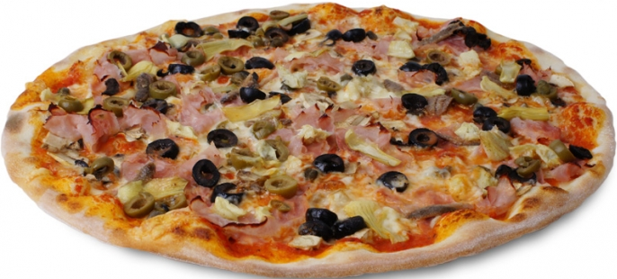
Pizzas
Pizza Margherita- Pizza Margherita may have set the standard, but there are numerous popular varieties of pizza made in Italy .

Slide 5
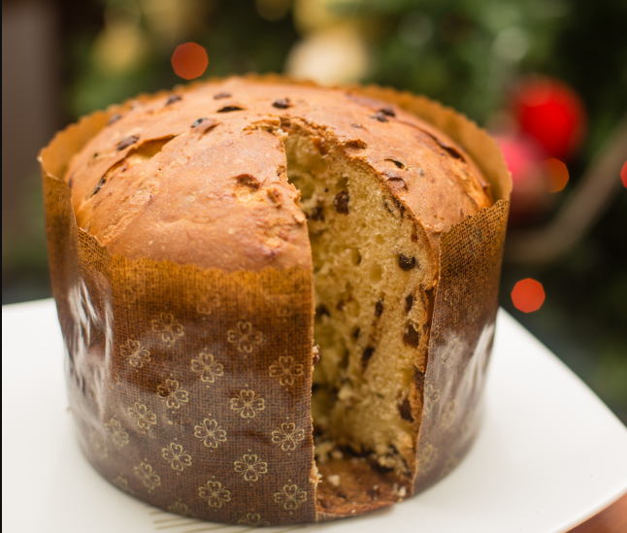
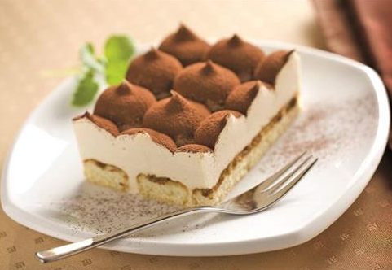
Traditional desserts
Panettone
In Christmas the Italian people eat Panettone. It is made with flour, butter, eggs and sugar with candied citron and sultanas.
Tiramisu
The most tradicional dessert is the Tiramisu. It is made with biscoits, coffee, cheese, eggs, sugar and coccoa.

Slide 6
Trabalho realizado por:
Carolina Correia Liberato
Nº5
7ºD

