Slide 1
D.D.A.F.R. shopping center
Students:
Denis Ilina
Flavia Ilina
Rebeca Olteanu
Diana Cîrciumaru
Alex Sfetcu

Slide 2
D.D.A.F.R. shopping center
D-Desing
D-Development
A-Attention
F-Fashion
R-Refinement

Slide 3
Factual information
Name:D.D.A.F.R Shopping Center
Adress:Str.Riului,nr.15,200195
Postcode/Town:Craiova
Email:D.D.A.F.R@yahoo.com
Tel.:0792539851
Web:www.D.D.A.F.Rshoppingcenter.com

Slide 4
Company description
D.D.A.F.R is represented by our qualities:
We dedicate at designing, development, attention offered to clients, giving clients informations that they need.

Slide 5
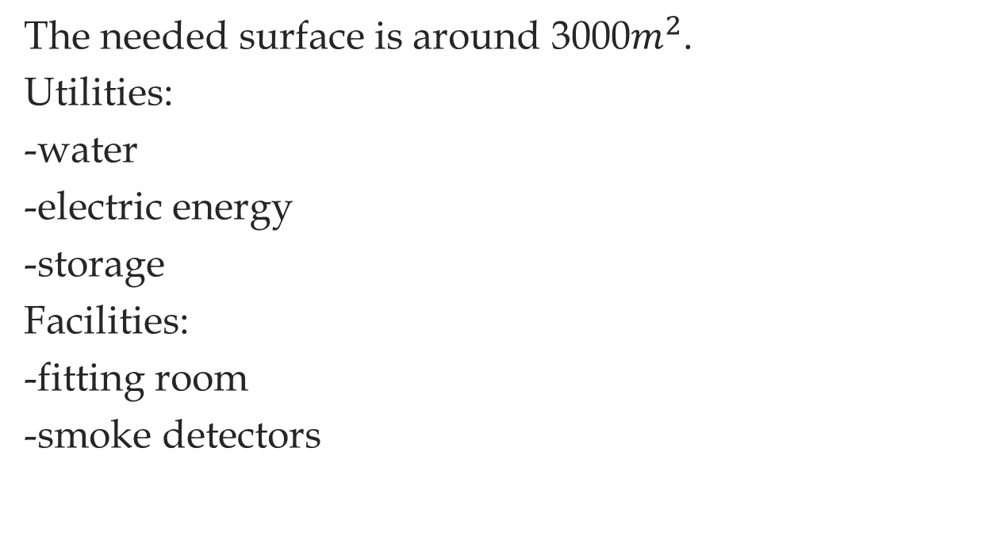
Material resources
The needed surface is around 3000$m^{2}$.
Utilities:
-water
-electric energy
-storage
Facilities:
-fitting room
-smoke detectors

Slide 6
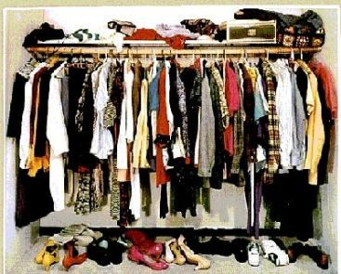
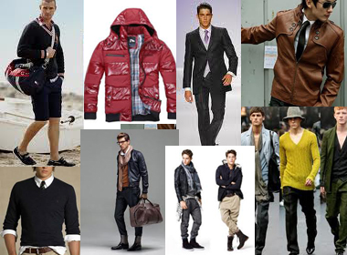
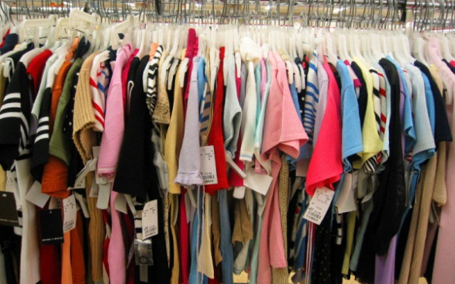
Products and services
Our company is based on fashion and elegance.
We have many types of clothes for men and women, for all kind of events and occasions.
In our store you can find all type of clothes and products you need for a good price and best quality.

Slide 7
In our store the prices from clothes are available for all people even if they have a large budget or a small budget.
We have quality products and low prices to be available for all type of customers because we trust our own power and our motto is:
“The client is always right and he deserves the best for him”.

Slide 8
Finnancial resources
Documents setting up company-1000lei
Rent for store/month:1.700 lei
Employers:
Sellers x3-800lei/month
Janitors x2-700lei/month
Security:
-security camera x4-401,01lei
-security gates-3,859lei
-smoke detectors x2-110lei
Merchandise:
-clothes-20.000lei

Slide 9
Marketing plan
Products descripiton:
-we have 100% cotton products and products for all people and for all ages.
Market Position:
-we are the number 5 on market position from our field.
Customer Profile:
-our technique makes our customers like our services and buy our products because we have better products than others.
Competitors Profile:
-our competitors got also good products but we have the advantage of better services.better prepared employees and better type of products.
Market techniques used:
-we have the best seller agents that know how to sell our products;
-we also have our advertisement on the internet;
-we try to draw our clients by applying discounts at every month and many deals.
Action Plan:
-we will start by buying better IT items and better computer;
-after we will improve our store by upgrading it look and to make it more accessible for all;
-secondly we will extend our store and we will make more dressing rooms.

Slide 10
Recruiting employees requirements
We choose our employees based on:
-C.V;
-testing them by having an one week practice in our store;
-testing their abilities which need to be:
-teamwork and organized person.

Slide 11
Financial Predictions
We will start with an amount of 20.000€.
A part of this money we will buy things necessary for our store(security cameras, security gates, clothes).
For first year we are estimating our incomes somewhere around at 30.000€.

Slide 12
Long term expectations
We are expecting to have a larger store and a lot of faithfully clients who like our products and they buy from our store because we give them the best products.
On revenues we are expecting to have good income for first year and we will work hard for having them because we want to give our clients the best products because they deserve it.

Slide 13
Team management
Cîrciumaru Diana
General Director
Ilina Denis Ilina Flavia Olteanu Rebeca
Procurement Director Deputy Director Accountant
Sfetcu Alex
Responsible supply

