Slide 2
Project BUDD.E.R.S. Budding Entrepreneurs Running School Project code: 2014-1-1T01-KA201-003979_1
“The conditions and motivations that determine the choice of becoming an entrepreneur today are not different from the usual ones. However, an ever-changing world has introduced others and requires sensitive integration of features and skills. Family traditions, skills or craft production, the preparation for the implementation of the independent self, the disposable income and assets combined with a kind of "visionary" sensitivity is often augmented today by the need to survive and perhaps even by a greater desire to uphold values and ideals.
It is certainly not a walkover, the market is complex and many skills are essential.
In the past it was not different, but today the waters are less calm and an entrepreneur needs to be able to make the right choice through a mix of skills without which there wouldn’t be safe route. Our age is characterized by frequent changes of wind that require the ability to trim the sail having clear goals. It is said that there is no favourable wind for the sailor who does not know where to go. ”
Mauro Favretto

Slide 3
Business idea of the Bulgarian team: Tourism and Territorial Marketing in Burgas region, the Republic of Bulgaria

Slide 4
RURAL TOURISM
Over the past 20 years, the tourism in Bulgaria is characterized by very high growth rates, leading to ultra-urbanization and a glut in tourist resorts.
Logically it was to lead to an outflow of tourists and especially the wealthier ones. This fact actually did not make things so black as the media constantly try to impress the mass audience. Ultimately, every problem has led and leads to new horizons, new opportunities for those who are enterprising. So it is now - and this time no exception.
This nuance of the tourism market is the logical appearance of rural tourism as an alternative type of tourism. It opposes the mass (industrial tourism), which facilities and tourist product have characterized one already depressing standardizing.
Rural tourism, as a rest in the countryside, became not only in fashion but a necessity, given the pollution of the natural environment, dynamic and strenuous pace of life in cities, which naturally led people to search for tranquility and relaxation in clean environment and more secluded places, which, of course, does not preclude its combination with the hobby tourism, sea tourism, hunting and fishing, and all other types of alternative tourism with the aim of more variety during your stay.

Slide 5
TOURISM IN BURGAS REGION MARKETING ANALYSIS
Tourism is the leading sector of Burgas region, and one of the tasks of the regional and local authorities to work together with the business and NGO sector, and to create conditions the seasonal tourism to become year-round tourism.
The tourist offer in Burgas brings its specificity, and each municipality has specific and unique natural, cultural and historic resources. The excellent geographical location, diverse terrain, the presence of golden sands, wetlands, rich flora and fauna, healing mud, museum complexes, unknown history and culture, unique folklore and cultural events, fire dancing, customs, music, dance, cuisine etc., are unique part of the established tourist products in the coastal municipalities, which can be supplemented by stunning scenery and biodiversity, offering the Eastern Balkan mountains and the close to Burgas mysterious Strandzha mountain.

Slide 6
Bulgaria and the European Union
Bulgaria as a member country of the European Union, has recognized itself as "close" and easily accessible tourist destination, offering a sense of stability, reliability and predictability. This positive image in recent years has become an important factor in the choice of destination of traditional European markets.
The Black Sea tourist region attracts the largest share of foreign and Bulgarian tourists. In high season (late spring-summer-early autumn) is a combination of the "specialized mass tourism" and in inactive - a combination of two or more specialized types of tourism. The most common combination, and probably - combined with the greatest potential are those between cultural, ecological and other tourism.

Slide 7
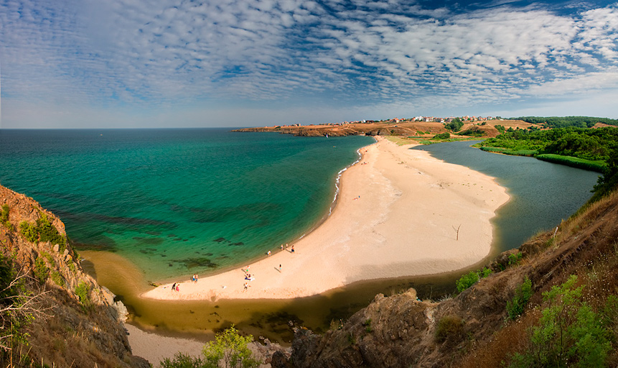
The mouth of the Veleka river in the Strandzha mountain, Burgas area

Slide 8
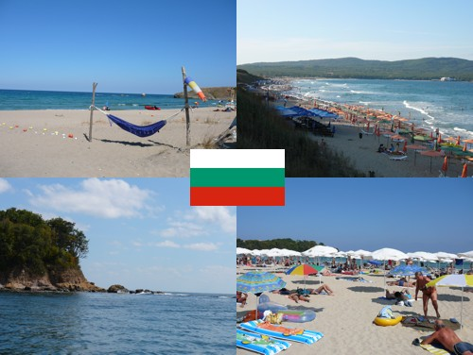
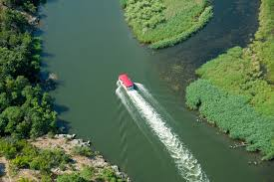
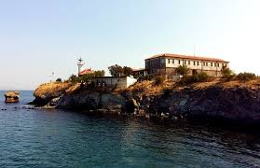
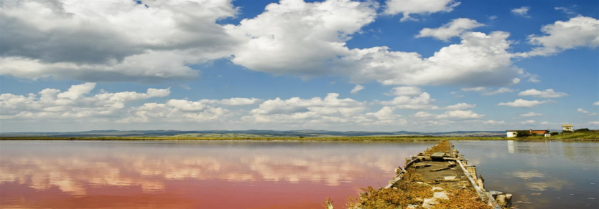
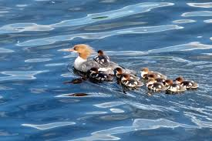
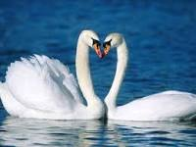
The Black Sea coast, the Ropotamo river n Strandzha, one of Burgas lakes-limans – the Atanasovsko lake and its protected bird species, which is a paradise for ornithologists,

Slide 9
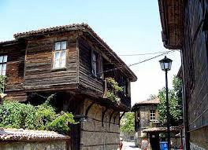
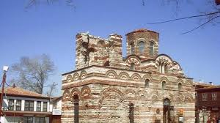
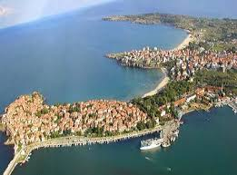
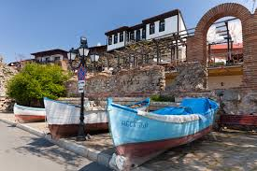
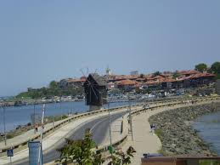
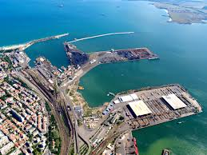
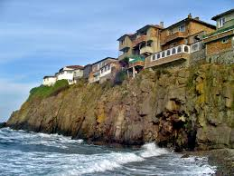
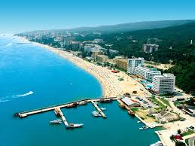
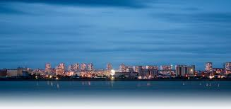
The proximity of Sunny Beach resort, the antient towns of Sozopol and Nessebar

Slide 10
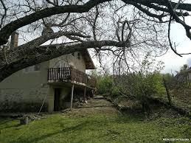
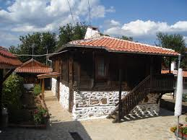
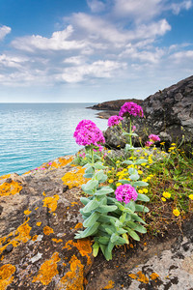
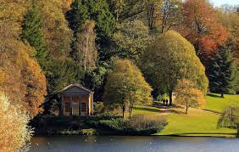
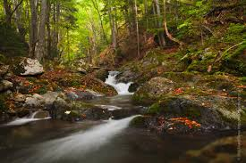
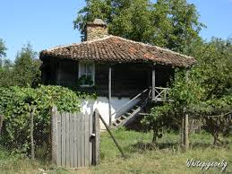
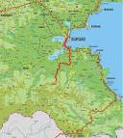
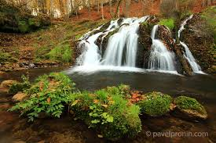
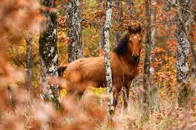
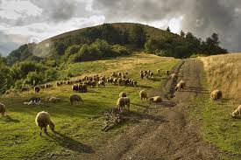
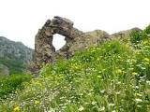
Rural houses in the Strandja mountain, unbelievably beautiful nature, with typical only for this mountain flora species subject of our business idea

Slide 11
PROJECTS AND INVESTMENTS, THE ROLE OF THE BURGAS MUNICIPALITY
Bulgaria's accession to the EU, created significant opportunities for the development and implementation of projects aimed mainly at: Investments in basic and tourism infrastructure Development of tourism products and destination marketing.
A large part of projects implemented by municipalities to improve road, ecological, cultural and tourism infrastructure are related to the creation of conditions for development of tourism in Burgas.
The main source of funding for infrastructure projects in Burgas are operational programs and especially the Rural Development Programme 2007-2013 and the "Environment 2007-2013".

Slide 12
OUR CONTRIBUTION TO THE FUTURE
Our goal and mission, inspired by the project Budd.E.R.S. and the workshops and exercises during the course of the project, as well as our confidence of young budding entrepreneurs acquired during our visit to EXPO, Milan, and our successfully prepared, presented, and especially well understood marketing strategy of the visited by us pavilions of the countries we were directed to, and the fact that we are lucky to live in an area with dynamically developing tourism, such as the Burgas region, we face the challenge to focus not on the typical regional marine tourism, but to offer more interesting, relaxing, allowing combination with any other type of tourism, which the region offers - namely, the rural tourism, combined with the hobby tourism.

Slide 13
FINANCIAL PART
A family house in a village in the Strandzha mountain.
Advantage: own real estate
Options for use of funds in the business:
mortgaging property against funds for the purchase of at least two more properties
applying for European grant on projects for development of rural and mountainous areas
own funds
in carrying out profit, investment of funds in business expansion
renting of other houses and drafting contractual relationship with the owners of farmhouses to provide rural and hobby tourism - profits from intermediary activities
offering additional services: hunting tourism fishing tourism, trips, meals prepared with organic products from their own garden, and other by request of the guest

Slide 14
CALCULATED RISK
- force majeure
- a decline in the tourist flow
- the possibility of eliminating the dependence on the season - in view of this kind of tourism be offered all year round
Target groups:
- tourists from Europe
- tourists from Asia (Japanese tourists extremely interested in this type of tourism)
- tourists from home
- families
- organized tourists
- Individual tourists, etc.

Slide 15
ESTIMATE FOR RETURN OF FUNDS
As it is well known, the T&H (Tourism and Hospitality) industry with the fastest return of funds is tourism. Our estimate is at the start of the business idea implementation, with invested capital of € 100.000, the means to regain a period of five years and begin to grow with the possibility of investments up to 8-10 years.
This reflects our long-term strategy and planning: GROWTH AND EXTENSION OF THE SCOPE OF THE BUSINESS.

Slide 16
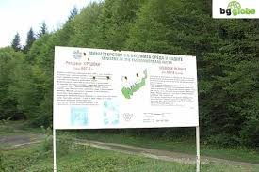
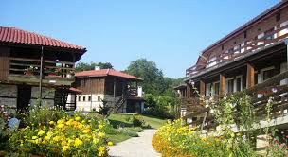
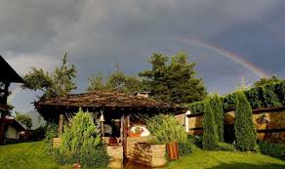
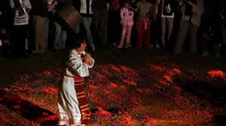
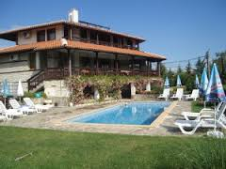
CLOSED CYCLE
The idea is to offer the tourists everything they need, from accommodation - to the food and entertainment purpose - attracting to the business a large amount of the funds they intend to invest in their holiday.

Slide 17
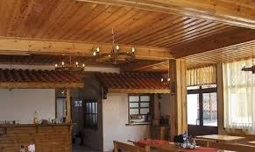
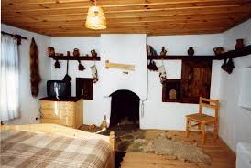
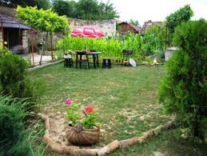
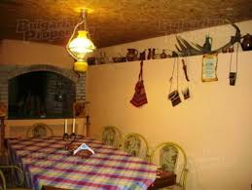
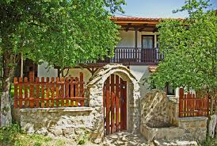
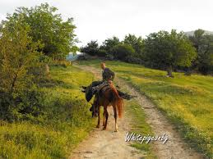
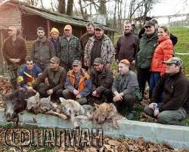
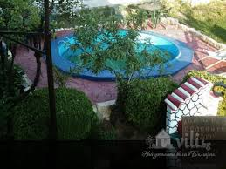
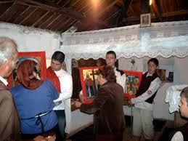
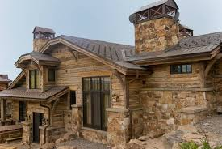
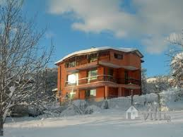
THE BUSINESS IDEA DRESSED IN IMAGES

Slide 18
ONE DIFFERENT VACATION In the Strandja mountain food and people are unique
In close proximity to the sea to a large city in the heart of the mountains, surrounded by quiet rivers, waterfalls and greenery, among the white peace of the soft for the region winter, we suggest you to try one of the many surprise, that are waiting for you with the implementation of our business idea:

Slide 19
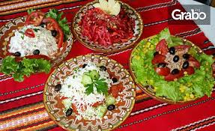
OUR MENU
Cooked dishes and soups
Tripe soup 300 g. € 2.90
Chicken Soup 300 g. € 2.90
Bean soup 300 g. € 2.50
Boiled beef 400 g. € 5.90
Cream soup of porcini mushrooms 300 g. € 5.9
Salads
“Our village “salad
(Tomatoes, cucumbers, onion, pepper puree, bread) 400 g. € 3.10
Bulgarian salad
(On thin bread baked in the coals, put the puree, olive oil, hot pepper, roasted pepper, aubergine puree, chopped into large washers tomato and basil) 400 g. € 3.30
Garden salad
(Lettuce, tomato, cucumber, red onion, balsamic vinegar) 400 g. € 2.50
Parlenka with fresh vegetables
(Cucumber, tomato, pepper, bread, spread with appetizer and basil) 400 g. € 3.50
Salad with basil
(Tomato basil) 400 g. € 3.10
monk salad
(Parlenka with roasted peppers, cheese, onions, garlic sauce and baked beans) 400 g. € 3.50
hunter's salad
(Roasted tomatoes, mushrooms, bacon, onion, cheese and garlic paste) 350gr. € 3.10
Salad grandmother
(Peppers with cheese, tomatoes, cabbage, fennel, red pepper) 400 g. € 3.90

Slide 20
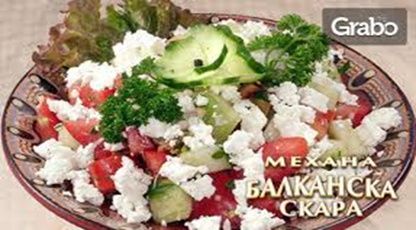
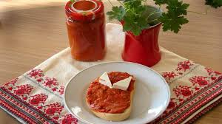
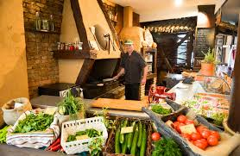
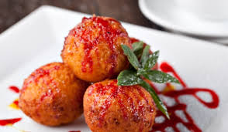
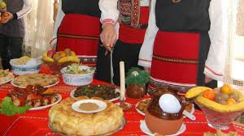
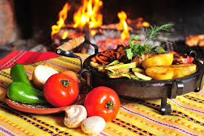
Shopska salad 400 g. € 3.95
Aubergine 300 g. € 3.20
Balkan salad
(Tomatoes with strained yogurt) 350 g. € 3.50
monastery salad
(Big beans, tomatoes, red onion, dried meat, fenugreek, Elena fillet) 450 g. € 3.10
Pickles 200 g. € 2.20
St George's day salad
(Lettuce, radish, cucumber, onion, egg) 350 g. € 2.50
Puree with roasted peppers 300 g. € 2.90
Tomatoes with mozzarella
(Tomato, mozzarella, basil, olive oil) 425 g. € 3.90
Cold appetizers
Wolfish cold appetizer / sausage, sausage, jerky, fillet "Elena" / 400 g. € 11.00
Rural rich appetizer
(Blend cheese, garlic, chili pepper and olive oil, roasted tomato and roasted pepper) 300 g. € 3.90
Cow cheese (Feta) 100 g. € 1.50
Fresh buffalo cheese 100 g. € 2.20
Sausage 100 g. € 3.00
Blue cheese 100 g. € 4.50
Elena fillet 100 g. € 3.90
Cheese plate with fruits 500 g. € 12,00

Slide 21
Hot appetizers
Baked beans in the oven 300 g. € 2.90
Kathy appetizer
(Pork tenderloin, onion, mushrooms, roasted peppers, pickled. Cucumbers, cheese) 300 g. € 5.90
Spinach meatballs 350 g. € 3.20
Parsley meatballs 350 g. € 3.50
Fried cauliflower 350 g. € 3.90
Fried pork mestse with oil and garlic 350 g. € 4.90
Fried chicken mestse with oil and garlic 350 g. € 3.50
Chicken liver in Straldjanski with onions, bacon and mushrooms 450 g. € 4.50
Mushrooms with garlic paste and cheese 300 g. € 3.90
Cheese skillet 250 g. € 2.90
Fried potatoes in rural style 400 g. € 3.50
Fried rustic potatoes with cheese 450 g. € 2.50
Fresh french fries in a pan 400 g. € 3.90
French fries 400 g. € 2.00
French fries with cheese 450 g. € 3.90
The rest is surprise. Welcome and see how tasty and very affordable.

Slide 22
ACCOMMODATION
Single room: EUR 60 / night
Double room: EUR 50 / night
Triple: EURO 65 / night
Discounts: for children, people with disabilitie,s and groups: 20%
Additional services:
- trips
- hunting and fishing equipment rentals
- at the request of guests - preparing food by themselves
animation and games for children
performances of Bulgarian customs and traditions
picnics
other

Slide 23
Prepared by: the team of students from Vocational School of Tourism “Prof. Dr. Asen Zlatarov”, Burgas, Bulgaria

