Slide 1
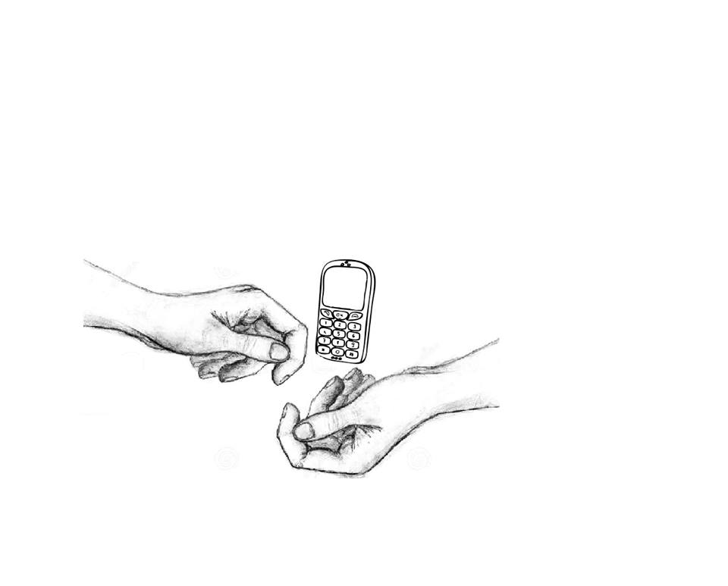
Shopassistant
Izabela Kaczmarczyk
Urszula Kwiatek
Artur Szczypta

Slide 2
Our offer
This is an aplication which is to help customers to shop electronic and household goods.
It works very simple:customers contact and tell us what product they need, whether they want a new or second hand product, give price limit, what this device will be used for, how many people will use it etc. Just basic information. That’s all we need. We do the rest.

Slide 3
This aplication is for:
hard-working people,
big companies,
People who lack technical knowledge,
people who don’t have free time or don’t want to waste their time
anybody who needs professional information and help to do the right purchase

Slide 4
Market analysis
Nowadays people want to shop fast and good. They put attention to good quality products and the choice of all appliances and household goods is really enormous. It is not so easy to buy a washing machine or a TV these days. There are lots of models to choose from, different brand, price and quality. To choose well, sometimes you need to study technical parametres, which is not always so easy for everybody, especially the older people. Besides, every person should buy the device which really addresses to their needs, to be sure that this particular machine will be used effectively, which is a question of ecology too. Buying the most expensive products of famous brands does not always mean buying the best! This aplication is to help everybody to choose right!
It is for people who feel responsible for their choices.

Slide 5
Recruitment strategy
Our company will need only a few workers at first, we will make sure they have good technical knowledge, one person must be specialised in computers, also we will hunt for experienced workers who have already worked with this kind of products.
Communication skills, dealing with customers, ability to work in a team, foreign languages and very good ICT litteracy, this is what we will put stress on, while looking for employers.

Slide 6
Financial analysis
Expenses
computers | 3 x 1000€
software | 3 x 100€
workers | 3 x 1000€
maintanance | 500 €
All: | 6800€
subsidy | 2000€
Return | 8000€

Slide 7
Why we expect success
We will be better than other aplications, because:
We will work all the time, at weekends too, because we have checked that generally people shop for household goods during their free days.
We will employ staff with good technical knowledge, qualified in electrical goods, computers, home appliances
we will not be expensive
we will be fast and effective
We need need only a few workers which will make us reduce costs. For more sophisticated demands we will consult experts from all over Poland and the world, if needed.

Slide 8
Erasmus+
‘Budding Entrepreneurs Running School’
2014-2016

