Slide 1
Fan Bike
Name of students :
Ioan Fieraru
Octavian Gheorghe
Marius Ion
Gabriel Chimigeru
Catalin Sandita

Slide 2
1. Factual information
Name: Fan Bike
Address: Macelarilor , number 69
Postcode/Town: -Craiova
Email: Fan.Bike@yahoo.com
Tel.: 0772324287
Web: www.Fan-Bike/Craiova.com

Slide 3
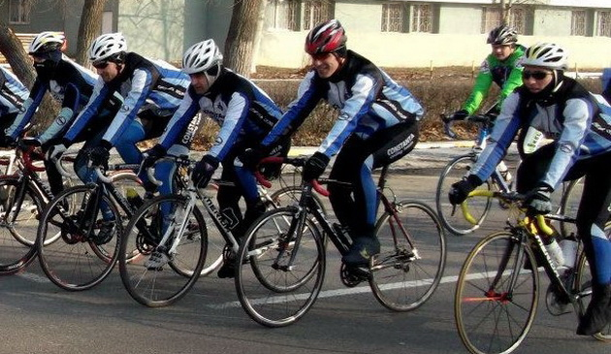
Type of business you want to start
Fan Bike is a company built for satisfying people’s needs of sending a package on short distances.
The company is a local courier business in Craiova.

Slide 4
Product or services you will sell
Our company signs a contract when the package is given to our employees .In the contract you’ll be informed about the amount of money you will have to pay after the package is sent and the date it will arrive to its destination. When the receiver gets the package we will call the sender to inform him/her about the package’s arrival.

Slide 5
Type of customers you will sell your products/services to.
Our employees will receive the packages and they will send them to their destination in about 2 or 3 hours. Our services can be offered everywhere in Craiova. We send packages with a maximum weight of 5 kg,we are very punctual, our clients are always happy about our services. Our services are of good quality, we can send packages everywhere in Craiova in a very short time.

Slide 6
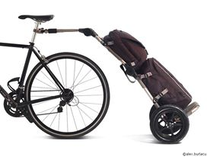
Financial Resources
Financial Credit
Our investment come from European funds. With the help of these funds we bought new tools to help us do our job like:
-5 bikes
-Another 5 bikes that costs 2000 RON/each
-3 trailers all of a total cost of 3500 RON
-In total 55000 RON for the beginning

Slide 7
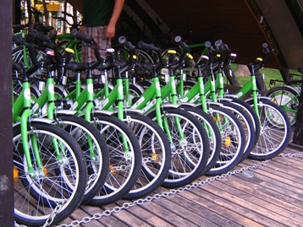
We intend to get our business at a higher level after we gain more experience in the domain and the trust of even more people.
We intend to expand our business after we buy more bikes, maybe some scooters too, and we’ll try to make our clients happy.

Slide 8
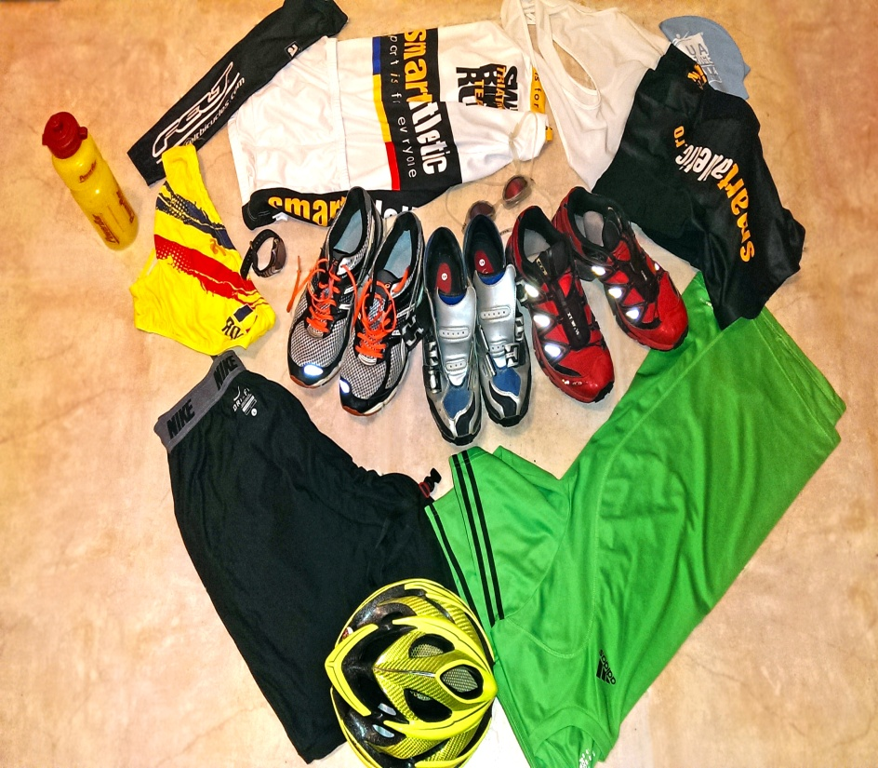
Our employees’s uniforms is provided by Nike,the company we have a contract with.
Partnership:
Our bikes are bought from a company called “De Rosa”equipped with high-tech GPS systems.We are very well organized and prepared for every situation.

Slide 9
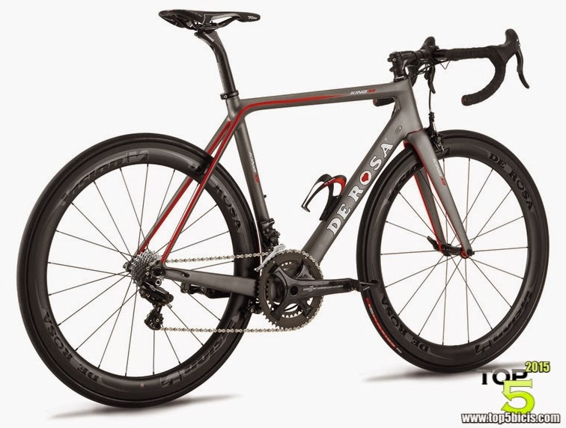
Objectives
We hope that every employee can do 10 deliveries in a day. We would like to mention that we currently only have 3 employees others 2 will be hired soon.
An employee has an objective on 10 deliveries in a total of 100-200 RON/day.
5 employees would earn 500-1000 per day.
If our company will grow enough we will get at a weekly total of 2500-5000 RON with 5 employees.

Slide 10
Marketing strategy
We adapt our strategy and change our plan if something is not going according to the plan.
We want to become the best company from Craiova in a year. By time we will expand our business in other cities from Romania.
We want to become the fastest courier service company because that’s what people want in our days.
We think that in about 3 months we should recover our investments and after that we will begin to make some profit. As long as we will get as fast as we can to the receiver we will become one of the top companies.
Our relationship with our clients will be a good one. We hope there will be no misunderstandings.

Slide 11
Recruiting employee strategy
At the beginning our employees will be the people that had the same idea as we did, the ones that helped creating the company. When we will get enough money we will hire more people.
The qualities we look in a new employee:
-To be respectful
-To know all the streets of the city
-To be sociable and to enjoy his job
-Determination, good reacting time, stamina and attention

Slide 12
Financial predictions
Initial business capital
5.000 euro , Ioan has 1000 , Octavian 1000 , Marius 1000. Gabriel 1000, Catalin 1000
-most of the money will go on bike , repair, garage modernization and authorizations
*First years expenses -if at first we are workers , we divide among us
First year net income -15.000

Slide 13
Long-Term expectations
From our point of view, we think that our business is a future business and we will expand across the country. We hope to become number one. The world wants serious people, and that's what defines us. Everybody started from the bottom when they initiated a business, why can't we do the same? We trust our clients and we hope to grow bigger with their help.

Slide 14
Management :
Administrator – Gabriel Chimigeru
Director general - Ioan Fieraru
Director of human resources - Marius Ion
Accountant - Catalin Sandita
Procurement Director – Octavian Gheorghe

