Slide 1
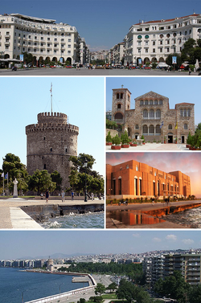
"Carpe Librum: The School library and the communication skills through the study of literary and cultural relations between Greece and Spain» 2018-1-ES01-KA229-050022 2nd Meeting: Thessaloniki 27.3.2019 to 3.4.2019

Slide 2
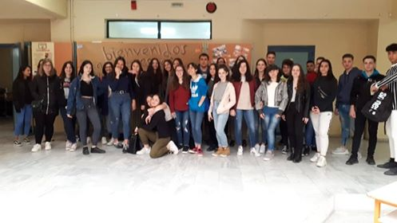
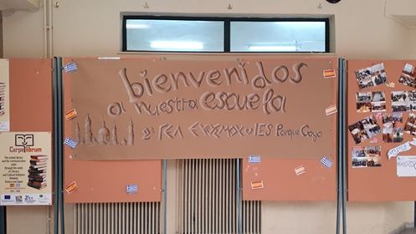
Host: 2nd General Lyceum of Evosmos
Thursday 28.3.2019
Meeting at the 2nd General Lyceum of Evosmos, the Headmaster and the teachers

Slide 3
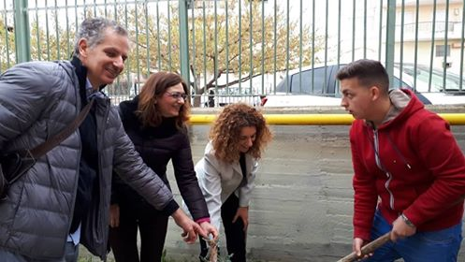
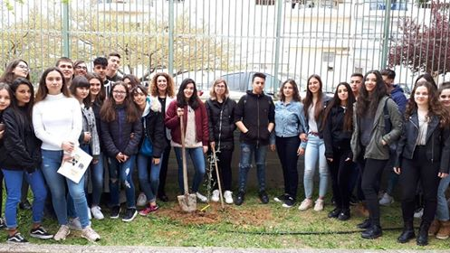
"Tightening the bonds": planting of a tree at the school-yard.

Slide 4
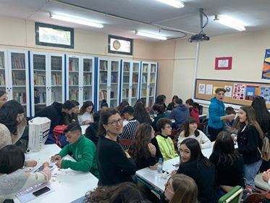
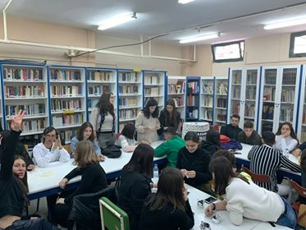
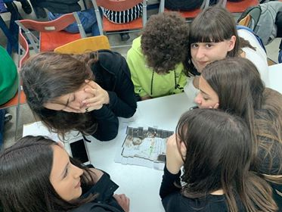
School library: Preparation of the 1st Literature Suitcase (gathering of materials of the 1st meeting in Zaragoza).

Slide 5
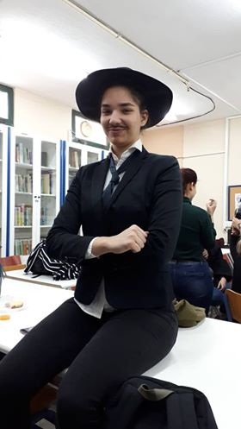
"Miguel Cervantes/ Nikos Kazantzakis: life and travels of the two writers in Greece and Spain" through presentations of the students. Short dramatization of the two writers' lives

Slide 6
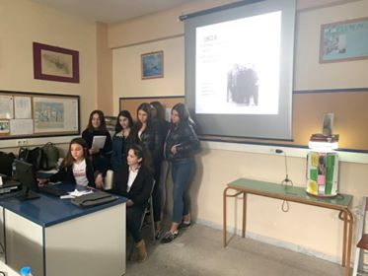
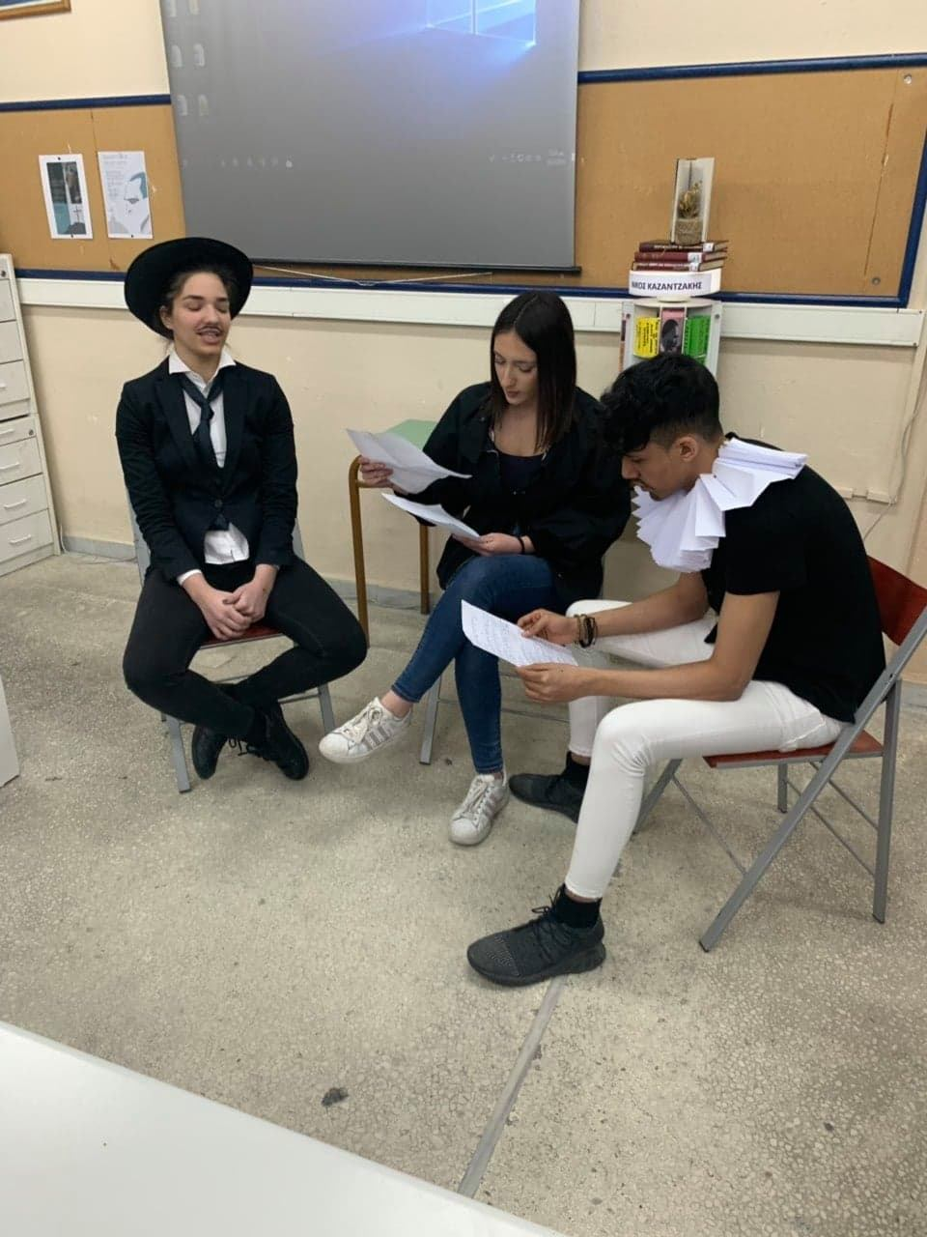

Slide 7
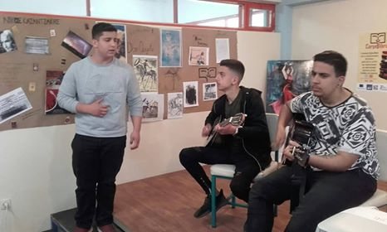
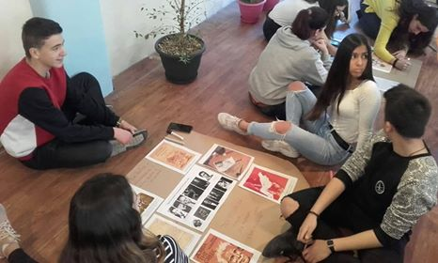
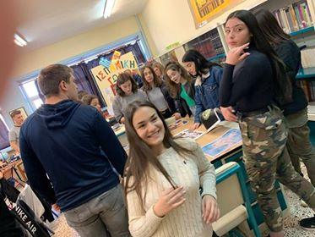
Friday 29.3.2019
Meeting at 1st EPAL of Evosmos. Meeting with the Headmistress and teachers

Slide 8
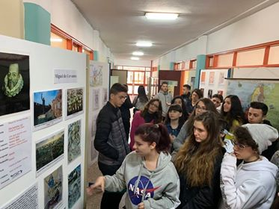
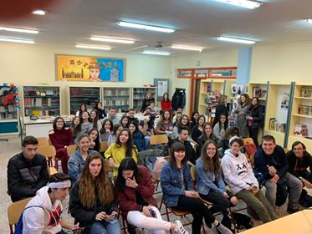
Set up of a small photo and poster exhibition about Cervantes and Kazantzakis at the school library.

Slide 9
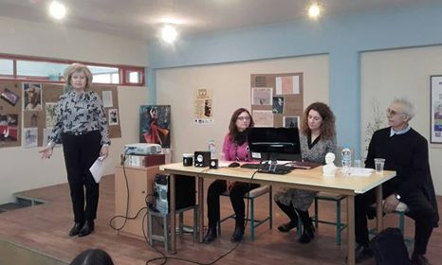
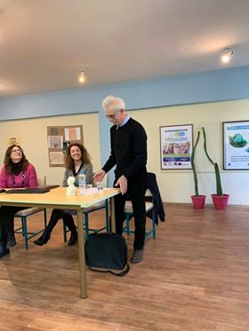
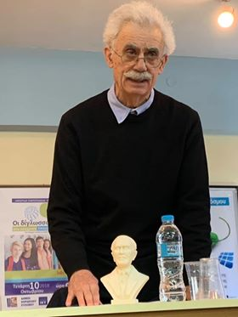
Lecture by Mr Dimitris Gounelas, Professor of Modern Greek Literature at Aristotle University of Thessaloniki concerning Kazantzakis' relationship with Spain. Discussion.

Slide 10
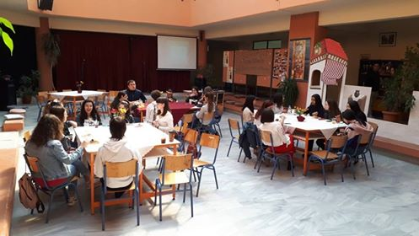
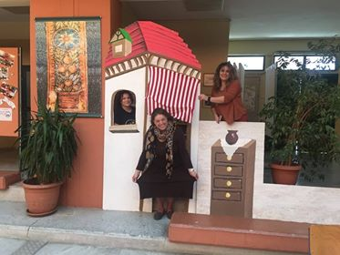
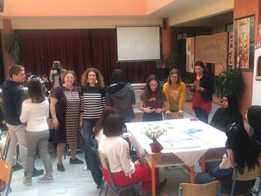
Saturday 30.3.2019
Meeting at 2nd GEL of Evosmos.
School Hallway: "Federico Garcia Lorca /Odysseas Elytis" . Gathering of sketches in order to make a common booklet.

Slide 11
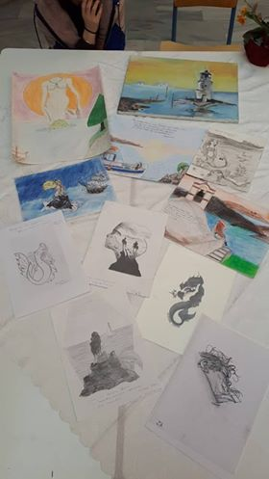
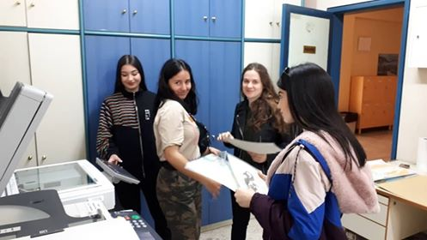

Slide 12
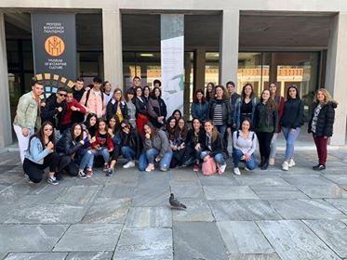
Departure for Museum of Byzantine Culture to visit the exhibition "Nikos Kazantzakis and Byzantium: the quest of Divine".

Slide 13
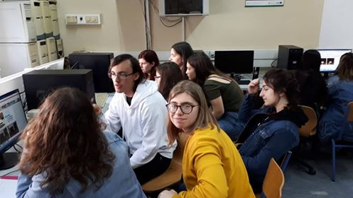
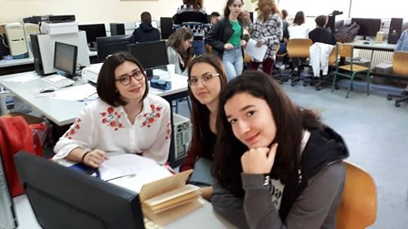
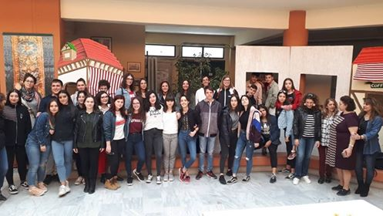
School library: "Blooded wedding" by Federico Garcia Lorca. Working on Storyboard in mixed teams.

Slide 14
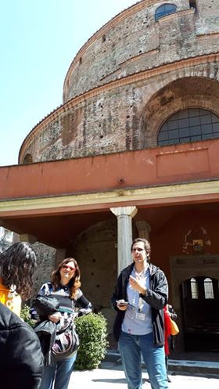
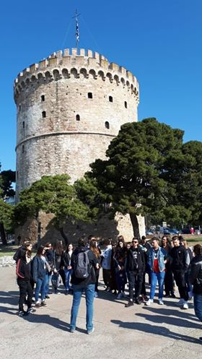
Sunday 31.3.2019
Guided tour at Thessaloniki’s monuments

Slide 15
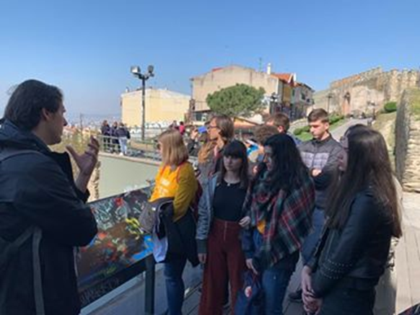
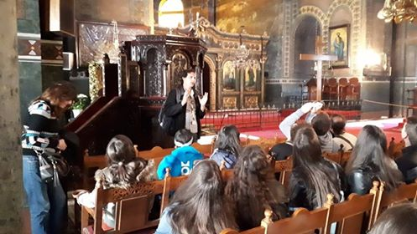

Slide 16
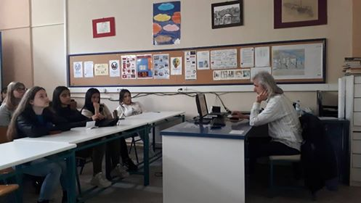
Monday 1.4.2019
Gathering at 2nd GEL of Evosmos.
Meeting with the writer Kostas Koutroubakis to discuss the influence of Lorca's poetry to well known Greek poets.

Slide 17
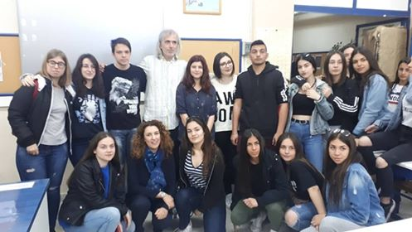
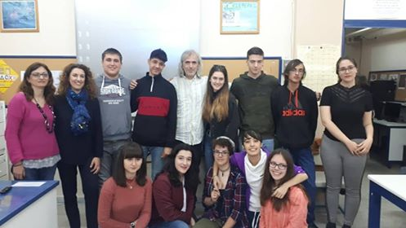

Slide 18
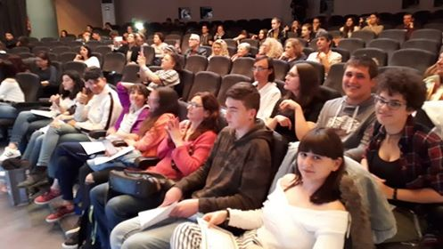
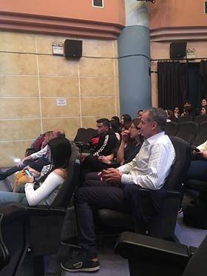
Theatrical performance of Lorca's play La zapatera prodigiosa at Evosmos Cultural Centre by the theatrical team of 2nd GEL of Evosmos. Award giving to students and teachers for their participation to the project.

Slide 19
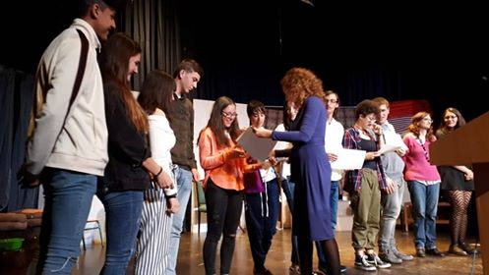
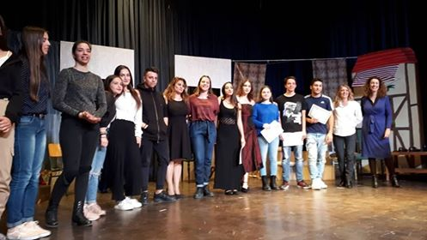
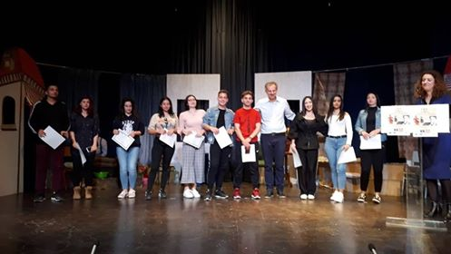

Slide 20
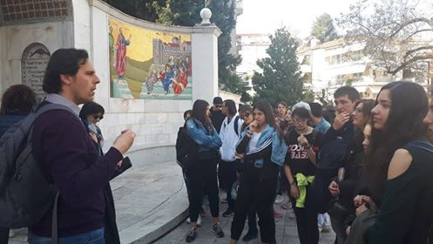
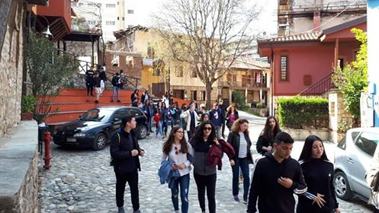
Tuesday 2.4.2019
Guided tour to Veria and Vergina. Visit to the Municipal
Library.

Slide 21
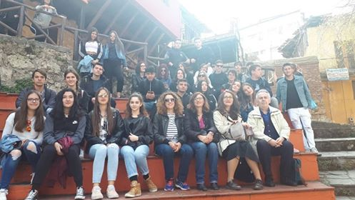
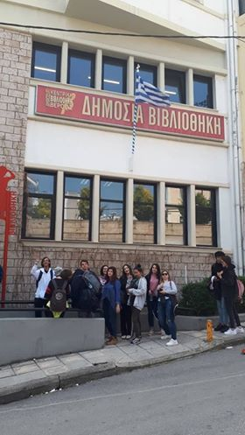

Slide 22
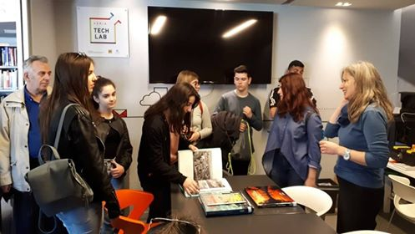
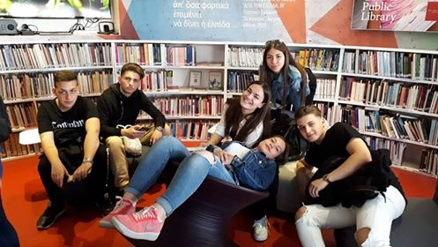
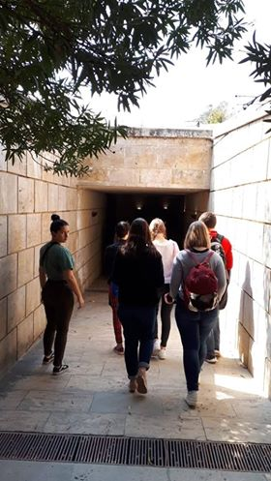

Slide 23
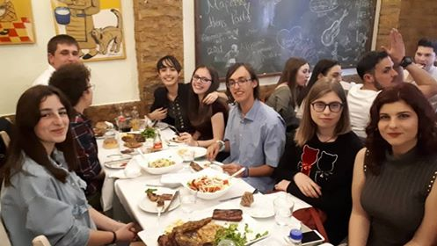
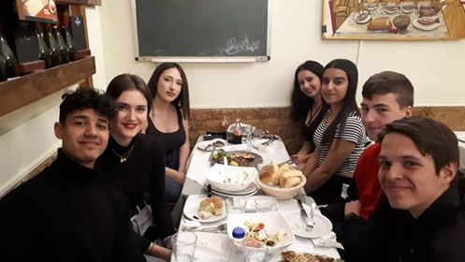
Farwell diner at a restaurant

Slide 24
