Slide 1
TASK 1: CREATE A COVID-19 CHATBOT WITH MachineLearning4Kids
Questions and answers prepared by my students (Matej Z., Fran J. and Edo R.)
eTwinning project ME THE A.I #2.0
Iva Naranđa
II. osnovna škola Čakovec, Croatia
May and June 2020

Slide 2
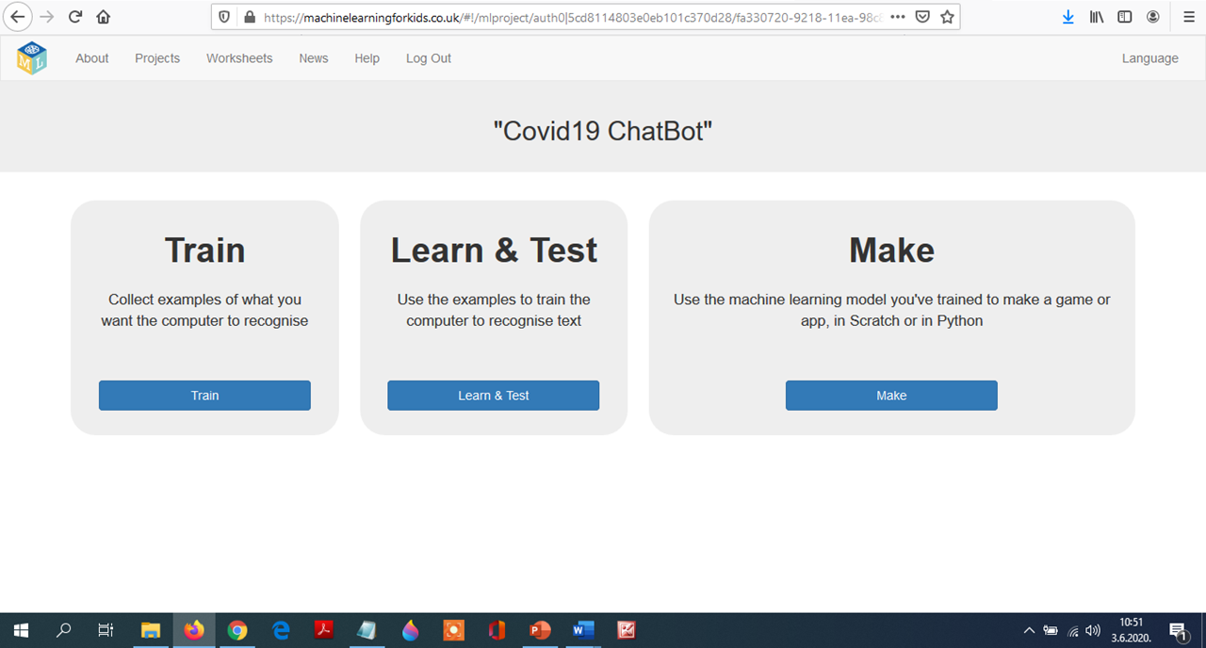

Slide 3
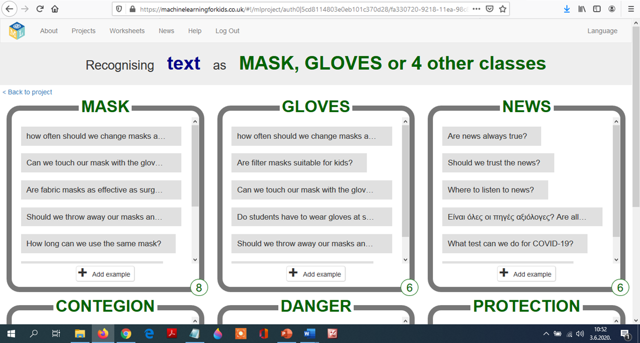

Slide 4
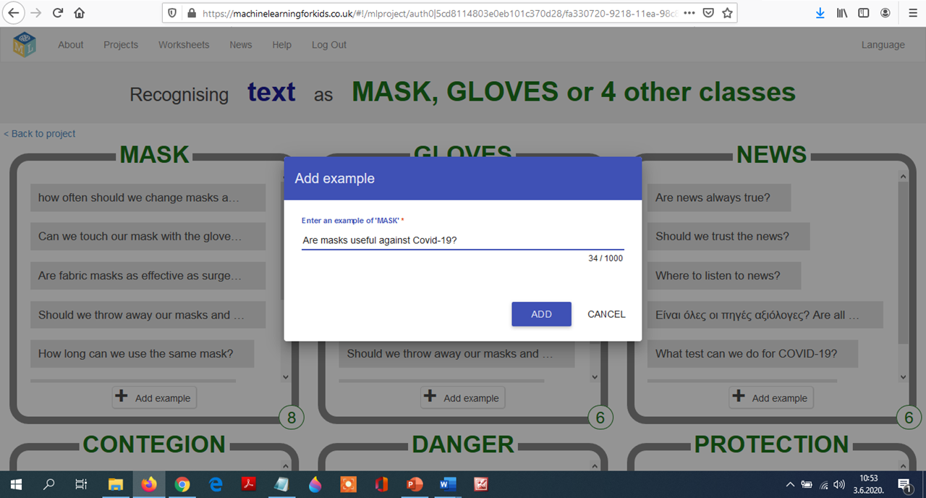

Slide 5
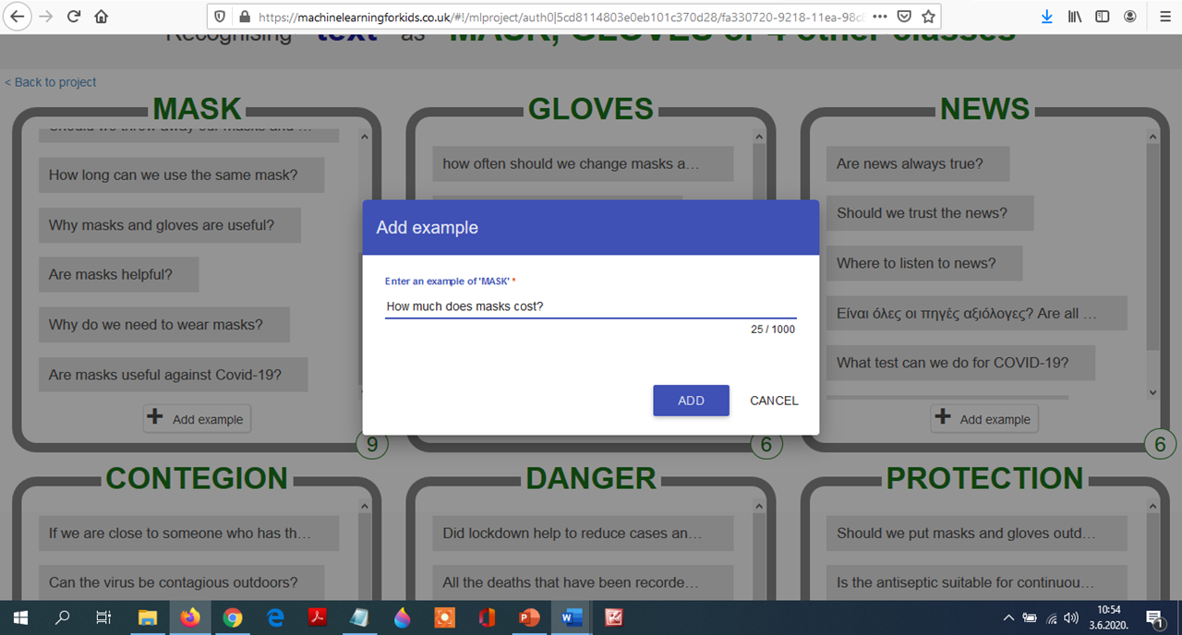

Slide 6
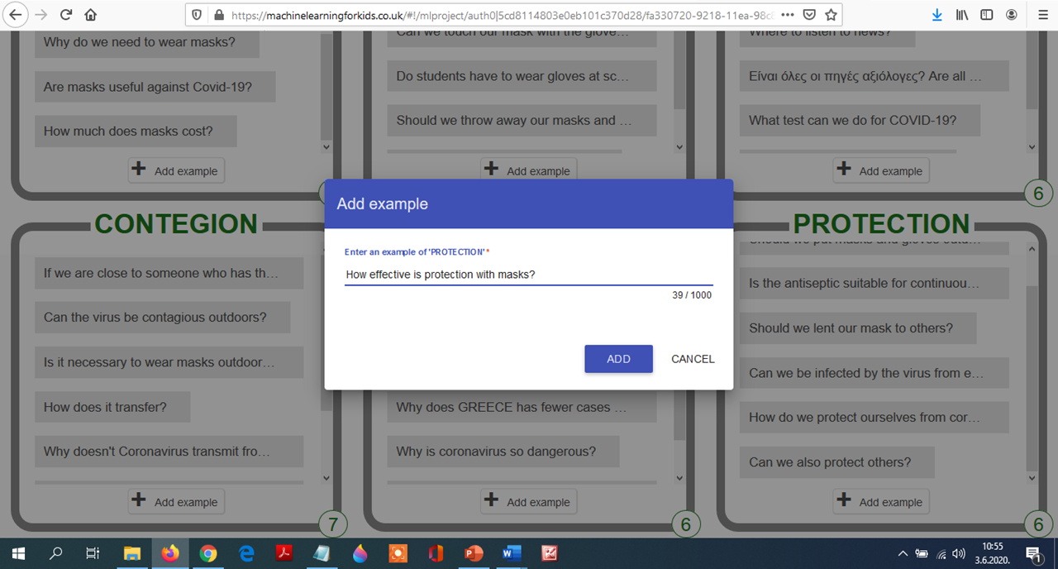

Slide 8
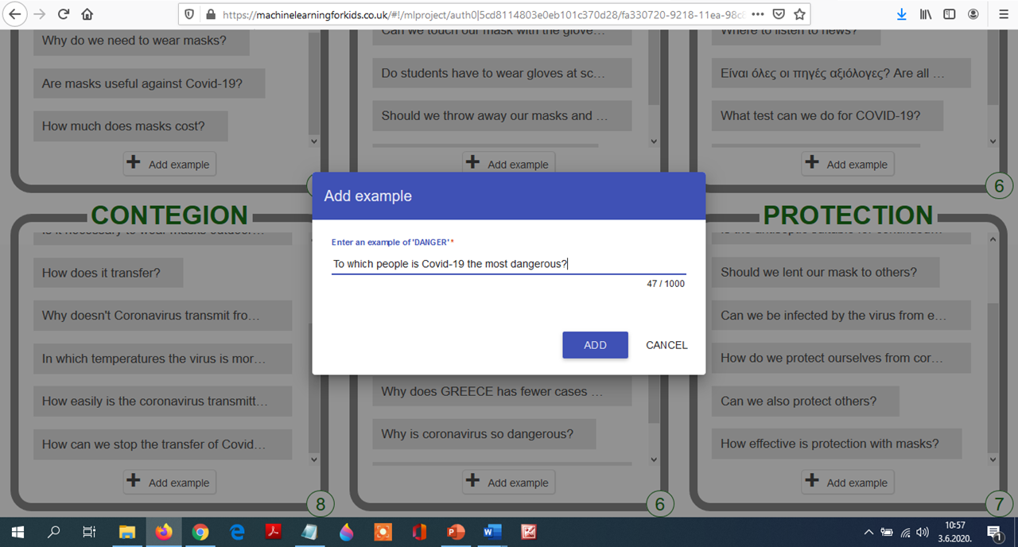

Slide 9
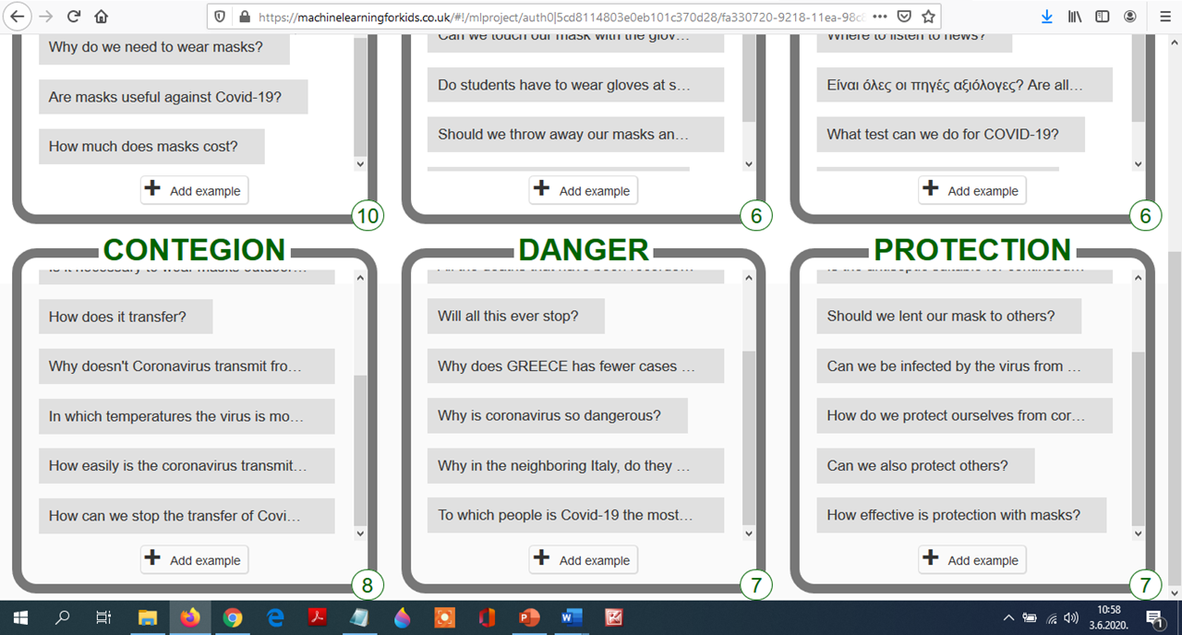

Slide 10
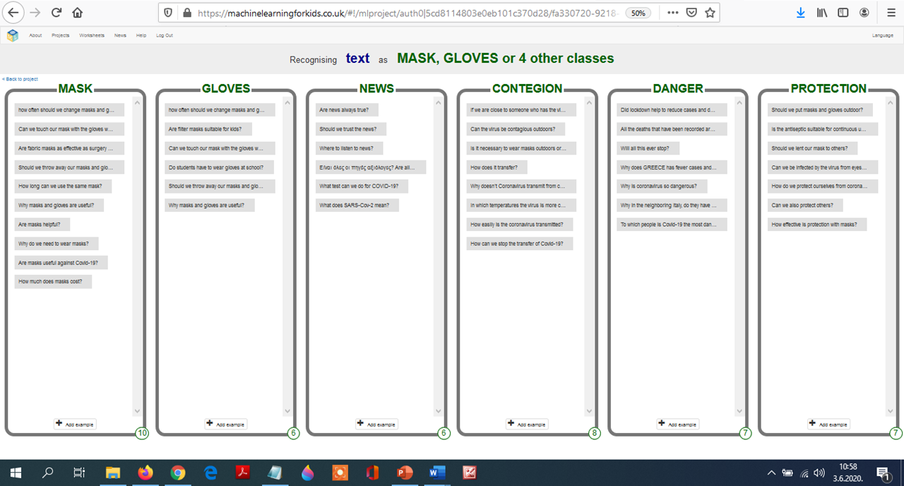

Slide 12
We also used Mindmeister to collaborate on this task.

Slide 13
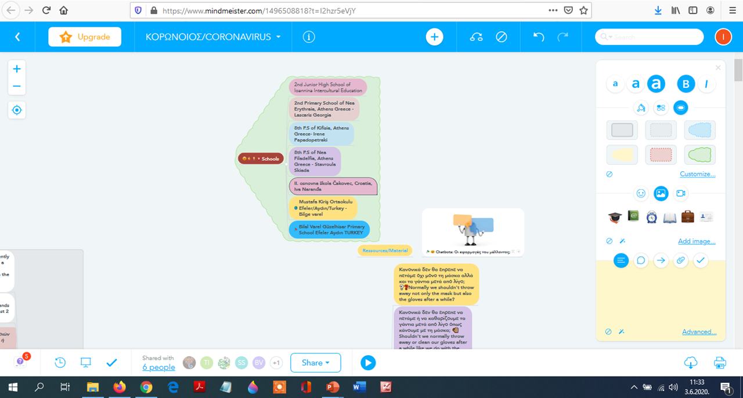

Slide 14
