Slide 1
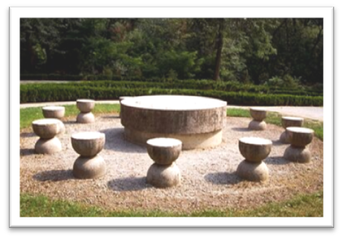
Masa Tăcerii
(The Table of Silence)
The Table of Silence is one of the most beautiful monuments in Romania. It is located in Targu Jiu, Gorj County, being built by Constantin Brancusi representing one of the three monumental sculpture pieces of the monumental ensemble.
The table of silence is also known as the monumental ensemble being a tribute of fallen heroes during world war.
The table of silence is made of stone and was built in early 1937 and was completed on October 27 in the same year.

Slide 2
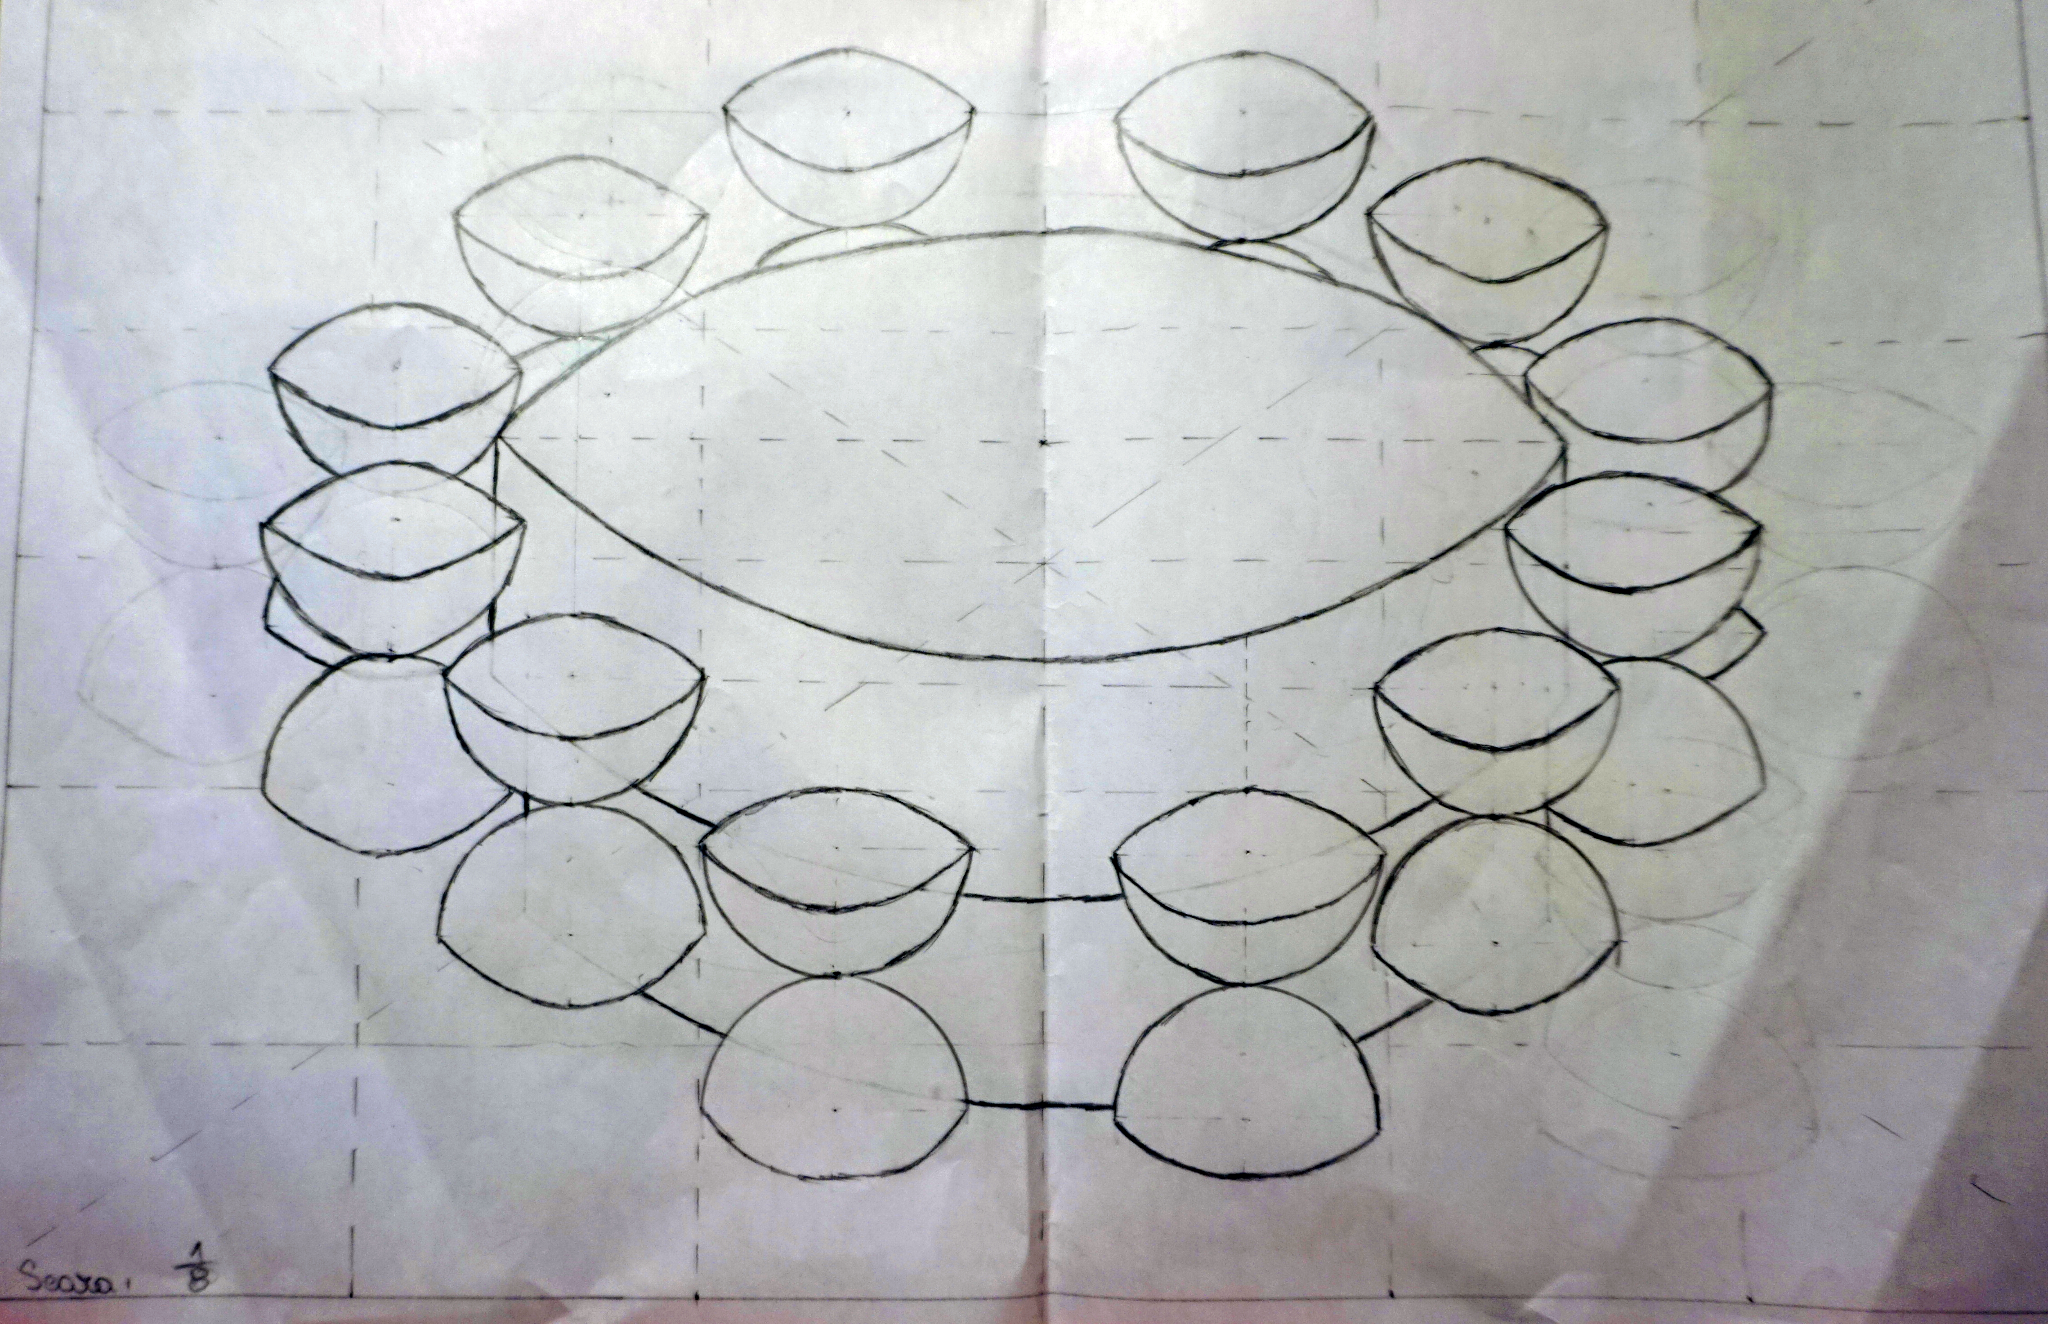
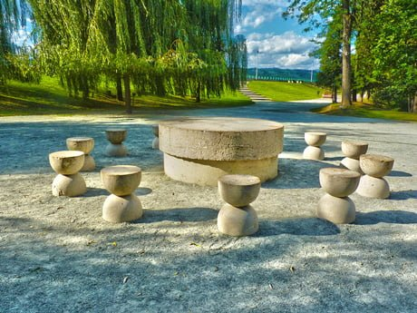
Masa Tăcerii
(The Table of Silence)
The monument's sketch
The table of silence is comprised of a circular stone table with 12 chairs. The table represents where soldiers gather in silence before battle. There’s one chair for each month of the year, their hourglass shapes stand for the passage of the time

Slide 3

“The table of Silence” is made of limestone, having the following dimensions:
the diameter of the table: 2.15 m, the thickness: 0.43 m,
the foot has a diameter of 2 m and a thickness of 0.45 m.
The surface of the table:
Circumference of the table :

Slide 4
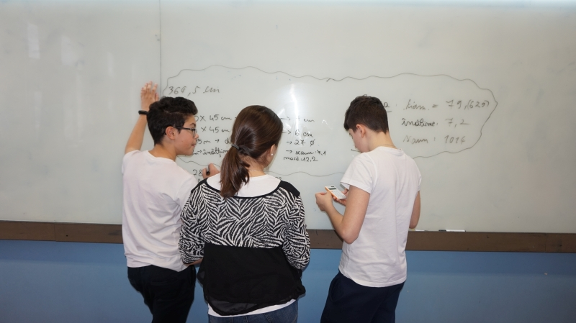
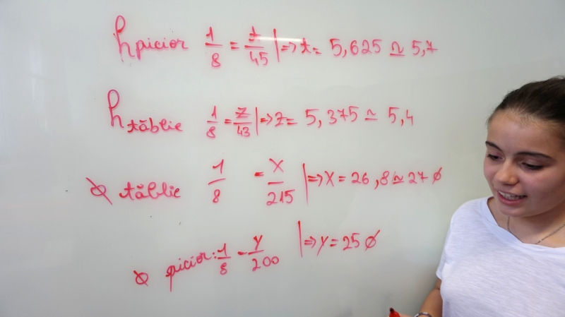
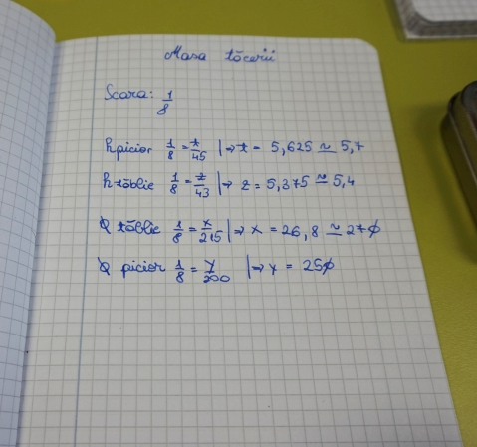
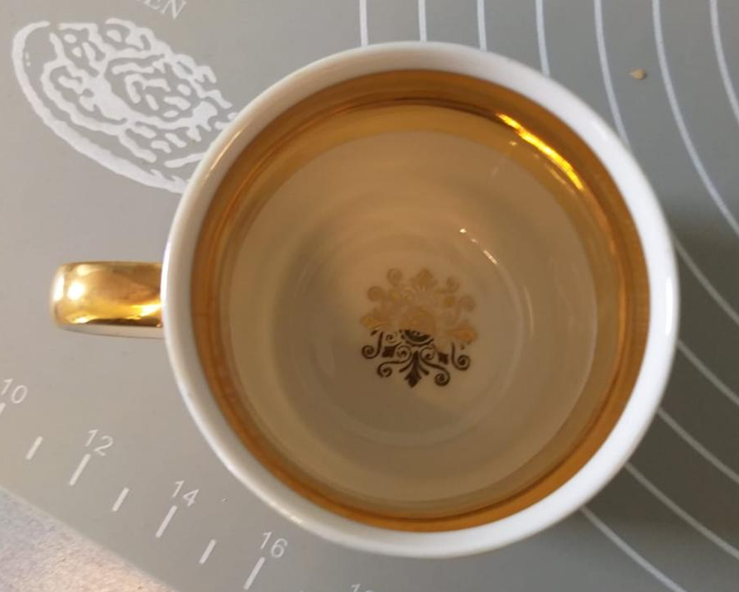
Together with my colleagues, I made a 1:8 scale model of the monument using plaster material to be modeled. I did it in the following way: at the 12 chairs I used a glass with a circle shaped opening and two forms of cake for table and leg.

Slide 5
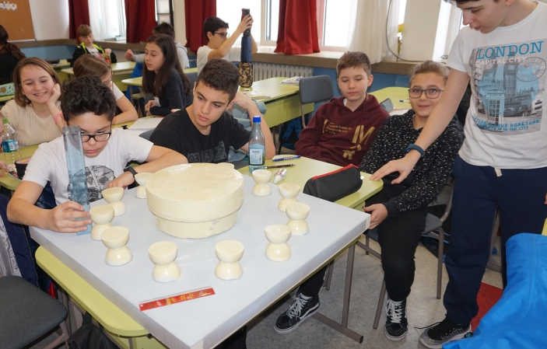
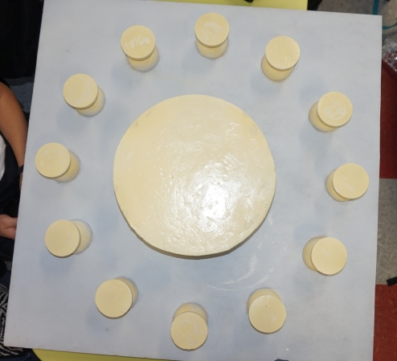
Finally we were glad to have participated in this project, we learned how to work in the team and learned more about this monument, geometry and building a model on a certain scale!
The team that made the project “The Table of Silence”: Rafik, Clara, Vlad, Denis, Lorena, Alexandra, Elissa, Lavinia, Eduard (Class 6D)

