Slide 1
APPLICATION OF THALES' THEOREM
BIRTH HOUSE OF dr. franjO tuDJman
Made by:
8th graders, district school dubravica, elementary school pušća, croatia

Slide 2
Dr. franjo tuDJman
Dr. Franjo Tudjman was born on May 14, 1922, and died on December 10, 1999
he was the first Croatian president
he became president in 1992 and was president until his death

Slide 3
BIRTH HOUSE OF dr. franjO tuDJman
Dr. Franjo Tudjman's birthplace is Veliko Trgovisce, Croatia
in that house he spent his childhood with his parents and two brothers
the house was built by a craftsman from Varazdin in the 1920s

Slide 4
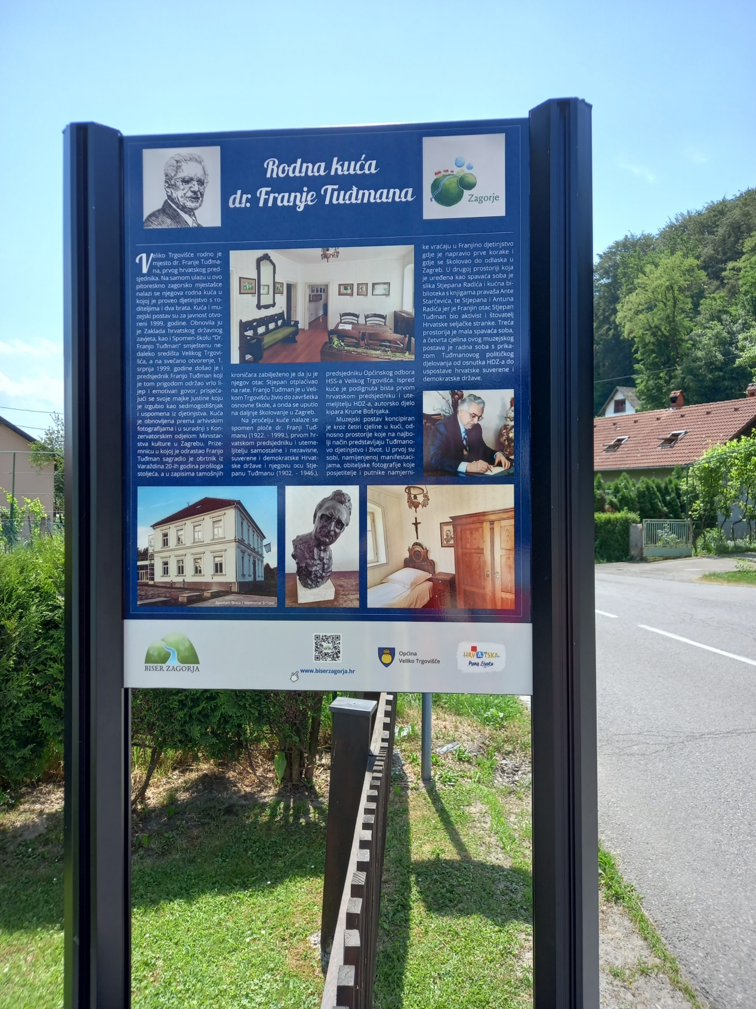
BIRTH HOUSE OF dr. franjO tuDJman

Slide 5
BIRTH HOUSE OF dr. franjO tuDJman
the house was renovated according to archival photographs and in cooperation with the Conservation Department of the Ministry of Culture in Zagreb
the house then became a museum, the grand opening of which was attended in 1999 by President Dr. Franjo Tudjman

Slide 6
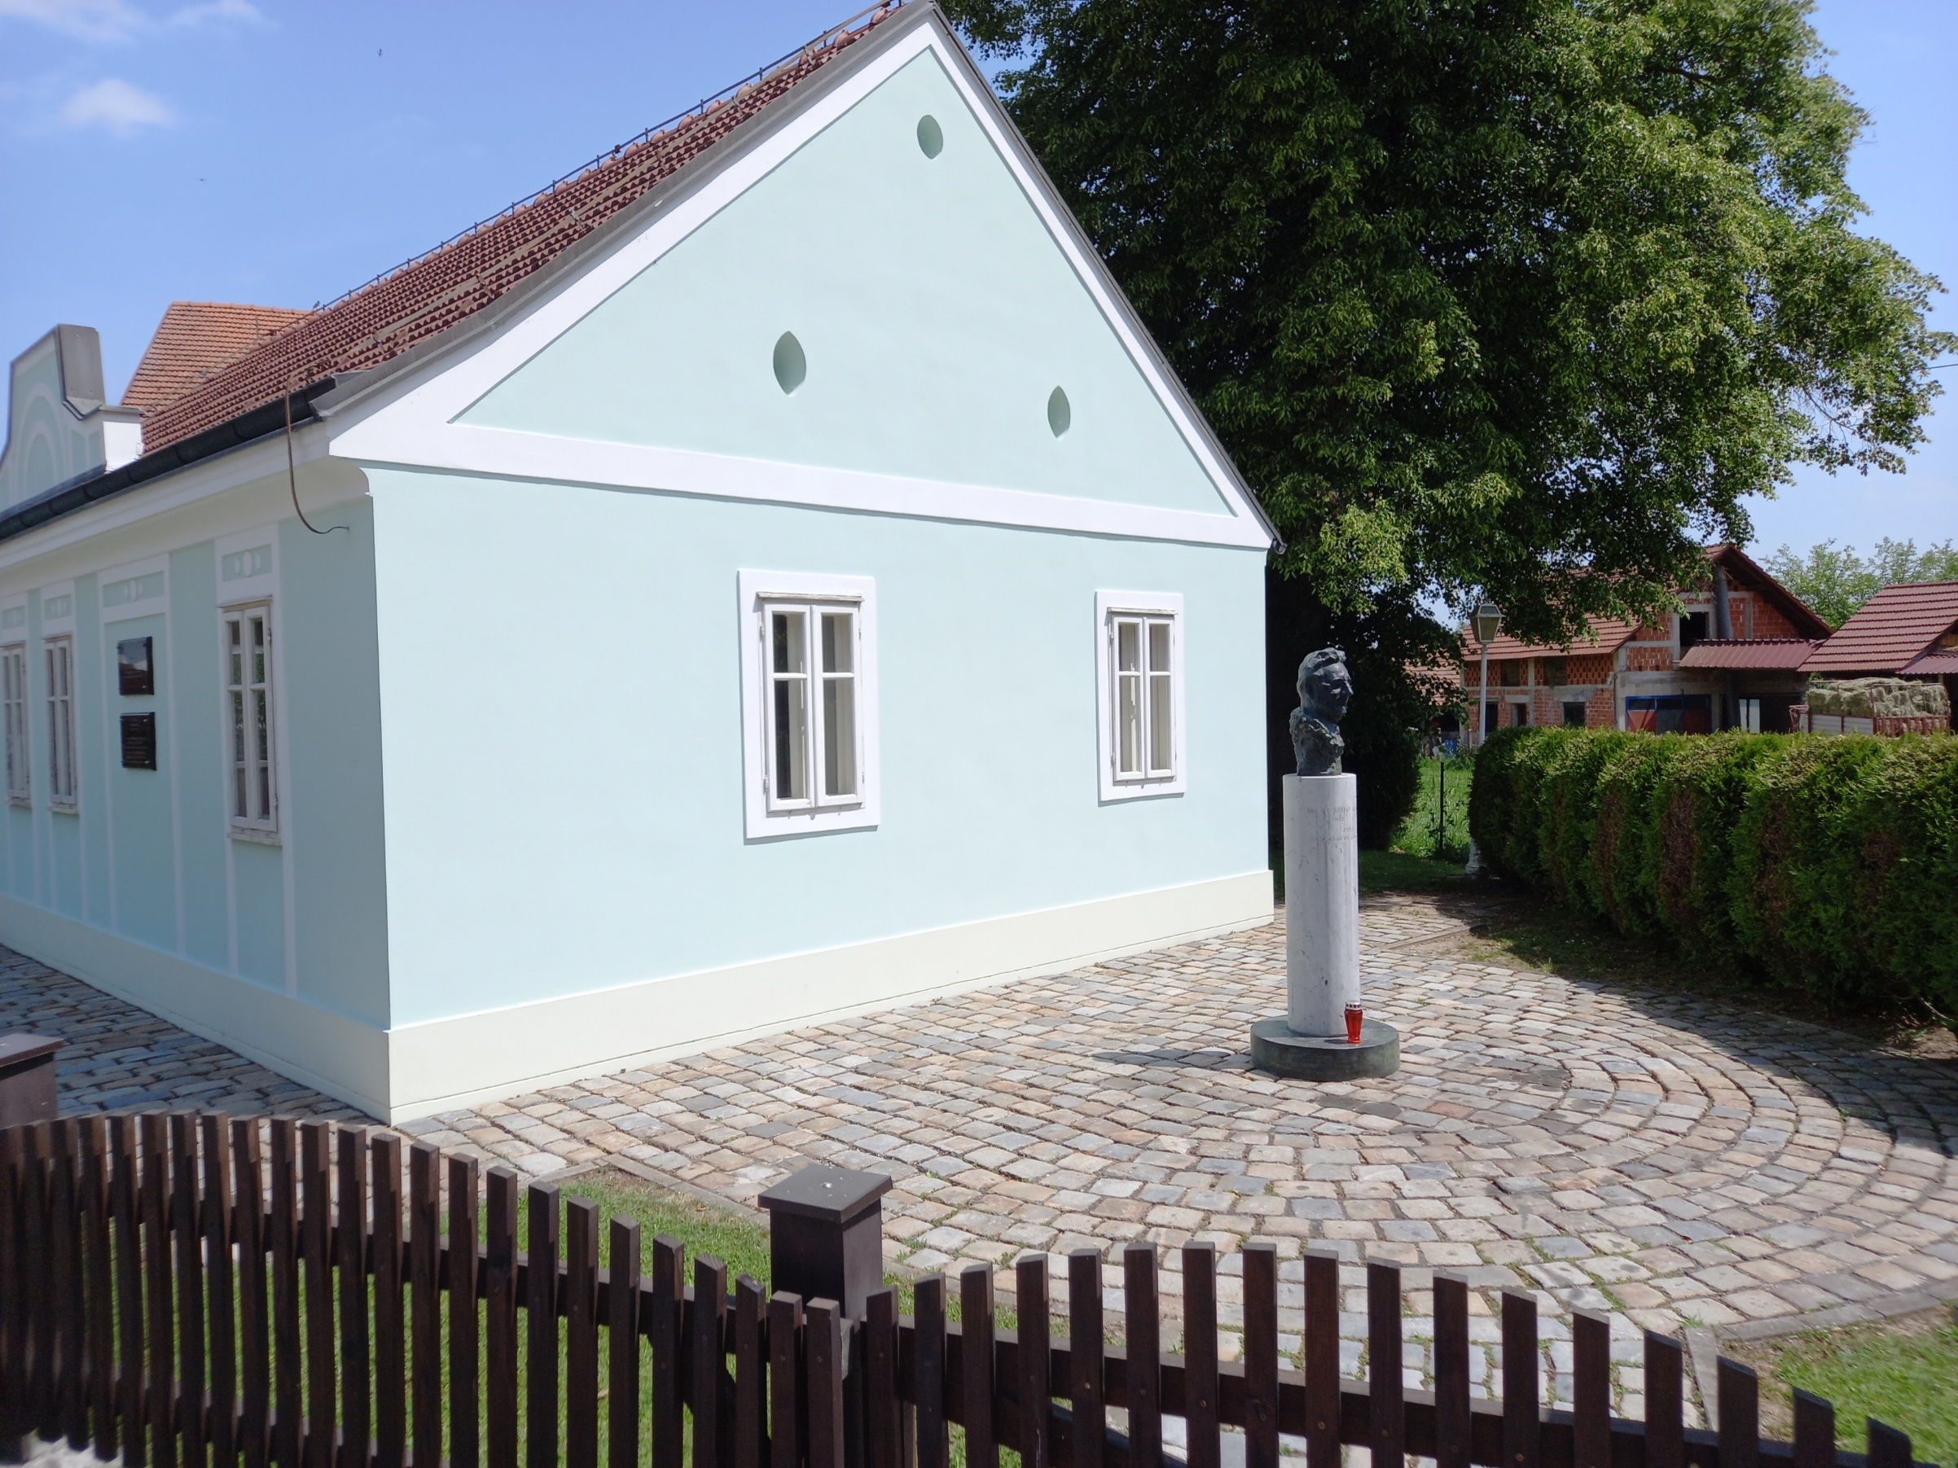
BIRTH HOUSE OF dr. franjO tuDJman

Slide 7
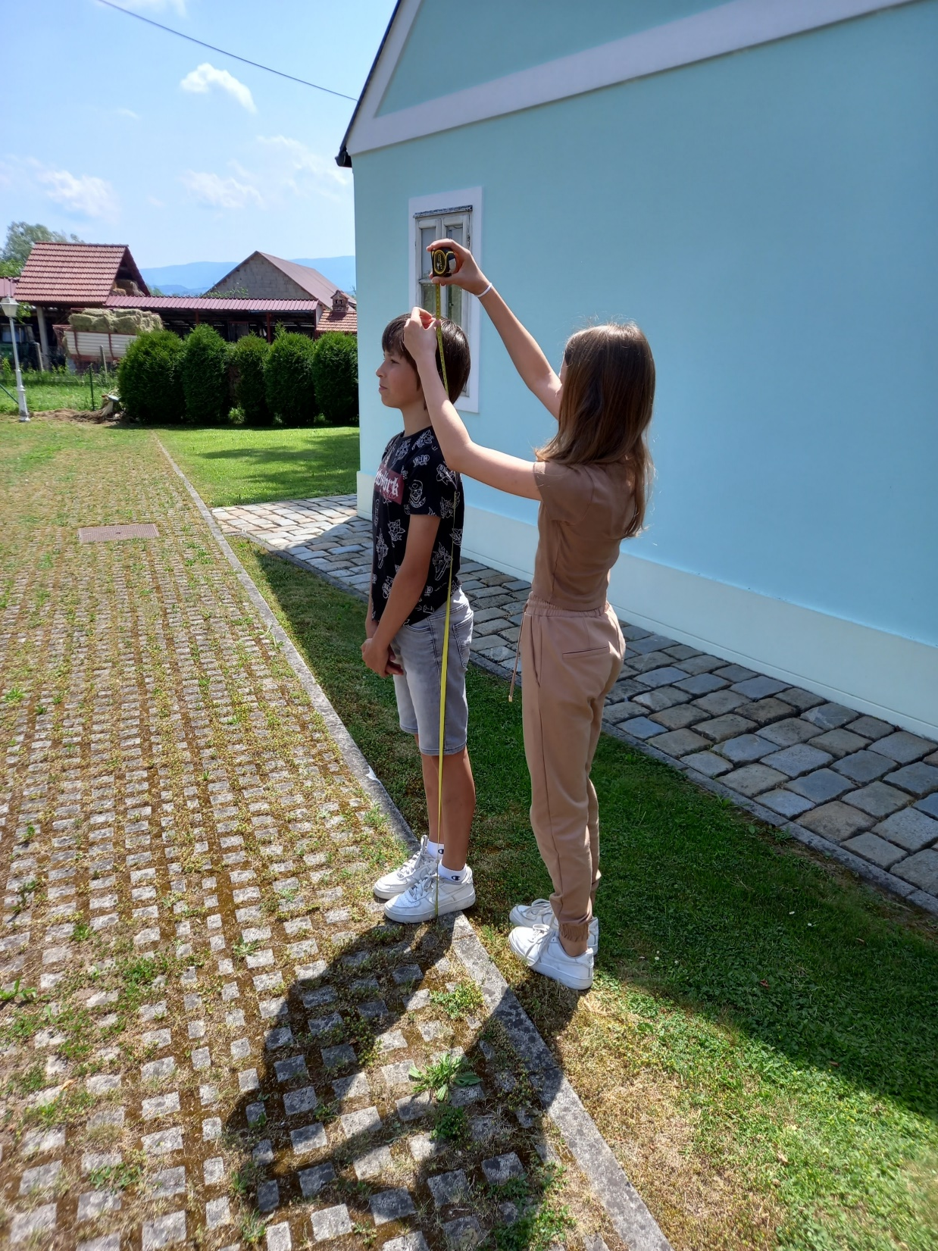
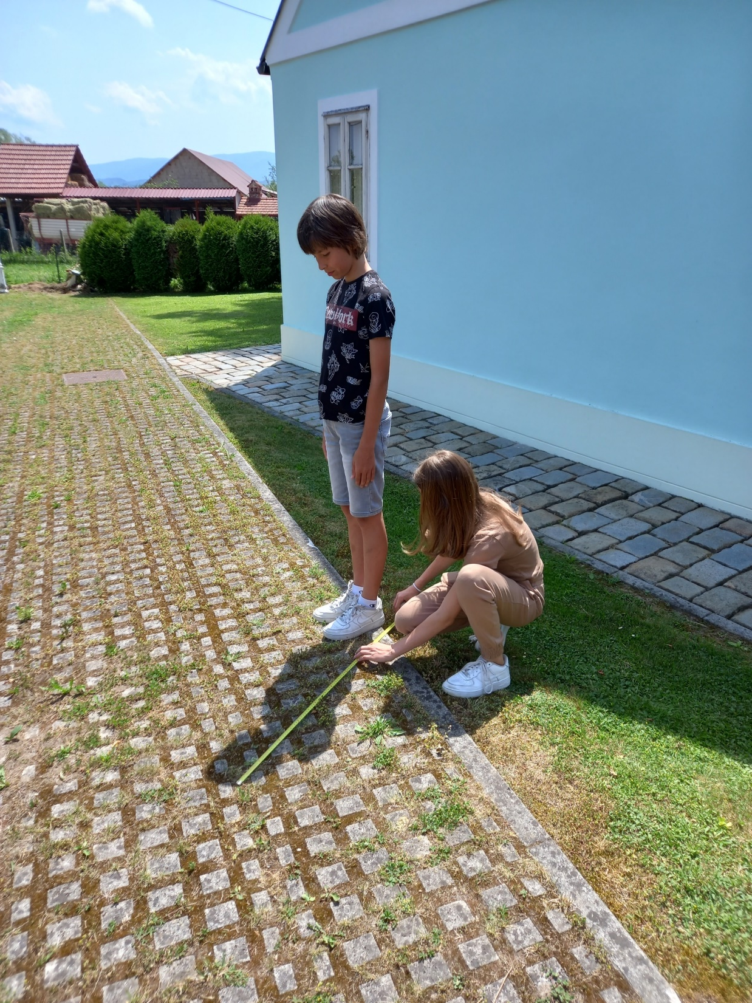
MEASURING PUPIL HEIGHT AND SHADOW LENGTH

Slide 8
APPLICATION OF THALES' THEOREM
we determine the height of the house by applying Thales' theorem
the height of the pupil (158 𝑐𝑚), the length of his shadow (99 𝑐𝑚) and the length of the shadow of the house (261 𝑐𝑚) are known

Slide 9
APPLICATION OF THALES' THEOREM
student height: $\left|\overline{BC}\right|=158 cm$
student shadow length: $\left|\overline{AB}\right|=99 cm$
shadow length of the house: $\left|\overline{BD}\right|=261 cm$
house height: $\left|\overline{DE}\right|=?$

Slide 10
Triangles $∆ABC$ i $∆ADE$ are called similar:
$∠DAE≡∠BAC$
$∡B=∡D=90°$
$⇒∡C=∡E$
$⇒∆ABC$ $\sim$ $∆ADE$

Slide 11
Now let us apply Thales' theorem:
$$\left|\overline{AB}\right| :\left(\left|\overline{AB}\right|+\left|\overline{BD}\right|\right)=\left|\overline{BC}\right| : \left|\overline{DE}\right|$$
$99 :\left(99+261\right)=158 :x$
$99 :360=158 :x$
$99x=360∙158$
$$99x=56880$$
$$x≈574.5454 cm≈5.75 m$$

Slide 12
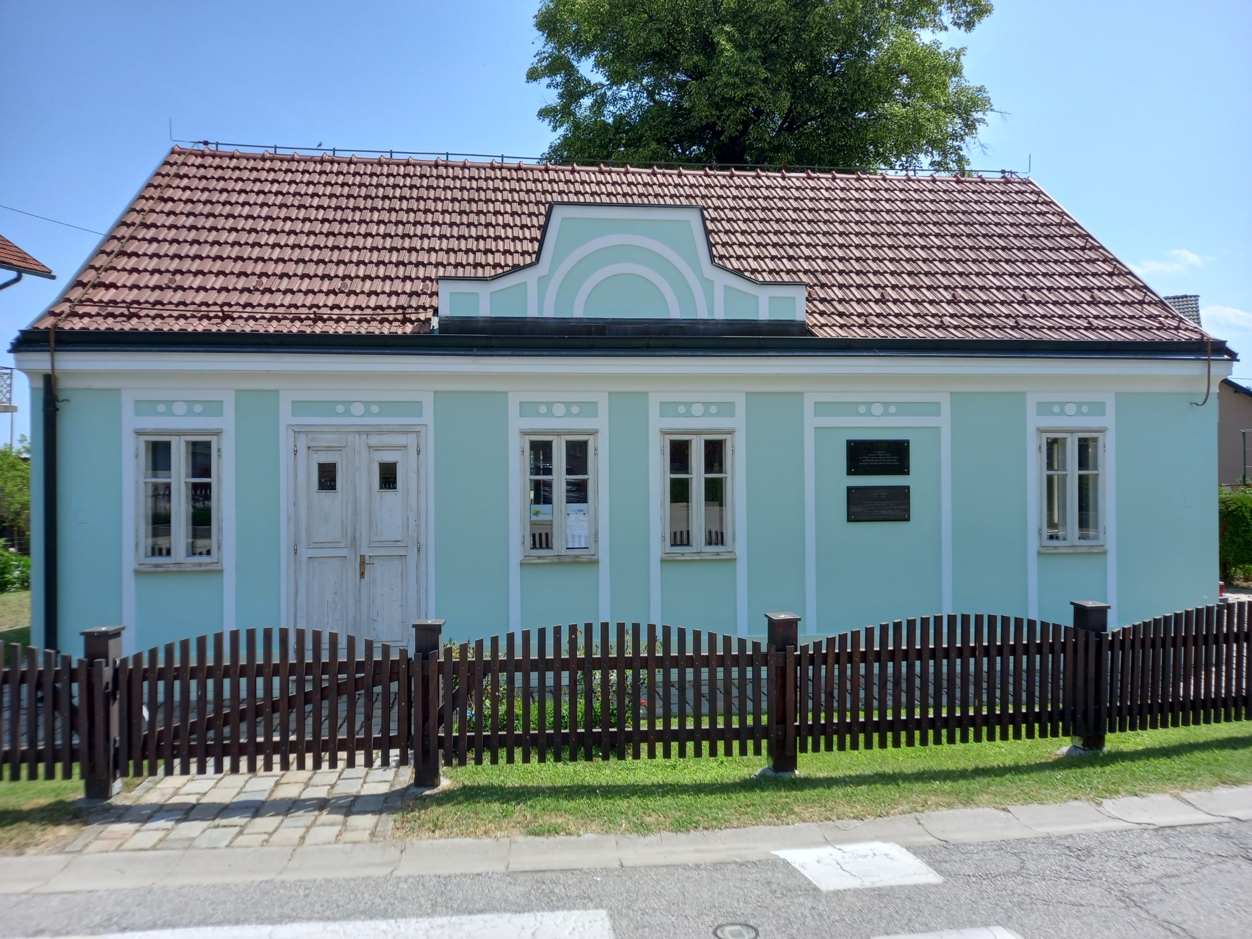
The height of the house is $5.75 m$.

Slide 13
literature
https://hr.wikipedia.org/wiki/Franjo_Tu%C4%91man
https://visitzagorje.hr/kultura/rodna-kuca-dr-franje-tudmana/
https://hr.wikipedia.org/wiki/Datoteka:Rodna_ku%C4%87a_Dr._Franje_Tu%C4%91mana.jpg
https://edutorij.e-skole.hr/share/proxy/alfresco-noauth/edutorij/api/proxy-guest/af9b8682-eef4-478e-9b92-edcba4790886/html/24827_Talesov_poucak.html

