Slide 2
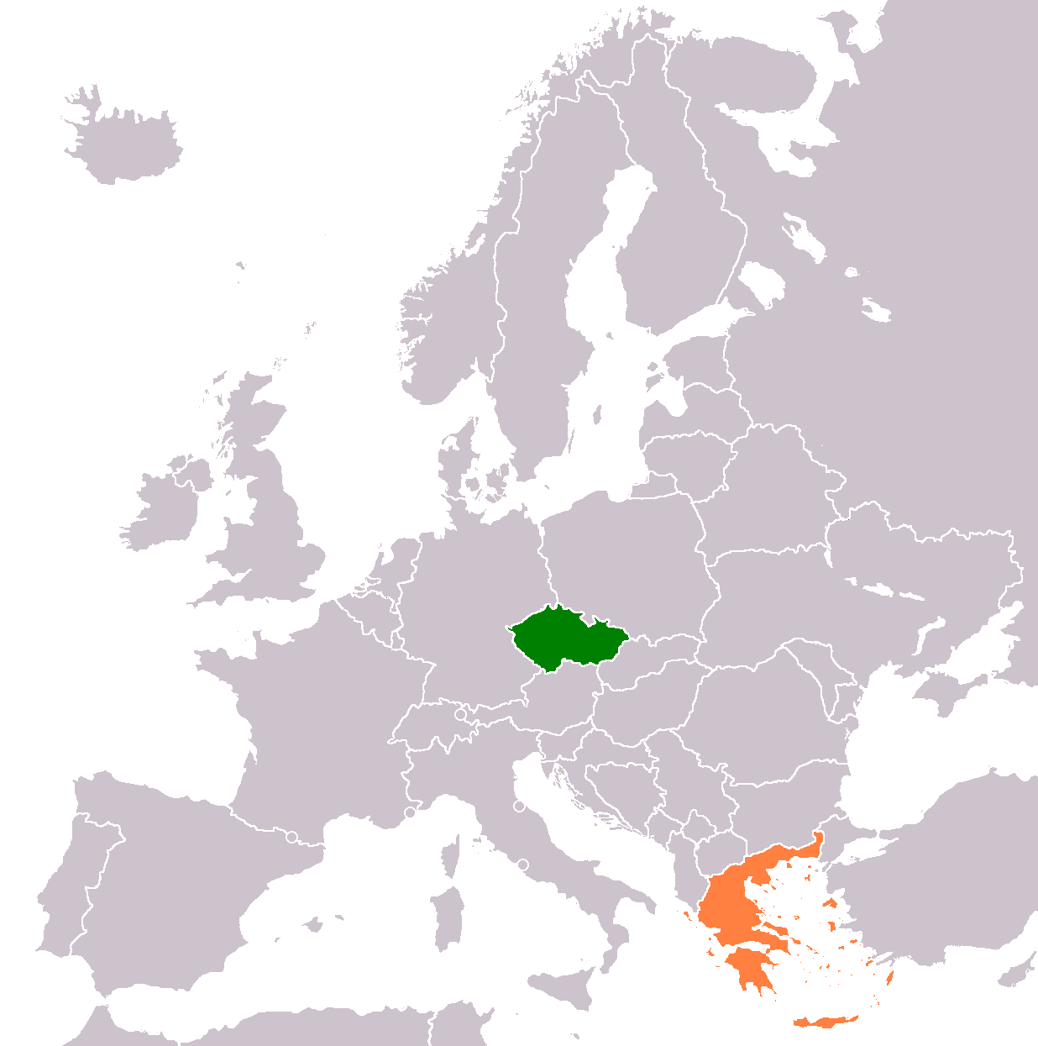
Greek migration
To the Czech Republic

Slide 3
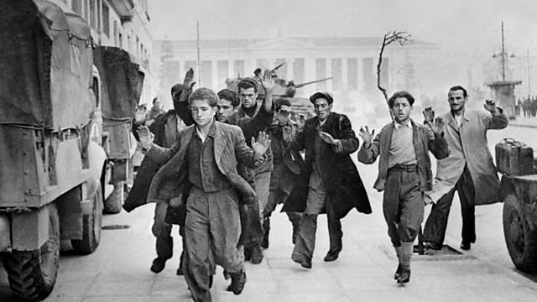
Migration during the Greek Civil War
when? In 1948 and 1949
why? because of the Greek Civil War communists had to flee
how many? nearly 100,000 Greek citizens
where? to the Eastern Bloc countries in Eastern Europe,
such as Poland,
Hungary,
Romania,
Eastern Germany and Czechoslovakia where the first refugees arrived and began to seek shelter at the end of summer in 1949.

Slide 4
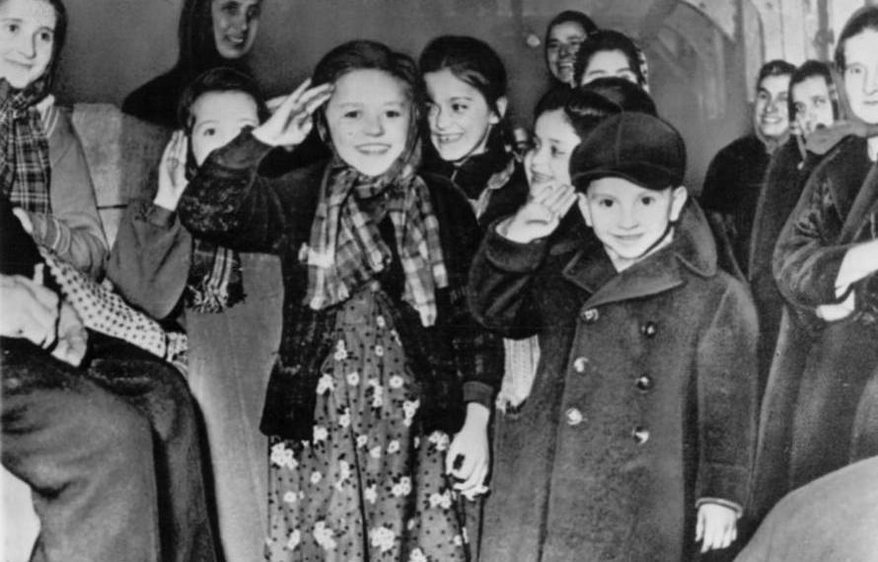
A warm welcome
After their arrival,
refugees were placed
in temporary sanitary camps
where they were provided with
food, clothing and basic medical treatment;
all children were placed in
about 40 children’s homes.

Slide 5
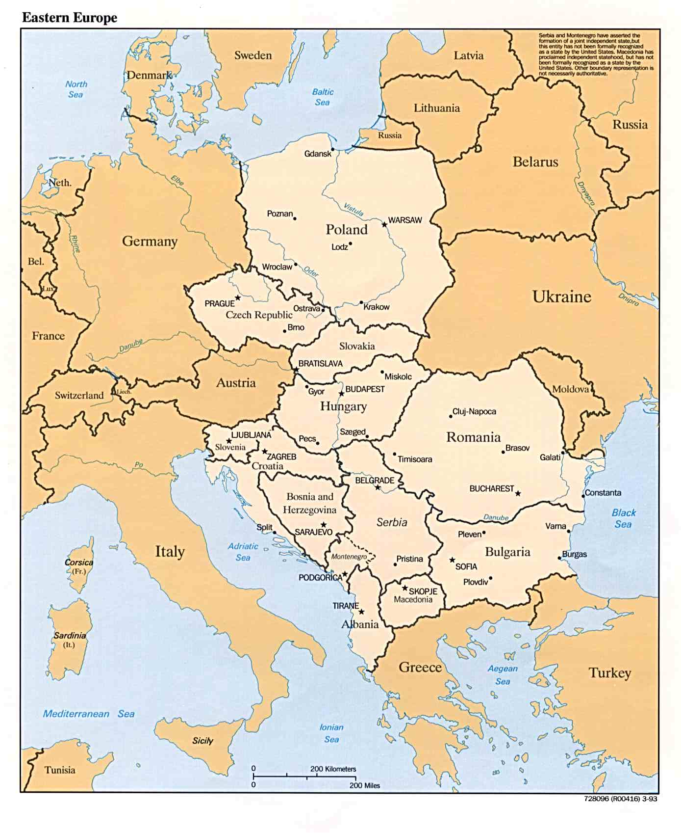
Next Generation
when? on 2008.
how many? a minimum of 200.000 young educated people
why? to find jobs
The reason of choosing the Czech Republic and Slovakia is the foreign companies - mostly IT companies - that reside in those countries and many more foreign or local companies that have many vacancies for IT people.

