Slide 1
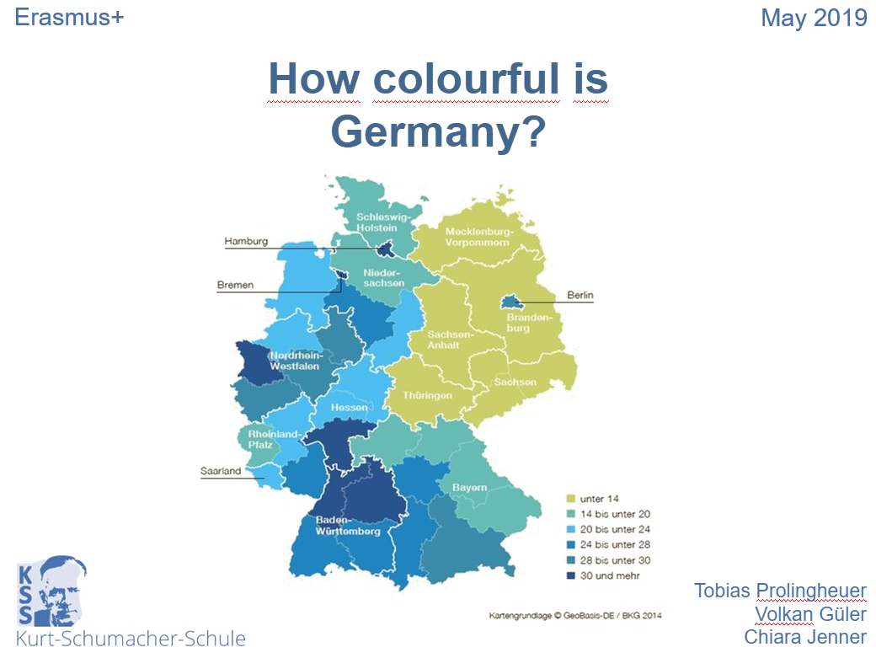
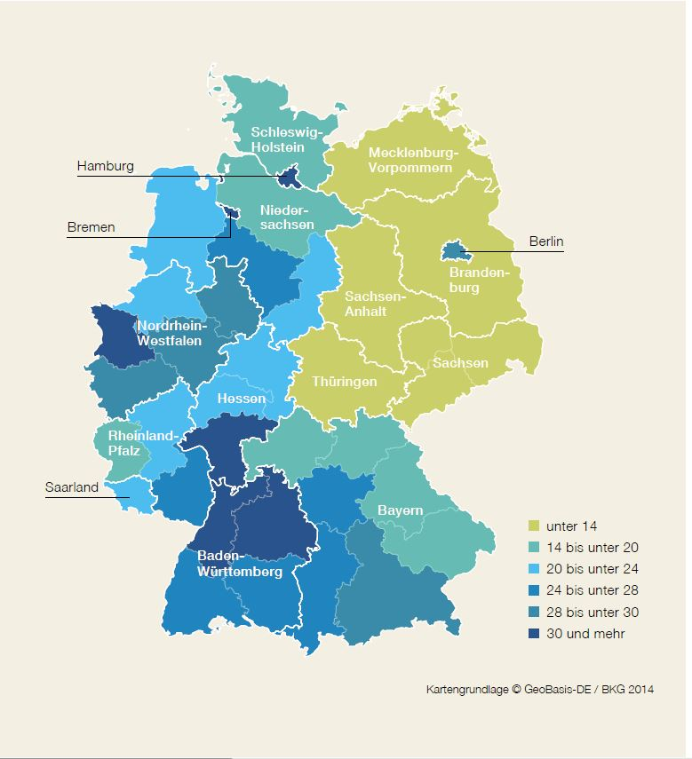

How colourful is Germany?
Erasmus+
May 2019
Tobias Prolingheuer
Volkan Güler
Chiara Jenner

Slide 2
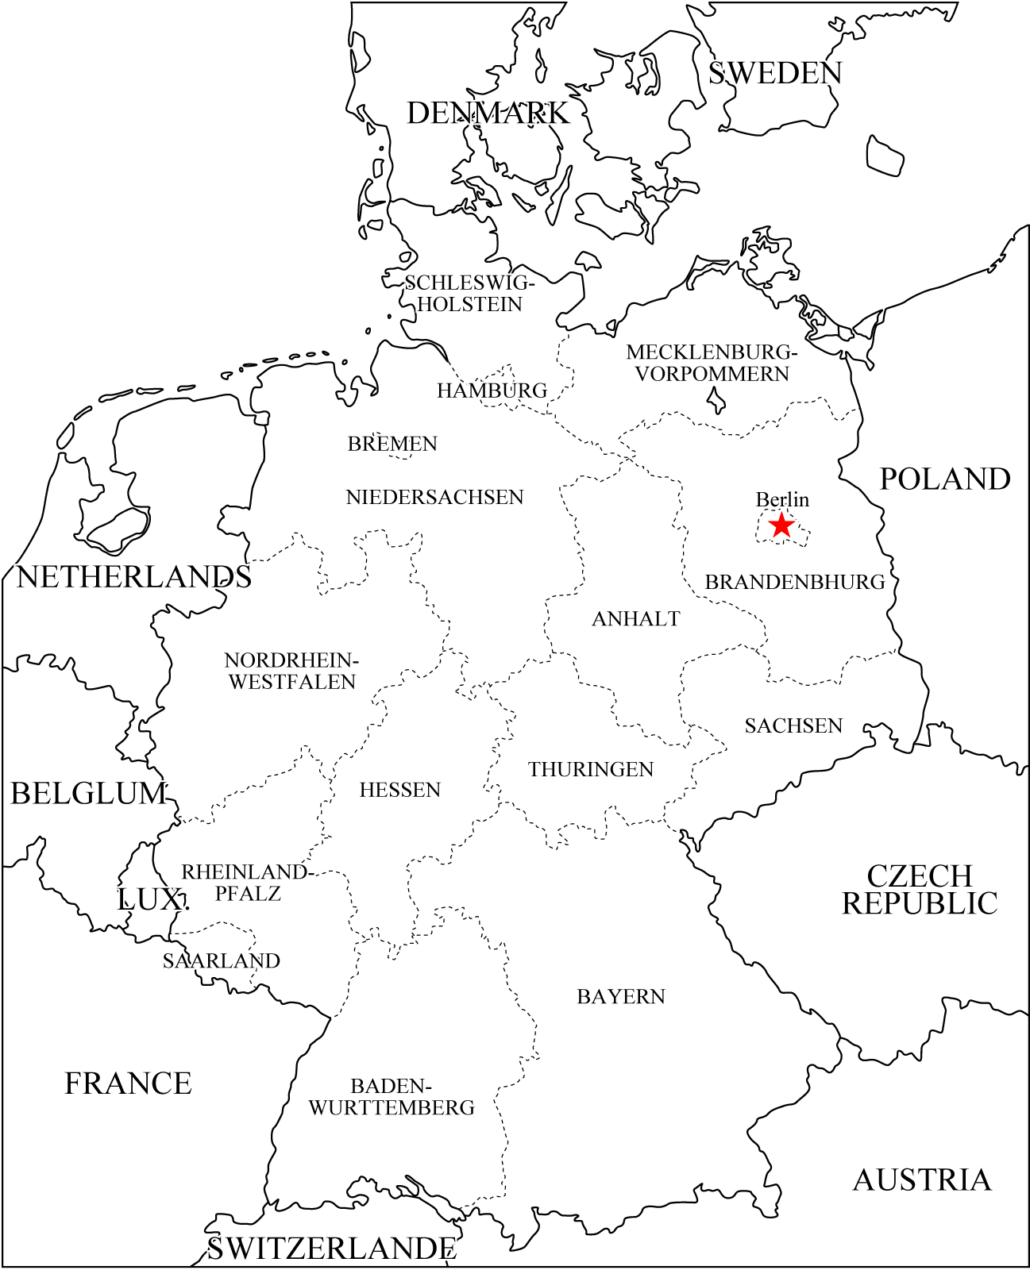
A few facts about Germany:
area: 357.600 km²
federal states: 16
population: 81,74 Mio.
amount of migrants: 19,3 Mio. (23,6%)
A few facts about Hesse:
area: 21.115 km²
rural districts: 5 kreisfreie Städte
und 21 Landkreise
population: 6,15 Mio.
Amount of migrants: 1,9 Mio. (31,1%)
Karben
A few facts about Karben and Kurt-Schumacher-School Karben:
area: 44 km²
population: rund 22.000
students at the KSSK: ca. 1.300
students in the 7th - 9th classes: 269
of which students with immigrant background: 93 (34,6%)

Slide 3
Immigrant background in comparison

Slide 4
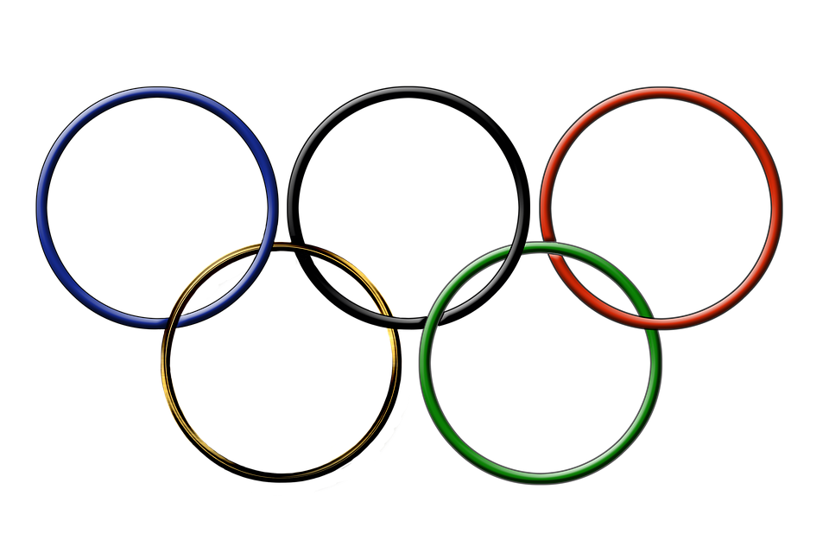













































Slide 5





Our written survey: Some statistic dates to our students
German as
mother tongue: 210
second language: 53
third language: 4
146
123
Speak in their family
more German: 213
more their mother tongue/ their first language: 61
Their father was born in Germany
yes: 187
no: 75
Their mother was born in Germany
yes: 178
no: 87
239
27

Slide 6
Think of you ten best friends. How many of them have German roots only?
Average: 4,6 friends

Slide 7
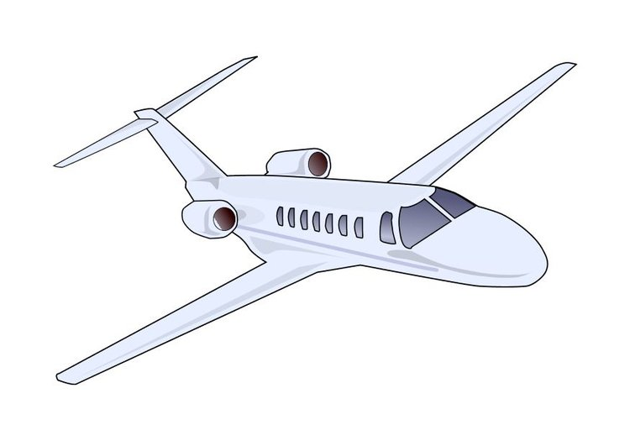
Holidays
109 students have holidays to visit their family.
75 students have holidays to get to know the culture of other countries.
 | most visited country | students
1. | Spain | 43
2. | Germany | 32
3. | Italy | 28
4. | France | 27
5. | Turkey | 19

Slide 8




favorite dishes
 | nationality of the dish | students
1. | Italian | 86
2. | German | 34
3. | Turkish | 26
4. | Asian | 23

Slide 9
"Typical" German characteristics
ranking | characteristics | amount of participants who said it | amount of participants who associate with the characteristic
1. | punctuality | 100 | 30
2. | boozing/ beer | 63 | 5
3. | Bavaria | 41 | 0
4. | tidy | 28 | 11
5. | potatoes | 23 | 5

Slide 10





What country and its culture would you like to get to know?
USA - 46
Japan - 26
USA - 46
Japan - 26
Griechenland - 16
Greece - 16
Australia - 12
Spain - 12
Australien - 12
Spanien - 12

Slide 11


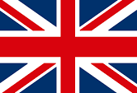
Where would you like to live after final examinition, if you had the choice?
USA - 71
Germany - 93
USA - 71
France - 10
Deutschland - 93
Frankreich - 10
England - 10
Japan - 8
England - 10
Japan - 8

